Slide 1
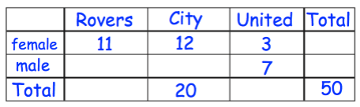
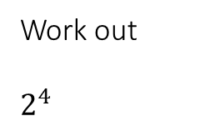
STARTER
Write 0.08 as a fraction in its simplest form.
Write 14% as a fraction in its simplest form.
Work out
$$2^{4}$$
One angle in an isosceles triangle is 50⁰.
Write down the sizes of the other two angles.
Write two different possible answers.
Y pounds is shared equally among n children.
Write down a formula for the amount, A, that each child should receive.
The two – way table gives some information about the football teams 50 students support.
Complete the two way table.

Slide 2
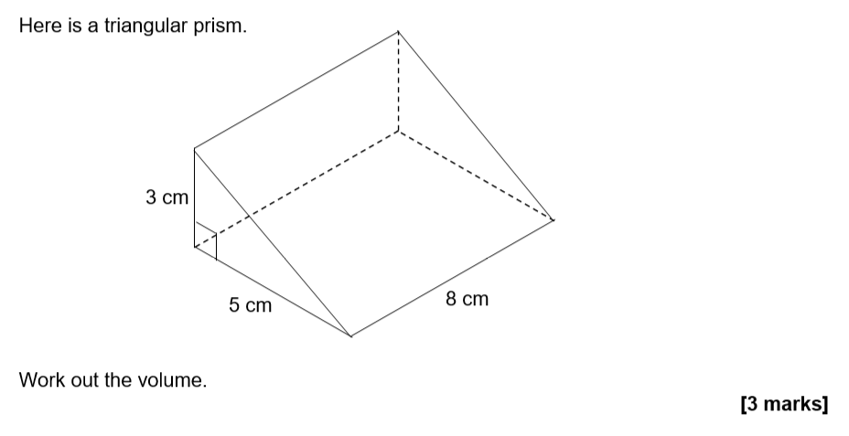
Pythagoras’ Theorem
- To be able to know and use the formula for Pythagoras’ theorem
Recap

Slide 3
Pythagoras’ Theorem
In what type of triangle can we apply Pythagoras’ Theorem?
What is the side opposite the right angle called?
Hypotenuse
The side opposite the right angle (the longest side) is called the hypotenuse.

Slide 4
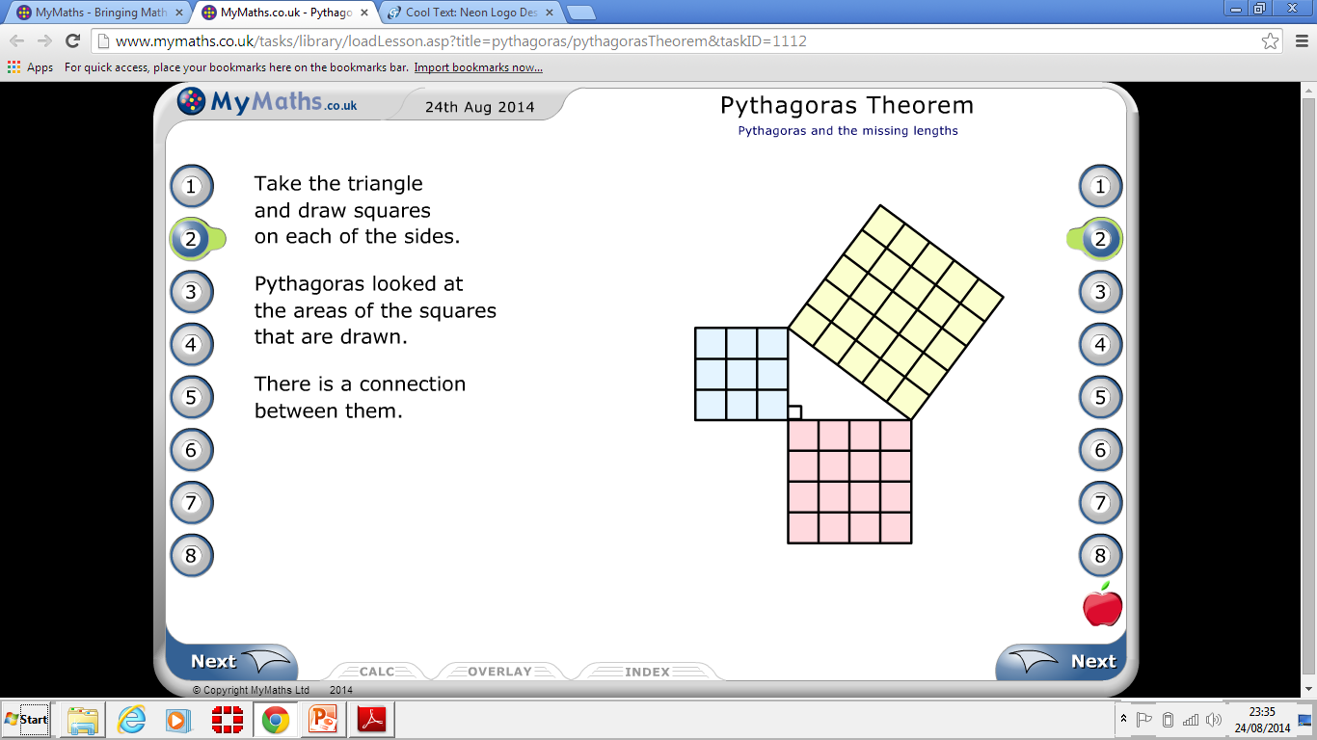
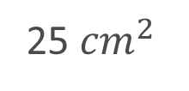
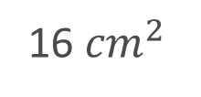
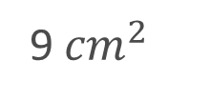
Pythagoras’ Theorem
Pythagoras and the missing lengths
‘’The square on the hypotenuse is equal to the sum of the squares on the other two sides.”
25 ${cm}^{2}$
Area A
Area C
9 ${cm}^{2}$
ac
aa
ab
Area B
16 ${cm}^{2}$
a² + b² = c²

Slide 5
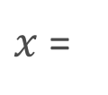



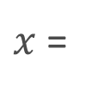



Example
ccccccvbnbhjnihiuhjuijil$x^{}x$
$$x^{2 }= 5^{2}+ 3^{2}$$
$$x^{2 }=25+9$$
$x cm$
5cm
$$x^{2 }=$$
34
$x$=
$$\sqrt{34}$$
3cm
$x$=
5.83095…

Slide 6
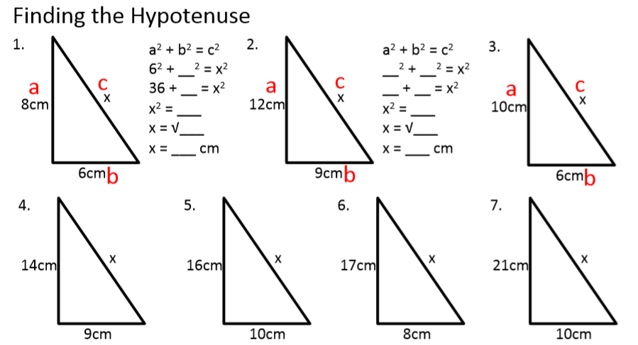

Slide 7
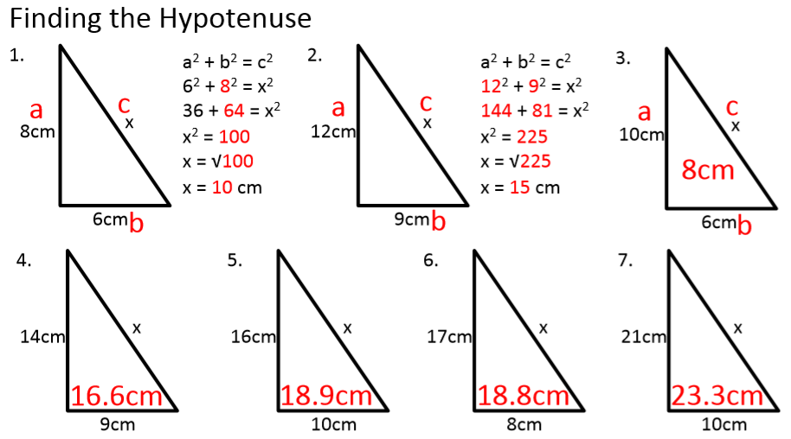

Slide 8







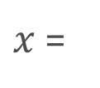
Using Pythagoras’ Theorem to find the smaller sides
Example
$$5^{2 }= x^{2}+ 3^{2}$$
$$x^{2 }= 5^{2}− 3^{2}$$
5cm
$$x^{2 }=25 −9$$
$x cm$
$$x^{2 }=$$
16
3cm
$$\sqrt{16}$$
$x$=
$x$=
4 cm

Slide 9








Using Pythagoras’ Theorem to find the smaller sides
Example
$${13}^{2 }= x^{2}+ 5^{2}$$
$$x^{2 }= {13}^{2}− 5^{2}$$
13cm
5cm
$$x^{2 }=169 −25$$
$$x^{2 }=$$
144
$xcm$
$$\sqrt{144}$$
$x$=
$x$=
12 cm

Slide 10
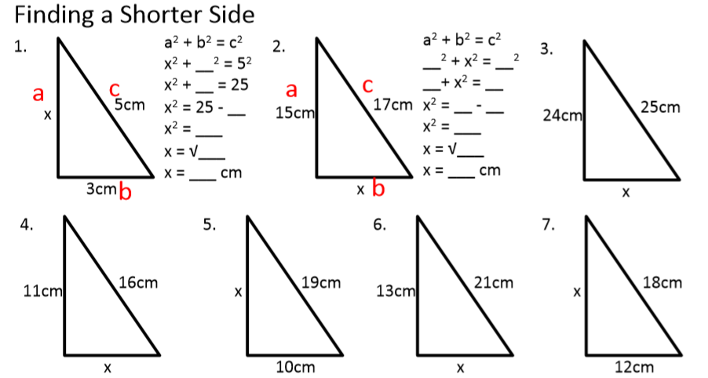

Slide 11
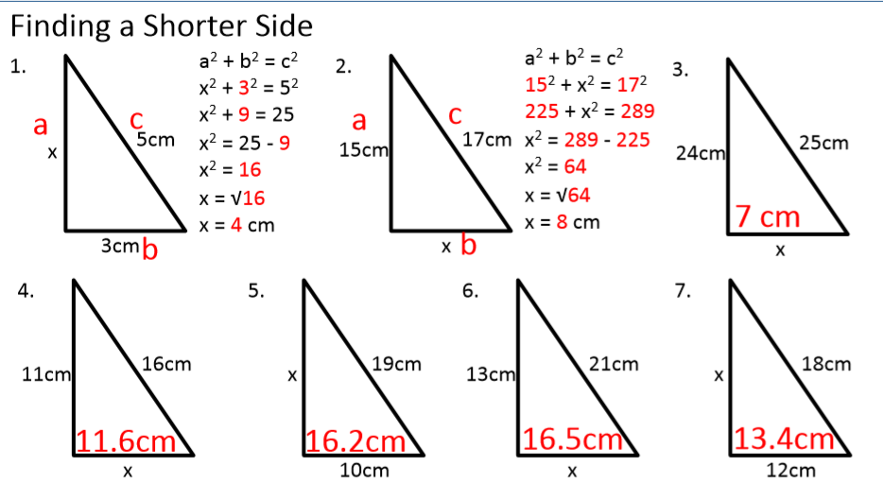

Slide 12


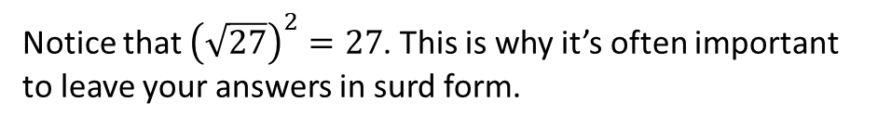
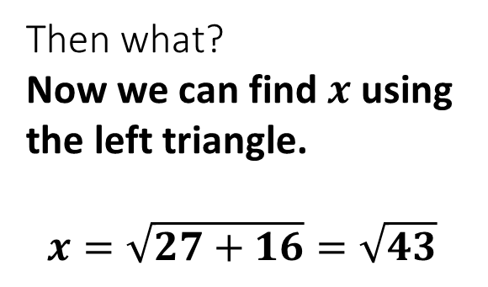

A :: Multiple Triangles
What should we do first?
Find the central length using the right triangle.
$$y=\sqrt{6^{2}−3^{2}}=\sqrt{27}$$
$$x$$
6
?
$$y$$
4
3
Then what?
Now we can find $x$ using the left triangle.
$$x=\sqrt{27+16}=\sqrt{43}$$
?
Notice that ${\left(\sqrt{27}\right)}^{2}=27$. This is why it’s often important to leave your answers in surd form.

Slide 13











B :: Split the shape into triangles
Give answers in exact form unless specified.
$$3$$
2
1
$$12$$
$$5$$
$$x$$
$$2$$
$$4$$
$$5$$
$$1$$
$$y$$
?
$$x=\sqrt{185}$$
?
$$y=\sqrt{13}$$

Slide 14




B :: Algebraic manipulation
Determine $x$.
$$x^{2}+27=4x^{2} \\ 3x^{2}=27 \\ x^{2}=9 \\ x=3$$
$$2x$$
?
$$\sqrt{27}$$
$$x$$

Slide 15




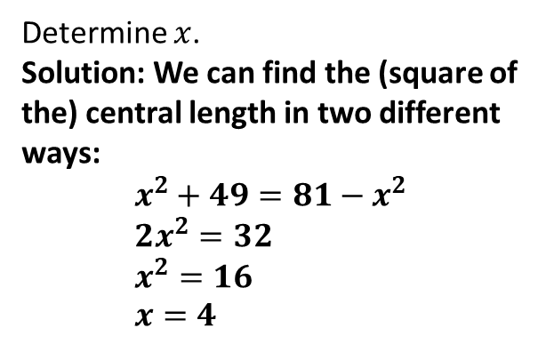





Challenge
N₅
$$x$$
N₆
$$9$$
$$27$$
$$x$$
$$7$$
$$3x$$
$$3$$
Determine $x$ (to 2dp).
Solution: Using similar strategy to the previous question:
$$27^{2}−{\left(3x\right)}^{2}=x^{2}−3^{2} \\ 729−9x^{2}=x^{2}−9 \\ 10x^{2}=738 \\ x^{2}=\frac{738}{10} \\ x=2.72$$
$$x$$
?
Determine $x$.
Solution: We can find the (square of the) central length in two different ways:
$$x^{2}+49=81−x^{2} \\ 2x^{2}=32 \\ x^{2}=16 \\ x=4$$
?

Slide 16
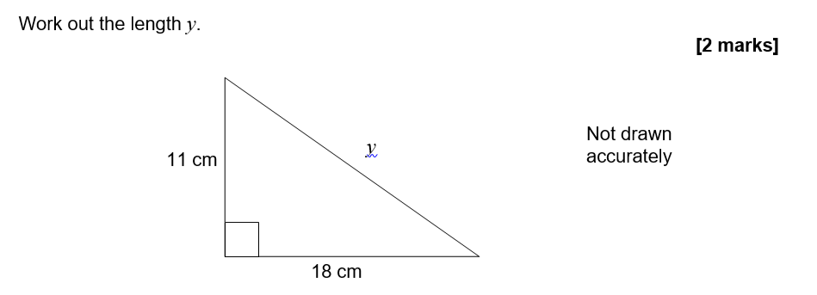
Pythagoras’ Theorem
Exam Question
AQA Topic test

Slide 17
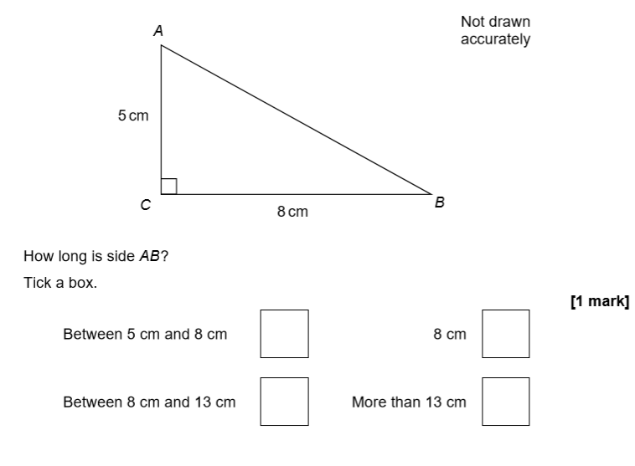
Pythagoras’ Theorem
Exam Question
PP Set 1 2F Q 17

Slide 18
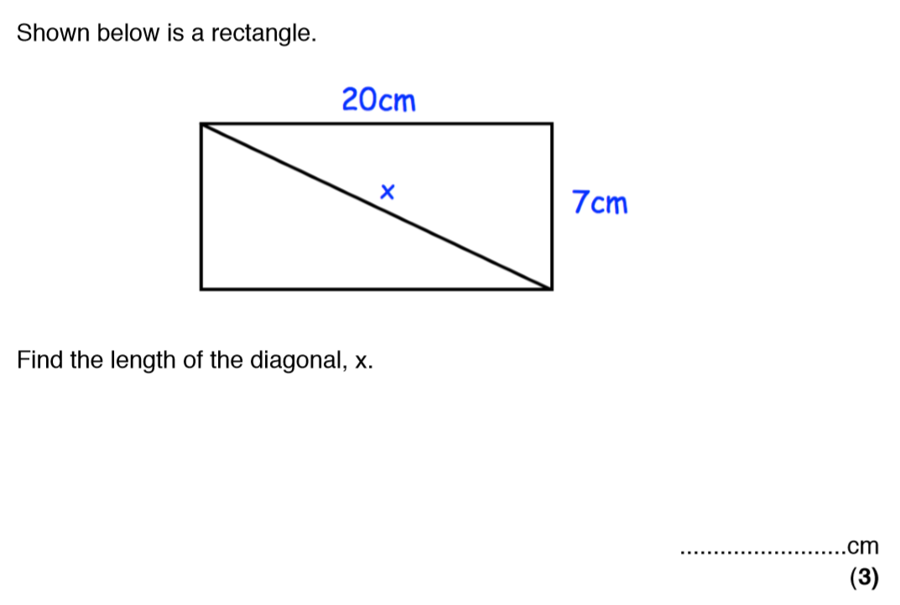
Pythagoras’ Theorem
Exam Questions

Slide 19
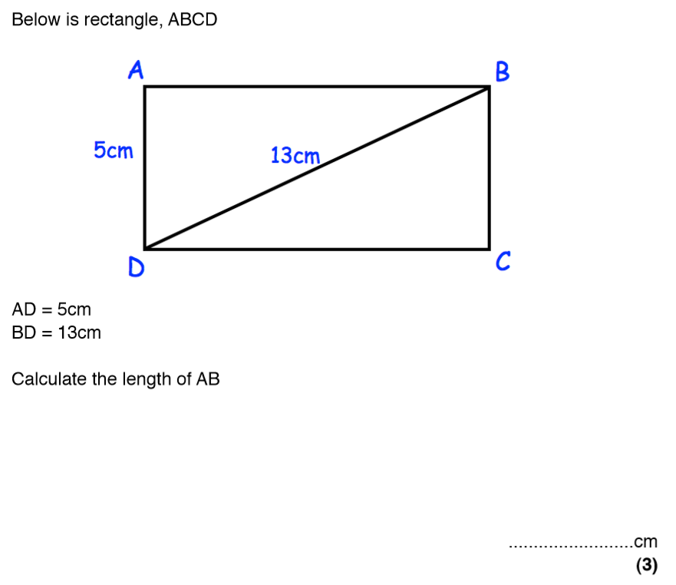
Pythagoras’ Theorem
Exam Questions

Slide 20
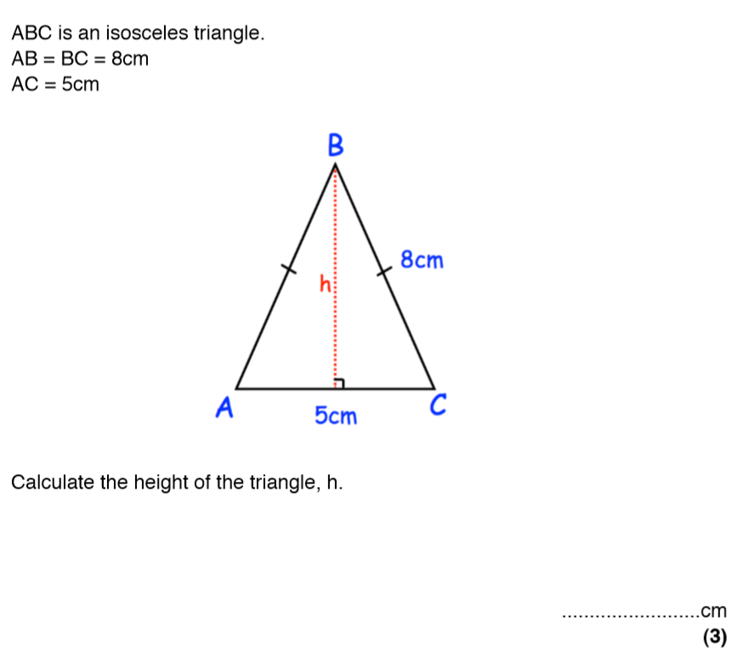
Pythagoras’ Theorem
Exam Question

Slide 21
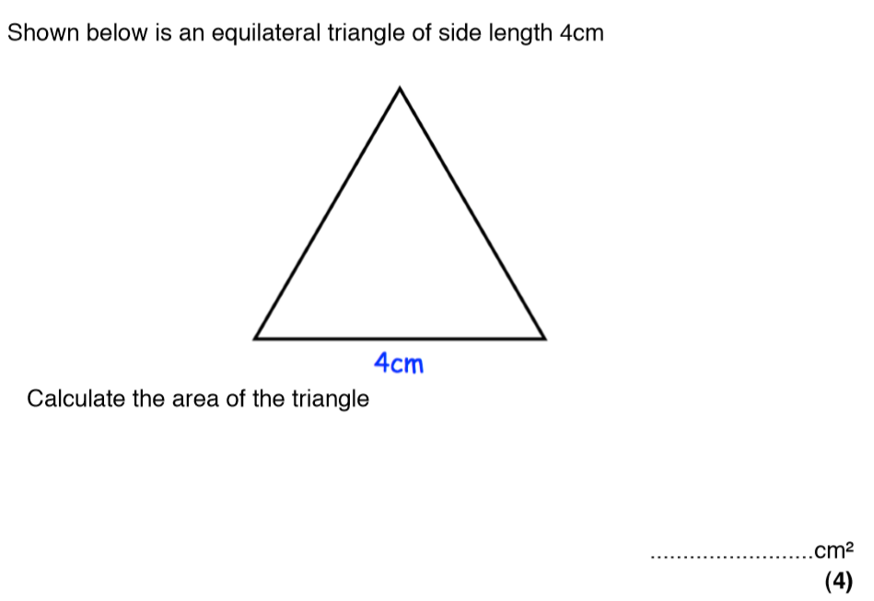
Pythagoras’ Theorem
Exam Question

Slide 22
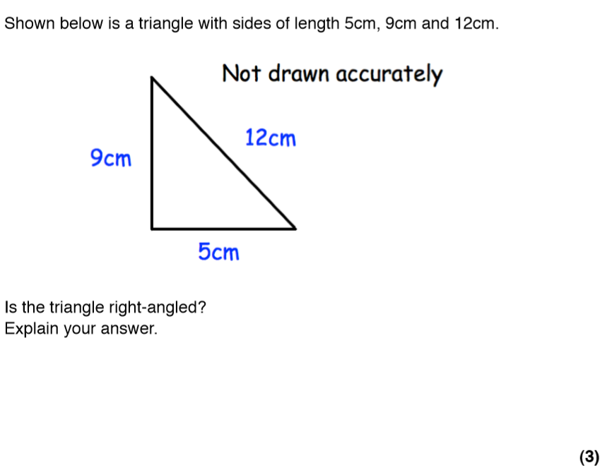
Pythagoras Theorem
Exam Question

Slide 23
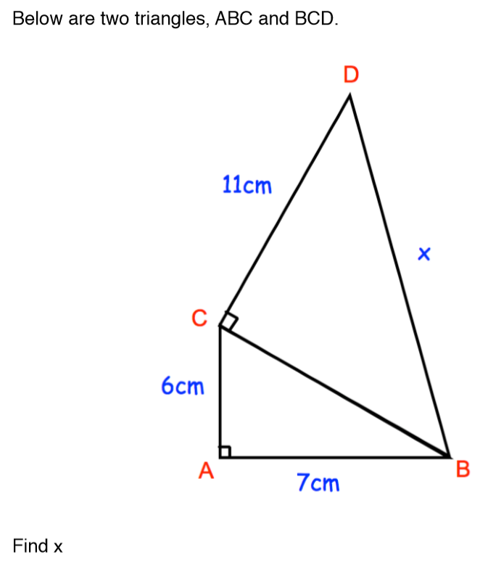

Pythagoras’ Theorem
Exam Question

