Slide 1
Starter
Find the area of this triangle:
3) a) Write 0.00068 in standard form.
b) Write 9.34 x ${10}^{5}$ as an ordinary number.
8cm
7cm
4) Share £3600 in the ratio 2:7
2) There are 12 red roses, 5 yellow roses and 3 white roses in a vase. Felix takes a rose, at random, from the vase. What is the probability that Felix takes a rose that is not red?
5) What is 3/8 – 2/7?

Slide 2
Frequency Trees and Tree Diagrams
Learning Objectives
To be able to :
- Record, describe and analyse the frequency of outcomes of probability experiments using frequency trees
- Understand and use tree diagrams to solve problems
Recap:
12cm
9cm
7cm
6cm
x cm
y cm
Find side ‘x’.
Find side ‘y’.

Slide 3
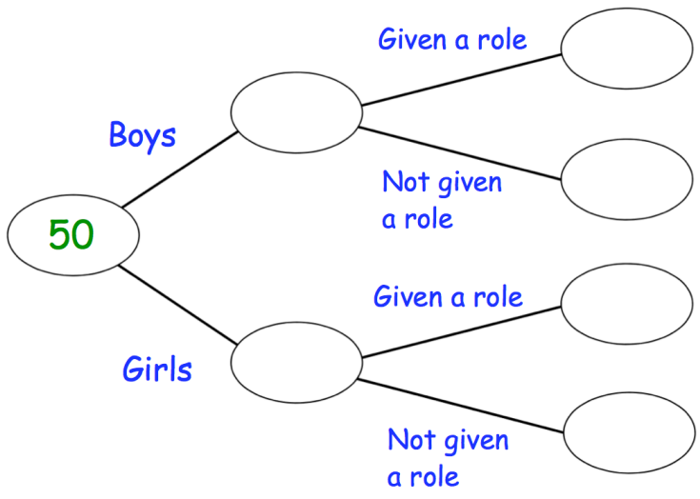
FREQUENCY TREES
50 children audition for the school play.
18 of the children are boys.
15 children were given a role in the play.
8 girls were given a role in the play.
Complete the frequency tree.
What fraction of the boys were given a role in the play.

Slide 4
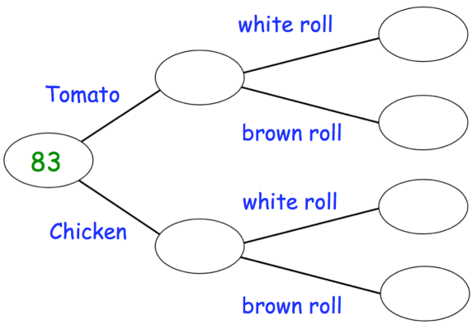
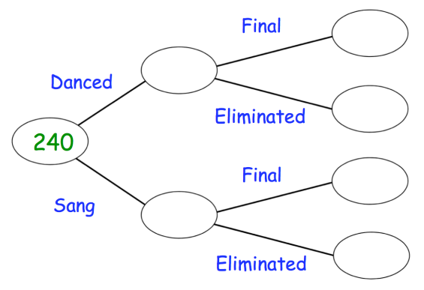
Your turn…
240 acts took part in a talent show.
20% of the acts danced and the rest sang.
30 acts made it through to the final.
21 of the acts in the final sang.
Show this information on a frequency tree.
83 people are offered a choice of soup and roll.
9 of the 37 people who had tomato soup, had a brown roll.
31 people had chicken soup and a white roll.
28
9
37
9
48
39
31
46
21
15
192
Complete the frequency tree.
What fraction of the people chose chicken soup?
171

Slide 5
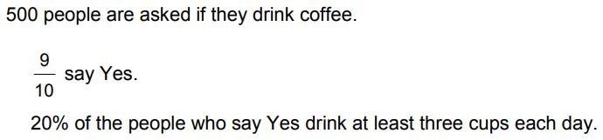


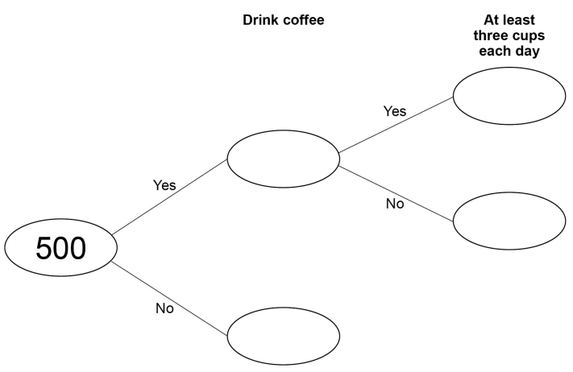
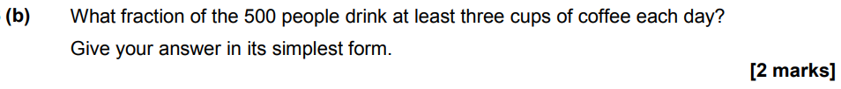
June 2017 Paper 1

Slide 6
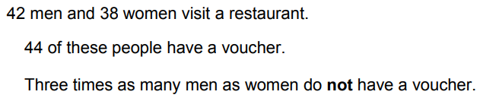
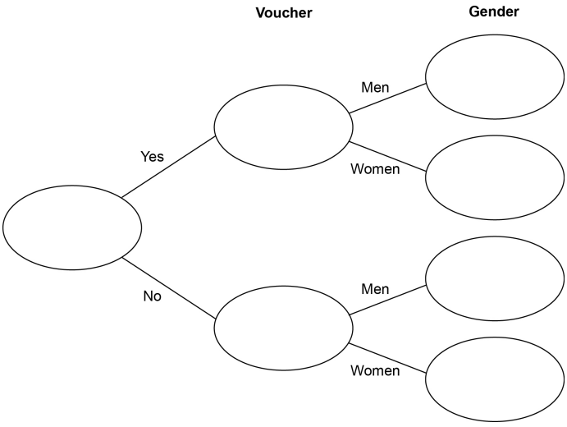
HARDER FREQUENCY TREES

Slide 7
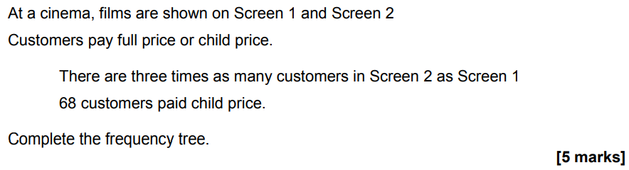
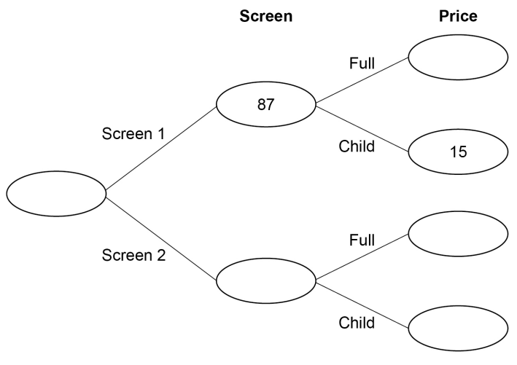
November 2018 Paper 1

Slide 8
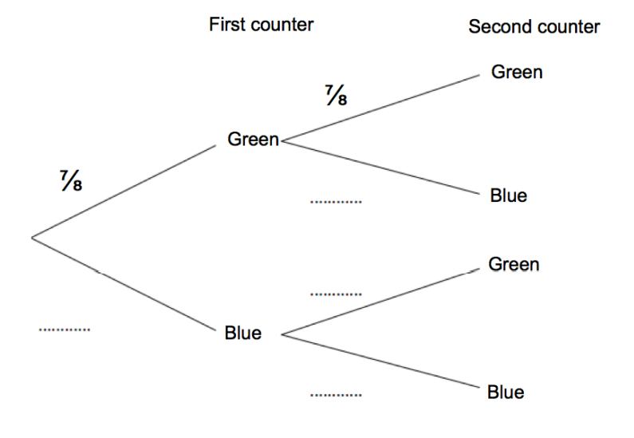
Tree Diagrams
There are green counters and blue counters in a jar. Kevin takes a random counter.
He then replaces the counter, and selects a new one.
(a) Complete the Tree Diagram.
(b) Work out the probability that he selects two blues.

Slide 9
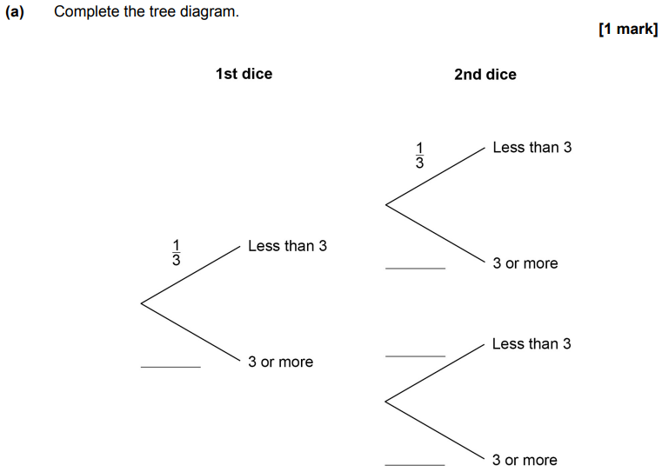
June 2018 Paper 2

Slide 10
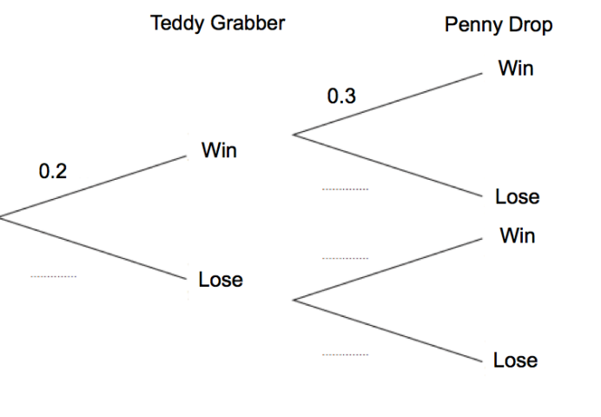
Tree Diagrams
James goes to an arcade. He has one go on the Teddy Grabber and one go on the Penny Drop.
(a) Complete the Tree Diagram.
(b) Work out the probability that James wins on the Teddy Grabber and loses on the Penny Drop.

Slide 11
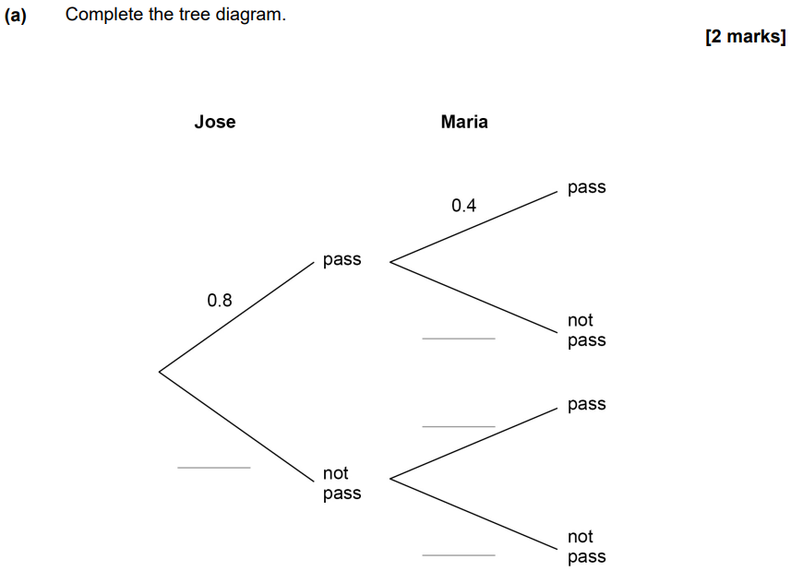
June 2022 Paper 2

