Slide 1
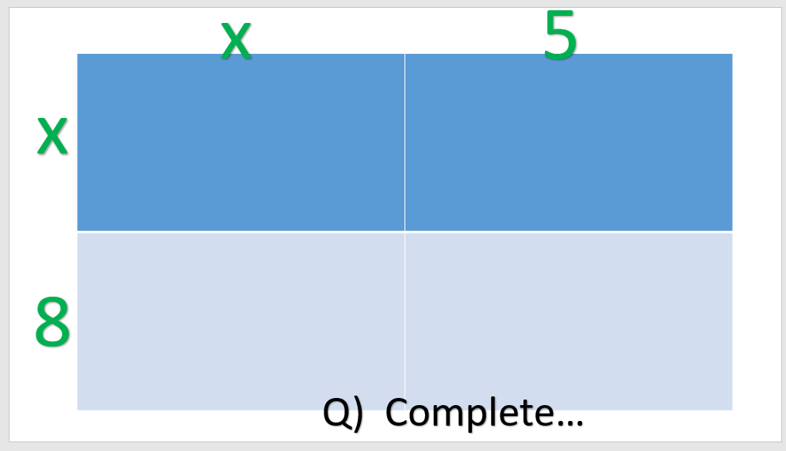
Quadratic Equations
Aims:
Make a quadratic from real life (area)
Factorise an expression
Expand double (or single) brackets
Draw (sketch) quadratic graphs

Slide 2
x
5
x
8
Q) Complete…

Slide 3
X² +7x +10
Q) Factorise…

Slide 4
(x-3)(x-6)
Q) Expand…

Slide 5
(x+4)(x-2)=0
Q) Sketch…

Slide 6
(-2x+4)(x-2)=0
Q) Find turning point…
Higher only !

