Slide 1
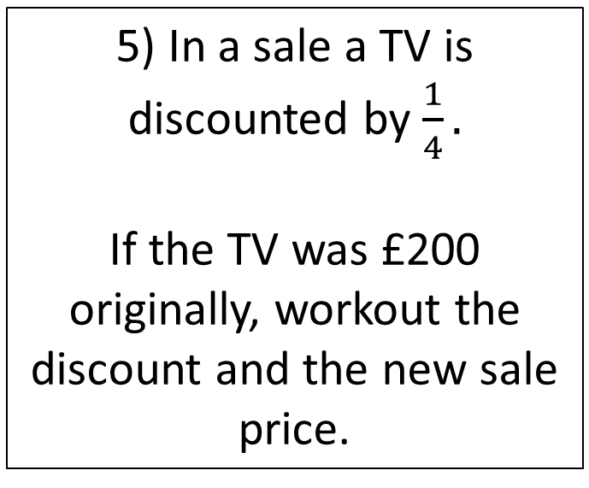
Starter
1) Workout 9² + 3²
4) 15 - 24 ÷ 3
5) In a sale a TV is discounted by $\frac{1}{4}.$
If the TV was £200 originally, workout the discount and the new sale price.
2) Write 16.99 correct to 1 decimal place
3) Share £85 in the ratio 2:3

Slide 2
Decimals
Round numbers to 1, 2 and 3 decimal places
Round numbers to 1, 2 and 3 significant figures

Slide 3
Rounding to Decimal Places
1 d.p
2 d.p
2 . 6 3 8 5 3
2 . 6 3 8 5 3

Slide 4
Your turn…
Round 785 to the nearest ten
Round 623.819 to 1 decimal place
Round 0.214 to 2 decimal places
Round 0.2175 to 3 decimal places

Slide 5

Estimation
By rounding, estimate the answer to this 482 x 12.2
By rounding, estimate the answer to this $\frac{48.3+290}{7.1}$

Slide 6
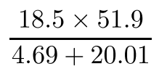
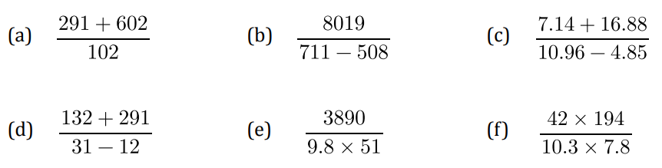
Estimation - Your Turn
Work out an estimate for the following:
Your turn:

Slide 7
Order and compare decimals
Write the following numbers in order of size. Start with the smallest number.
0.08, 0.25, 0.81, 0.2, 0.68
Put the correct inequality sign in between the decimals.
5.1 5.3
0.4 0.14
0.653 0.7
0.1 0.09

Slide 8
Your turn…
Arrange the numbers in order of size, starting with the smallest.
3.11 3.1 3.0 3.011 3.001
6.06 60.06 6.606 66.06 6.066
0.08 1.16 0.12 1.09 0.999
1.8 0.8 8 8.1 0.008

Slide 9
Add and subtract decimals
Sebastian buys a gift which costs £18.20 He pays with a £20 note.
How much change does he receive?
1) 6.5 + 1.73
2) 10.4 – 2.2

Slide 10
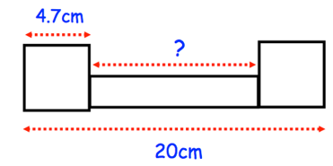
Your turn…
1) a) 0.14 + 0.69
b) 2.49 +10.56 + 1.6
c) Add together 0.8, 0.113, 0.438
1) Luke had £20 with him when he went shopping. He bought
2 books at £5.75 each
1 toy at £6.50 each
How much money did he have left after he bought these goods?
2) Chloe has a ribbon 8 metres long.
She cuts two pieces from the ribbon.
The first piece was 1.28 metres long.
The second piece was 0.65 metres long.
How much ribbon is left?
2) Two identical squares and a rectangle are drawn below
Find the length of the rectangle.

Slide 11
Multiply and divide decimals
A magazine article recommends everyone to drink 2.5 litres of water a day. How many litres of water is this in a week?
Tariq paid £436.80 for gas in a year. He paid in twelve equal monthly instalments. How much did he pay for gas each month?

Slide 12
Your turn…
3) Chloe is building a fence for her garden. The fence costs £7.20 per meter to build. The fence is 15 meters long.
Work out the total cost of building the fence
1) Six friends shared the cost of a meal. The bill came to £78.12.
How much did they each pay?
4) Class 5A are going on a trip to a windmill.
The trip costs £2.40 and there are 30 students going on the trip.
How much money should be collected?
2) A shop sells cans of drink for 52p each. Thomas buys seven cans and pays for them with a £5 note.
What change should he get?

Slide 13

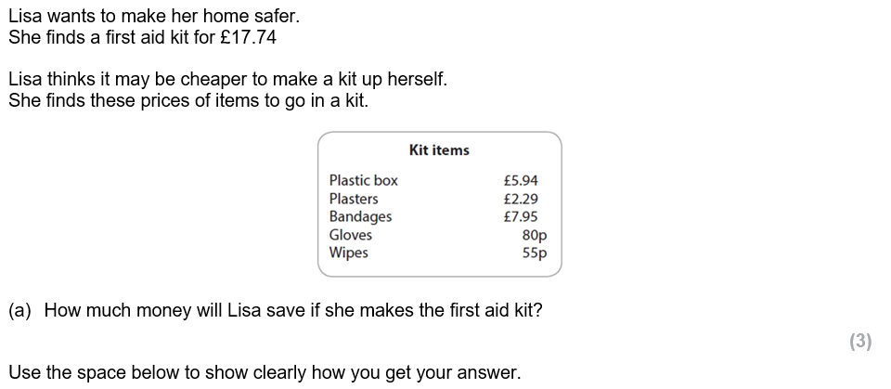
July 2016

Slide 14
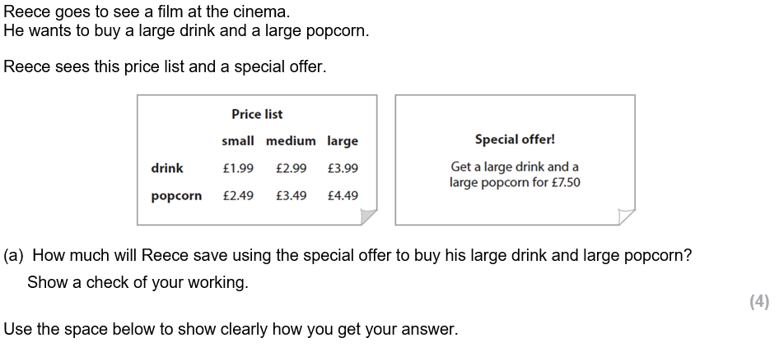
Mar 2018

Slide 15
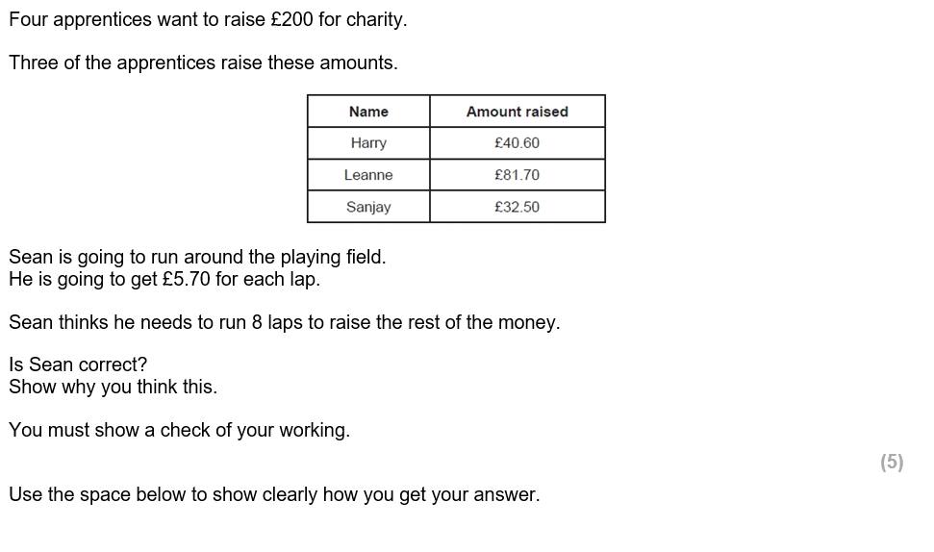
July 2015

