Slide 1




Slide 2







Whole Number and Functions
Averages

Slide 3



















Course Content: Choose your topic …
Whole Number and Functions
place
value
negative
numbers
add and
subtract
multiply
divide
round
numbers
ratio
scale
fraction
decimal
numbers
percent
percent
decimal
fraction
MATHS L1 to L2
Parts of a whole
metric
measure
imperial
measure
perimeter
area
volume
formulae
bodmas
charts
data
averages
prob-
ability
Measure and Shape
Handling Data

Slide 4





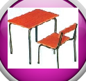







Home Revision Progress Check 1 Video/Discuss Vocab / jobs Lesson Activities Quizzes Topic Answers Progress Check 2 Cont. Learning
Topic Introduction : Averages
An average value is a number that you expect to see. When dealing with lots of answers such as prices of a loaf of bread to the distance the earth is to the sun, there will be a variety of values but often only one is needed. Finding the average value is really useful so a simple answer can be given for what would be lots of answers.
There are four average calculations in this topic, Mean, Median, Mode and Range. Each calculation gives a value that tells you something about your collection of numbers and attempts to give a representative value of all the others.
Choose an icon to select where to start
A V E R A G E S

Slide 5


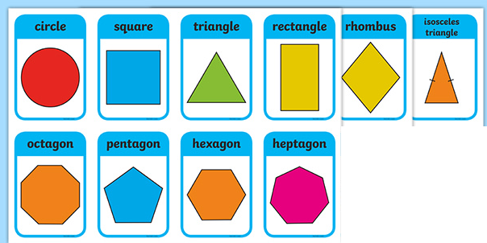
Warm up Exercise 1
Which shapes have
have a single line of
symmetry?
2) Which shapes have angles of 90⁰ in them?

Slide 6


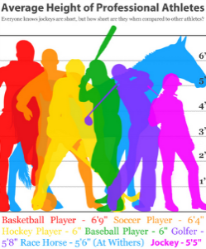
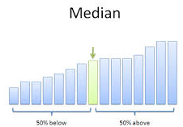
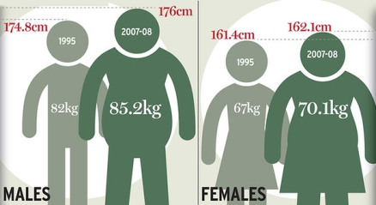
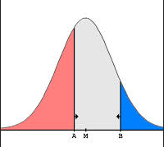
Progress Checker 1
W
What do you already know about Averages ?
How would you rate your skills in finding average values ?
Excellent ability
Good ability, but working to improve
Ok, making a start but I know I have lots to still learn
My aims for today are…
A Find the average (mean) value and range of a set of data (level one)
B Find the Mode and Median value of a set of data (level two)
C Calculate average values in a variety of real and practical situations

Slide 7




Introductory Video and Discussion
KHTU.
What is the difference between the different types of average ?
Which is the easiest type of average to calculate ?
Who uses averages and why ?
Why are there more than one type of average ?
What do you do if there is no ‘average’ amount ?
Can averages be misleading ?
Watch the introductory video and then discuss the above
Your thoughts..

Slide 8

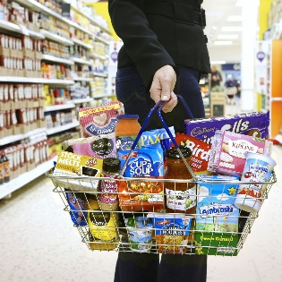
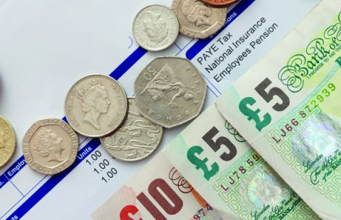
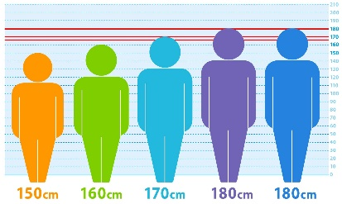


Vocabulary and Jobs
Average
Mean
Mode
Median
Range
Midpoint
Variance
Difference
Halfway
Between
Equidistant
Ascending
Descending
These are the words you will be using in this topic
Accountants
Statistical Analysis
Banker
Scientist
Sales and Retail
Warehouse
Media
IT / Tech
Transport …. Can you think of more?
…………………………………
…………………………………

Slide 9
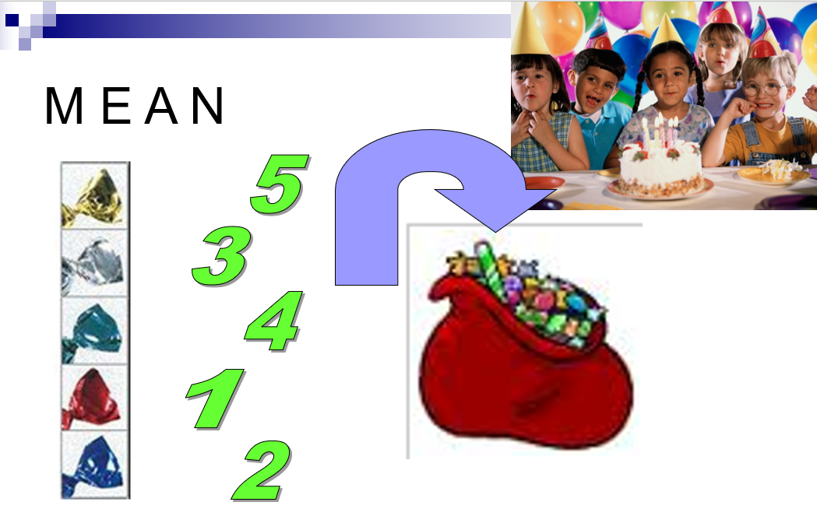
Lesson: Concept Activity

Slide 10
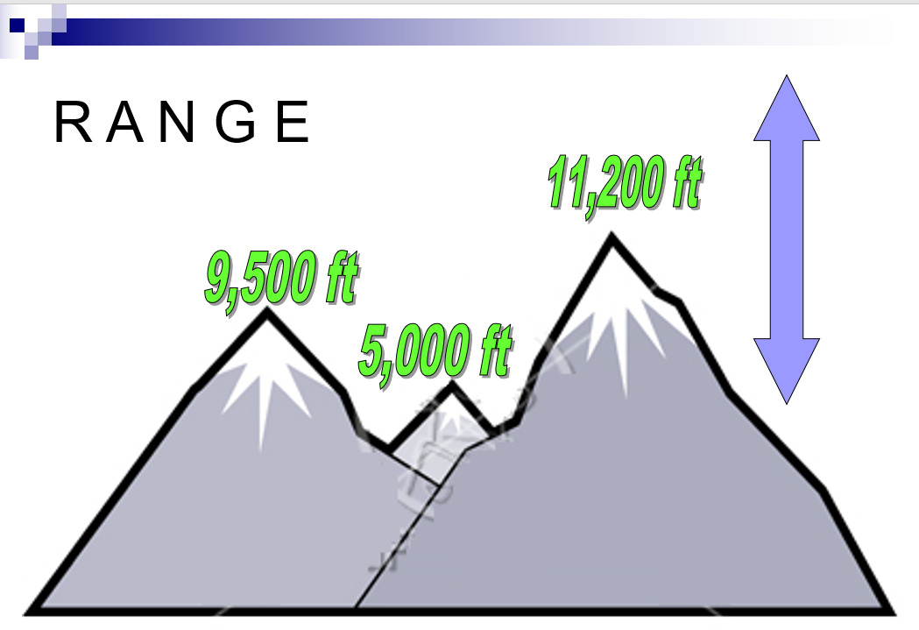
Lesson: Concept Activity

Slide 11

Lesson: Try out
Block 1 : Watch tutor led demo (in class or on video)
Try these, 1) The mean of 7, 9, 2, 4 and 8 = 2) The range between 8, 4, 3, 0, 12 is ….
3) The mean of 15, 5, 35, 25, 20 and 15 = 4) The range of 10, 20, 40, 15, 9, 2, 30, 35 is ….
Block 2 : Watch tutor led demo (in class or on video)
Try these, 5) Find the mean of -2, 7, 0, -4, 9 6) Find the range between 200, -400, 600, -200
7) Find the mean of £215, -£300, £50, -£150 8) Find the range of 3km 5km 1km 9km 12km 0.5km
Block 3 : Watch tutor led demo (in class or on video)
Try these, 10) Find the mean of… 18.7 points, 20.6 points, 7.9 points, 8.4points
Find the range of £15.23 £28.09 £08.19 £04.03
Find the missing value if the mean of 6 values is 30 5 7 1 ..?... 5 6
Find possible missing value if the Range of the 8 values is 20 -2 ..?.. 5 16 2 10 1 8

Slide 12
Lesson: Websites and links

Slide 13
Lesson: Activity A

Slide 14
Lesson: Activity B
Practice Reading and Writing Large Numbers by having a go at ‘Top Trumps’.

Slide 15

Lesson: Activity C
Computer based activity - a) find the answers to each card on the computer b) produce a ‘place value table’ on a spreadsheet c) copy the answers found onto the spreadsheet in the correct columns ….extension: d) order the values e) convert the values f) write each value in words on the spreadsheet

Slide 16
Lesson: Activity D Functional Skills
Write a cheque for a lottery win using your telephone number

Slide 17

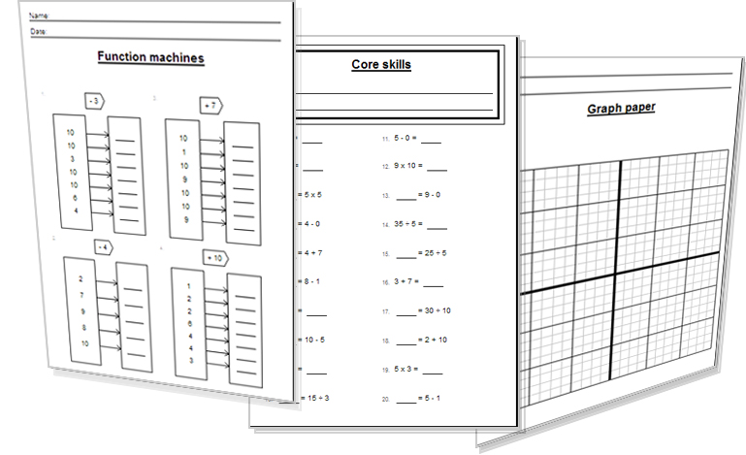
Lesson: Activity E
Try a variety of written practice
Worksheets
Workbooks
Practice Exam Papers
Maths Problems

Slide 18
Lesson: Practice – just the numbers
541

Slide 19
Lesson: Practice – word problems
Solv

Slide 20
Lesson: Practice – Making it Functional 1
BB

Slide 21
Lesson: Practice – Making it Functional 2
Use the information on the previous page
a

Slide 22
Homework: Quiz to assess LEVEL 1

Slide 23
Homework: Quiz to assess LEVEL 2

Slide 24

TOPIC ANSWERS 1

Slide 25
TOPIC ANSWERS 2

Slide 26
TOPIC ANSWERS 3

Slide 27
Progress Checker 2
W
What do you now know about Averages ?
How would you now rate your skills in finding average values ?
Excellent ability
Good ability, but working to improve
Ok, making a start but I know I have lots to still learn
My aims for today were…
A Find the average (mean) value and range of a set of data
B Find the Mode and Median value of a set of data
C Calculate average values in a variety of real and practical situations

Slide 28
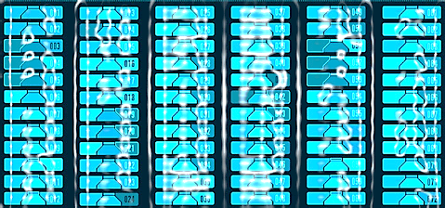

Continuing to Study and Learn
What else can you do to help yourself to learn and practice? Here are ten suggestions, record which you do each week and also record your progress.
Internet websites
Repeat the lesson, make notes, organise a folder, revise
Own maths workbook
Study together with a friend or family member
Finish activities in this book
Complete class handouts or tasks
Practice exams / past papers
Use maths skills learnt at home or at work in real situations
Play games
Experiment yourself, try new things ask yourself questions
Try making a graph of number of practice methods you use against your progress score in each topic. Are you showing more practice gives better results?

