Slide 1
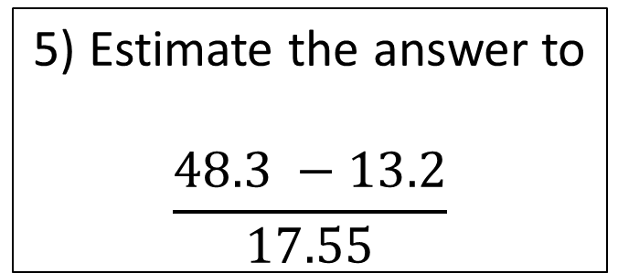
Starters
1a) 48 x 64
b) 4.8 x 6.4
c) 48 x 0.64
3) a) Simplify
4a + 7a – 2a
b) Simplify 5ab + 2b + 3ab + 6b
4) I throw a fair 6-sided dice. What is the probability of it landing on an even number?
5) Estimate the answer to
$$\frac{48.3 −13.2}{17.55}$$
2a) 784 ÷ 4
b) 784 ÷ 5

Slide 2
FRACTIONS
Learning Intent
To be able to :
Convert mixed fractions to improper fractions and vice versa
Add, subtract, multiply and divide fractions
Find fractions of amounts

Slide 3


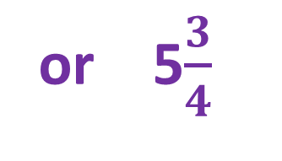
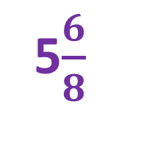

Converting Mixed Numbers and Improper Fractions
$$1\frac{4}{7}$$
$$\frac{11}{7}$$
$$\frac{46}{8}$$
5$\frac{6}{8}$
or 5$\frac{3}{4}$

Slide 4
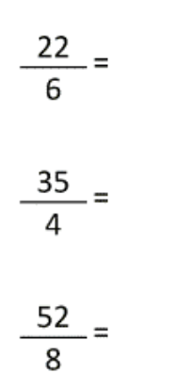
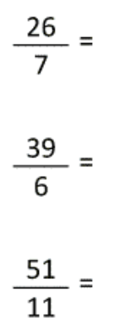
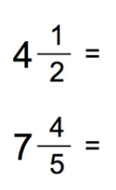



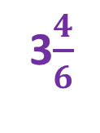
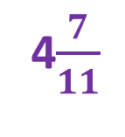




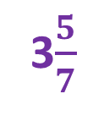




Your turn…
Convert to mixed fractions
Convert to improper fractions
3$\frac{4}{6}$
3$\frac{5}{7}$
$$\frac{9}{2}$$
$$\frac{13}{4}$$
8$\frac{3}{4}$
6$\frac{3}{6}$
$$\frac{39}{5}$$
$$\frac{20}{3}$$
6$\frac{4}{8}$
4$\frac{7}{11}$
$$\frac{11}{4}$$

Slide 5


Fractions of Amounts
$$Find\frac{3}{4}of 20.$$
15
$$What is \frac{5}{3} of 90?$$
150

Slide 6
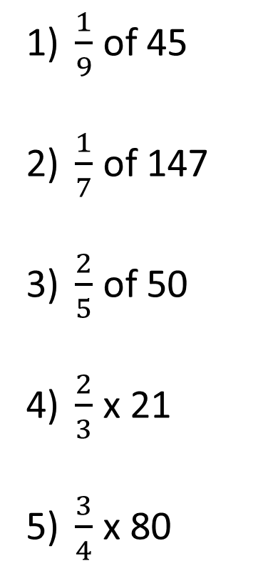
Your turn…
$\frac{1}{9}$ of 45
$\frac{1}{7}$ of 147
$\frac{2}{5}$ of 50
$\frac{2}{3}$ x 21
$\frac{3}{4}$ x 80
A pair of jeans normally costs £40. In a sale they are ¼ off. Work out how much the jeans cost in the sale.
In January a baby elephant weighs 180kg. By March the weight of the baby elephant had increased by ⅜. Work out the weight of the baby elephant in March.
Bill is 80 years old. His son Max is ⅝ of his age. His granddaughter Jayne is ⅕ of his age. How many years older than Jayne is Max?
5
£30
21
20
247.5kg
14
60
34 years

Slide 7

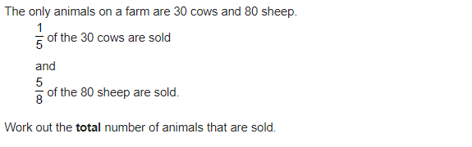

June 2022 Paper 1
6 cows
50 sheep
6 cows + 50 sheep = 56 animals sold

Slide 8






Adding and Subtracting Fractions
$$\frac{7}{9}$$
$$\frac{47}{40}$$
$$\frac{5}{9} + \frac{2}{9}$$
$$\frac{4}{5} + \frac{3}{8}$$
$$\frac{9}{8}$$
$$\frac{7}{4} − \frac{5}{8}$$

Slide 9
















Your turn…
Add or subtract the following fractions:
$$a) \frac{1}{3}+ \frac{2}{4}$$
$$b) \frac{2}{5}− \frac{2}{6}$$
$$c) \frac{1}{3}+ \frac{3}{5}$$
$$d) \frac{3}{5}− \frac{8}{15}$$
$$\frac{5}{6}$$
$$\frac{1}{15}$$
$$\frac{14}{15}$$
$$\frac{1}{15}$$
Add or subtract the following fractions, giving answers as mixed numbers where possible:
$$a) 3\frac{1}{3}+ 9\frac{2}{4}$$
$$b) 5\frac{1}{2}− 1\frac{2}{4}$$
$$c) 6\frac{1}{5}+ 8\frac{9}{10}$$
$$d) 5\frac{2}{3}− 3\frac{1}{2}$$
$$12\frac{5}{6}$$
$$4$$
$$15\frac{1}{10}$$
$$2\frac{1}{6}$$

Slide 10




Multiplying And Dividing Fractions
$$\frac{7}{9} × \frac{2}{5}$$
$$\frac{14}{45}$$
$$\frac{5}{9} ÷ \frac{2}{7}$$
$$\frac{35}{18}$$

Slide 11















Your turn…
Multiply or divide the following fractions:
$$a) \frac{2}{3}÷\frac{1}{5}$$
$$b) \frac{3}{5}×\frac{1}{2}$$
$$c) \frac{4}{11}÷\frac{2}{9}$$
$$d) \frac{4}{8}×\frac{1}{12}$$
$$\frac{10}{3}$$
$$\frac{3}{10}$$
$$\frac{18}{11}$$
$$\frac{1}{24}$$
Multiply or divide the following fractions, giving answers as mixed numbers where possible:
$$a) 3\frac{1}{3}÷2\frac{1}{5}$$
$$b) 2\frac{1}{3}×\frac{1}{4}$$
$$c) 2\frac{3}{4}÷1\frac{2}{3}$$
$$d) 1\frac{1}{3}×2\frac{1}{4}$$
$$1\frac{17}{33}$$
$$\frac{7}{12}$$
$$1\frac{13}{20}$$
3

Slide 12




Bonus Topic - Comparing Fractions
Which is bigger?
$$\frac{2}{5} OR \frac{3}{7}$$
$$\frac{3}{7}$$
Write the following in ascending order:
$\frac{2}{10} \frac{4}{5} \frac{3}{4}$ $\frac{11}{25}$
$$\frac{2}{10} \frac{11}{25} \frac{3}{4} \frac{4}{5}$$

Slide 13




November 2021 P1
$$0.75$$
$$1.3$$
$\frac{3}{4}$ is closer!

