Slide 1
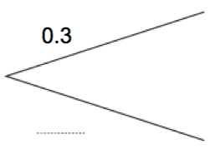
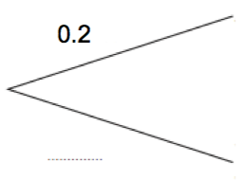
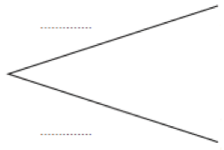
Venn Diagrams
Learning Objectives
To be able to :
Understand and use a Venn Diagram to solve problems.
To be able to understand the notation P(A), P(A’), P (A U B), P (A n B)
Win
James goes to an arcade.
He has one go on the Teddy Grabber
He has one go on the Penny Drop
The probability that he wins on the Teddy Grabber is 0.2
The probability that he wins on the Penny Drop is 0.3
(a) Complete the tree diagram.
Win
Lose
Win
Lose
Lose

Slide 2
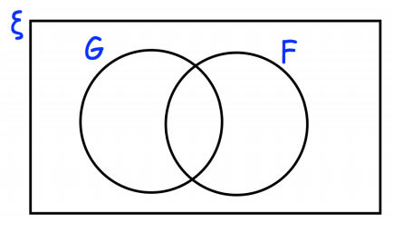
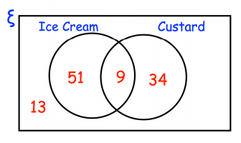
STARTER
Solve Problems
Notation
There are 80 students in Y11.
9 students study French and German
35 students only study French
2 students do not study French or German
1) Work out how many students study German.
P (A Ո B)
P (A U B)
P (A’)

Slide 3
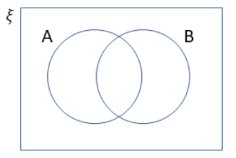
SOLVING PROBLEMS
ξ = {1, 2, 3, 4, 5, 6, 7, 8, 9, 10, 11, 12, 13, 14, 15}
A = {Multiples of 3}
B = {Even numbers}
Complete the Venn diagram.
(b) What is the probability of a multiple of 3 and an even number?

Slide 4
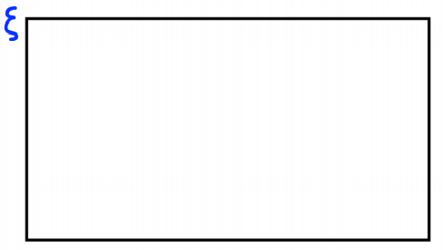
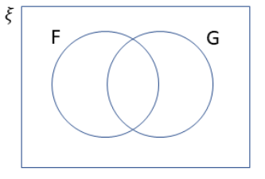
Your turn…
A gym runs a spinning and circuit class.
On Saturday 100 people visited the gym.
18 people attended the spinning class.
10 people attended both classes.
56 people did not attend either class.
Represent this on a Venn diagram.
In a group of 25 people, 3 people can speak
fluently both French (F) and German (G). 18
can speak either neither of these languages.
If two people can speak German but not
French, find out how many can speak French
but not German.

Slide 5
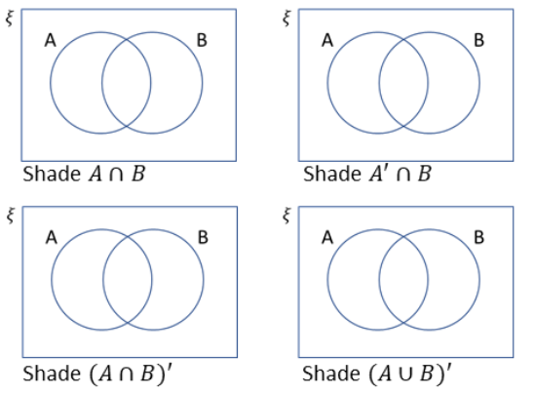
NOTATION

Slide 6
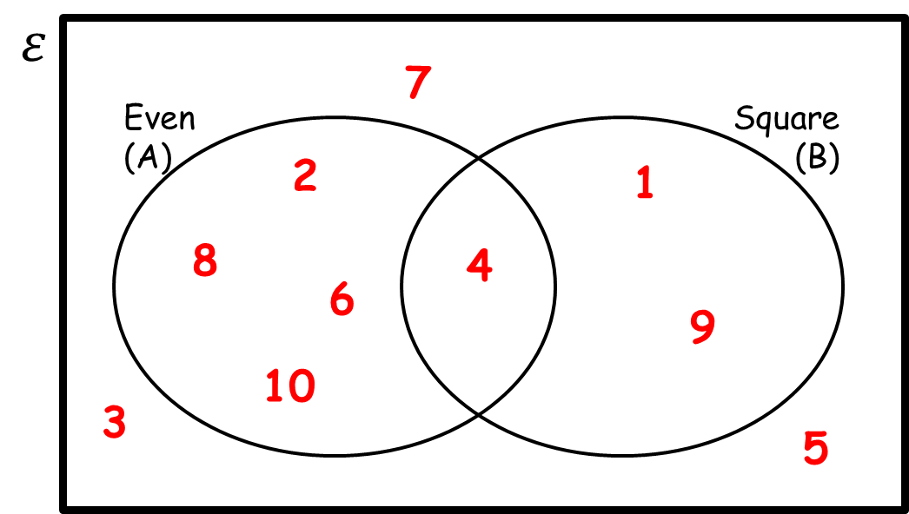
NOTATION
P(A’) =
P(AUB) =
P(B) =
P(A’ՈB) =

Slide 7
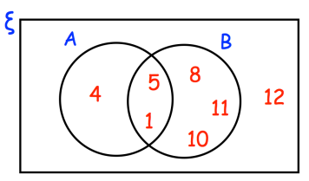
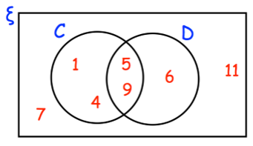
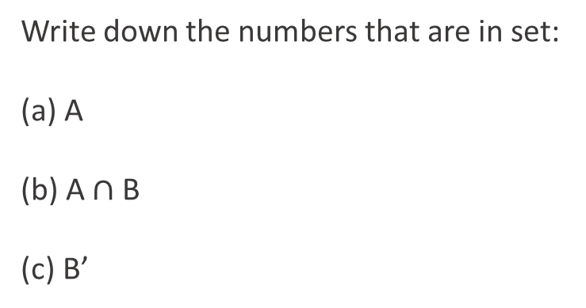
Your turn…
Write down the numbers that are in set:
(a) A
(b) A $∩$ B
(c) B’
A number is chosen at random.
Write down P (D)
Write down P (C U D)
Write down P (C’)

Slide 8

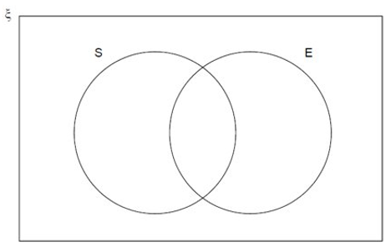
Specimen X Paper 2
ξ = {1, 2, 3, 4, 5, 6, 7, 8, 9, 10, 11, 12}
S = Square numbers
E = Even numbers
(a) Complete the Venn diagram. (3 marks)
(b) One of the numbers is chosen at random.
Write down P (S Ո E) (1 mark)

Slide 9
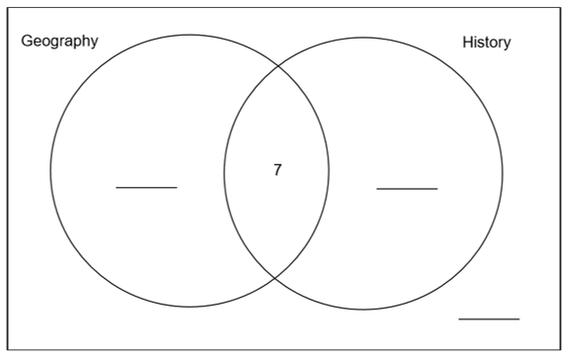


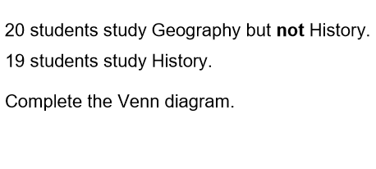

Specimen 2 Paper 1

