Slide 1

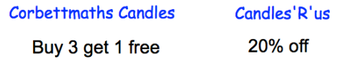
STARTER
1.
What is 10% of £30
b) What is 5% of £30.
What is 15% of £30
d) What is 95% of £30.
2.
230 people paid entrance.
How much money is that in total?
4.
Candles normally cost £6 each.
Two websites have special offers
Laura wants to buy 30 candles.
Which website should Laura use?
3.
Write 50 as a product of primes.

Slide 2
Formula
- To be able use simple formulae expressed in words for a one or two-step operation.
Recap
Recap
Find 2 of 84 miles.
7
Put the following fractions in order.
Small to large.
7 2 3 1
5 9 6 7

Slide 3
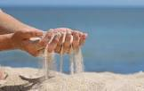
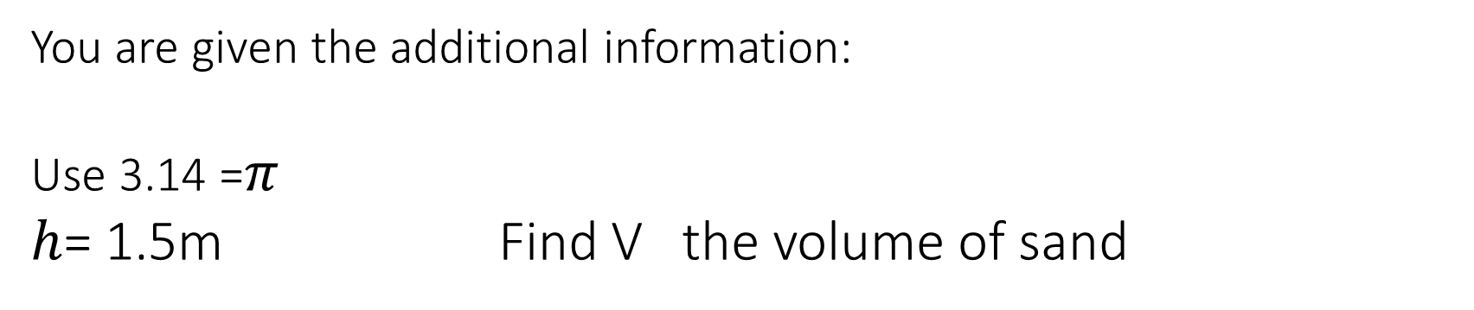
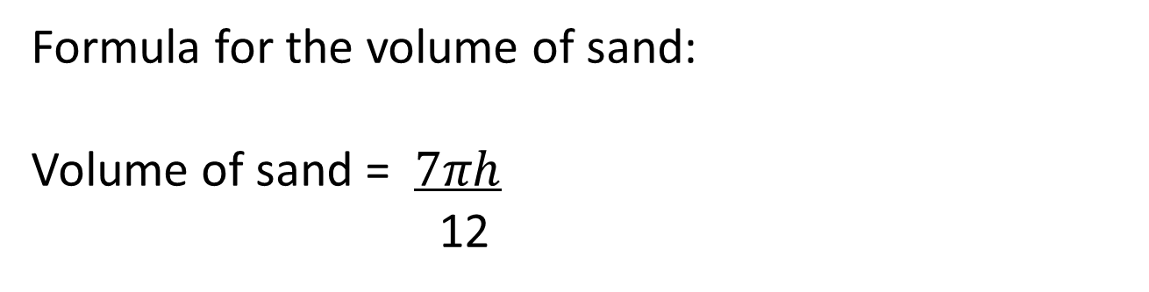
Example
Formula for the volume of sand:
Volume of sand = $7πh$
12
You are given the additional information:
Use 3.14 =$π$
$h$= 1.5m Find V the volume of sand

Slide 4

Practice
Sally has driven 1,457 miles this year. On average her car does 56.5 miles per gallon.
f is the number of litres of fuel used
d is the number of miles driven in a year
r is miles per gallon
f= d x 4.5
r
She wants to know how much it has cost her to drive her car this year, so first she has to find the amount of fuel she has used.
She uses this formula
Fuel is 143.8p per litre. How much has she spent on fuel this year?

Slide 5
Function machines
Sometimes, instead of a formula to follow you are given a function machine. This is easer than a formula as it gives you the order.
Looking at the previous question in a function machine you would have:
Miles driven
X 4.5
÷ miles per gallon
Fuel used
Sally has driven 1,457 miles this year. On average her car does 56.5 miles per gallon. Find the fuel used.

Slide 6

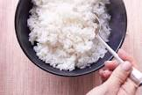
Exam questions
Magda works at a charity for homeless people.
She needs to make lunch for 15 people.
Magda knows this rule to find the amount of rice she needs to cook.
Magda thinks she needs to cook 10 cups of rice for 15 people.
Is Magda correct?
(3)

Slide 7
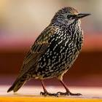

Exam questions
Jon sees this information about starlings.
In 2015 there were 2M starlings.
In 2016 the number of starlings had decreased by 75k
He uses this rule to calculate the percentage decrease.
.
Jon thinks the percentage decrease in the number of starlings is 5%
(b) Is Jon correct?

Slide 8
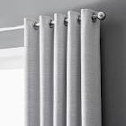
Exam questions
Tim wants to hang curtains along all 4 walls of his shed.
He uses this formula to work out the amount of material he needs to buy.
The length of the shed is 7.25 m and the width is 3.75 m.
Tim thinks he needs to buy 44 m of material.
(b) Does Tim need to buy 44 m of material? (3)

Slide 9
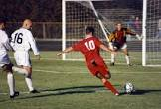
Exam questions
Mikael plays football.
Mikael wants to know how fit he is.
He measures his heart rate in beats per minute (bpm).
Mikael uses this formula to work out his fitness value
f = m X 15
r
f = fitness value
m = maximum heart rate
r = resting heart rate
Mikael has a
Maximum heart rate of 192 bpm
Resting heart rate of 50 bpm.
A footballer should have a fitness value greater than 54
Does Mikael have a fitness value greater than 54? (3)

Slide 10

Exam questions
Jenny goes swimming at the fitness centre to burn calories.
She uses this formula to work out how many lengths of the pool she needs to swim.
L = c x 64
300
L = lengths to swim
c = calories to burn
Jenny wants to burn 350 calories.
Jenny thinks she needs to swim 65 lengths to burn 350 calories.
Is she correct? (3)

Slide 11
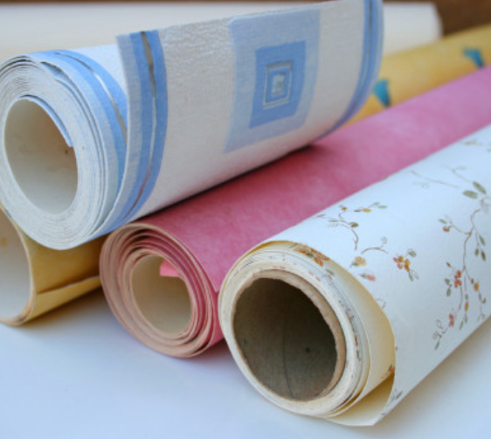
Exam questions
Ged is a decorator.
He is going to put wallpaper on the walls in the living room for Liz.
Ged uses this rule to work out how many rolls of wallpaper he needs.
Ged knows the perimeter of the room is 1800 cm.
He works out he will need 11 rolls of wallpaper.
Is Ged correct?
Show why you think this.
(3)

Slide 12

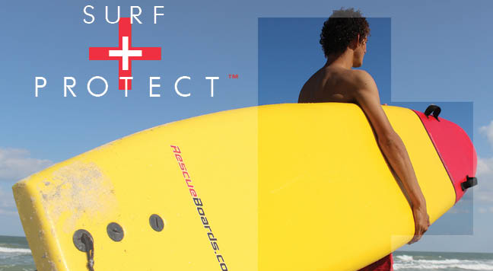
Exam questions
Marta works at the beach office.
She needs to buy a new surfboard for the lifeguards.
The surfboard must be 6 feet in length.
Marta uses this formula to convert feet into metres.
What is 6 feet in metres?
(4)

