Slide 1
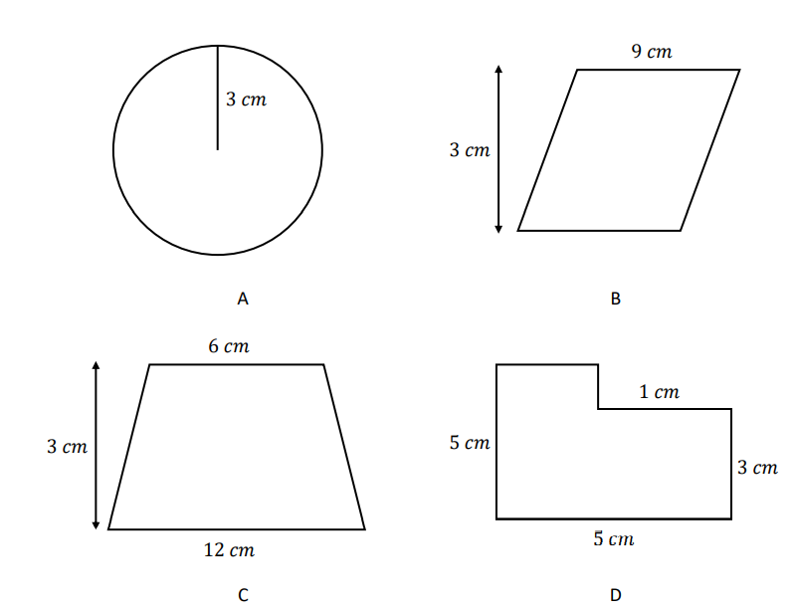
VOLUME AND SURFACE AREA
Learning Objectives
To be able to :
- use formulae to find volume and surface areas of 3D shapes including cylinders
Identify the two shapes which have the same area

Slide 2
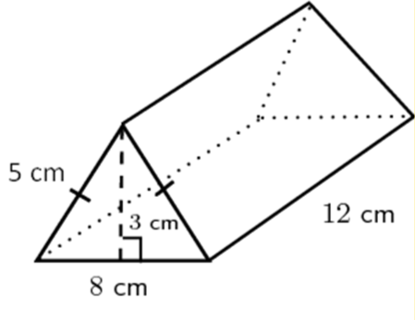
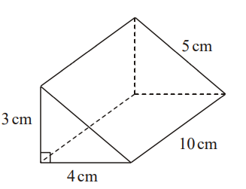
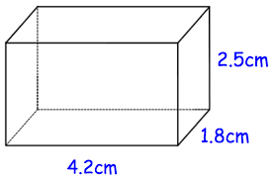
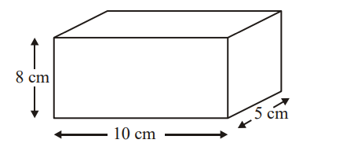
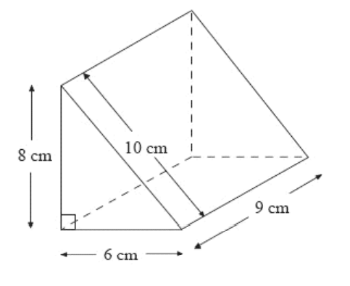
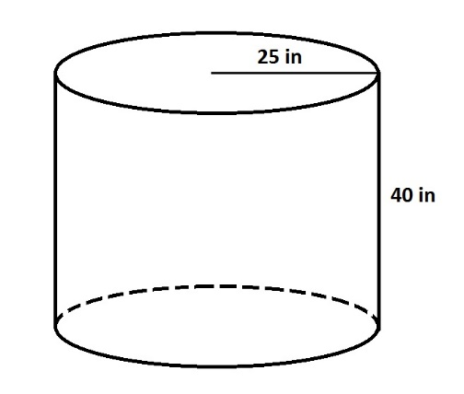
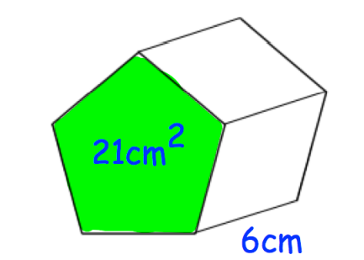
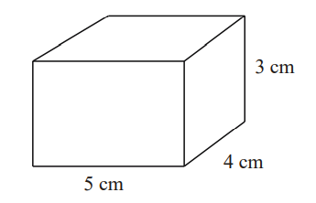
STARTER
Volume
Surface Area
Find the volume of the following;
Find the surface area of the following;

Slide 3
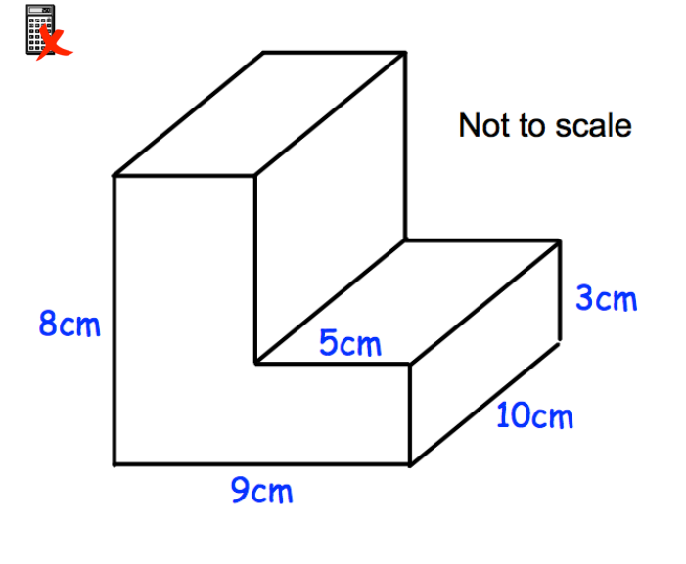
Your turn ….
Work out the volume of the composite shape below

Slide 4
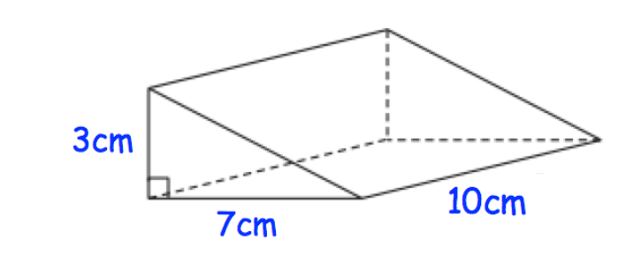
Your turn ….
Work out the volume of the shape below

Slide 5
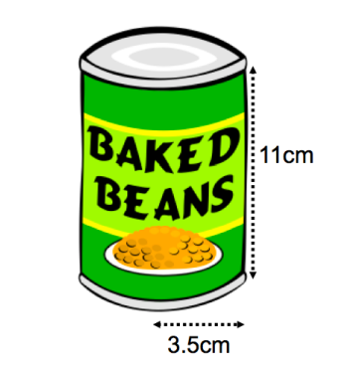
Your turn ….
Calculate the volume of the can

Slide 6
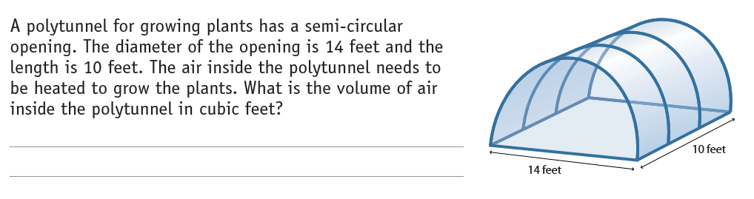
Practice Questions

Slide 7
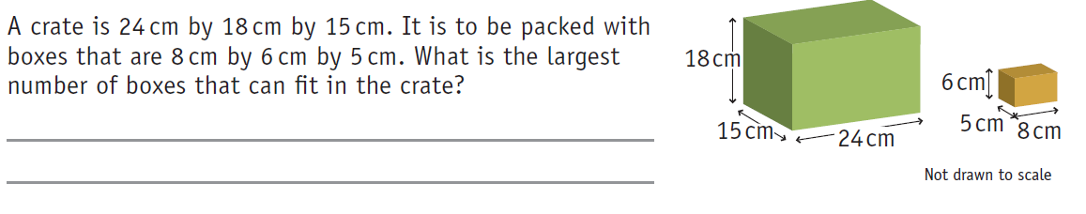
Practice Questions

Slide 8
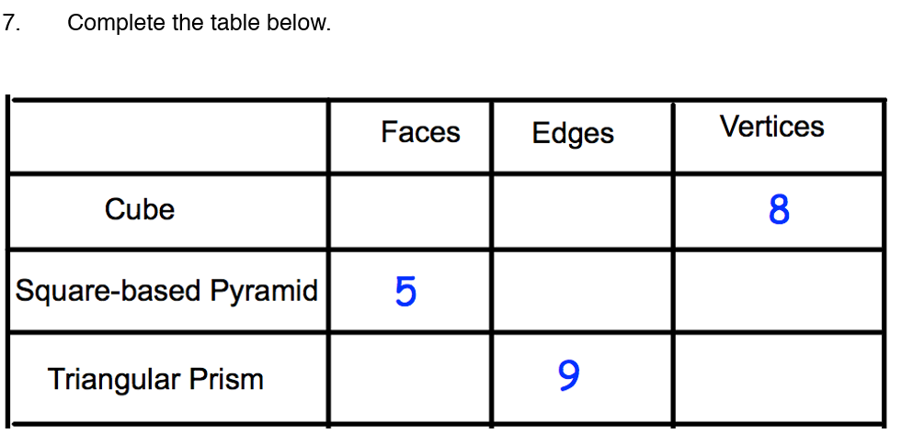
Practice Questions

Slide 9
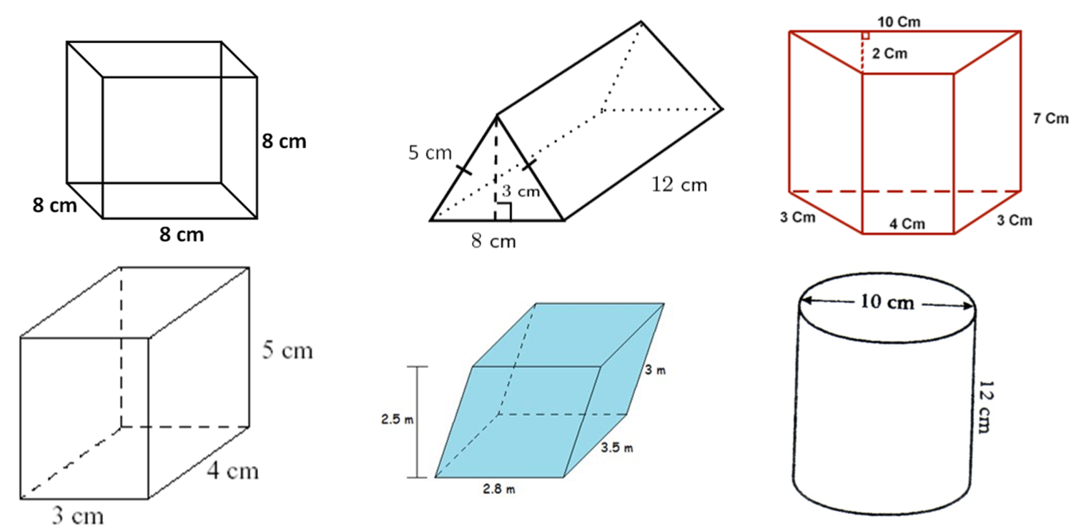
Surface Area

Slide 10

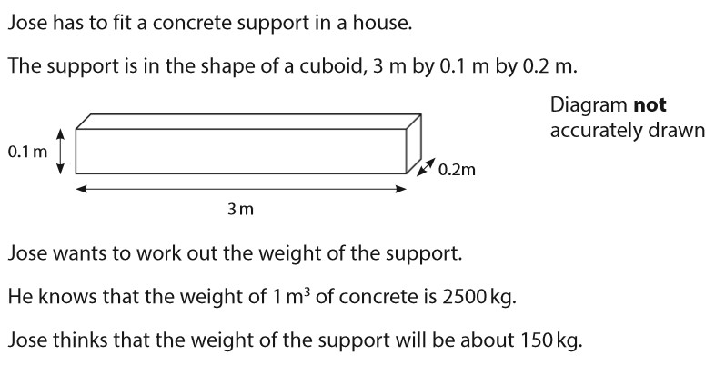
Exam Question
Feb 2018 Q8

Slide 11
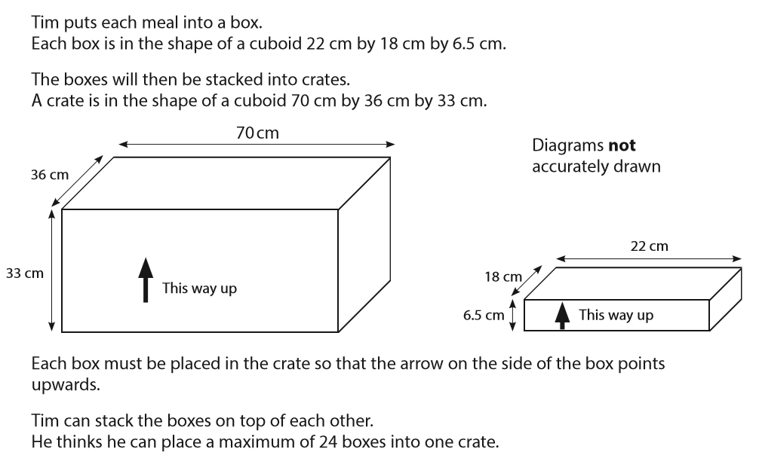
Exam Question
Jan 2017 Q3

Slide 12
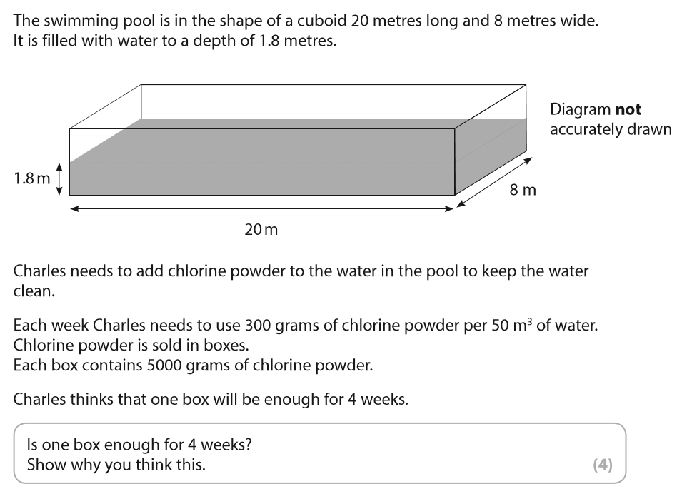
Exam Question
May 2017 Q3

Slide 13
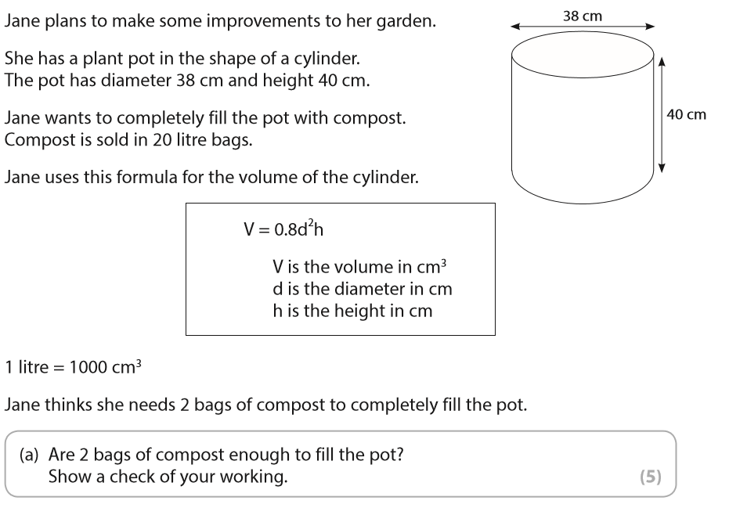
Exam Question
Jan 2017 Q7

Slide 14
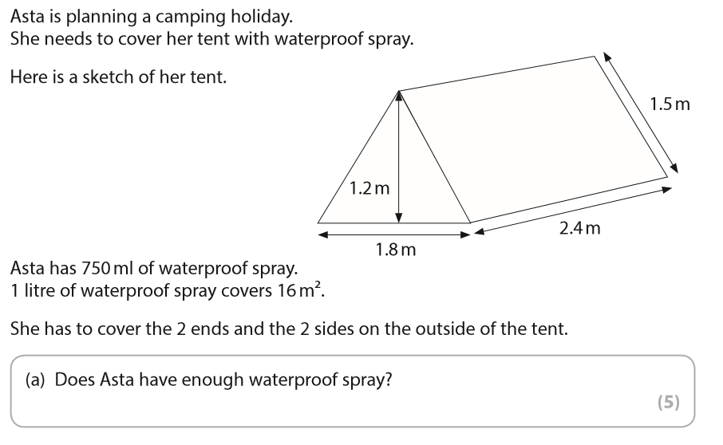
Exam Question
Jan 2016 Q7

