Slide 1




Slide 2







Multiply and Divide

Slide 3












Course Content: Choose your topic …
Whole Number and Functions
place
value
add and
subtract
multiply
divide
round
numbers
fraction
decimal
numbers
MATHS E1 E2 E3
Parts of a whole
Time
temperature
2d and 3d Shapes
metric
measure
money
charts
data
Measure and Shape
Handling Data

Slide 4





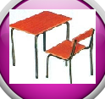







Home Warm up Progress Check 1 Video/Discuss Vocab / jobs Lesson Activities Quizzes Topic Answers Progress Check 2 Cont. Learning
Topic Introduction : Multiply and Divide
Multiplication is the another maths function that changes a value into another. It is another form of adding to a value but this time when adding you keep adding the same amount. You can learn the answers to some of these multiple adding sums to make multiplication of larger numbers easier (this is called learning your tables!).
Division is (again like add and subtract) very closely linked to multiplication as it simply asks the multiplication question in a different way. What if you start with the answer to a multiplication sum and want to know what you started with. Division splits up a number back into its groups, sets, multiples. Learning your multiplication tables will greatly help when dividing.
Choose an icon to select where to start
multiply
divide

Slide 5



Warm up exercise 1
Lets start today by revising ! Complete the above sums and multiplication grid

Slide 6


Warm up exercise 2

Slide 7
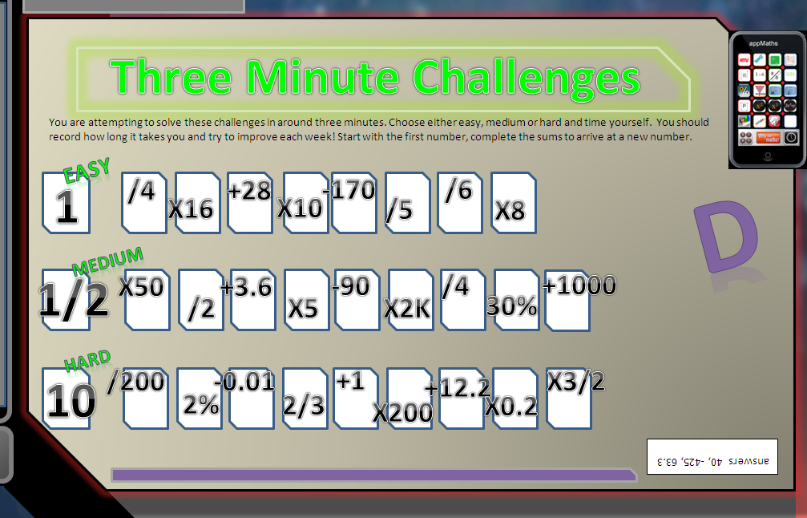

Warm up exercise 3

Slide 8

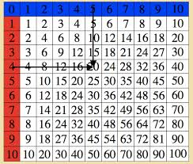
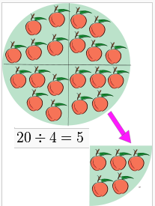
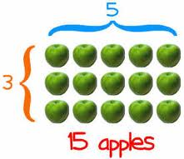
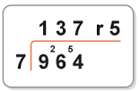
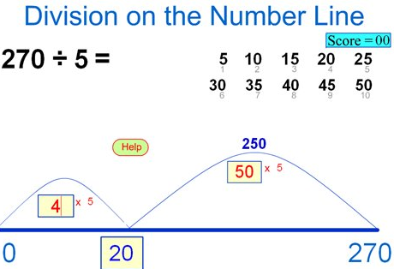
Progress Checker 1
What do you already know about multiplying and dividing ? What did you learn during the week? Examples…
How would you rate your skills in multiplying and dividing ?
Excellent ability
Good ability, but working to improve
Ok, making a start but I know I have lots to still learn
The date I started studying: My aims are…
A Identify multiple adding as ‘Multiplication’ and know single digit multiplying to 10x10
B Select a method to multiply larger whole numbers and use to solve problems
C Relate ‘Division’ as the reverse of multiplying and divide back whole numbers

Slide 9

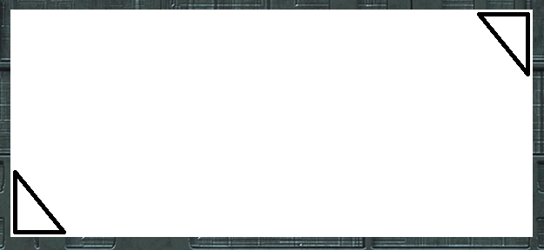


Introductory Video and Discussion
KHTU.
Does multiplying always make a number bigger ?
Can you divide up every number, fractions, decimals, neg etc..?
Do we need to learn our times tables to ten or 12 now..?
Is it still necessary to learn our times tables if we have calculators ?
What is the best method for multiplying (or dividing) ?
Is the order in which we multiply then divide important ?
Watch the introductory video and then discuss the above
Your thoughts..

Slide 10

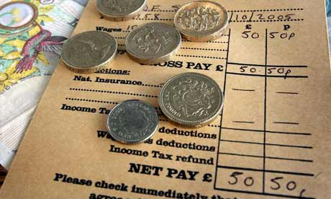


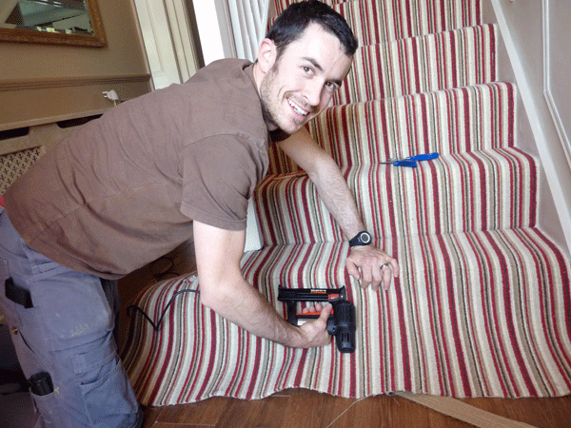

Vocabulary and Jobs
Groups
Sets
Multiply/Multiple
Times
Divide/Division
Split
Share
Factor
Prime number
Fraction
These are the words you will use in this topic
Internet Sales
Stock orders
Carpet Fitter
Gardener
Tiler
Wages
Cashier
…. Can you think of more?
…………………………………
…………………………………

Slide 11

Lesson: Concept Activity
Find as many different factors as you can to make these numbers
e.g. 42 = 2x7x3
÷∕x
factors
28
48
81
Find the definition of factor online
divide
59
196
division
multiple
products
multiplication
divide
multiply
times
share
What type of number are these factors?

Slide 12


Lesson: Main Teach
Multiple adding = Multiplication
Multiplication is just adding up lots of times
Eg 2+2+2+2 = 4 lots of 2 = 8
9+9 = 2 lots of 9 = 18
The answers to all the additions of single digits up to ten times are given in the grid on the right.
Main Learning Point : Learn all the answers on this grid

Slide 13

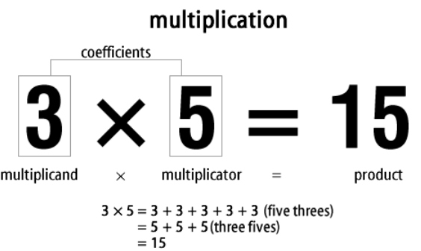
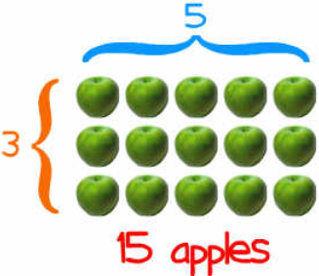

Lesson: Main Teach
What is Multiplication ??
Multiplication is about sets
Watch the tutor video for explanations

Slide 14
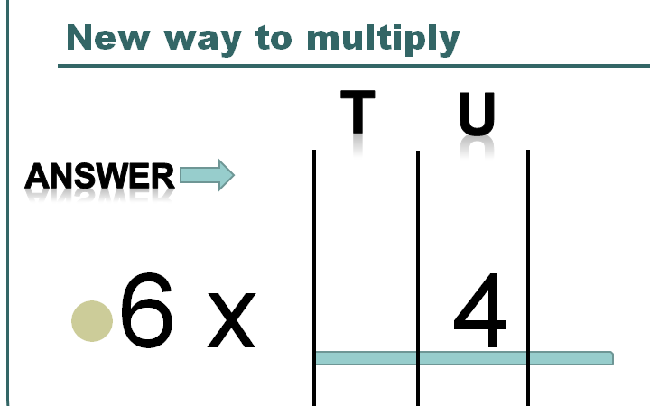
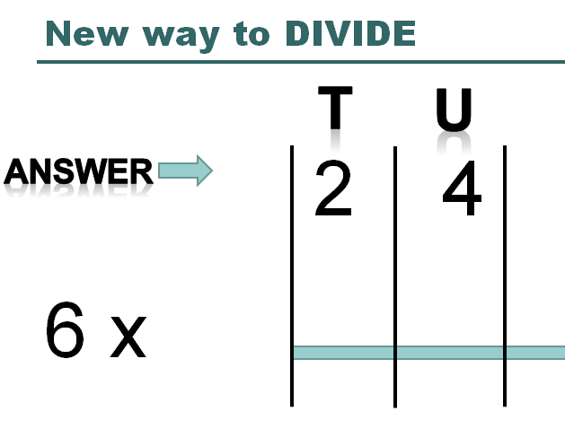
Lesson: Main Teach

Slide 15

Lesson: Main Teach
Multiplying larger numbers
46
This is called the ‘Traditional’ Method
Basically you need to ‘multiply’ each digit by the other one
In this example you want 46 x 3, which means 46 + 46 + 46
Notice this means you have three sixes in the units, then three fours in the tens place values
x 3
18
120
138
Watch the tutor video for explanations

Slide 16
Lesson: Try out
Block 1 : Watch tutor led demo (in class or on video)
Try these, 1) Multiply 8 x 4 2) Find the product of 3 and 9 3) Seven, five times
4) Zero times three 5) Ten lots of ten 6) 7 x 8 = 7) 2 + 2 + 2 + 2 + 2 + 2 + 2
Block 2 : Watch tutor led demo (in class or on video)
Try these, 8) 15 x 9 9) 23 x 4 10) 39 x 6 11) 8 x 74
12) 18 / 3 13) 25 / 5 14) 80 / 10 15) 40 / 8
16) 230 x 6 17) 454 x 2 18) 100 x 9 19) 50 x 50
Block 3 : Watch tutor led demo (in class or on video)
Try these, 20) 890 x 10 21) 400 / 6 22) 230 / 5 23) 700 x 23 24) 8,000 x 15 25) (30 x 30) / 4
26) 48 x 79 27) 2,149 / 7

Slide 17

Lesson: Websites and links
Multiplication Game
http://www.bbc.co.uk/skillswise/maths/games?page=3
Scribble Square multiplication grid
http://www.amblesideprimary.com/ambleweb/mentalmaths/scribbletable.html
Webpage of multiply and divide practice
http://mathszone.co.uk/calculating-xd/pencils-paper-division/
Division ‘Conveyor Belt’ Game
http://www.bbc.co.uk/skillswise/maths/games
Division Game
http://www.bbc.co.uk/skillswise/maths/games?page=3
Factorising by placing numbers in rows and columns
http://illuminations.nctm.org/Search.aspx?view=search&kw=multiplication&st=n
Multiply and Divide by 10, 100, 1000 manipulative
http://www.taw.org.uk/lic/itp/itps/moving_digits_08.swf

Slide 18

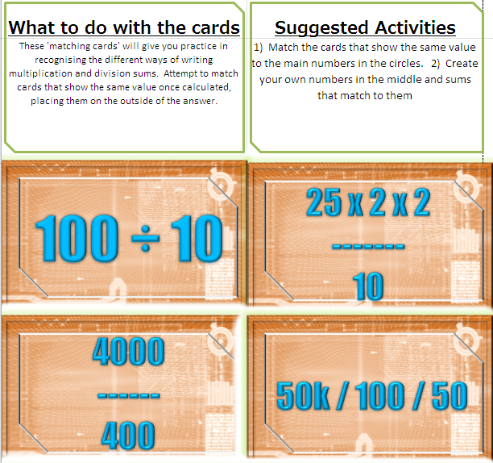

Lesson: Exploratory Activity A

Slide 19

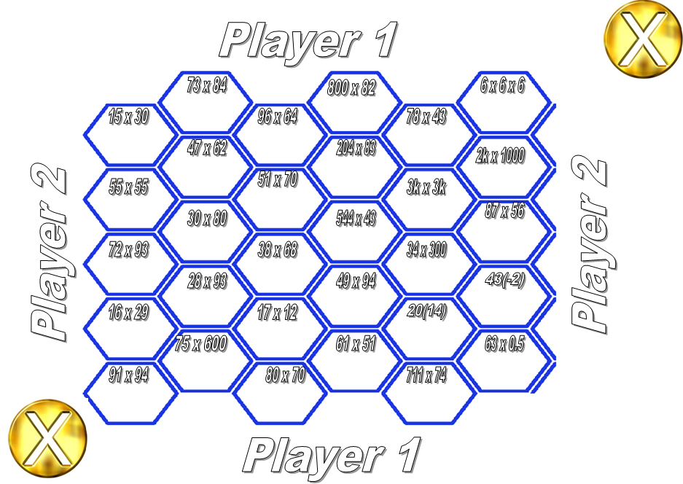
Lesson: Exploratory Activity B
Blockbusters Game
Play in pairs, be first to solve the sums and gain a space on the board. Cross the board in a connected line to win !

Slide 20
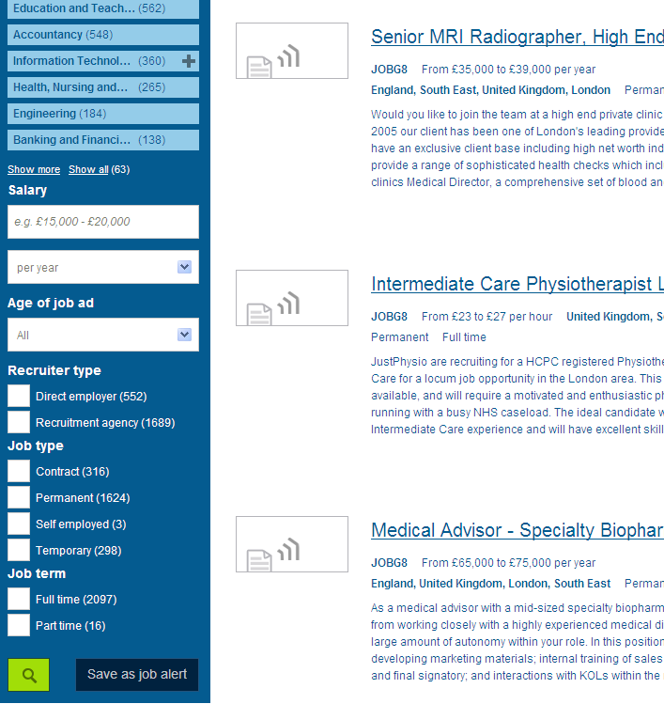


Lesson: Exploratory Activity C
Job Search……
1) Use computers to find job salaries.
2) Use spreadsheet to divide up the salaries
between each month to find monthly pay
/ weekly pay / daily pay/ hourly pay
3) Divide by 10 for pension
Divide by 5 for NI and TAX
Extension: use a wage rate and multiply up to find a salary
Maximum salary £20,000

Slide 21


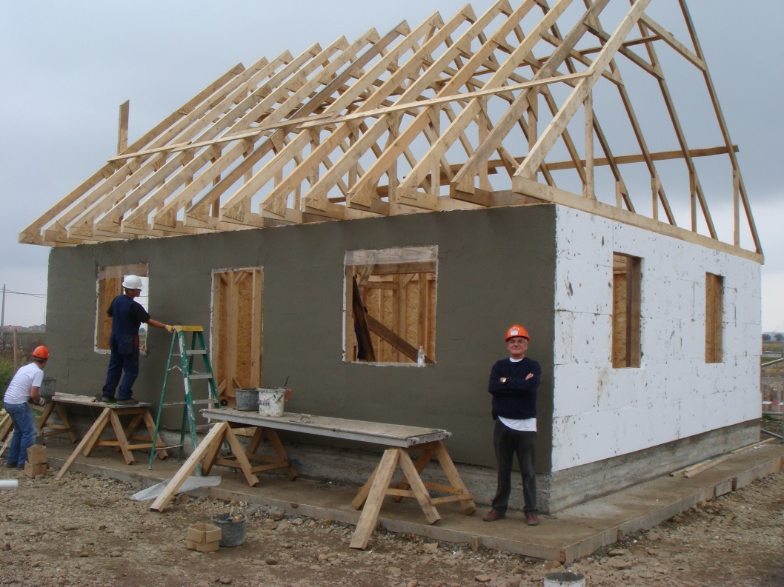
Lesson: Exploratory Activity D
Functional Questions:
Use the leaflet and question sheets

Slide 22

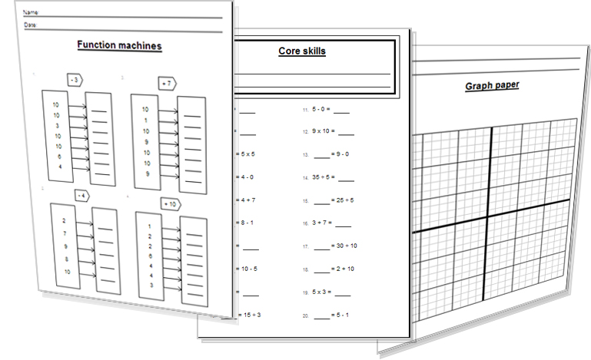
Lesson: Activity E
Try a variety of written practice
Worksheets
Workbooks
Practice Exam Papers
Maths Problems

Slide 23
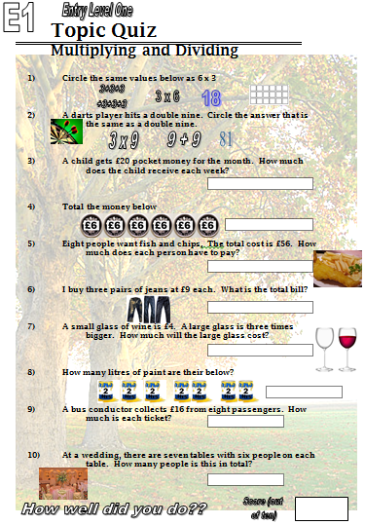

Quiz to assess Entry 1

Slide 24
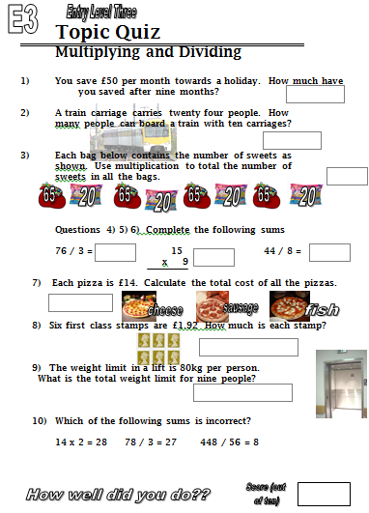
Quiz to assess Entry 3

Slide 25
TOPIC ANSWERS
Block 1 : Watch tutor led demo (in class or on video)
1) 32 2) 27 3) 35 4) 0 5) 100 6) 56 7) 14
Block 2 : Watch tutor led demo (in class or on video)
8) 135 9) 92 10) 234 11) 592 12) 6 13) 5 14) 8 15) 5
16) 1380 17) 908 18) 900 19) 2500
Block 3 : Watch tutor led demo (in class or on video)
20) 8900 21) 66 22) 46 23) 16,100 24) 120,000 25) 3,600 26) 3,792 27) 307

Slide 26


TOPIC ANSWERS
End of session quiz Entry 1
Multiply and Divide
All answers are correct
9+9
£20
6x6 = £36
£42
3x9 = £27
3x4 = £12
7x2 = 14 litres of paint
£16 / 8 = £2 each ticket
42 people at the tables
End of session quiz Entry 3
Multiply and Divide
£450
240 people
4x65 + 4x20 = 260 + 80 = 340 sweets
228
135
352
£42
192p or £1.92
720kg
76 x 3 = should be 228

Slide 27
Progress Checker 2
What do you now know about multiplying and dividing ? What did you learn during the session? Examples…
How would you now rate your skills in multiplying and dividing ?
Excellent ability
Good ability, but working to improve
Ok, making a start but I know I have lots to still learn
The date I finised studying: My aims were…
A Identify multiple adding as ‘Multiplication’ and know single digit multiplying to 10x10
B Select a method to multiply larger whole numbers and use to solve problems
C Relate ‘Division’ as the reverse of multiplying and divide back whole numbers

Slide 28
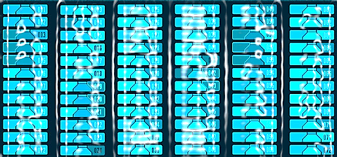

Continuing to Study and Learn
What else can you do to help yourself to learn and practice? Here are ten suggestions, record which you do each week and also record your progress.
Internet websites
Repeat the lesson, make notes, organise a folder, revise
Own maths workbook
Study together with a friend or family member
Finish activities in this book
Complete class handouts or tasks
Practice exams / past papers
Use maths skills learnt at home or at work in real situations
Play games
Experiment yourself, try new things ask yourself questions
Try making a graph of number of practice methods you use against your progress score in each topic. Are you showing more practice gives better results?

