Slide 1
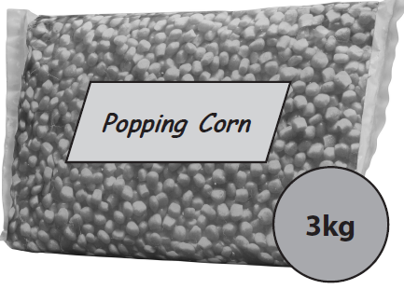
Percentage
Read, write, order and compare percentages in whole numbers
Calculate percentages of quantities, including simple percentage increases and decreases by 5% and multiples thereof
Recap
Tim buys this bag of popping corn.
Tim knows he can make 1 serving of popcorn from 50g of popping corn.
He thinks he can make 75 servings of popcorn from the 3 kg bag.
Is Tim correct?
Show why you think this?

Slide 2
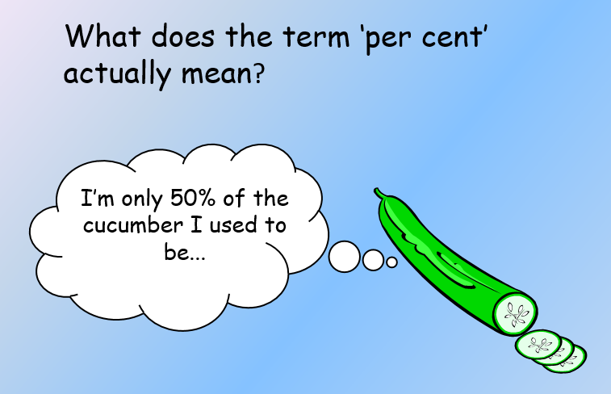

Slide 3
What method could you use to solve these questions
Calculate
46% of £360
12% of £ 874

Slide 4
Calculate percentage of quantities
Calculate
21% of £340
64% of £1080
36% of £800
Calculate
17.5% of £58
20% of £5.40
61.7% of £200

Slide 5
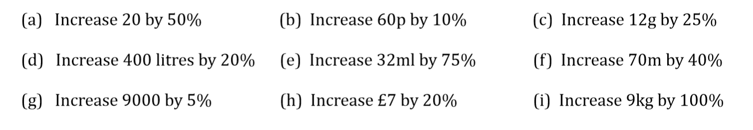
Percentage increase

Slide 6
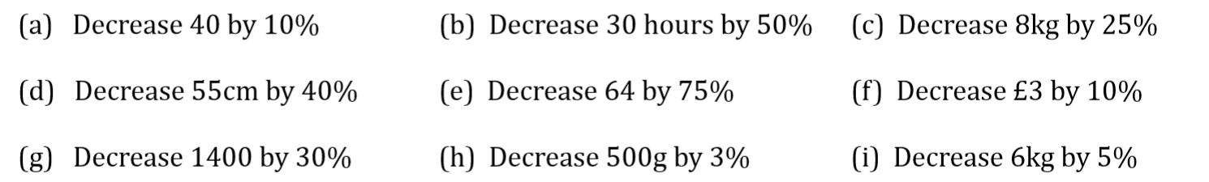
Percentage decrease

Slide 7
Percentage of quantities
Q1) 9500 people attended a festival and 22% of them are children. How many children are the festival
Q2) 65 % of a car, by weight, is steel and iron.
If a car weighs 1100kg, what is the weight of steel and iron in the car?
Q3) A Computer costs £406 plus VAT at 20%. Work out the total cost of the computer.
Q4) A car is usually priced at £9800 but now has a discount of 8%. What is the new price of the car?

Slide 8
Simple interest
Sally deposits £600 into an account with interest rate of 5% per year. Calculate the interest that Sally received in one year and find how much money she has in the account after one year.
Jamie’s bank account pays interest at a rate of 10% per year. If he puts £850 into his account, how much will Jamie have after a year?

Slide 9
Credit agreement
The price of a new TV if £690. It is available on credit agreement by paying a deposit of 15% followed by 12 instalments of £55.85.
Find the total credit agreement cost and the extra that you would pay (over cash price) using credit agreement.

Slide 10
Calculating instalments
The cash price of a bike is £220. The credit agreement price is £300.
If the deposit is 10% followed by ten equal monthly instalments, find the amount you pay each month.

Slide 11
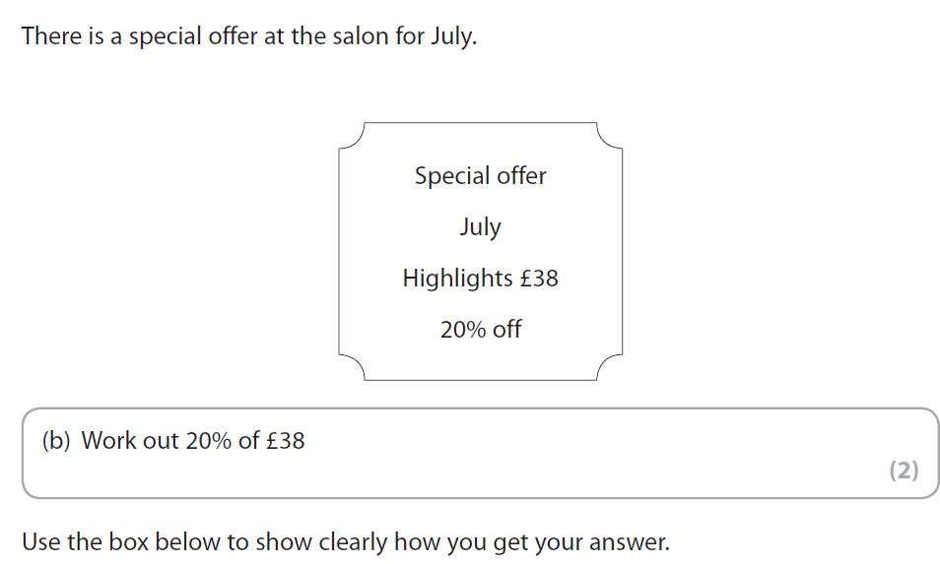
Exam questions
FSM01/01 Feb 2016.

Slide 12
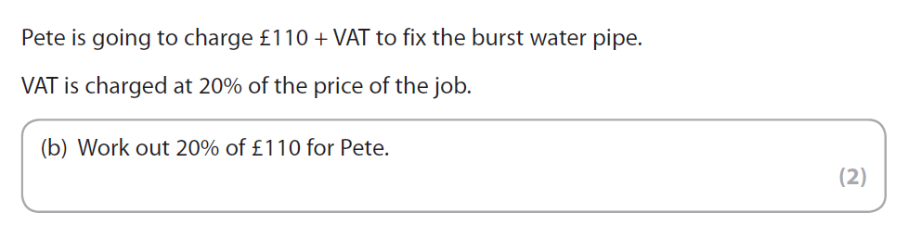
Exam questions
FSM01/01 May. 2016

Slide 13
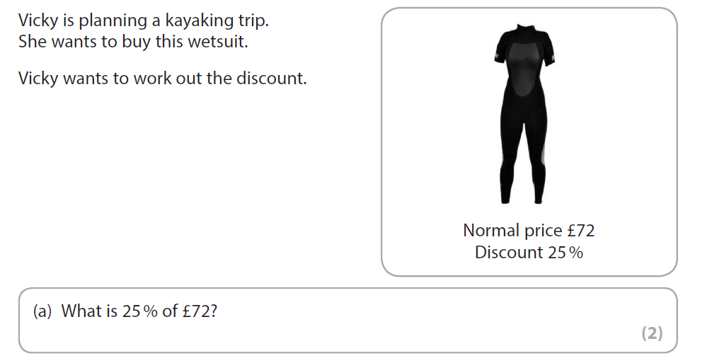
Exam questions
FSM01/01 June. 2016

Slide 14
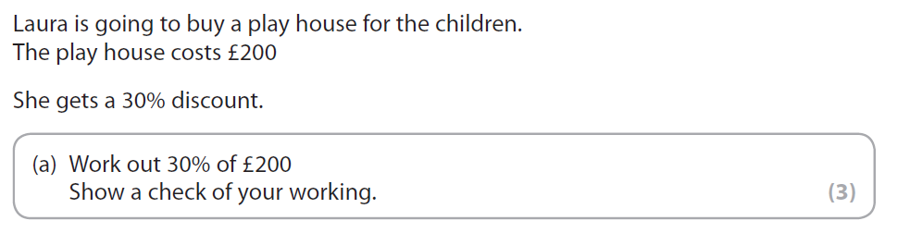
Exam questions
FSM01/01 Nov. 2016

Slide 15
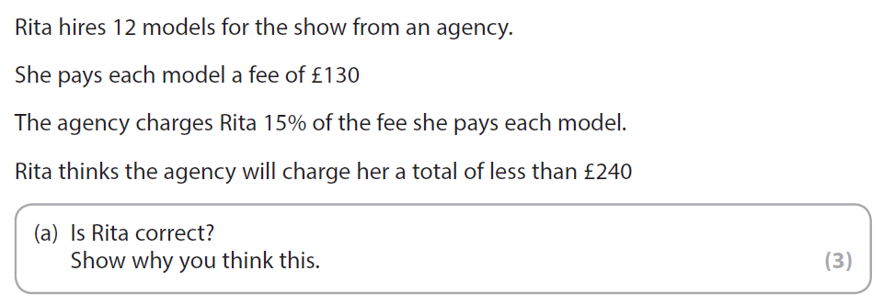
Exam questions
FSM01/01 March. 2016

Slide 16
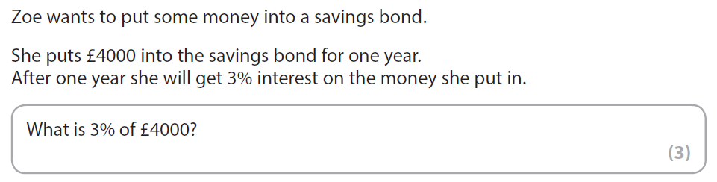
Exam questions
FSM01/01 Oct. 2016

Slide 17
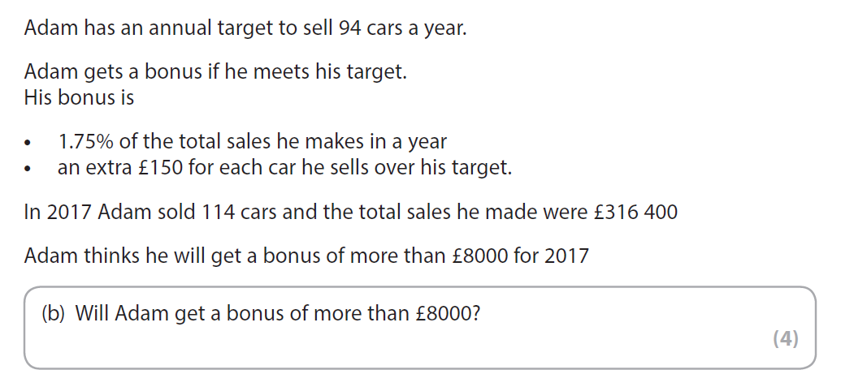
Exam questions
FSM02/01 May. 2018

Slide 18
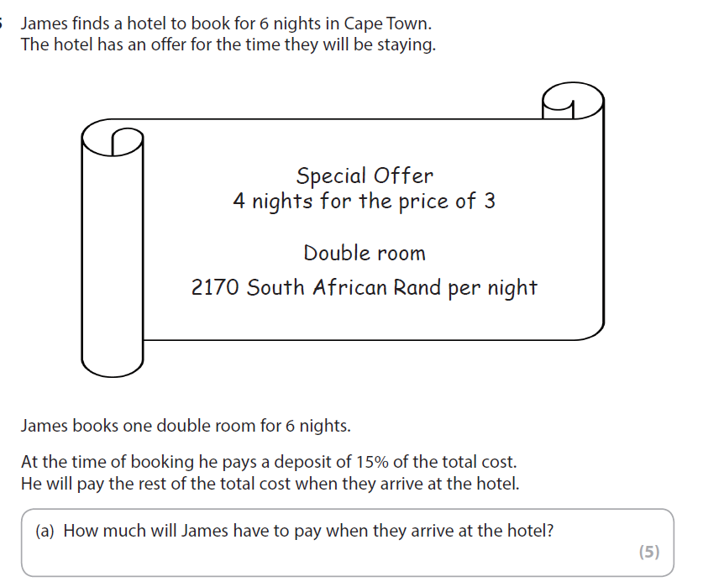
Exam questions
FSM02/01 Feb. 2016
FSM02/01 Feb., 2018

