Slide 1
FRACTIONS
Learning Objectives
To be able to :
Convert mixed fractions to top heavy fractions and vice versa
Add, subtract, multiply and divide fractions
Find fractions of amounts
Think about RULES we use for the following in terms of fractions :
ADDING
DIVIDING
MULTIPLYING
SUBTRACTING

Slide 2
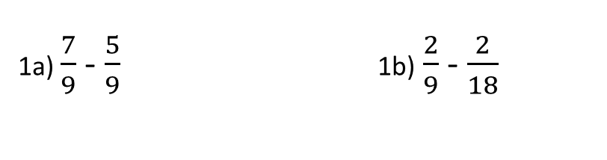
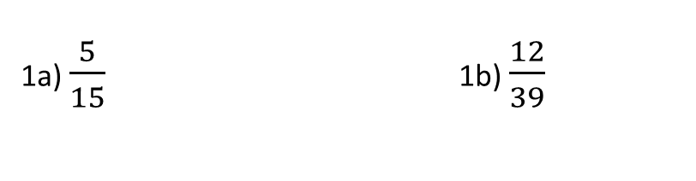
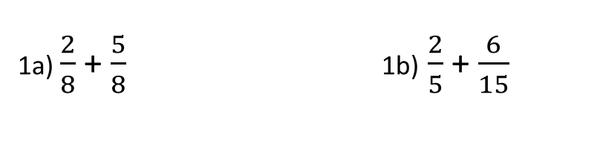
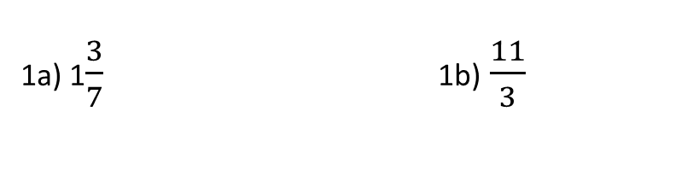
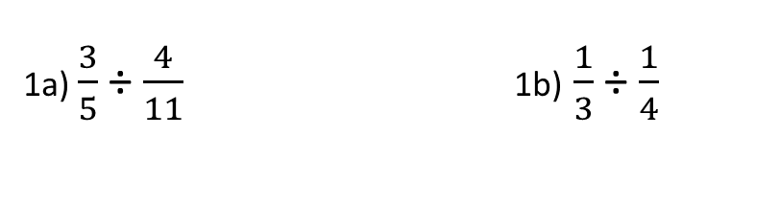
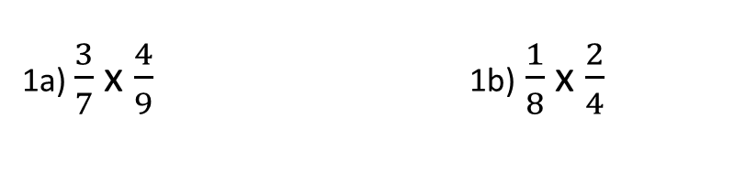
STARTER
Adding
Dividing
1a) $\frac{2}{8}$ + $\frac{5}{8}$ 1b) $\frac{2}{5}$ + $\frac{6}{15}$
1a) $\frac{3}{5}$ ÷ $\frac{4}{11}$ 1b) $\frac{1}{3}$ ÷ $\frac{1}{4}$
Subtracting
Converting
Convert to improper Convert to mixed
1a) $\frac{7}{9}$ - $\frac{5}{9}$ 1b) $\frac{2}{9}$ - $\frac{2}{18}$
1a) 1$\frac{3}{7}$ 1b) $\frac{11}{3}$
Multiplying
Equivalent
1a) $\frac{3}{7}$ x $\frac{4}{9}$ 1b) $\frac{1}{8}$ x $\frac{2}{4}$
Simplify the following fractions
1a) $\frac{5}{15}$ 1b) $\frac{12}{39}$

Slide 3


EQUIVALENT FRACTIONS
Simplifying fractions
$$\frac{12}{18}$$
$$\frac{32}{48}$$

Slide 4


CONVERTING FRACTIONS
$$1\frac{3}{7}$$
$$\frac{45}{8}$$

Slide 5
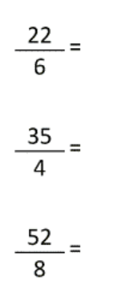
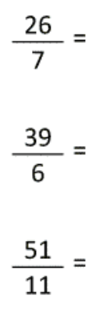
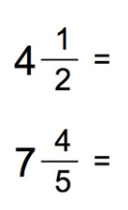



Your turn…
Covert to mixed fraction
Covert to improper fraction

Slide 6






ADDING AND SUBTRACTING FRACTIONS
$$\frac{5}{9} + \frac{2}{9}$$
$$\frac{3}{7} − \frac{1}{7}$$
$$\frac{3}{7} + \frac{2}{14}$$
$$\frac{3}{4} − \frac{7}{8}$$
$$\frac{4}{5} + \frac{3}{8}$$
$$\frac{2}{11} − \frac{3}{7}$$

Slide 7
















Your turn…
$$a) \frac{1}{3}+ \frac{2}{4}$$
$$b) \frac{2}{5}− \frac{2}{6}$$
$$c) \frac{1}{3}+ \frac{3}{5}$$
$$d) \frac{3}{5}− \frac{8}{15}$$
$$e) \frac{2}{5}+ \frac{2}{3}$$
$$f) \frac{8}{22}− \frac{1}{11}$$
$$g) \frac{5}{10}+ \frac{3}{5}$$
$$h) \frac{15}{22}− \frac{1}{4}$$
$$a) 3\frac{1}{3}+ 9\frac{2}{4}$$
$$b) 5\frac{1}{2}− 1\frac{2}{4}$$
$$c) 6\frac{1}{5}+ 8\frac{9}{10}$$
$$d) 5\frac{2}{3}− 3\frac{1}{2}$$
$$e) 3\frac{2}{5}+ 6\frac{2}{3}$$
$$f) 7\frac{1}{2}− 1\frac{1}{5}$$
$$g) 4\frac{2}{3}+ 6\frac{1}{5}$$
$$h) 9\frac{2}{4}− 2\frac{2}{5}$$

Slide 8






MULTIPLYING AND DIVIDING FRACTIONS
$$\frac{7}{9} × \frac{2}{5}$$
$$\frac{5}{9} ÷ \frac{2}{7}$$
$$\frac{3}{5} × \frac{1}{3}$$
$$\frac{5}{13} ÷ \frac{2}{3}$$
$$\frac{1}{7} × \frac{3}{11}$$
$$\frac{11}{9} ÷ \frac{2}{5}$$

Slide 9















Your turn…
$$a) \frac{2}{3}÷\frac{1}{5}$$
$$b) \frac{3}{5}×\frac{1}{2}$$
$$c) \frac{4}{11}÷\frac{2}{9}$$
$$d) \frac{4}{8}×\frac{1}{12}$$
$$e) \frac{2}{15}÷\frac{4}{7}$$
$$f) \frac{7}{12}×\frac{7}{9}$$
$$g) \frac{4}{13}÷\frac{5}{14}$$
$$h) \frac{1}{3}×\frac{11}{4}$$
$$a) 3\frac{1}{3}÷2\frac{1}{5}$$
$$b) 2\frac{1}{3}×\frac{1}{4}$$
$$c) 2\frac{3}{4}÷1\frac{2}{3}$$
$$d) 1\frac{1}{3}×2\frac{1}{4}$$
$$e) 3\frac{2}{5}+ 6\frac{2}{3}$$
$$f) 1\frac{1}{2}×2\frac{1}{5}$$
$$g) 7\frac{2}{5}÷6$$
$$h) 9\frac{3}{4}×3\frac{2}{5}$$

Slide 10






FRACTION OF AMOUNTS
28 $× \frac{3}{4}$
$\frac{2}{5}$ of 100 = of 50
$$\frac{3}{4}×36$$
$\frac{3}{4}$ of = $\frac{2}{3}$ of 90
$$\frac{5}{12}of 60$$
$\frac{1}{4}$ of 64 = $\frac{1}{4}$ of

Slide 11


June 2017 Paper 2

Slide 12

June 2018 Paper 1

