Slide 1

L2 Fskills Maths
Plan Design Perimeters Areas Volumes

Slide 2
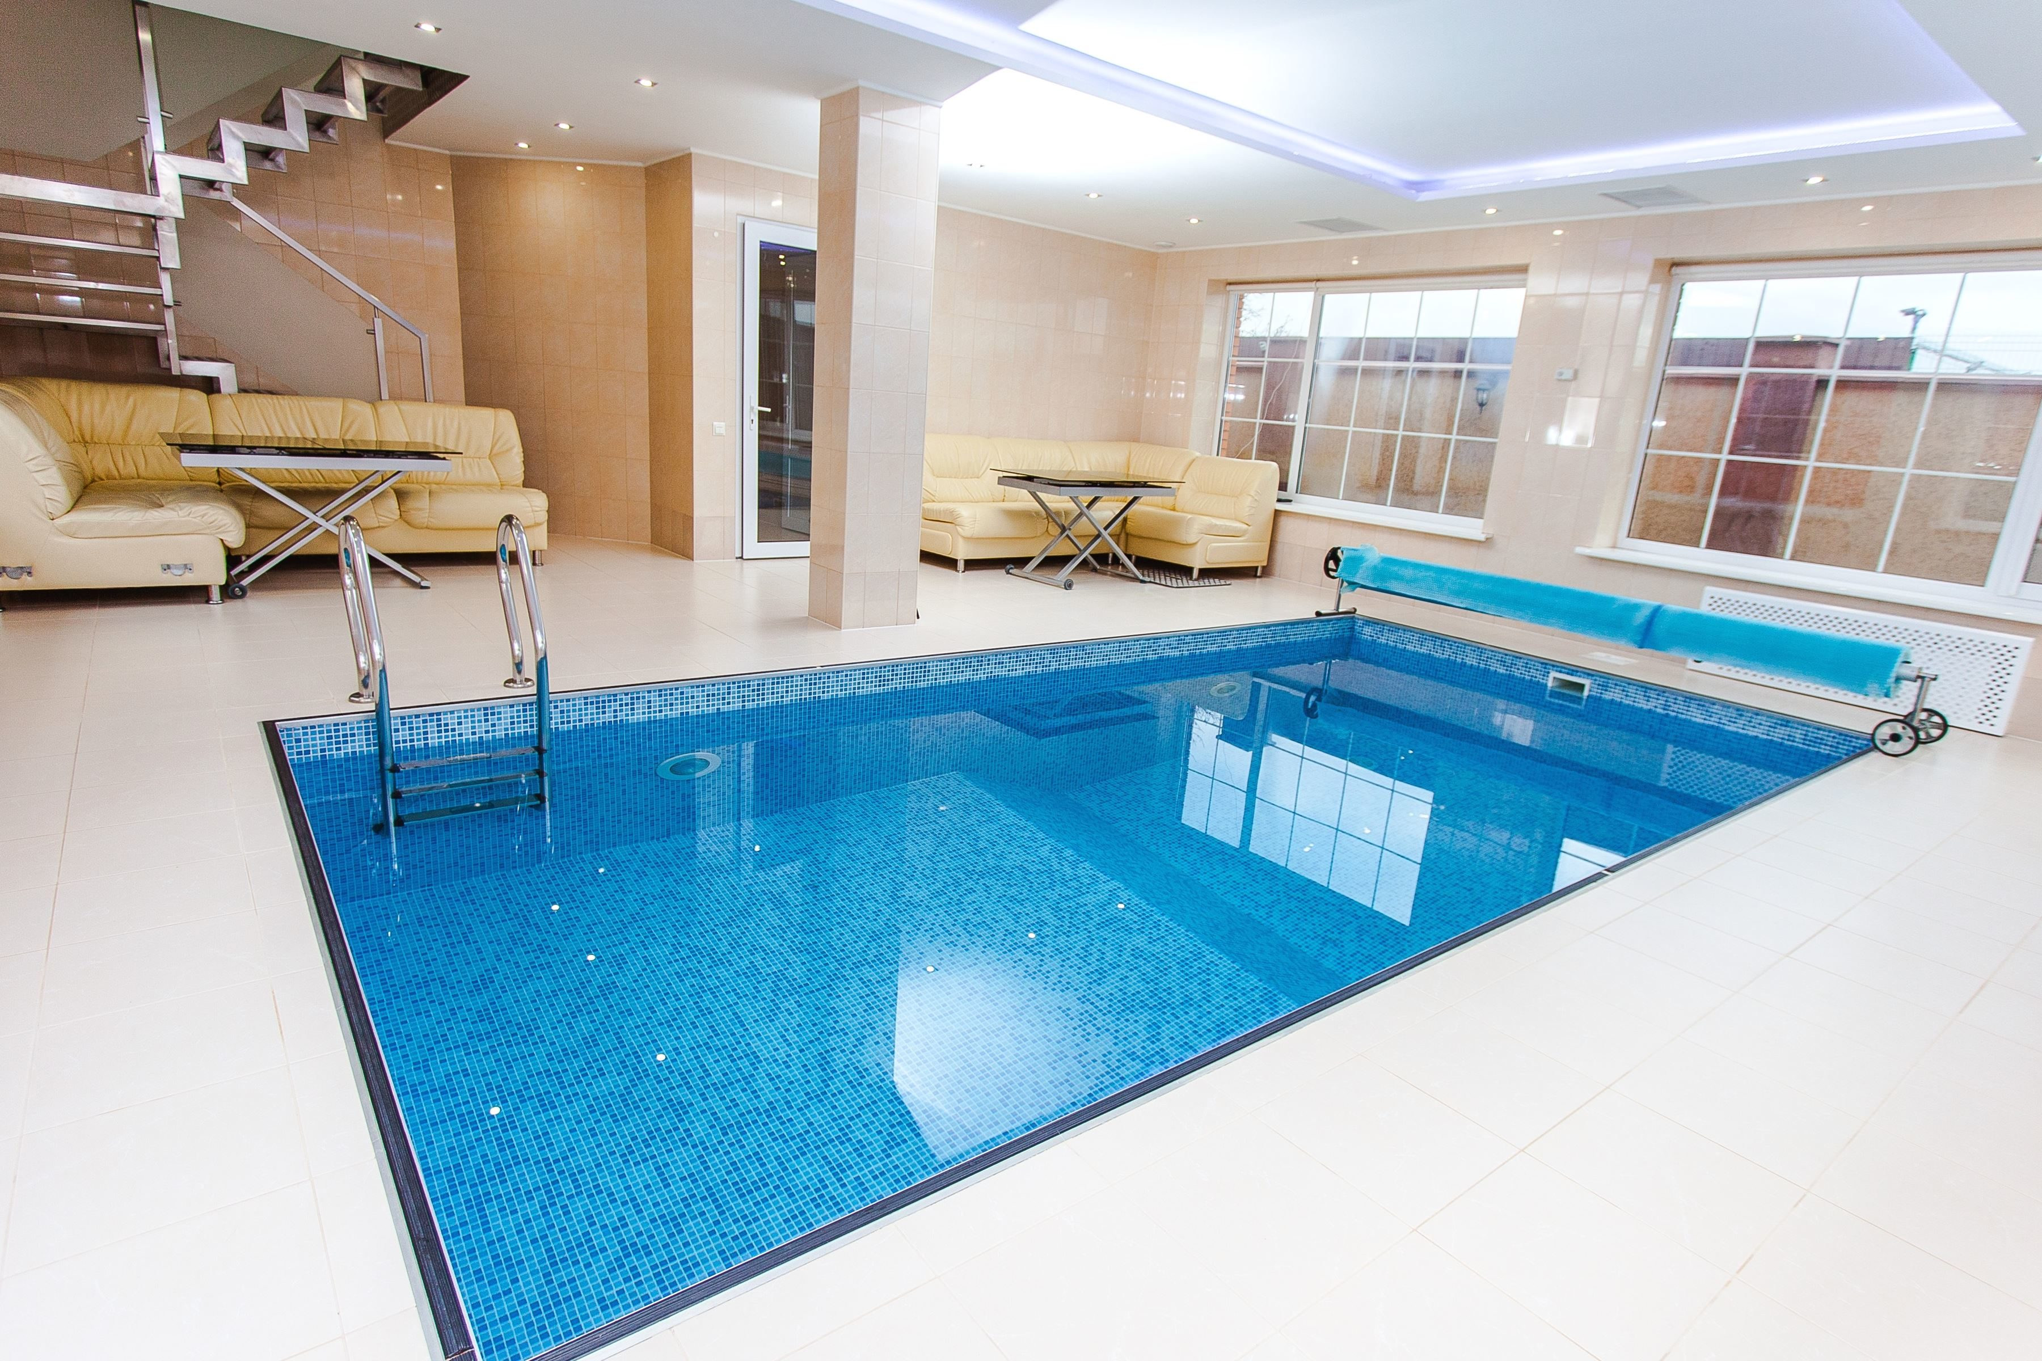

Slide 3
Exam Question Possibility?
Units
Shapes
Perimeters?
Areas?
Volumes?
Costs?

Slide 4
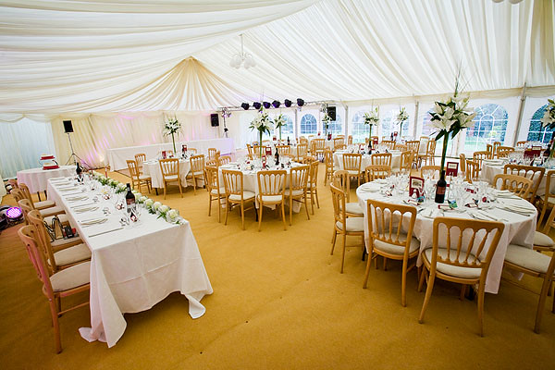
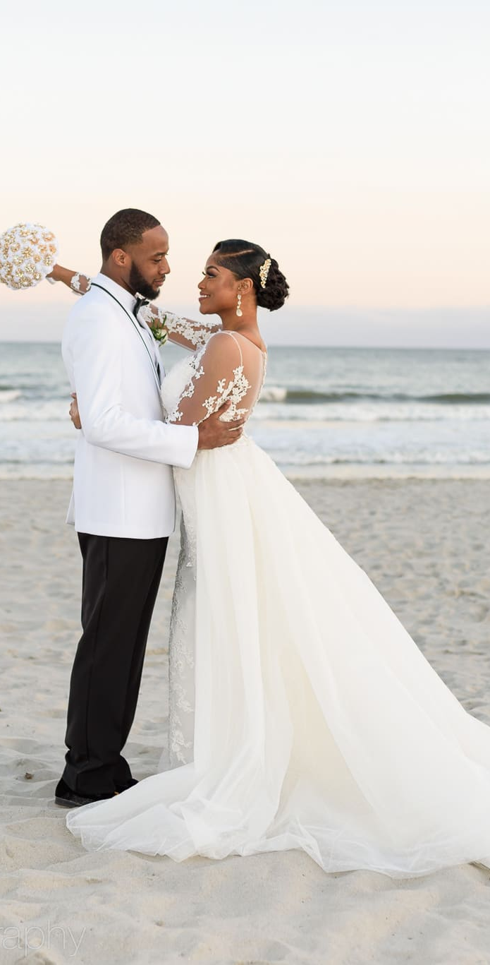
This Photo by Unknown Author is licensed under CC BY-NC-ND

Slide 5
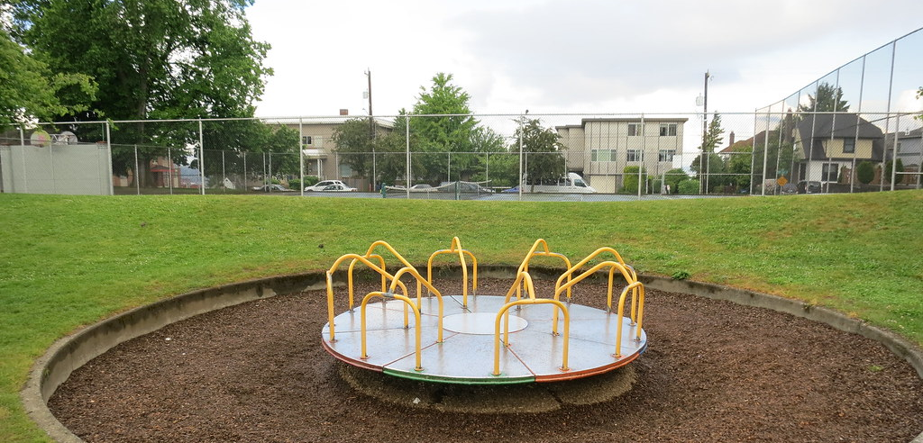
This Photo by Unknown Author is licensed under CC BY-SA-NC

Slide 6
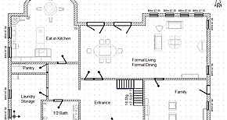
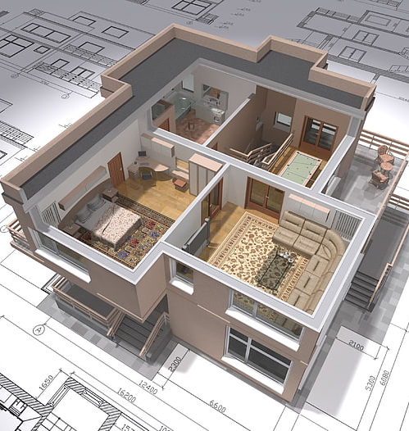

This Photo by Unknown Author is licensed under CC BY-SA
This Photo by Unknown Author is licensed under CC BY-NC

Slide 7
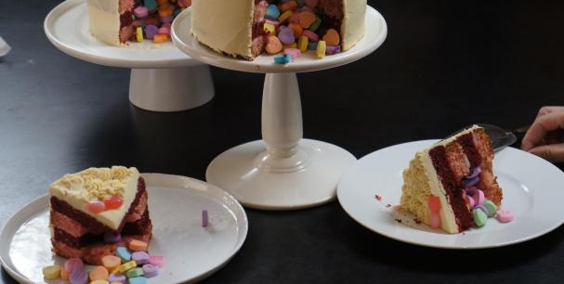
This Photo by Unknown Author is licensed under CC BY

Slide 8



Slide 9

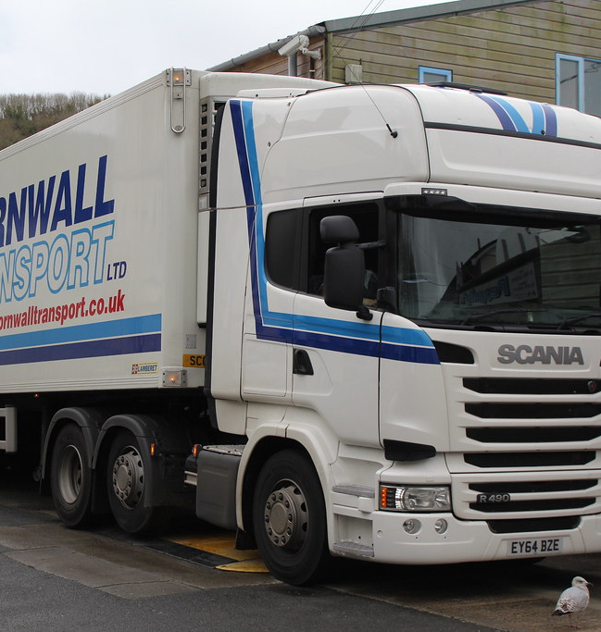
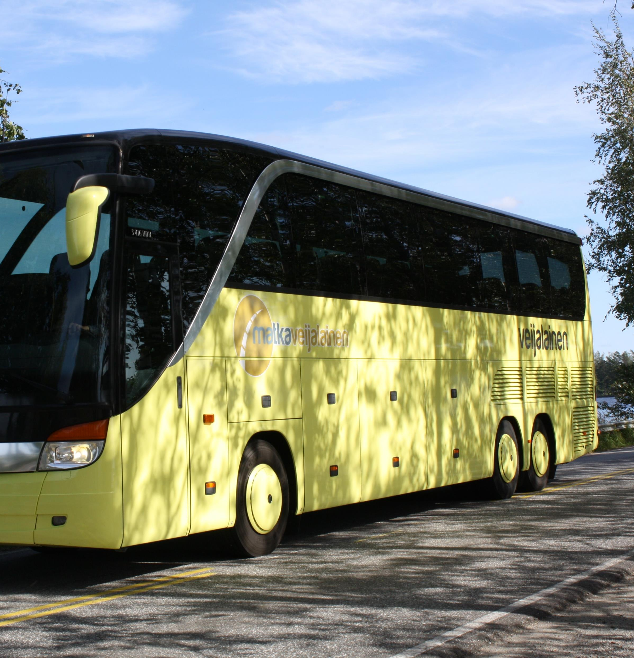
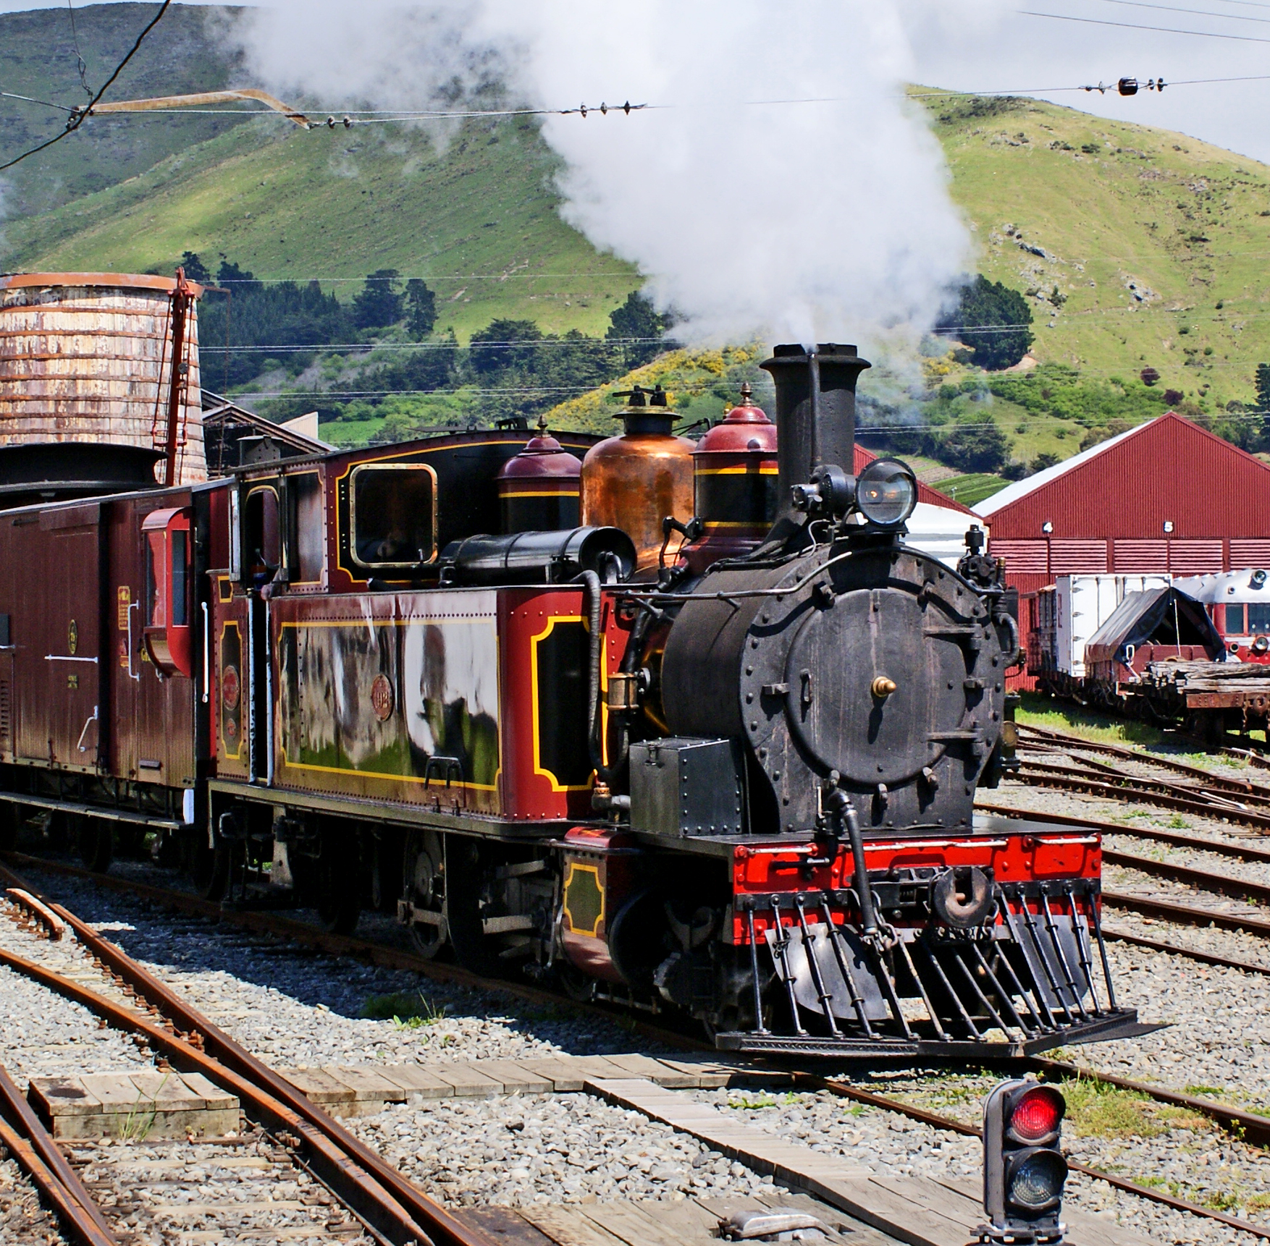
This Photo by Unknown Author is licensed under CC BY-ND

Slide 10

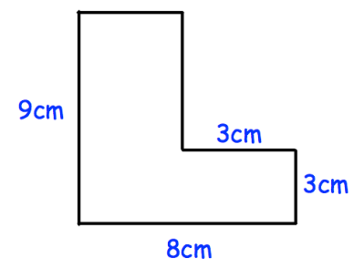
Exam Style Questions
A small present is wrapped using the piece of paper shown. Five of these presents get wrapped. Find the left over area of paper from a 1mx1m roll of wrapping paper

Slide 11
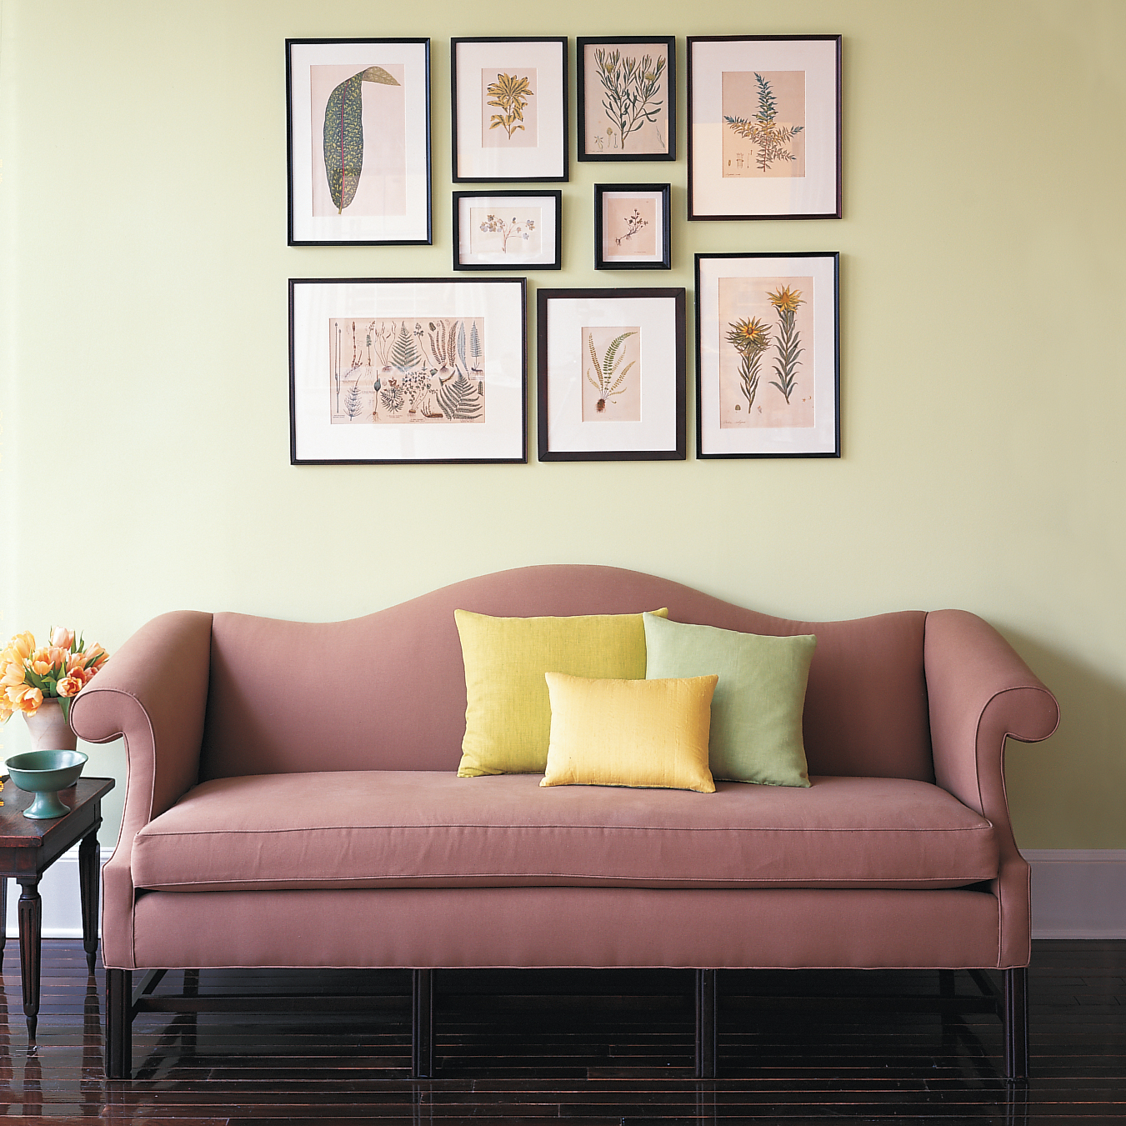
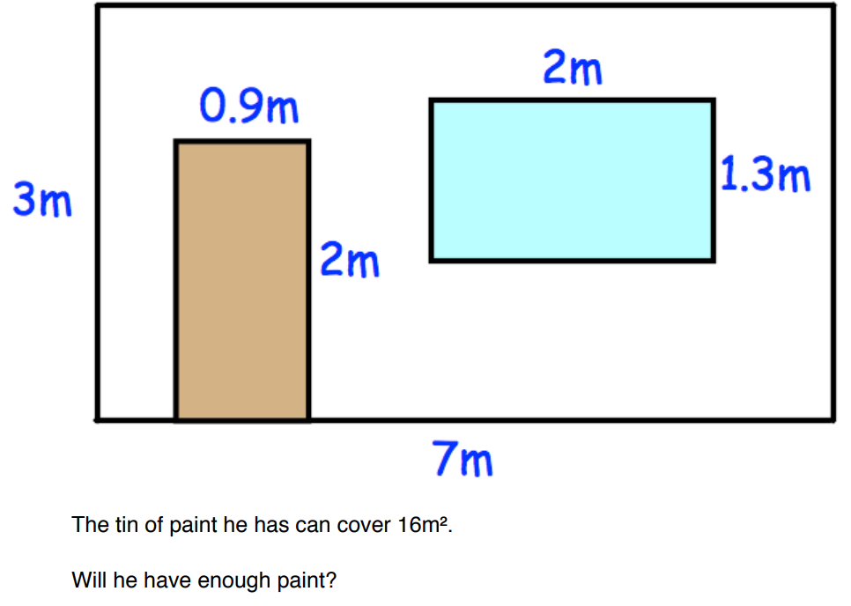
Exam Style Questions
The wall of a house is to be painted as per the image shown. The door will not be painted, nor the area 2x1.3 for the window.

Slide 12
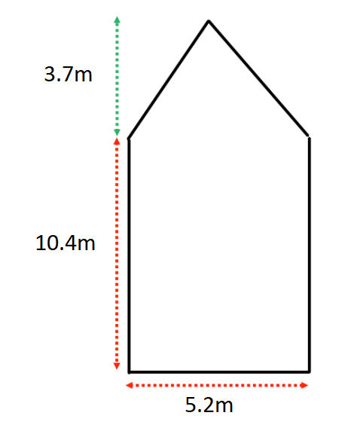
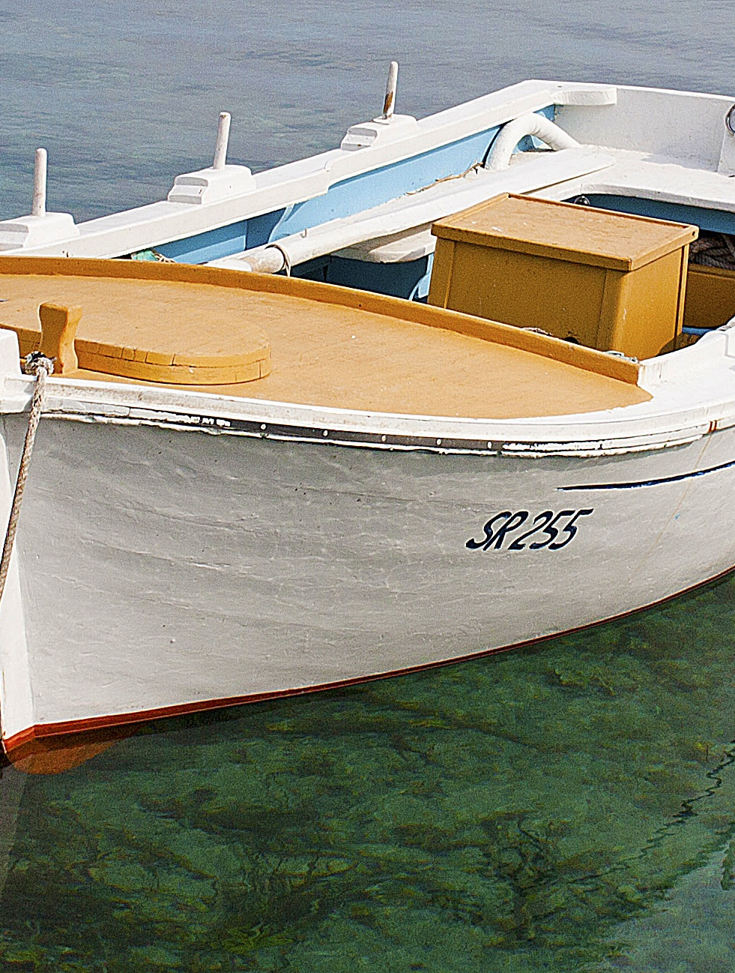
Exam Style Questions
The wood for the base of a boat is planned as the image.
A plank of wood is 2.5m x 70cm £17.50
Find the cost of the wood for the boat base.

Slide 13
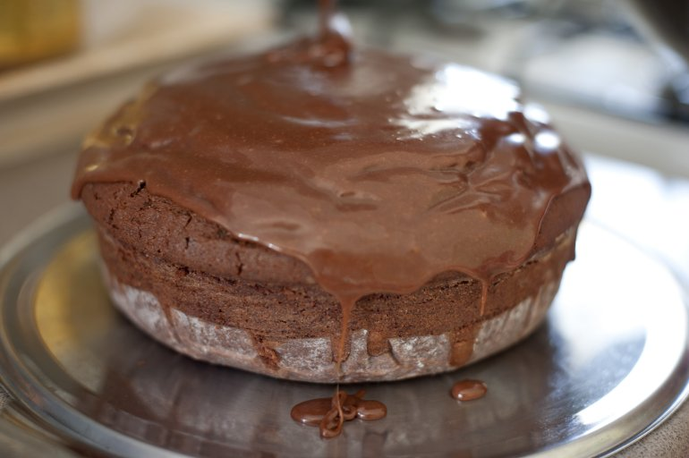
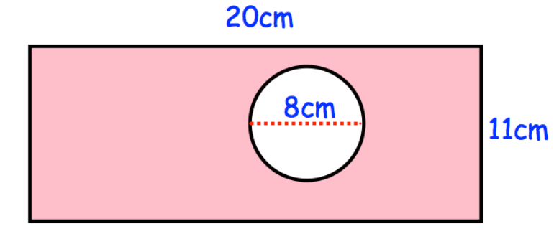
Exam Style Questions
Cakes are placed onto 20 trays as the tray shown in the image. As many 8cm diameter cakes are placed as possible per tray. Each cake is also 10cm in height.
Find the total volume of all the cakes placed on the 20 trays.

Slide 14
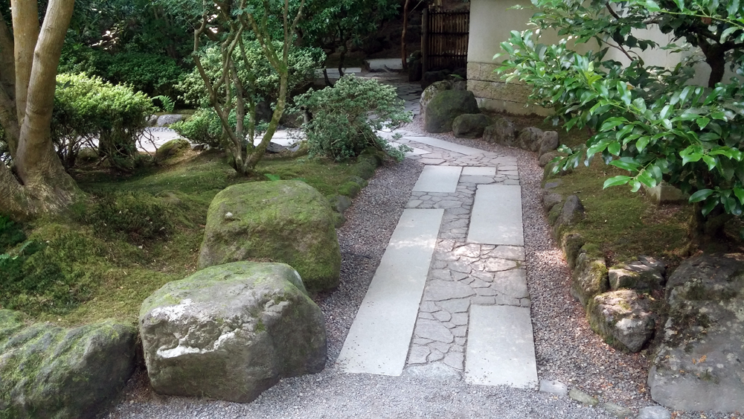
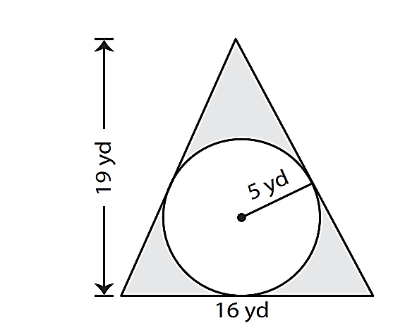
Exam Style Questions
The design of a garden is shown with triangular lawn and circular patio.
Tiles for the patio are sold in packs of 8 and are 20cm x 10cm and can be cut to fit any area. Packs of tiles are £14.
Grass is sold in rolls 3mx50cm and priced at £12.50 each. 0.91m = 1yd
Find the cost of the garden.

Slide 15
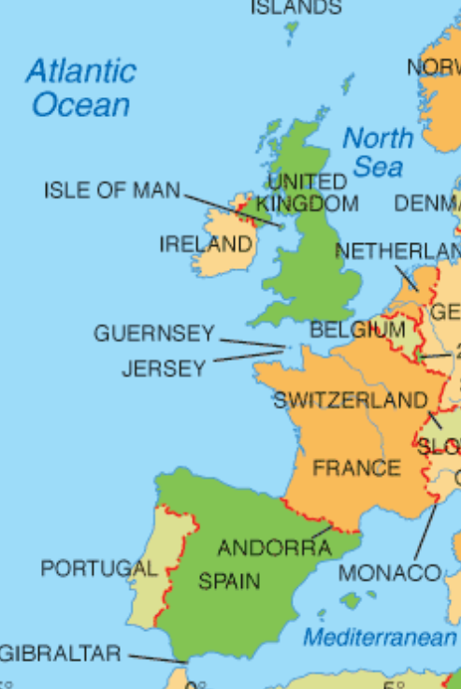
Exam Style Questions
Lara is flying from London (England) to Madrid (Spain) as shown on the map.
The distance on the map is 7.4cm
The map scale is 1: n
The actual distance is 1300km
Find ‘n’ the missing value in the map scale.
7.4cm

Slide 16
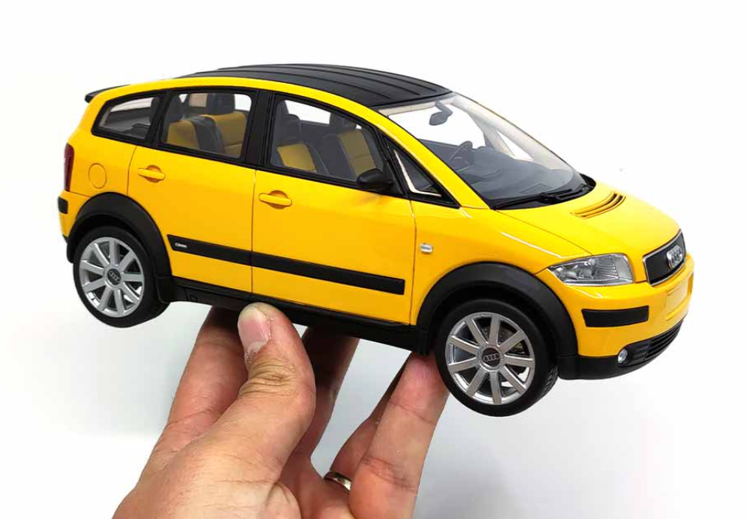
Exam Style Questions
The model car shown is a 1 : 18 scale
This car measures 15cm long.
Find the cars real length in metres
Find length of a model of this car if the real car is 2.5m long (still using 1:18)

