Slide 1
Welcome Week
September 2025
Adult & Community English & Maths

Slide 2
Welcome
Digital Learning Appointment
Learning Agreements
Aspirations
Expectations
Support
Engage in your Tutor’s introduction to your specific course

Slide 3
IT confidence
Have you used Multifactor Authentication, sometimes referred to as MFA? Y, N, IDK
Have you ever joined an online meeting through a link or calendar invitation? Y, N
Have you used Microsoft Teams? Y, N
Have you used Microsoft Outlook for emails? Y, N
Do you know what Microsoft 365 is? Y, N
Activity
https://create.kahoot.it/share/welcome-week-it-confidence/286dfcfe-b635-4a4b-a27c-0d9e3fb0f580

Slide 4
Why are we seeing the Digital Learning team?
Expectations – Working Online
Teams
Teams is the primary, and often only, way that staff members will communicate with learners.
Check your class Teams weekly before attending sessions
Check the ‘Adult & Community English & Maths’ Team regularly too
Using 365
College emails – check weekly. We will no longer use your personal email in the first instance. Teams is the primary, (and often only) way that we will communicate with learners. Secondly, we use college emails.
Calendar – can be viewed on Teams or through Outlook with your college emails.
Find your class Team and join the whole School Team.
https://teams.microsoft.com/l/team/19%3aXo-Qdi6jvRTEkSDEvh511H2zmczf1zfBP31XlELkOrM1%40thread.tacv2/conversations?groupId=96961db8-4342-48eb-b410-d96e6beb17b1&tenantId=952c9f77-608e-4fb2-9a07-fe66983b9967

Slide 5
IOT Groups only
Check you have access to all the areas you need
Note the location of physical display boards
Note the location of electronic display boards
Teams is particularly important for evening students, to stay in touch and support your learning journey. Make sure you take the details of the Digital Learning team and the IT Service Desk (both here today) in case you need to contact them later, in between sessions.

Slide 6
Aspirations
Why are you here?
Timed activity

Slide 7
Our Values
College Values
Equality and Diversity
Behaviours
Respect
Excellence
Integrity
Innovate
Inspire
Belong
Our aim is to ensure that everyone has access to our courses and enjoys a positive learning experience.
We want all our learners to achieve their goals and make progress.
To ensure everyone has a positive experience on their course, we operate zero tolerance towards any form of harassment or discrimination.

Slide 8
British Values
Your tutor may rush past this slide. You can read it properly later, on Teams. These values are integral, but we have a lot to fit in today.
Some learners know about British Values from previous learning. Some work in education themselves, and some will know about these values through their own children. For others, this will be a new term.
As our learners, it’s important for you to understand what British Values mean and why they are a basis for learning at college.
Democracy – We can have our say on our learning, college experience and learning environment.
Mutual Respect - Equality for all. Everyone has the right to be listened to and voice their own opinion. We must respect others and listen to their opinions, but this will be done responsibly.
Individual liberty - Everyone has the right to their own opinions and beliefs, but if that means people are placed in danger then we have a duty to report it.
The rule of law – We negotiate College, School and Class rules. We need to abide by these rules and adhere to policies and procedures. By signing up for a course, you have agreed to do this.
Tolerance – We are tolerant towards those of different faiths and beliefs. We celebrate and welcome diversity.

Slide 9
More than English and Maths
Enrichment Opportunities
Student Voice
College In the Community Day
MKCG Student of the Year
External award nominations
External events, such as the national Creative Arts in FE Association of Colleges Competition
Cultural Diversity Day
Trips
Careers sessions
Additional Reward & Recognition
Certificates for highest attending learners – great for your portfolio & CV
Shared mini-rewards each half-term for the class with the highest attendance – develop shared accountability practices
Lanyard badges for competition participants and winners

Slide 10
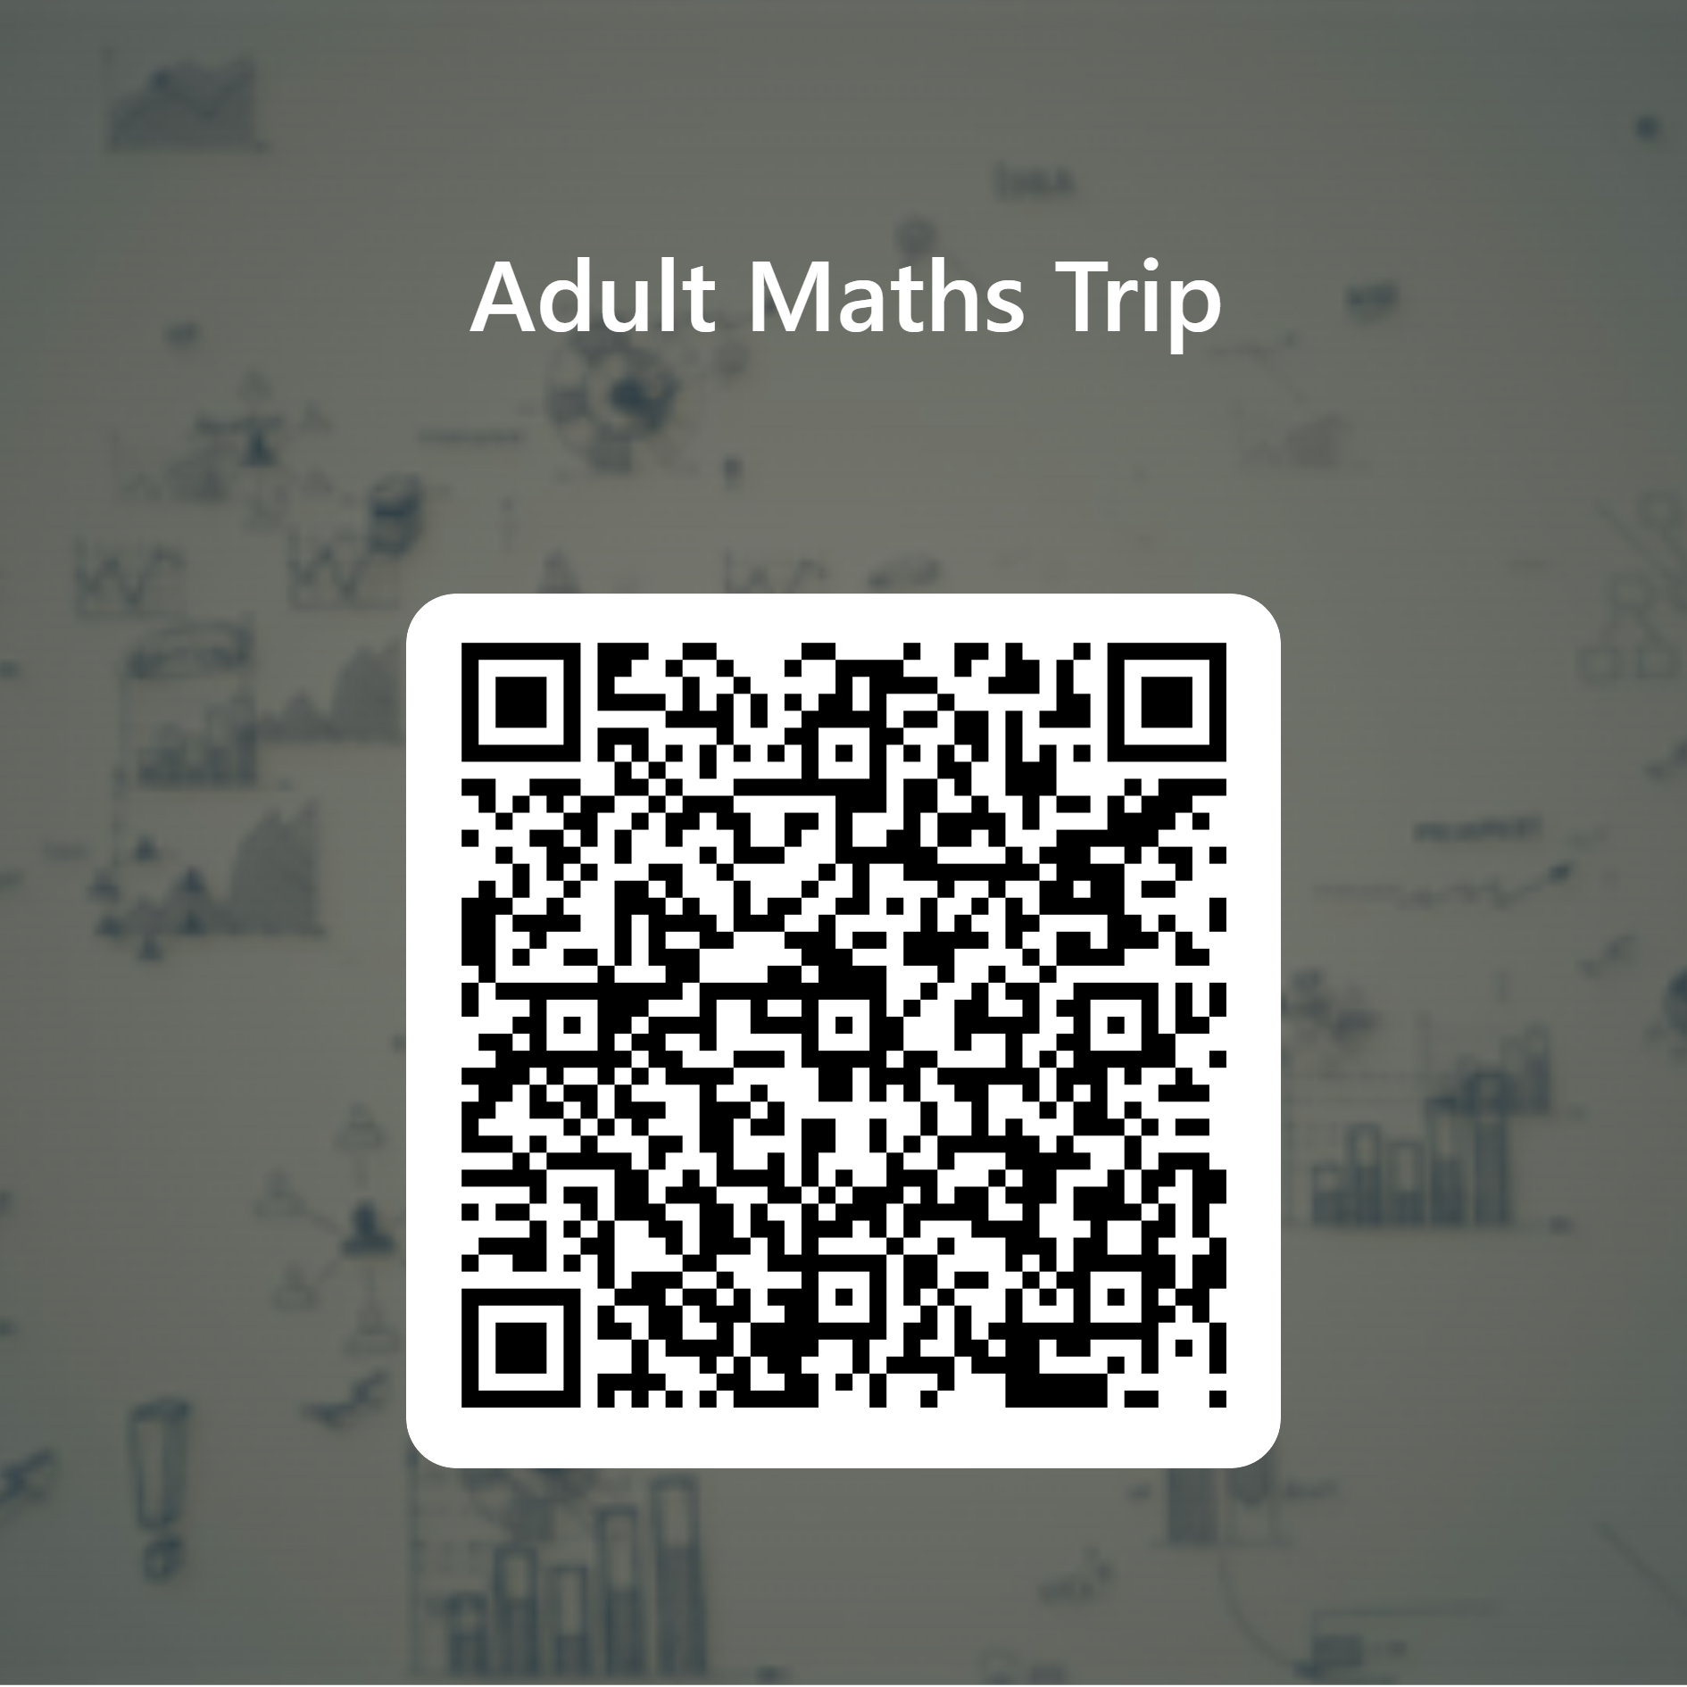
Maths Trip
Codes & Ciphers at
Bletchley Park
Date: Monday 11 November 2024
Arrival time: 09:50 AM
Departure time: 2PM
Approximately £14 per learner.
Own Transport Required
October Half Term break deadline.
Scan the QR code now to register interest
Save the date (in your personal and COLLEGE accounts)
Make arrangements
Budget
https://forms.office.com/Pages/ResponsePage.aspx?id=d58slY5gsk-aB_5mmDuZZ8HdeCtV4SBLqektO2PVX2hUNUdBSkhOTU5RTlVVUVlWQllCSUc5RUVGSS4u

Slide 11

English Trip
Murder on the Orient Express at MK Theatre
Date: Wednesday 26th February
Arrival time: 7:15PM
Departure time: Approx. 10PM
Approximately £14 per learner.
Transport not provided.
October Half Term break deadline.
Scan the QR code now to register interest
Save the date (in your personal and COLLEGE accounts)
Make arrangements
Budget
https://forms.office.com/Pages/ResponsePage.aspx?id=d58slY5gsk-aB_5mmDuZZ8HdeCtV4SBLqektO2PVX2hUMjZRWTNBTUlaSzE5QU5GVkI4NTVVWE5VRi4u

Slide 12

Expectations - Attendance & Punctuality
  The learning agreement is for all college learners.
  We have specific School guidance on Attendance and Personal Development, saved in the ‘whole school’ Team that you can access.
  Holidays cannot be taken during term time.
  If an unavoidable situation occurs that means you need to take time away from studying, you must meet with the Head of School to develop an individual study plan, with clear targets.
Check now that all Learning Agreements are signed!

Slide 13
Expectations and Support
If you must miss a session, inform your tutor beforehand. If you cannot, inform them as soon as you can after the session.
If you miss a session, you must access the lesson content provided by your tutor on Teams.
Each year, we support many learners to complete courses through highly challenging personal circumstances that can affect their college work. They achieve this through working with us, maintaining excellent and timely communication, and sticking to SMART targets.

Slide 14
Expectations – Taking Ownership of Your Learning
If you want to do more homework, access the online learning content provided between sessions.
Use the revision sessions during half term holidays.
Participate and contribute to Student Voice through meetings, comments and completing feedback.
If you do not understand something (anything, not just the work) or need help, ask.

Slide 15
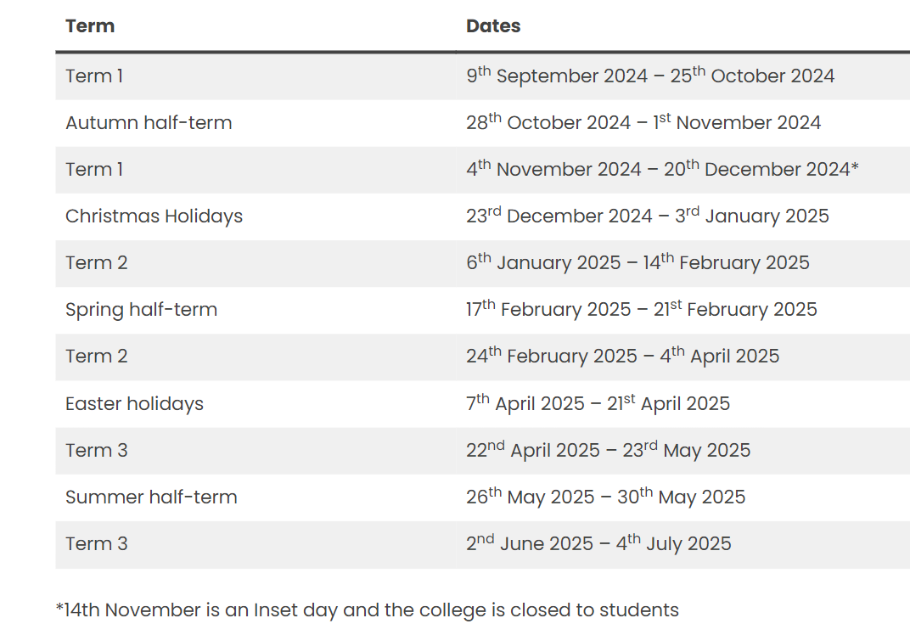
Term dates
Term dates - MK College
Sometimes, for things like GCSE exam days, there are campus closures or classes move online. Your tutor will keep you up to date. Remember to check Teams.
Term dates and exam dates are on Teams

Slide 16

Student Voice
Student Voice
College Voice is the democratic process we have in place at MKC to ensure that you are kept at the heart of how things work here.
It allows a two-way process for feedback, review and contribution to quality improvements for courses, services, support and facilities: from the food served in the refectory to having your say on major changes the senior leaders at the College seek to make.
Each half-term, A&C E&M Student Voice will take place. Details of how to participate will be shared on the whole School Team. Ways to contribute will vary. There will be in-person meetings, Teams meetings and contribution through more flexible methods like Padlet.
This Photo by Unknown Author is licensed under CC BY-NC-ND

Slide 17
Knowledge, Skills & Behaviours Developed through Student Voice
Confidence
Experience speaking in a professional forum
Collaboration
Expressing opinions
Email communication and etiquette, such as responding to emails and calendar invitations
Experience of office conventions and paperwork procedures, such as itineraries and minutes with actions
British Values – Democracy, Rule of Law, Individual Liberty, Mutual Respect, Tolerance of those of different faiths and beliefs
Active Citizenship
You can use Student Voice participation for:
CVs and job applications
Further study applications and statements
Discussion in interviews
Implementation in everyday life

Slide 18

We promise to work hard to support you to learn and achieve.
This is a two-way relationship, so we have expectations in return.
Timed activity.
Pair up or get into small groups.
Your tutor will assign you a ‘problem scenario’ on paper.
Discuss solutions.
Feedback your suggestions to the group.

Slide 19
Student Support Services
Our college support systems are for ALL our students. Contact details for the main ones at the end of this PowerPoint, which you can access later.
Adults, part-time and evening learners are a vital part of our college community.
Wellbeing.
The Careers Team, who provide independent careers advice.
The Digital Learning Team are based in the study centres.
Additional Learning Support needs. This term includes physical needs.
And more…
You can speak to your tutor about accessing any of these services.

Slide 20
Further Information
The rest of this PowerPoint can be accessed in your own time. It includes information on:
The Adult & Community English & Maths staff team
Accessing Student Support Services
Online Safety
Safeguarding
Prevent Duty
You can access this later. Kept safe in Teams.

Slide 21
Adult & Community English & Maths
Teachers
Josie Spencer
Rebecca Wong
Amanda Capp
Malcolm Cooke
Debbie Rice
Margaret Wong
Glenda Rhodes
Administrators
Brooklin Warner - Adult English & Maths
Michelle Bennett - Multiply
Head of School
Kat McKiernan
General enquiries department inbox: adulteandm@mkcollege.ac.uk
You don’t need our email addresses. Using your college account for emails and Teams, you can find us easily.

Slide 22
Universal Options for Mental Health & Wellbeing Support – Stage 1
These options can be accessed directly and sit outside of our college Wellbeing Team services.
All MKC students have access to a 24/7 online global community and professional support from trained professionals. Togetherall provides a safe space online to get things off your chest, explore feelings, get creative and learn how to self-manage personal mental health and wellbeing. Simply go to www.togetherall.com and sign up under ‘organisation’ using your MK College email address.​
Call Samaritans 24 hours a day, 365 days a year at 116 123. They are a fantastic resource open to all and will talk through any and all problems you may be facing.​
24/7 text service, free on all major mobile networks, for anyone in crisis anytime, anywhere. It’s a place to go if you’re struggling to cope and you need immediate help. Text SHOUT to 85258.​
Home - Qwell is an online community for free, safe and anonymous mental wellbeing support for adults across the UK. This is the adult version of Kooth that you may have heard of for young people.​

Slide 23



Mental Health & Wellbeing Support at College
Discuss concerns with a staff member. They will read any information already on ProMonitor and make a new note on what you talked about.
You will be signposted to Wellbeing team and may be advised to try other services too.
Complete referral on ProMonitor for Wellbeing Advisor.
Students can complete self-referral by emailing wellbeingteam@mkcollege.ac.uk
You will meet with Wellbeing adviser for an initial assessment
Engage in the agreed support, sometimes called ‘intervention’.
You will be referred back to suitable ‘main’ support following the intervention (E.g., the Wellbeing Team or another staff member) for monitoring.

Slide 24
Additional Learning Support
Let your tutor know if you need help or want a referral or appointment.
If your mobility or something else means you need practical adaptations, let your tutor know.
If you ask for help, someone may contact you directly for an interview or appointment
Does your class have a TSA in it? Have they already introduced themselves to the class? They can explain what they do and how they work.
Think now about help in exams.

Slide 25
Other Types of Support at College
Digital Learning
Careers
Bursary
Financial concerns can be discussed with the Bursary team, part of Admissions
Based in ‘Admissions’ near Reception
AdmissionsandEnrolments@mkcollege.ac.uk
Based at the Study Centres
DigitalLearning@mkcollege.ac.uk
1:1 appointments
Next Steps afternoon sessions
Careers events
CareersTeam@mkcollege.ac.uk

Slide 26
Online Safety
Online learning is a big part of studying at Milton Keynes College. We want you to stay safe online, while studying and in other aspects of your lives.
Keep your personal information safe
Protect your password
Remember that not everyone online is who they say they are
Never agree to meet up with anyone you have met online
Check your privacy settings
Think carefully before uploading photos
Be wary of online scams and people asking for money

Slide 27
Safeguarding
If you have concerns for your own safety or of others, you can:
Speak to a member of college staff or email your college contacts.
College staff will then liaise with our safeguarding and wellbeing teams. Together they can determine the best way to work with you.
In case of an emergency, call 999

Slide 28
Prevent Duty
What is Prevent?
What does that mean for learners?
Extremism
Prevent is one of the elements of the Government’s counter terrorism strategy.
Section 21 of the Counter-Terrorism and Security Act 2015 places a duty on certain bodies (such as colleges) to have “due regard to the need to prevent people from being drawn into terrorism.”
Prevent is about safeguarding you as a learner to keep you safe and within the law.
The Prevent Duty is not about preventing you from having political and religious views and concerns but about supporting you to use or act on those concerns in non-extremist ways.
The government has defined extremism as: “vocal or active opposition to fundamental British values, including democracy, the rule of law, individual liberty and mutual respect and tolerance of different faiths and beliefs.”
If you have any concerns about yourself or others being radicalised, please call the national Prevent advice line on 0800 0113764 or speak to the designated safeguarding team at college. Your tutor or any of the college staff members can put you in touch. In an emergency, call 999.

Slide 29
If you need help, ask.
Thank you for reading this information.

Slide 30

Your specific course
Next, your tutor will introduce you to the course you are enrolled on

