Slide 1

STARTER
£4800 is invested for 3 years at 5% simple interest.
What is the total value of the investment at the
end of the 3 years?
3. If the area of a square is 16m², what is the length of the side?
4. What is the probability that a fair sided dice, lands on an even number?
2. Workout the rotational symmetry of the shapes below
5. Find the mean and range of the following numbers:
12, 13, 15, 15, 13, 16, 18, 18

Slide 2
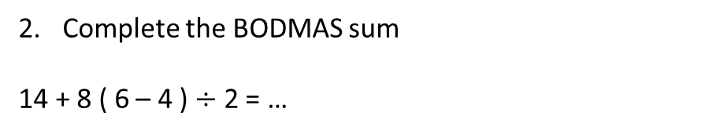
Ratio and Proportion L2
Learning Objectives
To be able to :
Understand and calculate using ratios, direct proportion and inverse proportion
Recap
Work out the value of ‘s’ in the formula when:
t=2 v=7
s = ½ ( v – 4t)
Complete the BODMAS sum
14 + 8 ( 6 – 4 ) $÷$ 2 = …

Slide 3
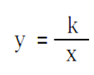
Try to solve:..
Write Twenty people is proportional to five tables as a ratio
Simplify 14 : 20
Find the missing value if Flour : eggs : sugar
      100g 2 150g
      ?? 1 75g
Write ‘M is directly proportional to N’ using correct maths notation
If and k=4 Find y when x=16

Slide 4
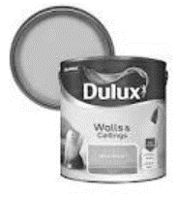
Calculating with Ratios
This ratio shows values that relate to each other for Red and White Paint
Find the quantity of red paint needed if the quantity of white goes from ten to thirty-five.
……………………………………………………………………………………….
……………………………………………………………………………………….
Red
White
4
10
?
35
Another go… Set out your problem in ‘Ratio Boxes’ if you like…
A lorry travels 300 miles taking two days. How far can it travel in four and a half days?
A phone has 200gb storage for £5. How much memory would £9 give?

Slide 5
Your turn…
Solve the following Ratio calculation problems..
A map shows a scale of 1:50,000. Find the actual distance of a 2.3 cm journey on the map.
A photo is enlarged by a scale factor of 1.76 Find the new length and width of a photo starting a length =15cm and width =9cm to the nearest cm
A cake recipe requires 240ml of milk to make enough for six people. Find the new quantity of milk for a cake for twenty people

Slide 6
Direct proportion
The cost to hire an area of land for a music festival is dependent on how much land is required.
Land 200m² Cost £1000
Land 500m² Cost ??........
The number of tables needed at a conference venue and costs of the food is directly related to the number of people.
Tables = 4 People = 20 Cost = £140
Find the cost for 10 tables
Find the number of people at 100 tables
Find the number of table if £2000 is spent on food

Slide 7
Your turn…
Solve the following Direct Proportion problems..
A photo is enlarged from length 7cm and width 5cm to a poster 2m long and how wide?
If t = 2.2 p a) Find t when p = 10
b) Find p when t = 50
A bag of crisps in the supermarket sells in a pack of 12, costing £2.40 A larger bag has 18 packs and sells for £3.50. Are the two bags in direct proportion? Show your working.

Slide 8
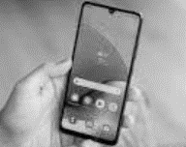
Indirect proportion
As the number of people use mobiles more, the time spent watching tv decreases indirectly.
TV viewing 3hrs Mobile use 2hrs
TV viewing 1hr Mobile use Find the new mobile use…
Try again..
As I eat more my energy level decreases. a) Food consumed 2000cal Exercise 30mins
Food consumed 3000cal Exercise ? …… mins
b) Food consumed 2000cal Exercise 30mins
Food consumed ?.......cal Exercise 10 mins
c) Food consumed 2000cal Exercise 30mins
Food consumed 5000cal Exercise ? …… mins

Slide 9

Your turn…
Solve the following indirect proportion problems..
If y = 10 Find x y = $\frac{4}{x}$
If $\frac{9}{n}$ = m a) Find n when m = 45
b) Find m when n = 4.5
a is inversely proportional to b.
When a= 40 b= 10. Find b when a = 200
4) Sixteen workers get 84 products produced in an hour. If the workforce is reduced to twelve workers, how many products can get produced in the same amount of time (1hr)?

Slide 10

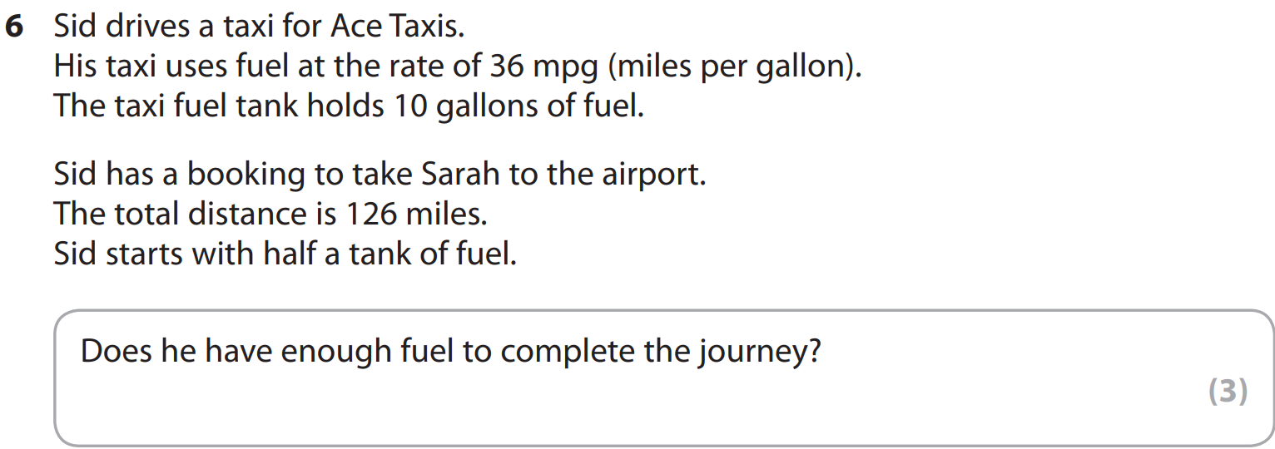
Edexcel Jan 2011

Slide 11
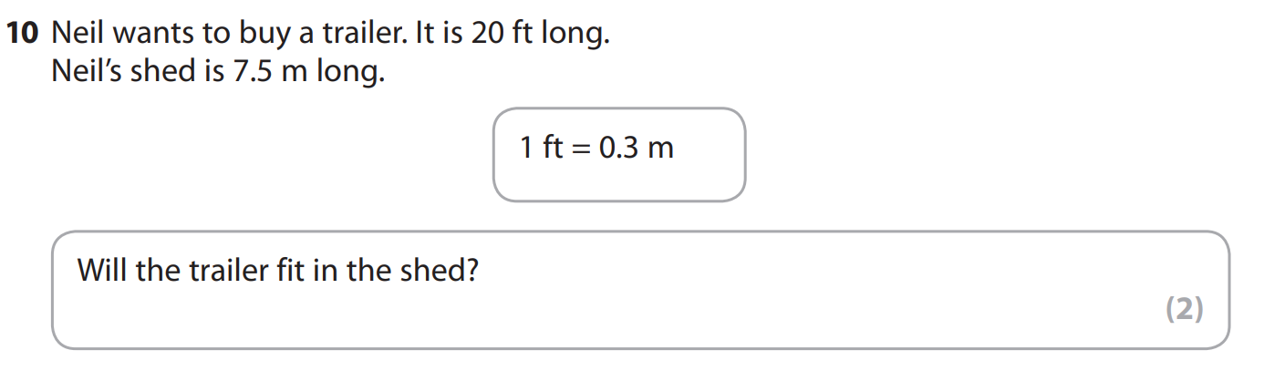
Edexcel Jan 2011

Slide 12
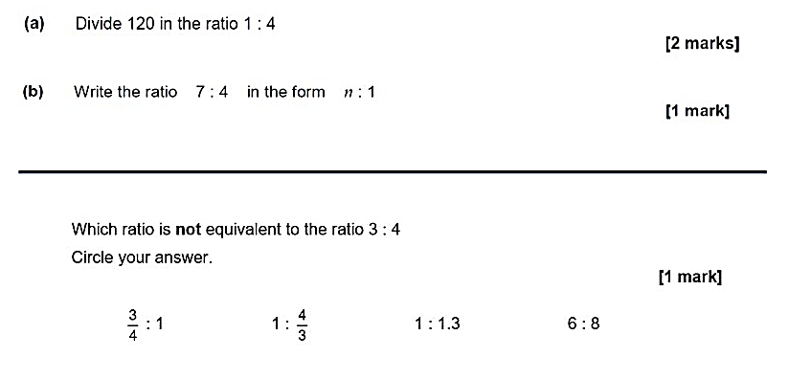
1.
(c)

Slide 13
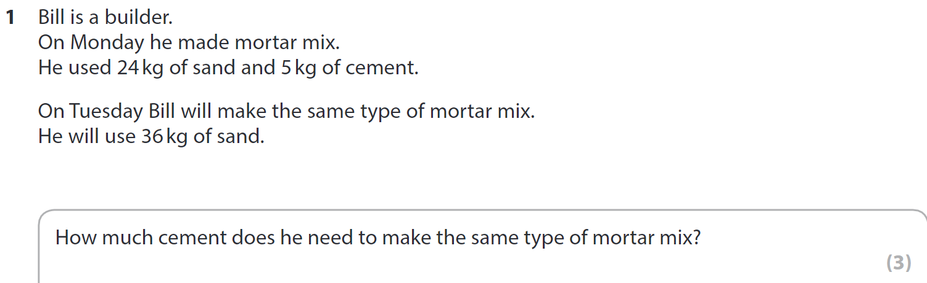
Edexcel Sep 2009

