Slide 1
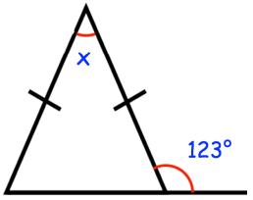
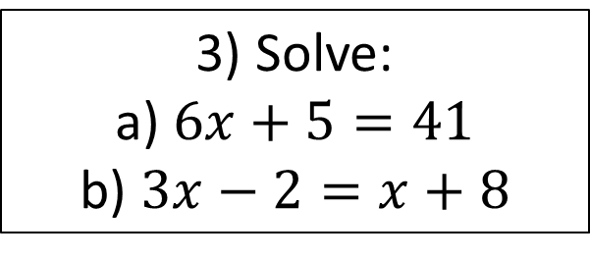
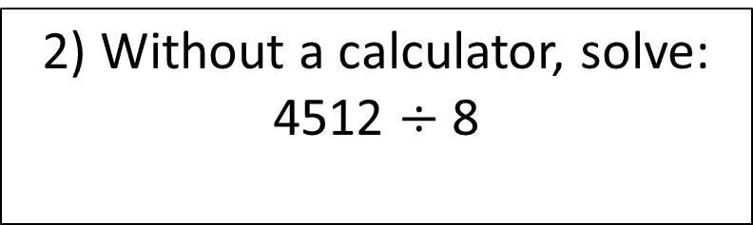
Starter
Find angle x.
3) Solve:
a) $6x+5=41$
b) $3x−2=x+8$
4) James is going on holiday in New York.
James changes £400 into dollars ($).
The exchange rate is £1 = $1.50
Work out how many dollars ($) James will receive.
2) Without a calculator, solve:
4512 $÷$ 8
5) What is 2/7 of 84?

Slide 2
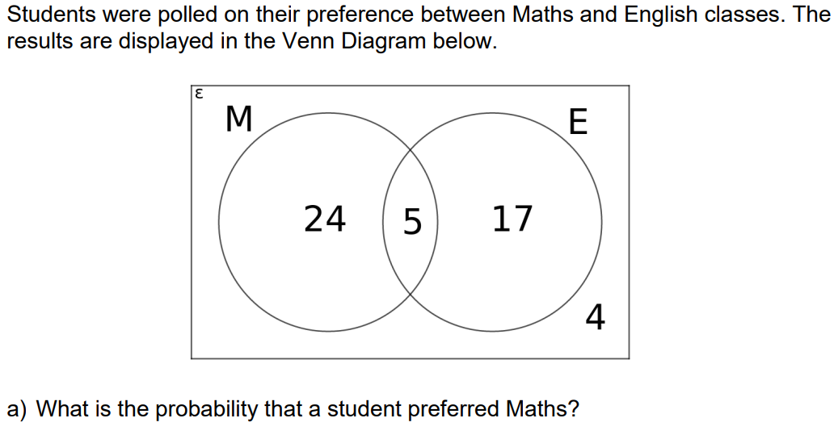
Proportion
Learning Objectives
- To be able to understand and use proportion as equality of ratio
- To be able to compare lengths, areas and volumes using ratio notation scale factors
50 students were polled on whether they were studying Maths or English classes.
5 students were studying both Maths and English.
29 students were studying English.
4 students did not take Maths or English.
Complete the Venn Diagram.

Slide 3
HOOK

Slide 4
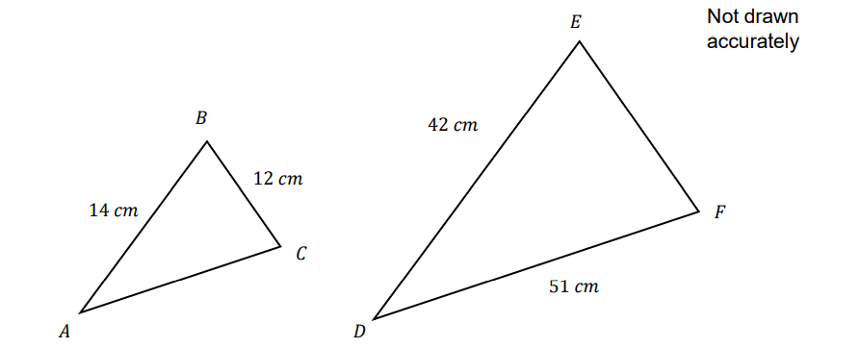
Scale
The two triangles, ABC and DEF shown below are similar.
What is the scale factor that transforms ABC to DEF?

Slide 5
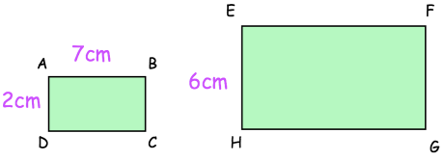
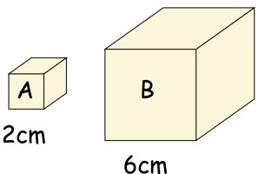
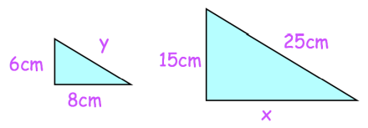
Your turn…
1) Rectangles ABCD and EFGH are similar.
Cube B is an enlargement of cube A.
Work out the length of EF.
Find the area of EFGH.
21cm
126cm²
2) The triangles below are similar.
What is the scale factor of enlargement?
How many times larger is the volume of cube B than A?
3
20cm
27
Find the size of x.
Find the size of y.
Find the area of the larger triangle.
10cm
150cm²

Slide 6

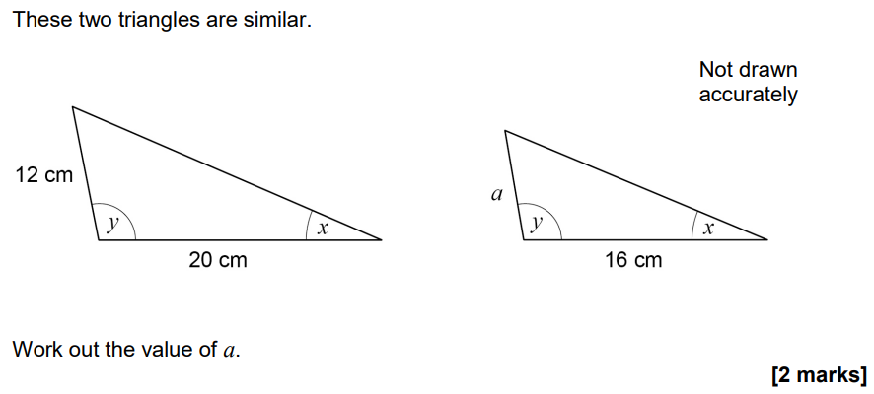
June 2020 Paper 3

Slide 7
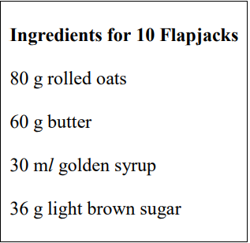
Recipe
Here is a list of ingredients for making 10 Flapjacks.
Work out the amount of each ingredient needed to make 15 Flapjacks.

Slide 8
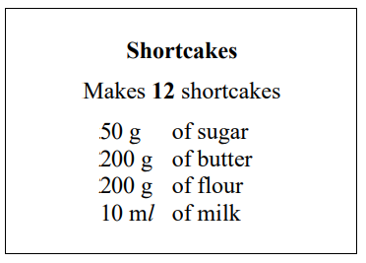
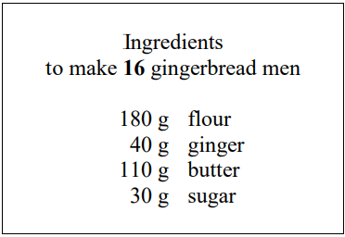
Your turn…
2) Here are the ingredients needed to make 12 shortcakes.
1) Here are the ingredients needed to make 16 gingerbread men.
Hamish wants to make 24 gingerbread men. Work out how much of each of the ingredients he needs.
270g
60g
165g
a) Liz makes some shortcakes. She uses 25 ml of milk. How many shortcakes does Liz make?
b) How much butter for 30 shortcakes?
c) Emma has 1.5kg of flour. How many shortcakes can she make?
45g
30
500g
90

Slide 9
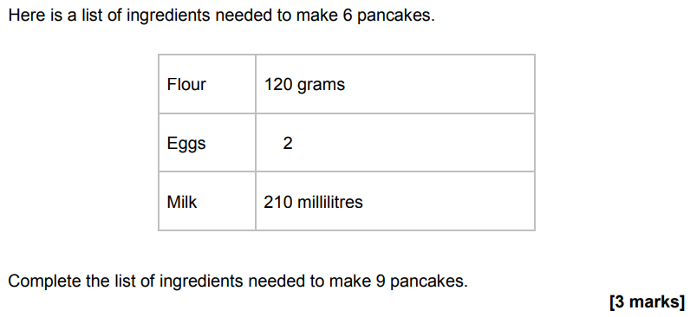
November 2018 Paper 2

Slide 10
Direct Proportion
4 tins of beans and 3 tins of soup costs £3.68
5 tins of beans cost £1.60
Work out how much one tin of soup costs.

Slide 11
Your turn…
1) A bus travels 50km in 40 minutes. Assuming the bus continues to travel at the same average speed, calculate the following:
The time is would take to travel 65km.
The distance the bus would travel in 16 minutes.
2) A car uses 35 litres of petrol to travel 250km.
How far, to the nearest km, can the car travel on 50 litres of petrol?
How many litres of petrol would the car use to travel 400km?
1) A machine fills 1000 bottles in 5 hours.
Work out how many hours it would take the machine to fill 1200 bottles.
Work out how many bottles can be filled in 24 hours.
2) It costs £0.75 to buy 5 bananas.
Work out how much it would cost to buy 7 bananas.
If I had £4.50, how many bananas could I buy?
52 minutes
6
20km
4800
£1.05
357km
30
56 litres

Slide 12
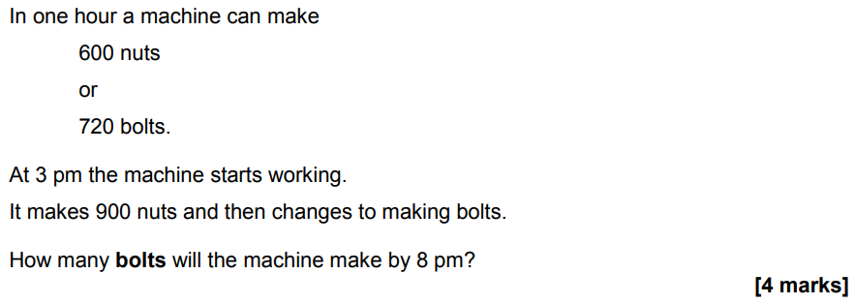
June 2019 Paper 3

Slide 13
Inverse Proportion
It takes 3 painters 6 days to complete a job.
Work out how many days it would take 4 painters to complete the same job.

Slide 14
Your turn…
1) It takes 6 machines 4 days to produce a batch of products.
Work out how long it will take 8 machines to produce the same batch of products.
2) It takes 5 machines 6 hours to produce 1000 DVDs.
Work out how long it would take 4 machines to produce 1000 DVDs.
It takes 12 men 5 days to complete a job.
Work out how many days it would take 3 men to complete the same job.
State one assumption you made in working out your answer.
How will your answer be affected if your assumption is not correct?
3 days
20 days
They worked at the same rate.
It could take more/less days to do the job.
7.5 hours

Slide 15
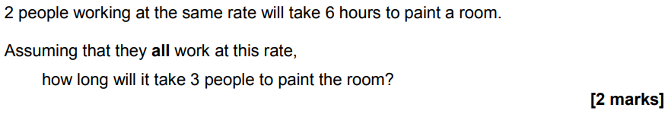
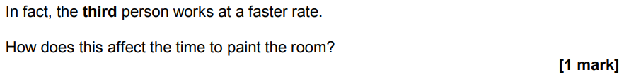
June 2018 Paper 1

