Slide 1

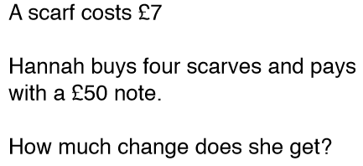
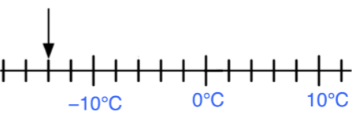

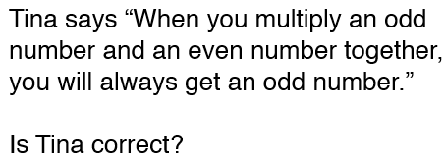

Starter

Slide 2
Area & Perimeter
- To be able to calculate perimeter of 2D shapes including triangles, circles and composite shapes.
- To be able to calculate area of 2D shapes including triangles, circles and composite shapes.
Recap
Recap
1. Liam runs 200 m in 25 seconds. What is his speed in m/s?
2. Diamond has a density of 3.5g/cm³.
What is the weight if a diamond that has a volume of 0.2cm³?

Slide 3
Find the area and the perimeter
3cm
7cm
5cm
6cm
6cm
3cm
7cm
10cm
4cm

Slide 4
Find the area and perimeter

Slide 5
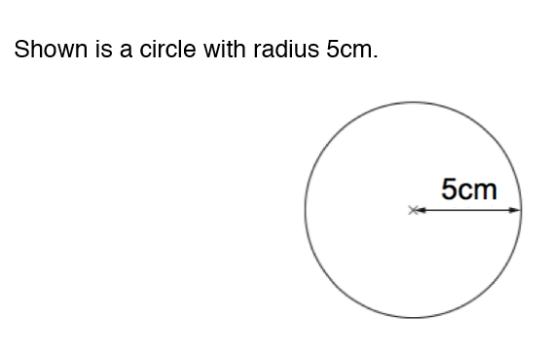
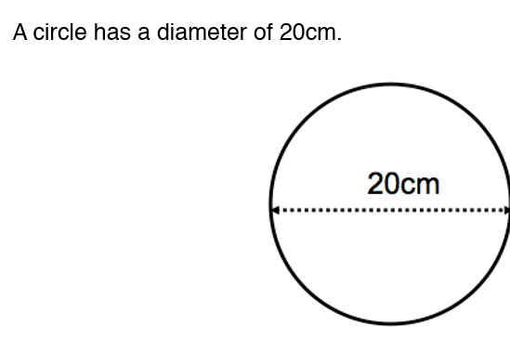
Find the area and circumference of the circle

Slide 6
Exam-styled questions

Slide 7
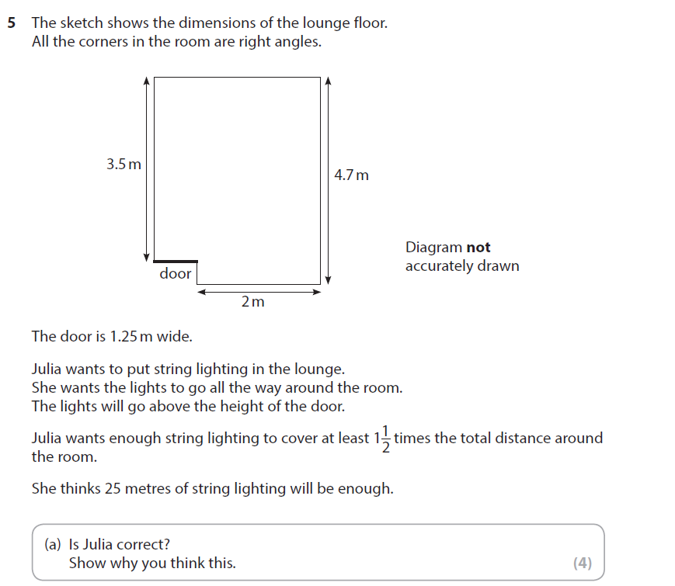
Question 1
May 2018

Slide 8
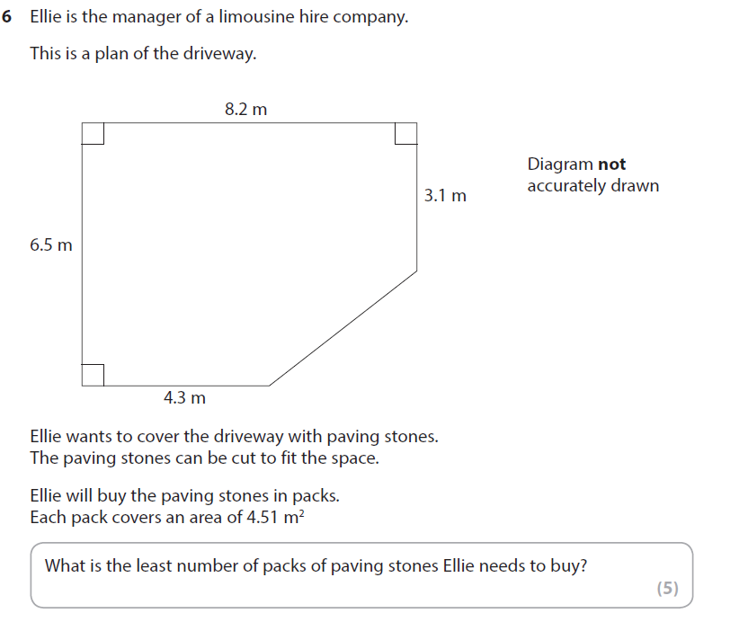
Question 2
May 2018

Slide 9
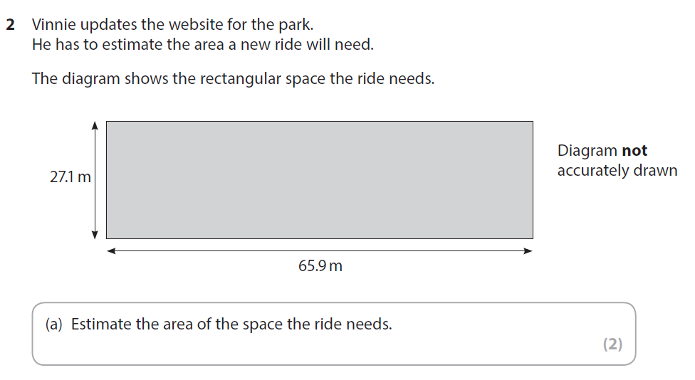
Question 3
January 2018 Q3

Slide 10
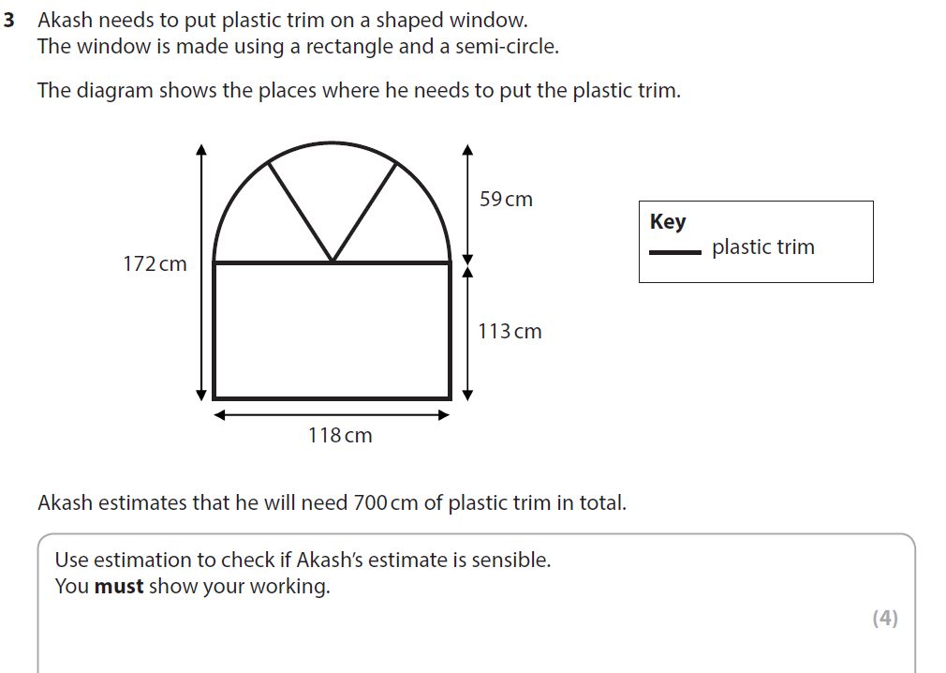

Question 4

Slide 11
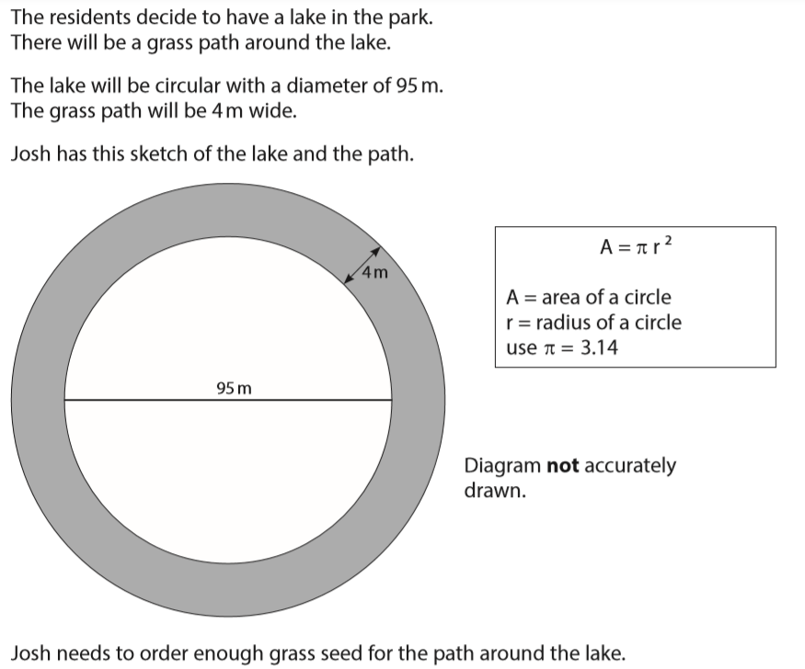
Question 4
June 2018 Q9

Slide 12
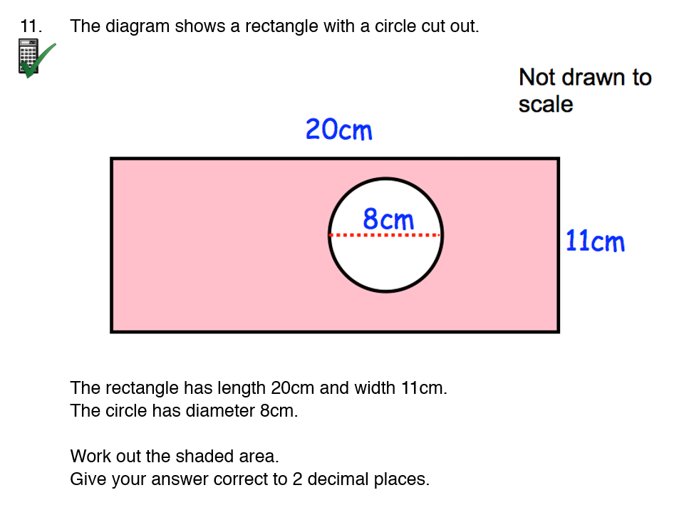
Question 5
Corbettmaths area of compound shape

