Slide 1
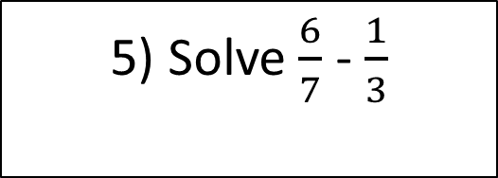
Starter
Solve:
Find 17% of 90 (non calc)
4) Find the volume of this shape:
14cm
8cm
2) If x=1.5 and y=2 then what is:
3x – y²
12cm
5) Solve $\frac{6}{7}$ - $\frac{1}{3}$
3) Without a calculator, solve: 17 x 6.5

Slide 2
Probability
Learning Objectives
To be able to:
- Identify fractions, decimals and percentages on a probability scale
- Determine the probability of an event
- Record, describe and analyse the frequency of outcomes of probability experiments using tables
- Find the relative frequency of an event

Slide 3

Probability
Probability of an event happening = $\frac{Number of ways it can happen}{Total number of outcomes}$
Your turn…
What is the probability of choosing a month of the year starting with the letter ‘m’?
What is the probability of picking an ace out of a deck of cards?
What is the probability of choosing a day of the week which ends with the letter ‘y’?
There are 8 red, 6 blue and 7 green balls in a bag. What is the probability of choosing neither red or green?

Slide 4
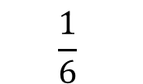
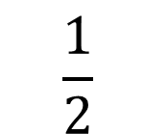
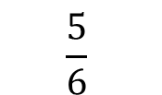
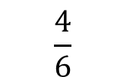
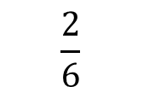
Probability Scales
Place the letters on the probability scale:
A - P(flipping a head on a coin)
B - P(rolling a number less than 7 on a dice)
C - P(rolling a 5 on a dice)
0
$$\frac{1}{6}$$
$$\frac{2}{6}$$
$$\frac{1}{2}$$
$$\frac{4}{6}$$
$$\frac{5}{6}$$
1

Slide 5
Your turn…
Place the letters on the probability scale:
A - P(flipping a head or a tail on a coin)
B - P(rolling an odd number on a dice)
C - P(rolling a number less than 5 on a dice)
0
1
Place these letters on probability scale:
D - P(rolling a square number on a dice)
E - P(rolling a prime number on a dice)

Slide 6

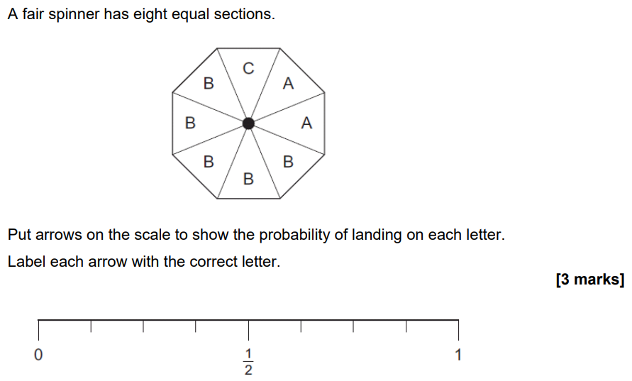
AQA Topic Test

Slide 7
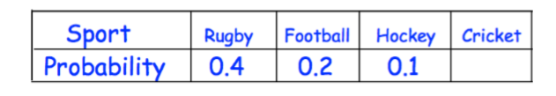
Probability Tables
Each boy at a school plays one of four sports.
The table shows the probability a student chosen at random plays rugby, football, hockey or cricket.
A student is chosen at random.
Work out the probability that the student plays cricket.
There are 600 boys at the school. Work out the number of boys who play rugby.

Slide 8
Your turn…
Counters labelled A, B, C, D and E are placed in a bag. The table shows the probabilities of picking each letter at random.
Riki has a packet of flower seeds. The table shows each of the probabilities that a seed taken at random will grow into a flower that is pink or red or blue or yellow.
Letter | A | B | C | D | E
Probability | 0.07 | 0.15 | 0.26 |  | 0.18
Colour | Pink | Red | Blue | Yellow | White
Probability | 0.15 | 0.25 | 0.20 | 0.16
Calculate the missing probability in the table.
Calculate the probability of a B or C.
Work out the probability that a seed taken at random will grow into a white flower.
There are 300 seeds in the packet. All of the seeds grow into flowers. Work out an estimate for the number of red flowers.
0.24
0.34
75
0.41

Slide 9
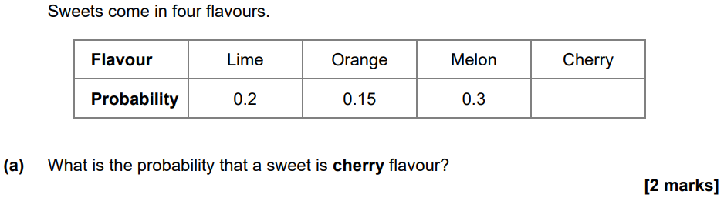
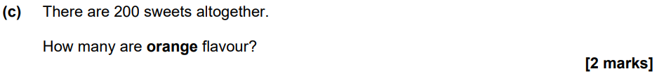
AQA Topic Test

Slide 10
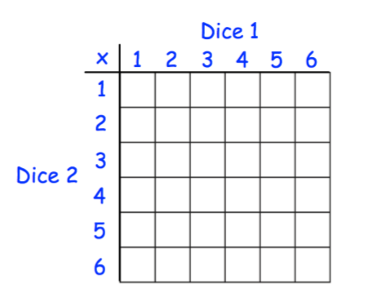
Probability Tables
Two fair six sided dice are rolled.
The number on the dice are multiplied together to give a score.
a) Complete the table to show all possible scores.
b) Find the probability of a score of 12.
c) Find the probability of a score of 10 or more.
d) Find the probability of an even number.

Slide 11
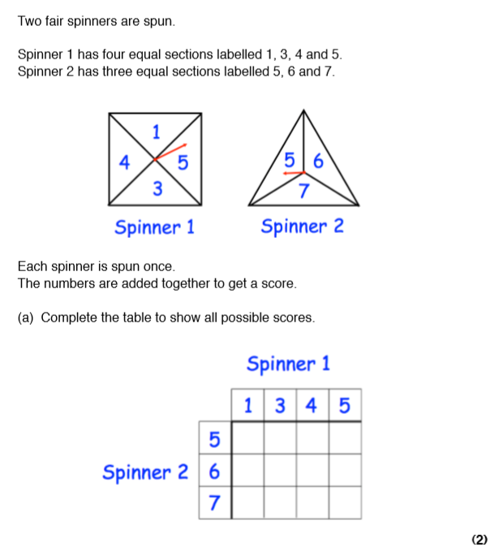
Your turn…
Two fair spinners are spun.
Spinner 1 has four equal sections labelled 1, 3, 4 and 5.
Spinner 2 has three equal sections labelled 5, 6 and 7.
Each spinner is spun once.
The numbers are added together to get a score.
a) Complete the table to show all possible scores.
2/12
b) Find the probability of scoring an 8.
c) Find the probability of scoring an odd number.
6
8
9
10
7
9
10
11
8
10
11
12
5/12

Slide 12
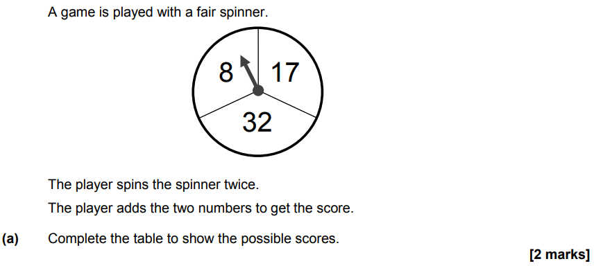
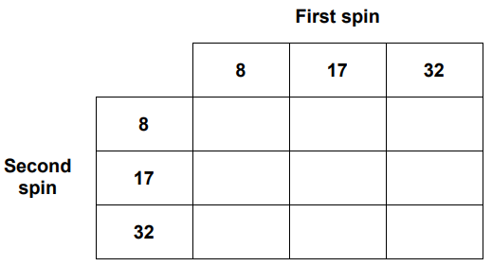
Practice Paper 3 Paper 1

Slide 13
Relative Frequency
Fred records the colour of 100 cars that pass his house. His results are shown below.
Calculate the relative frequency of each colour.
On an average day, 3500 cars pass Fred’s house. Based on his results, how many of these 3500 would we expect to be silver?
Colour | Red | Blue | Silver | Black | Other
Frequency | 10 | 15 | 38 | 32 | 5
Relative Frequency

Slide 14
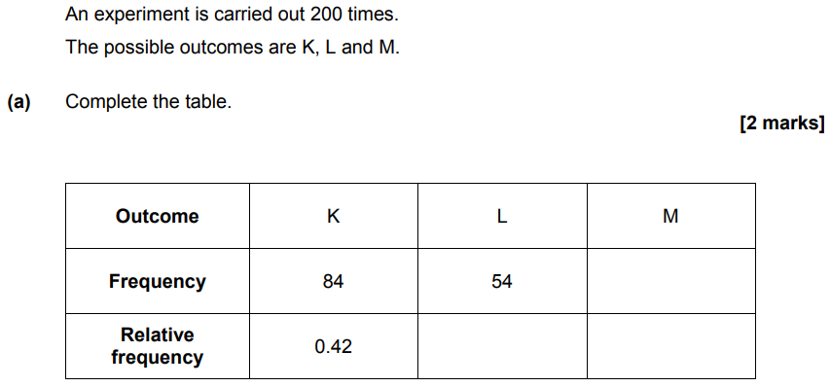
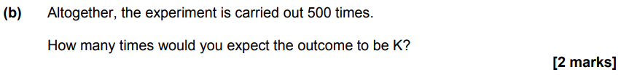
November 2017 Paper 2

Slide 15
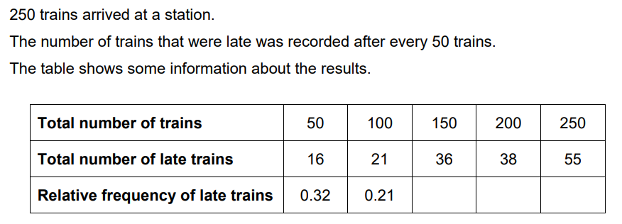
November 2021 Paper 2

