Slide 1
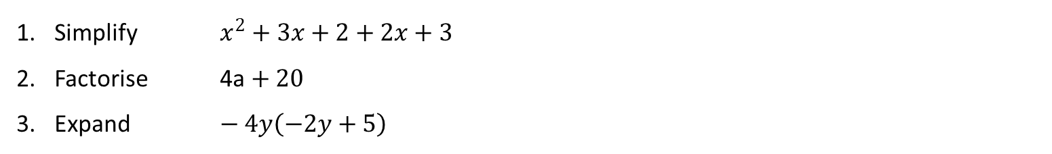
INTRODUCTION TO LINER EQUATIONS AND INEQULITIES
Learning Objectives
To be able to :
Solve linear equations on one unknown algebraically. Including those with the unknown on both sides of the equation
Solve linear inequalities in one variable
Represent the solution set on a number line
Simplify $x^{2}+3x+2+2x+3$
Factorise 4a $+ 20$
Expand $− 4y\left(−2y+5\right)$

Slide 2
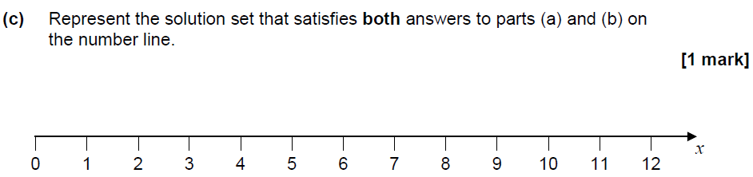
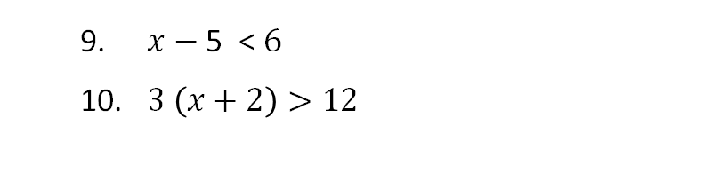

STARTER
Linear Equations
Inequalities
$x+5=16$
$8+x=4$
2 $x + 2=22$
$x−9=17$
10 $−x=19$
3$x− 9 =9$
6$x$+ 7 = 4$x$+ 13
2 (2$x$-1) = 2$x$-5
9. $x−\text{5 < }6$
10. $3 \left(x+2\right)>12$
Represent the solution
Represent the solution set that satisfies both answers to question 9 and 10 on the number line

Slide 3
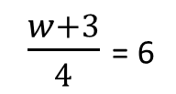

Solving linear equations (1)
$$2w−1=13$$
$\frac{w+3}{4}$ = 6

Slide 4
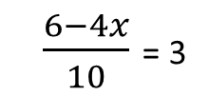
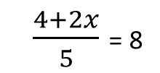
Your turn…
8w + 20 = 4
10y – 3 = 24
18 – 4a = 2
2e – 8 = 14
5. 4(2y + 7) = 20
3(y + 4) = 24
7.
8.
$\frac{4+2x}{5}$ = 8
$\frac{6−4x}{10}$ = 3

Slide 5


Solving linear equations (2)
$\text{4}x\text{+ 1 = 2}x\text{+ 7}$
2. $\text{5(}x\text{+ 3) = 3(}x\text{+ 9)}$

Slide 6
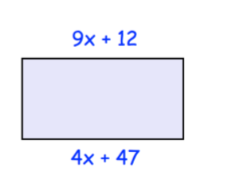
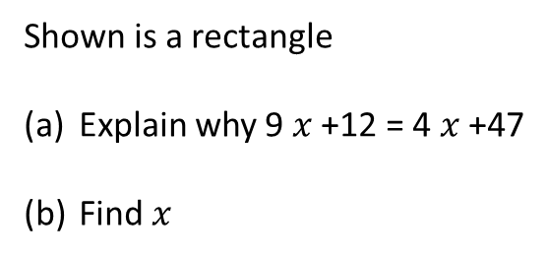
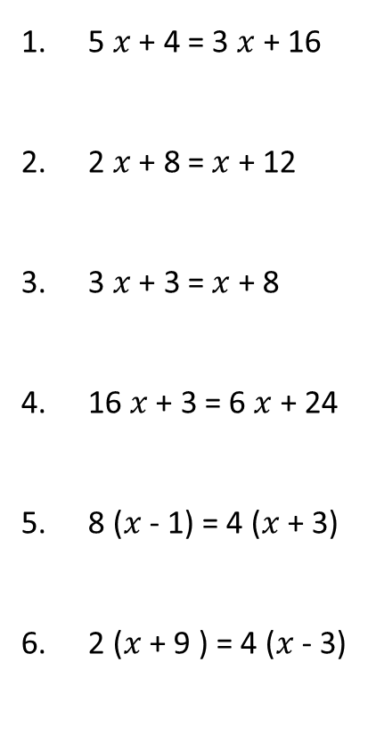
Your turn…
5 $x$ + 4 = 3 $x$ + 16
2 $x$ + 8 = $x$ + 12
3 $x$ + 3 = $x$ + 8
16 $x$ + 3 = 6 $x$ + 24
8 ($x$ - 1) = 4 ($x$ + 3)
2 ($x$ + 9 ) = 4 ($x$ - 3)
Shown is a rectangle
Explain why 9 $x$ +12 = 4 $x$ +47
Find $x$

Slide 7


Solving linear inequalities
$$\text{5}x\text{+ 1 < 11}$$
$\frac{x}{2}$ + 1 > 5

Slide 8


Your turn…
2 $x$+ 1 < 9
3 $x$ – 5 > 16
4 $x$ + 8 < 32
5 $x$ – 2 > 68
5.
$\frac{x}{9}$ – 6 > 4

Slide 9

Linear inequalities on number line (1)
1. Represent linear inequalities on the number line.
$x$ > 4
$x$ < 6
$x$≤ 10
$x$ ≥ 7

Slide 10
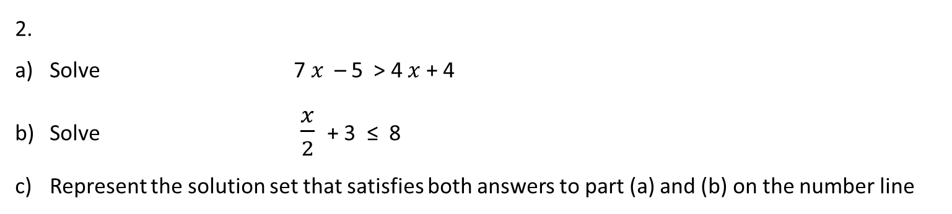
Linear inequalities on number line (2)
2.
Solve 7 $x$ – 5 > 4 $x$ + 4
Solve $\frac{x}{2}$ + 3 ≤ 8
Represent the solution set that satisfies both answers to part (a) and (b) on the number line

Slide 11
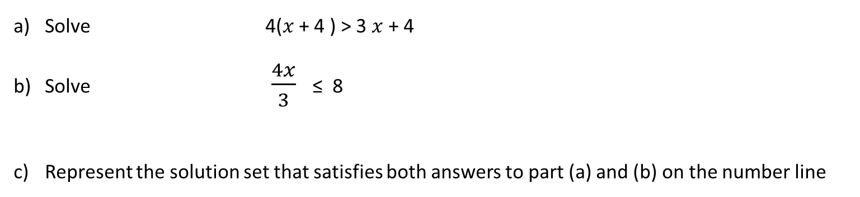
Your turn…
Solve 4($x$ + 4 ) > 3 $x$ + 4
Solve $\frac{4x}{3}$ ≤ 8
Represent the solution set that satisfies both answers to part (a) and (b) on the number line

Slide 12
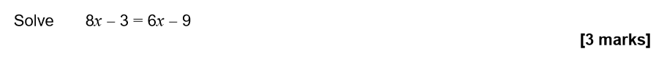
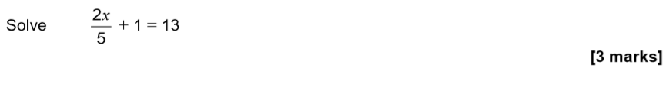
Specimen 4 Paper 1
Specimen 2 Paper 3
November 2017 Paper 2

Slide 13
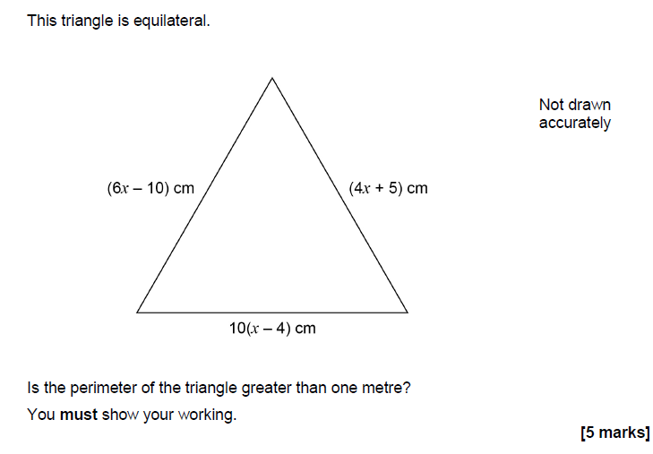
Plenary - November 2018 Paper 2

