Slide 1


Bi.Prob. Distr.
Chpt 6: p83-97
Write a Probability Distribution Table
Find the probability of multiple events if the outcomes follow a binomial prob distr. X~B(x=a)
Cumulatively add up probabilities in a binomial distribution

Slide 2


Slide 3
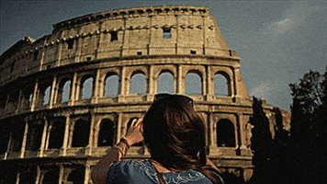
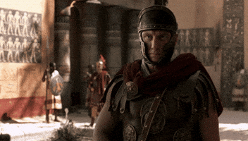
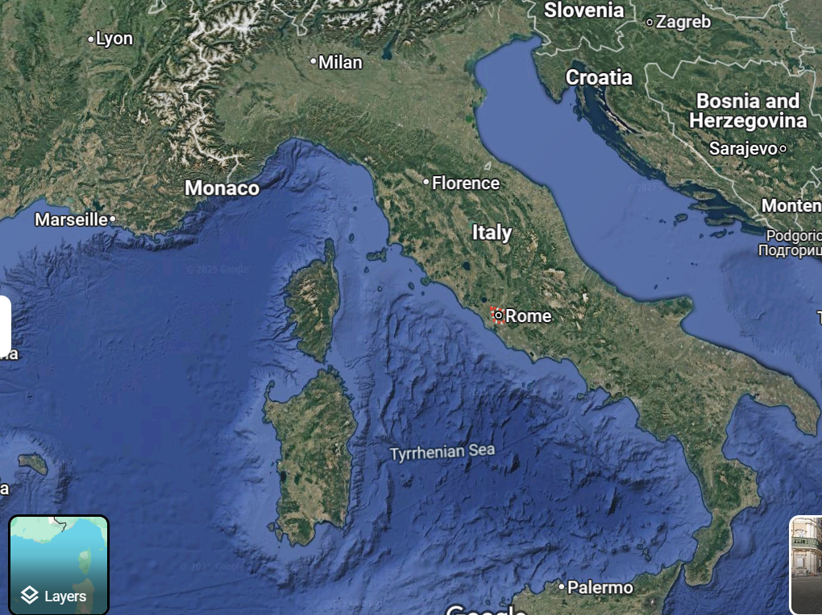
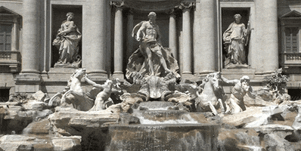

Slide 4
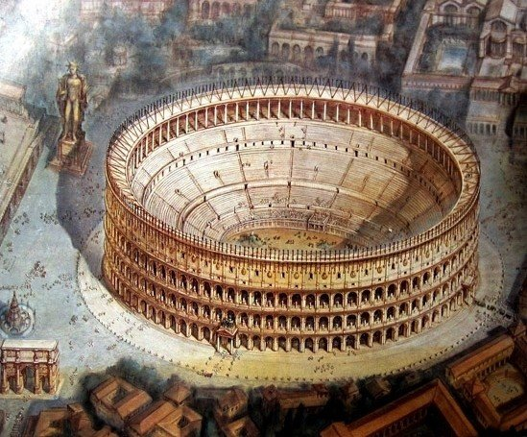

Slide 5
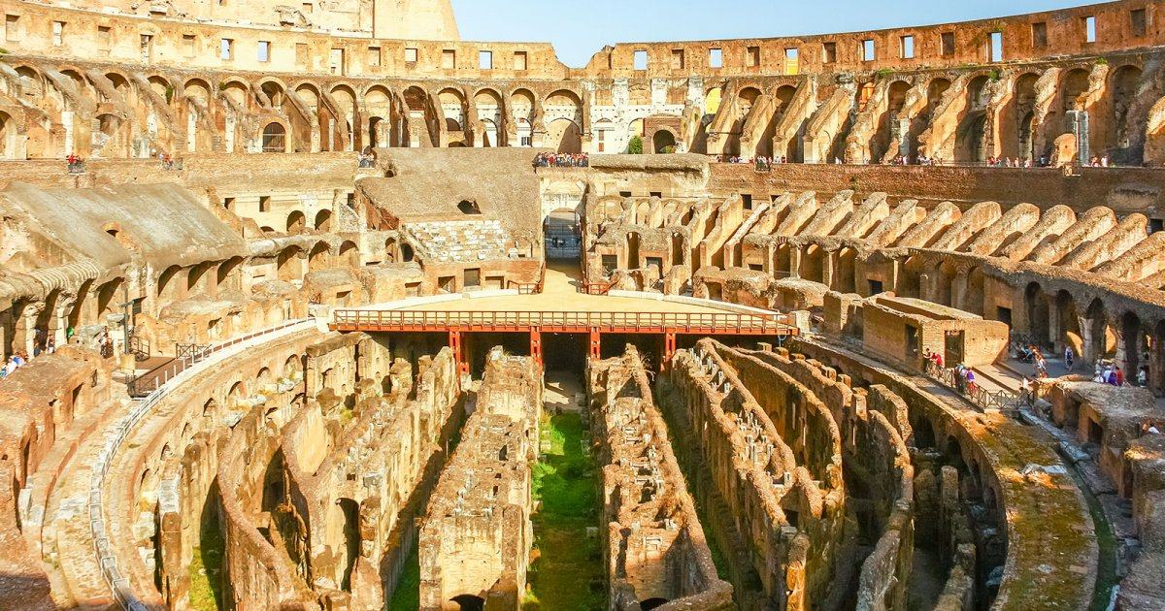

Slide 6
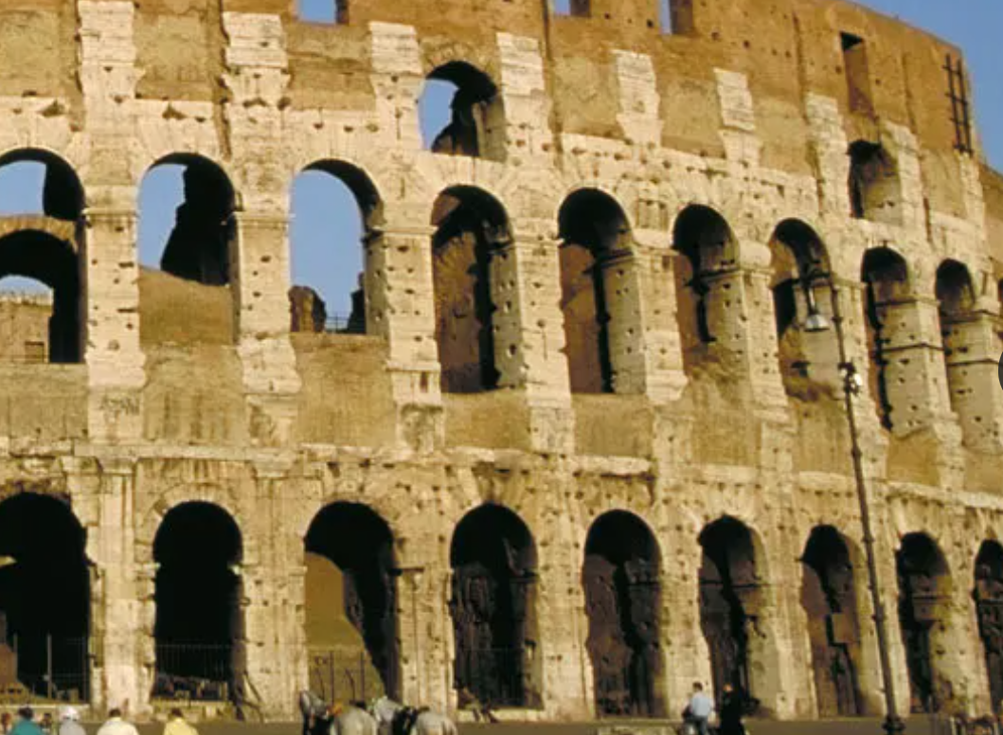
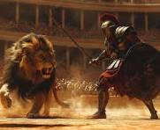
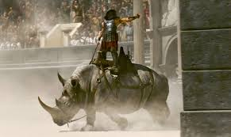
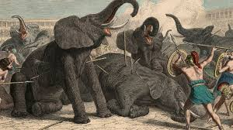
Probability of the animal in the arena is
A lion, a rhino, an elephant
X= The animal in the arena
P = probability
x= lion, rhino or elephant
P (X = x) means, the probability the animal in the arena is lion rhino or elephant

Slide 7
x = lion rhino elephant
2/6
3/6
1/6
6/6
P(X=x)

Slide 8
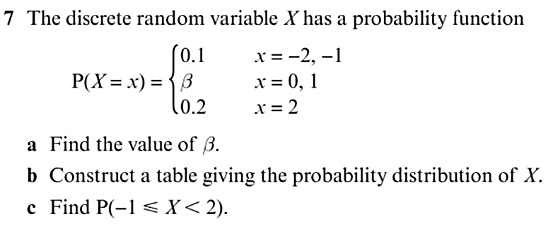
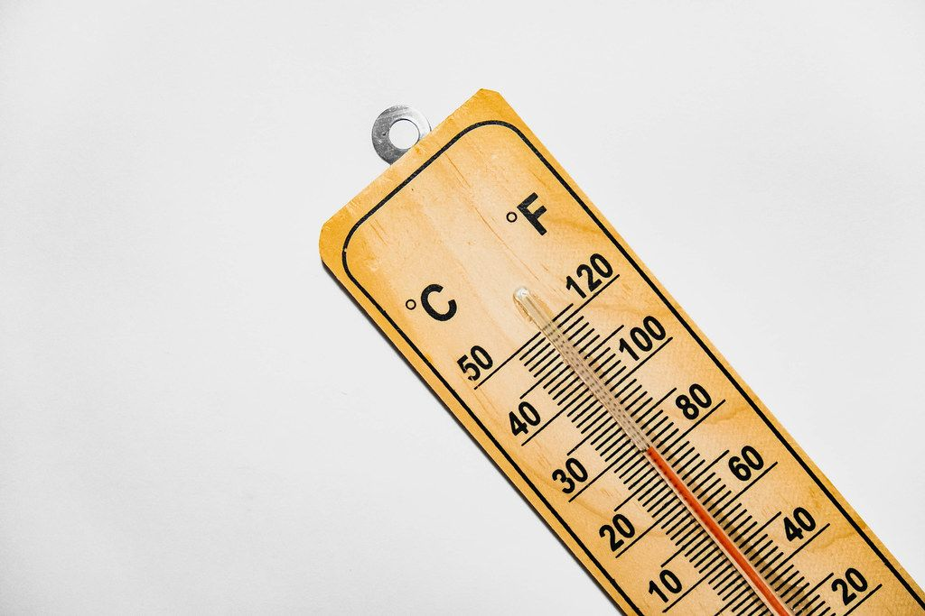

0.1
0.1
0.3
0.3
0.2
0.3+0.3 = 0.6
X | -2 | -1 | 0 | 1 | 2
P(X=x) | 0.1 | 0.1 | 0.3 | 0.3 | 0.2
0.1+0.3+0.3 = 0.7

Slide 9
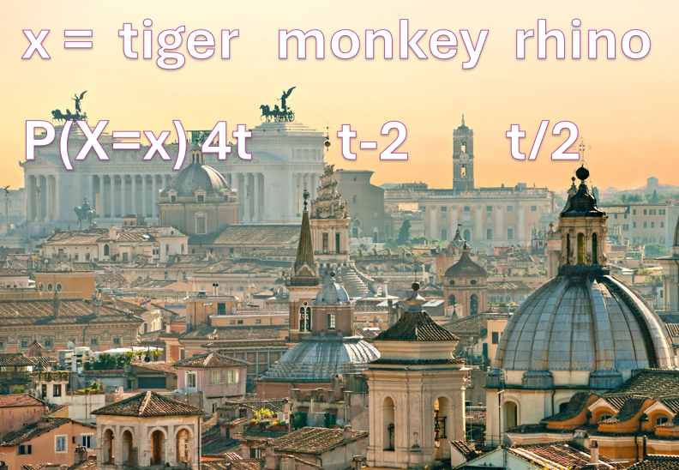
Q) If X=the animal in the arena,
find t
4t+(t-2) + t/2 = 1
5t+t/2 -2=1
5t+t/2 = 3
10t +t = 6, 11t = 6
t=6/11

Slide 10
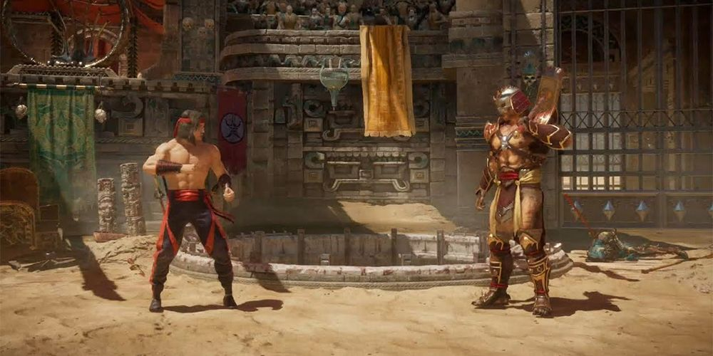
A
B
0.35
0.65

Slide 11
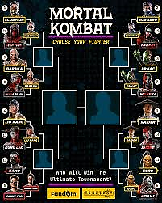
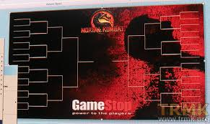
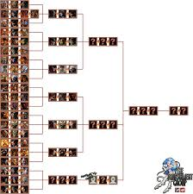
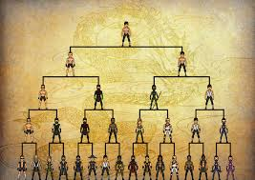
https://www.retrogames.cz/play_604-Genesis.php

Slide 12
P(X=x)=0.35 win
X~B(3,0.35)
0.35
0.35
0.35
0.65
0.35
0.65
0.65
0.35
0.35
0.65
0.65
0.35
0.65
0.65

Slide 13

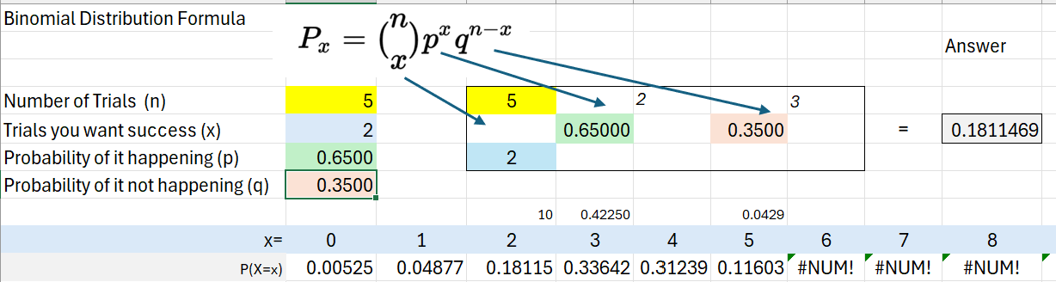
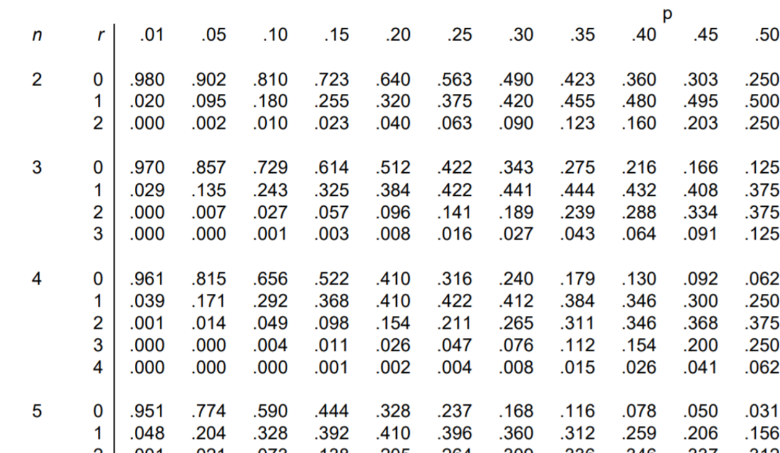
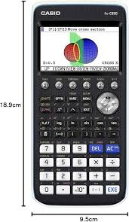
Binomial Distribution Probability Calculator
Binomial Distribution Explained! with the Casio CG50 GDC | IB Maths | Addvance Maths 😊➕

Slide 14

``
Q1) X ~ B (5,0.25)
Find P (X=4)
Q2) X ~ B (7,0.55)
Find P (X=3)
Q3) X ~ B (9,0.1)
Find P (X<2)
Q4) X ~ B (6,0.6)
Find P (X>4)
Q5) X ~ B (8,0.3)
Find P (X≤5)
0.01465
0.23328
0.23878
0.98871
0.77484

Slide 15
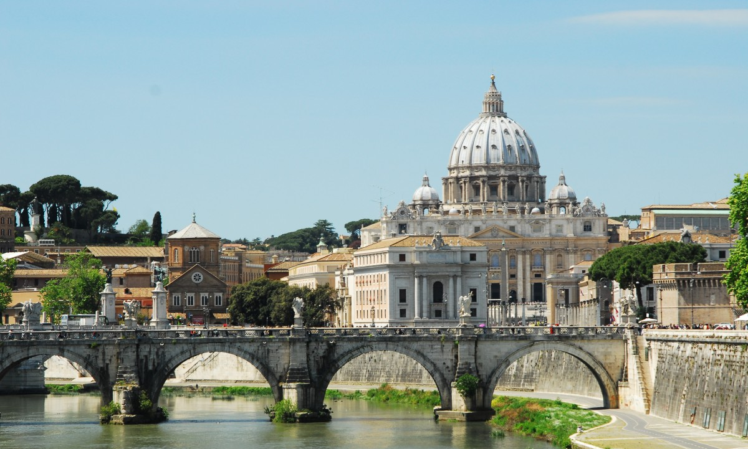
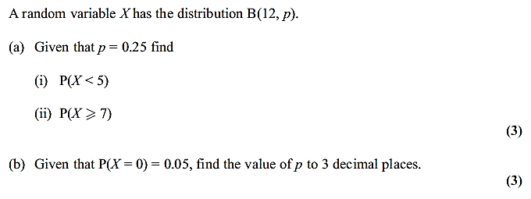
Answer = 0.84236
Answer = 0.01425
Answer = 0.221

Slide 16
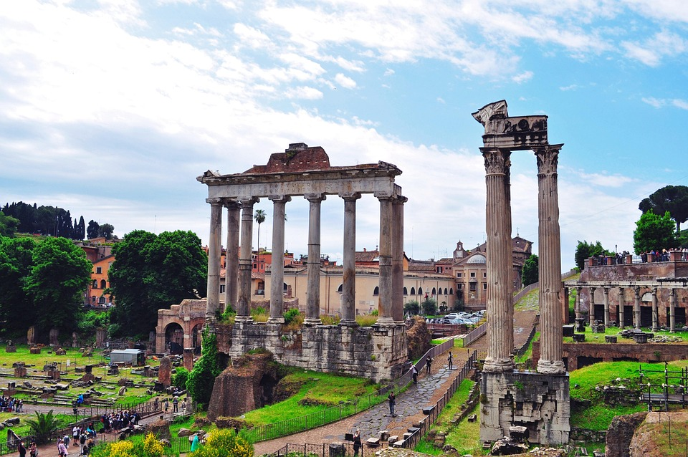
Hypothesis testing
Chpt 7: p98-112
Write a hypothesis test using correct notation
Check a one tail test for ‘null hypothesis’ acceptance or rejection
Check a two tail test for ‘null hypothesis’ acceptance or rejection

Slide 17
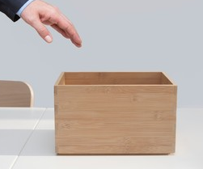

Hypothesis !
30% bites or not ???
H₀ : P= 0.3
H_{a} : P < 0.3
X = test statistic
X~B(10,0.3)
P(X<0.3) < 0.05

Slide 18
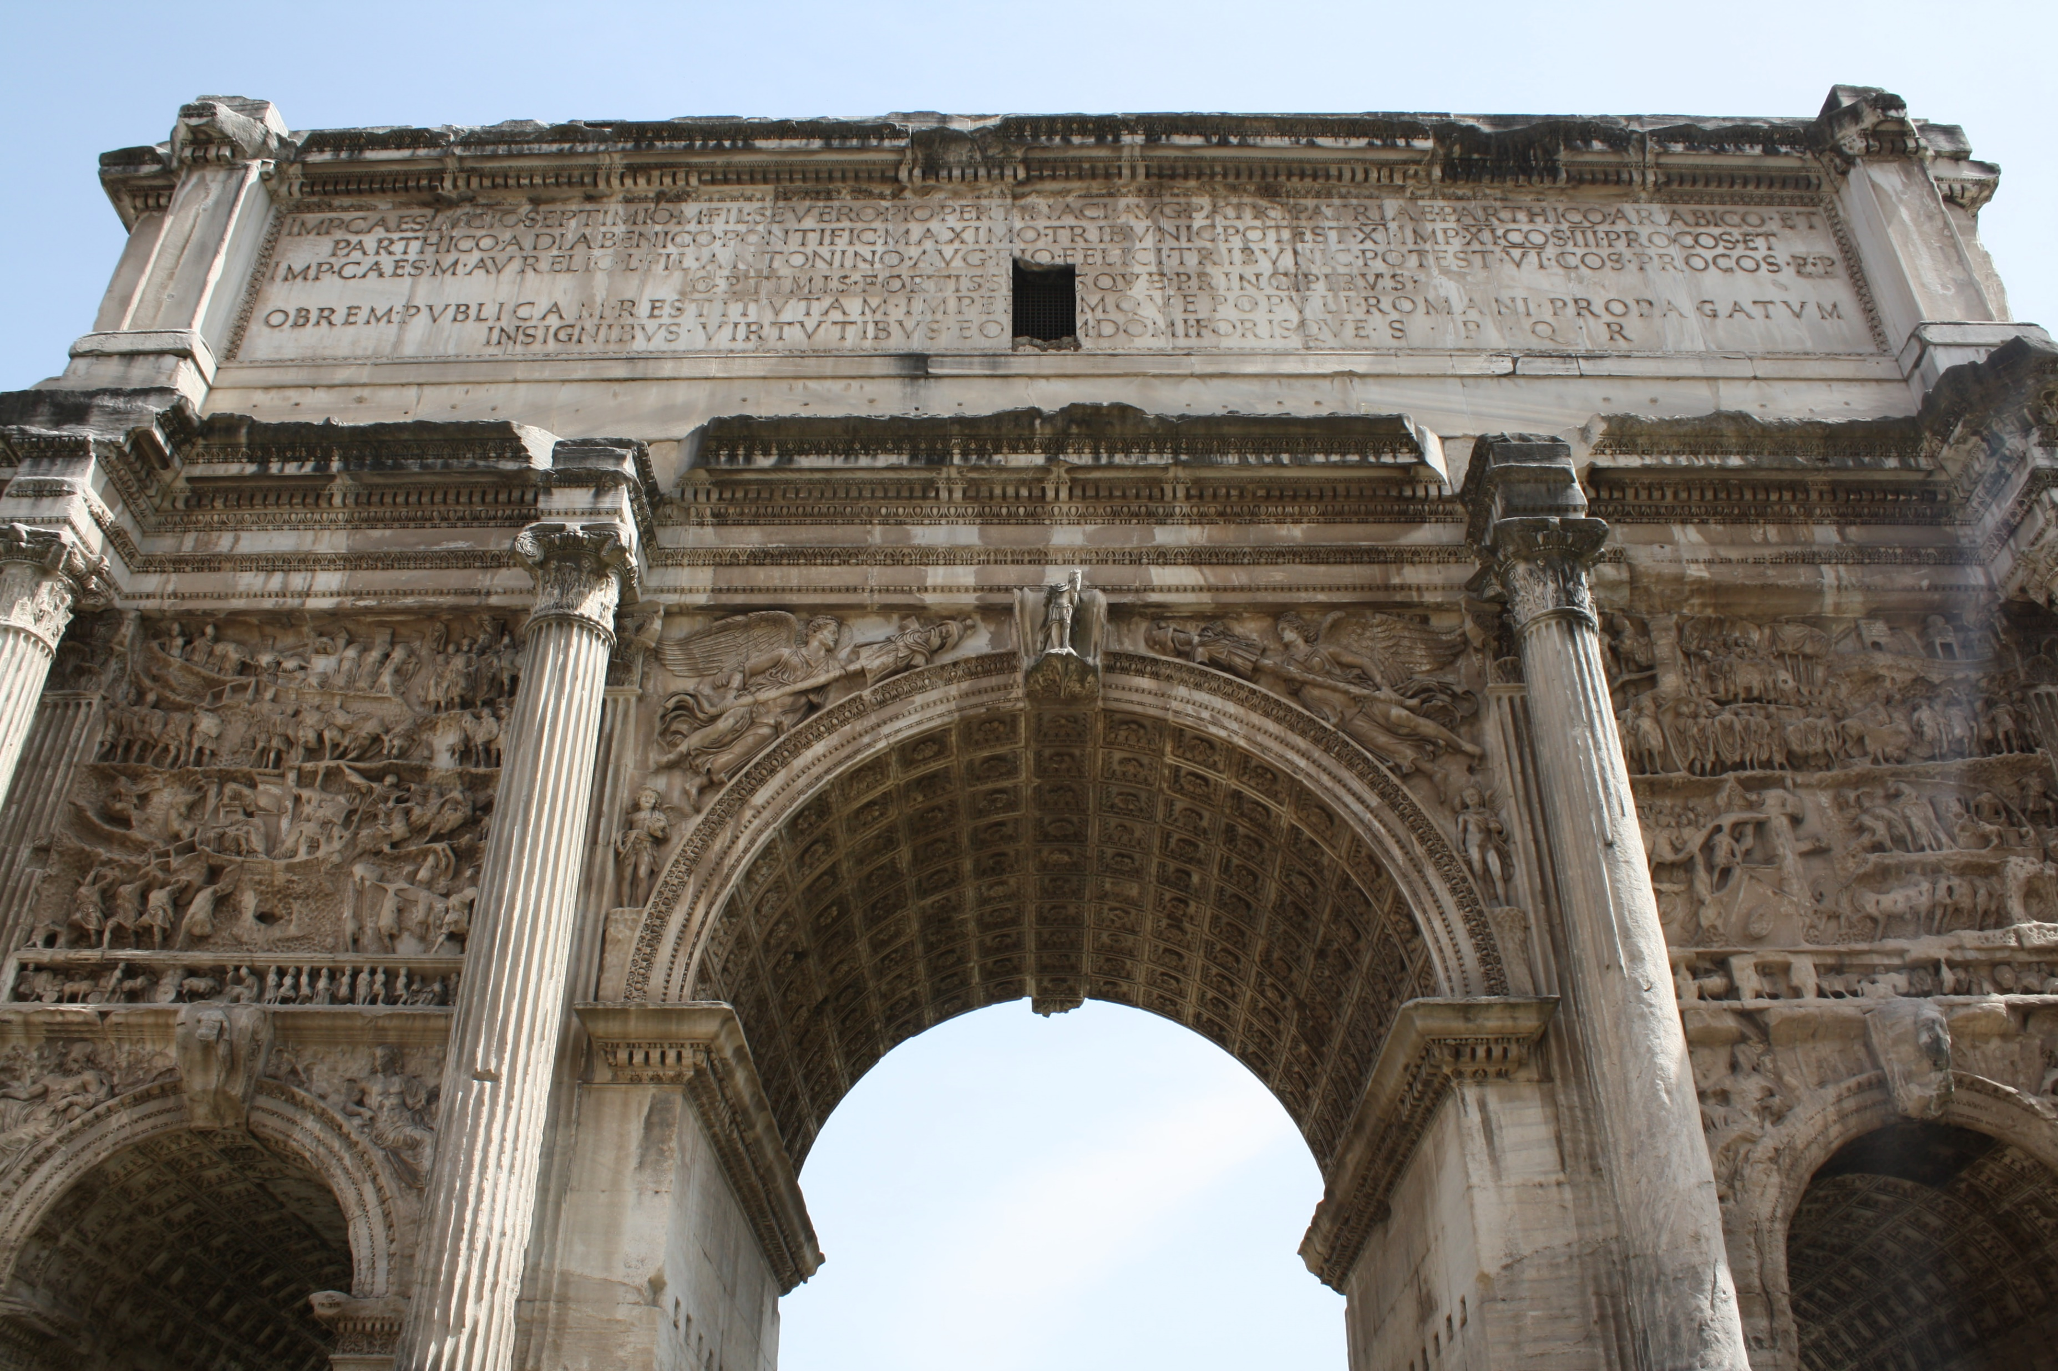
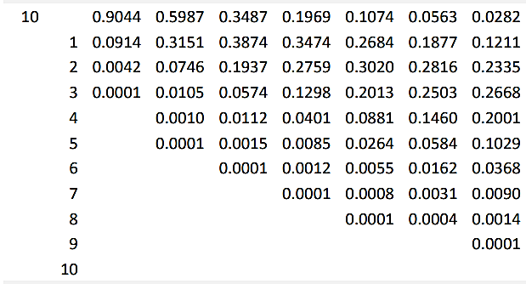
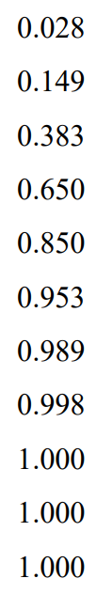
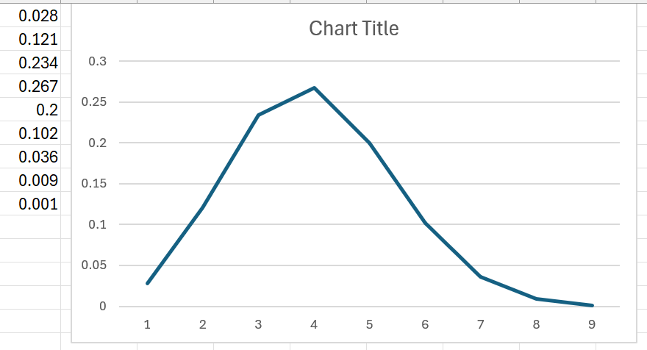
0.30
P<0.30
P(X≤0) <0.05
0
0
P(X≤1) >0.05

Slide 19
0.30
P>0.30
0
0
P(X≤5) >0.05
P(X≥6) <0.05

Slide 20
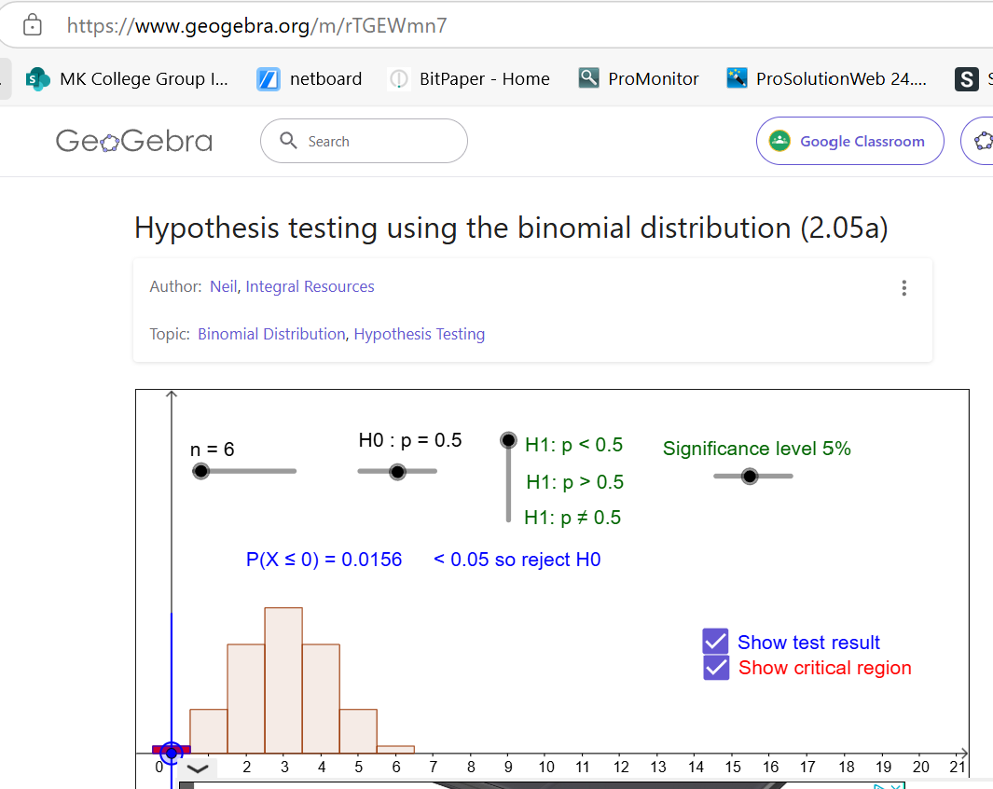
Hypothesis testing using the binomial distribution (2.05a) – GeoGebra

Slide 21

A In August the chance of it being sunny on any particular day in England is 60%. It is thought that twenty days in August are sunny. To test if this is true look at August sunshine stats for the past few years and decide whether to reject the hypothesis.

Slide 22

B It is thought that 50% of the time when looked at, a persons phone has less that 50% charge in it. Test this as a two-tail test with 5% significance and decide whether to reject this hypothesis

