Slide 1




Slide 2







Whole Number and Functions
ADD and SUBTRACT

Slide 3



















Course Content: Choose your topic …
Whole Number and Functions
place
value
negative
numbers
add and
subtract
multiply
divide
round
numbers
ratio
scale
fraction
decimal
numbers
percent
percent
decimal
fraction
MATHS E3 to L2
Parts of a whole
metric
measure
imperial
measure
perimeter
area
volume
formulae
bodmas
charts
data
averages
prob-
ability
Measure and Shape
Handling Data

Slide 4













Home Revision Progress Check 1 Video/Discuss Vocab / jobs Lesson Activities Quizzes Topic Answers Progress Check 2 Cont. Learning
Topic Introduction : Add and Subtract
The first two maths functions that change a number to another. These functions allow you to find the total of two or more values by combining them (adding) or to reverse that process, separating combined values back into their original values.
These two topics at first appear different and are often taught separately and using different methods, however they are strongly related and therefore should be worked on at the same time to make the connection between them.
Choose an icon to select where to start
Add and
Subtract

Slide 5



Warm up exercises 1
Lets start today by revising ! Complete the above sums and multiplication grid

Slide 6



Warm up exercises 2

Slide 7

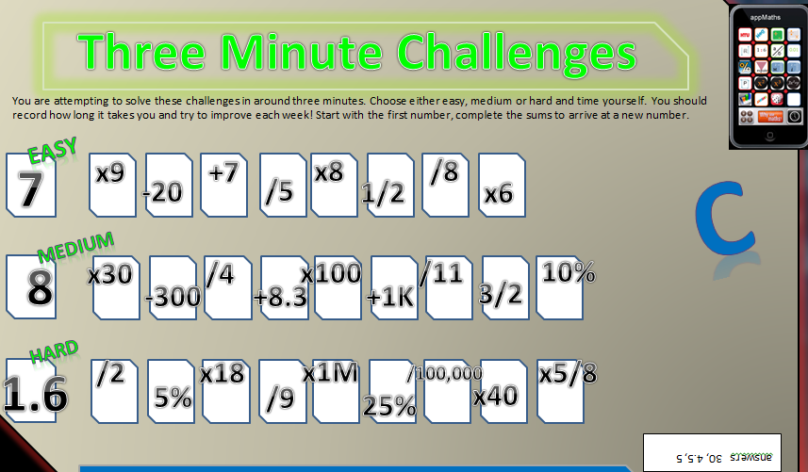

Warm up exercises 3

Slide 8

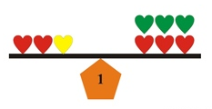
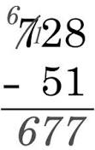
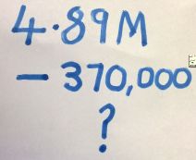
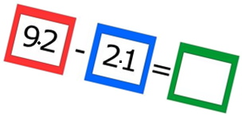


Progress Checker 1
What do you already know about addition and subtraction ? What did you learn before the session?
How would you rate your skills in adding and subtracting?
Excellent ability
Good ability, but working to improve
Ok, making a start but I know I have lots to still learn
The date I started studying : this sessions aims are …
A Discover a method to add two values of any size, including large numbers, decimals and negatives
B Discover a method of subtracting two values of any size, large / decimal / negatives
C Balance equations by adding and subtracting

Slide 9

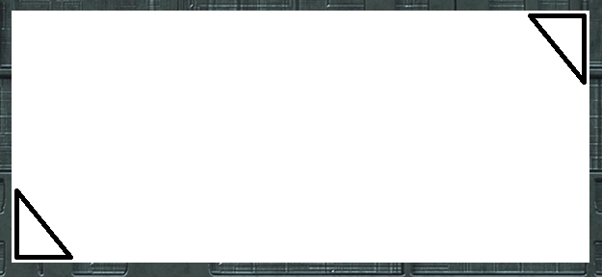


Introductory Video and Discussion
KHTU.
Does adding always make a number bigger ?
Does the order in which you add and subtract matter ?
Can you subtract a big number from a smaller one ?
Which is better, add in your head, on paper, on calculator?
Is there a best method for adding and subtracting?
Does a ‘Decimal point’ affect adding or subtracting?
Watch the introductory video and then discuss the above
Your thoughts..

Slide 10


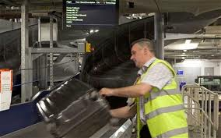
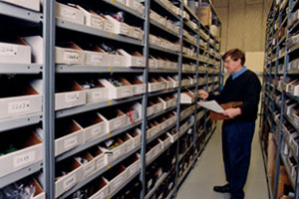
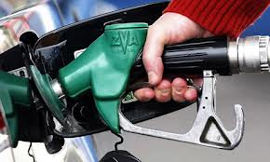

Vocabulary and Jobs
Addition
Subtraction
Take away
Total
Sum
Minus
Less
Difference
Traditional Method
Lining up
Number Line
These are the words you will use in this topic
Accountants
Stock Control
Mobile phone usage
Petrol pump manager
Car Sales
Estate Agent
Secretary
Baggage Handler
Driver …. Can you think of more?
…………………………………
…………………………………

Slide 11

Word Poster
Y
inverse
Add
Traditional method
Decimal point
minus
plus
difference
subtract
less
Number line
Take away
total
sum

Slide 12

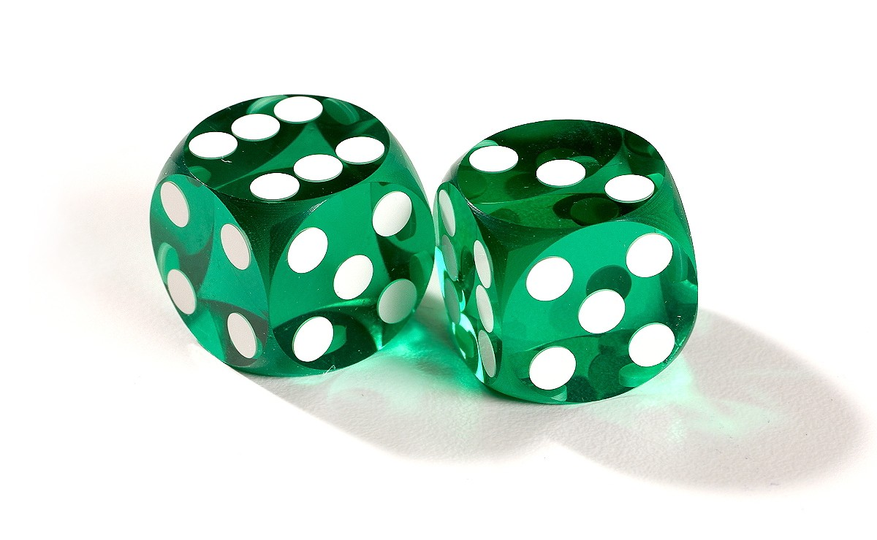
Lesson: Concept Activity
1) Roll two die and record the score, roll again and add to your score, repeat until you pass 100. How many throws did it take?
Now roll two die and start subtracting from your final score, roll, repeat until you pass zero. How many throws did it take?
Record the total number of throws it took you to past 100 and how many to go back past zero. What do you notice? What do you notice about other learners total number of throws?

Slide 13

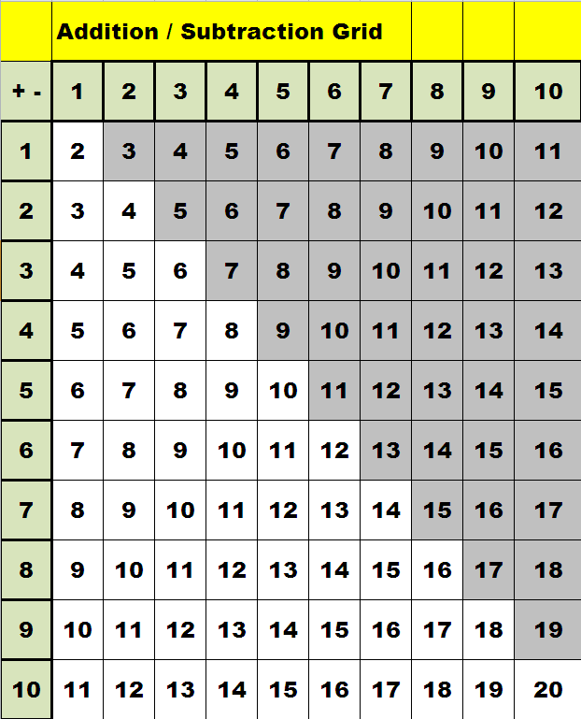

Lesson: Main Teach
Y
This is the essential addition and subtraction grid you need for looking up any sum where you have to take away a number from another or add to a number.
The grid is read like a table (bit like a bus timetable!) where you read across the top row and find the number you are adding to, then look down the column to the row that shows the number you are adding. The answer to the add sum is in the box where column and row meet
for example 6 + 7 = ?
look at column 6 on the top row
look down 7 rows
the answer in box is …..13 !
As you will notice when studying this topic, it will not matter in which order you add numbers together and so half of the answers and ‘greyed out’ as they are repeats of the same sums on the left hand side.
Important learning point !
Learn all of these answers off by heart

Slide 14
Lesson: Main Teach
A way of looking at addition and subtraction is on a number line, this is a line with a zero in the middle showing positive numbers on one side and negative on the other. You can use different labelled number lines to aid in visualising the processes of adding and subtracting.
Y
-14
-13
-12
-11
-10
-9
-8
-7
-6
-5
-4
-3
-2
-1
o
1
2
3
4
5
6
7
8
9
10
11
12
13
14
negative
positive
A D D I N G is moving from a starting value in the positive direction a number of steps, example
7 add 5 this means you have seven units and want add another five more units.
-14
-13
-12
-11
-10
-9
-8
-7
-6
-5
-4
-3
-2
-1
o
1
2
3
4
5
6
7
8
9
10
11
12
13
14
+5
In this example the answer is twelve. This answer is the number you land on when you start on seven and ‘MOVE’ five steps to the right (in the positive direction). Twelve is a ‘Larger’ value than seven, therefore you have increased your value (you have more now than when you started.
Try………… move from number two, six steps to the right, where do you land ?? That’s right, you should be on number eight !
move from -4, ten steps in the positive direction , where are you now?? That’s good, you are on number 6 !
Move from -14 and add until you get to number 9. How many steps did you move?? Excellent, you moved 23 steps !

Slide 15
Lesson: Main Teach
Subtraction is just MOVING but in the opposite direction on the number line.
Y
-14
-13
-12
-11
-10
-9
-8
-7
-6
-5
-4
-3
-2
-1
o
1
2
3
4
5
6
7
8
9
10
11
12
13
14
Example, 9 take away five. Here you are starting with nine units and want to take five of them away (9-5=?) . This is just a movement of five steps away from 9 but this time in the negative direction.
-14
-13
-12
-11
-10
-9
-8
-7
-6
-5
-4
-3
-2
-1
o
1
2
3
4
5
6
7
8
9
10
11
12
13
14
-5
Try…….. 7 minus 4. Good 7-4 is three !
13 take away 8. Yes, you arrive at 5 !
14 minus 23. Here you will pass zero and keep counting, where do you end up?? Good its -9 !
What about zero minus thirteen? Yes, just move 13 steps to the left (negative direction) from starting a zero. You get -13
And can you do -3 minus eight ? That looks like this…. -3 -8 = ? That just means, start at -3 and move left eight steps. Did you arrive at -11 ?? Good !
Finally, can you take -7 away from -8 ?? That means start at -8 and move left -7 places. How can you do that? Well -8 take away 7 would mean move left 7 steps, so -8 take away -7 must mean the opposite direction, try it….did you arrive at -1 ? Well done if you did !

Slide 16


Lesson: Main Teach
So…. Some rules for adding and subtracting of positive and negative numbers to learn !
Adding Positive Numbers Positive + Positive = Larger Positive Number
eg 23 + 48 = 71
Adding Positive to Negative Positive + Negative = Positive - value of the negative number
eg 15 + -7 = 15 - 7
Adding Negative to Positive Negative + Positive = Positive - value of the negative number
eg -30 + 15 = 15 - 30
Negative add Negative Negative + Negative = Larger Negative Number
eg -6 + -18 = - 24
Y
Main addition rule for larger numbers Main rule for subtracting of larger numbers
Traditional method – add each place value and Traditional method – take each place value away in columns
carry over any sets of ten made in each column If a column does not have enough in it, take one set of ten from
the column on the left ………….. 549 – 487 =
4 8 7
5 4 9 + 5 4 9
1 0 3 6 4 8 7 -
0 6 2
4
1
Now watch the tutor video

Slide 17


Lesson: Try out
Block 1 : Watch tutor led demo (in class or on video)
Try these,
1) add 78 to 59 2) add 294 to 1,203 3) total the amounts 3,975 to 5,050
4) Subtract 9 from 24 5) take 18 from 302 6) take 54 away from 33
Block 2 : Watch tutor led demo (in class or on video)
Try these, 7) add -3 to seven 8) add together 483, 098 and 16,500
9) take 859,372 from 1,000,000 10) -7 + 19 11) a) 8 + 2,
b) 80 + 20, c) 800 + 200 12) a) 150 – 12, b) 1500 – 120 , c) 15,000 – 1200
Block 3 : Watch tutor led demo (in class or on video)
Try these, 13) -130 + 2.7k 14) 326M + 14,700,000 15) 18k + (-3.2M)
16) 14.3M – 16,700,000 17) 4,789,032,060 + 89,970,320
18) 1,010,050 - 98,890, 009

Slide 18
Lesson: Websites and links
http://gamelicker.com/arcade-game-rapid-math-2647
Fast game of typing answers to single digit sums
Game of ‘Count down’ as per tv show, add and subtract to arrive at a final total
http://www.subtangent.com/maths/flash/numbers-and-letters.swf
Adding and subtracting positive and negative numbers
http://www.cimt.plymouth.ac.uk/projects/mepres/book7/bk7i15/bk7_15i1.htm
Use a running man to visualise moving in the positive or negative directions when adding and subtracting
http://www.mathsisfun.com/numbers/casey-runner.html
Whole page on adding and subtracting worksheets and information
http://www.aaamath.com/add.htm
http://www.ictgames.com/button%20only.html
Add and Subtract on a number line
Subtraction methods website
http://www.bbc.co.uk/skillswise/worksheet/ma09subt-e3-w-subtraction-methods
Create your own add/subtract worksheets
http://www.aplusmath.com/Worksheets/index.html

Slide 19
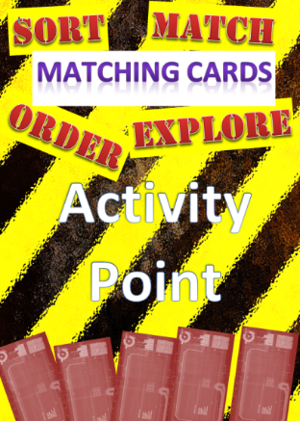

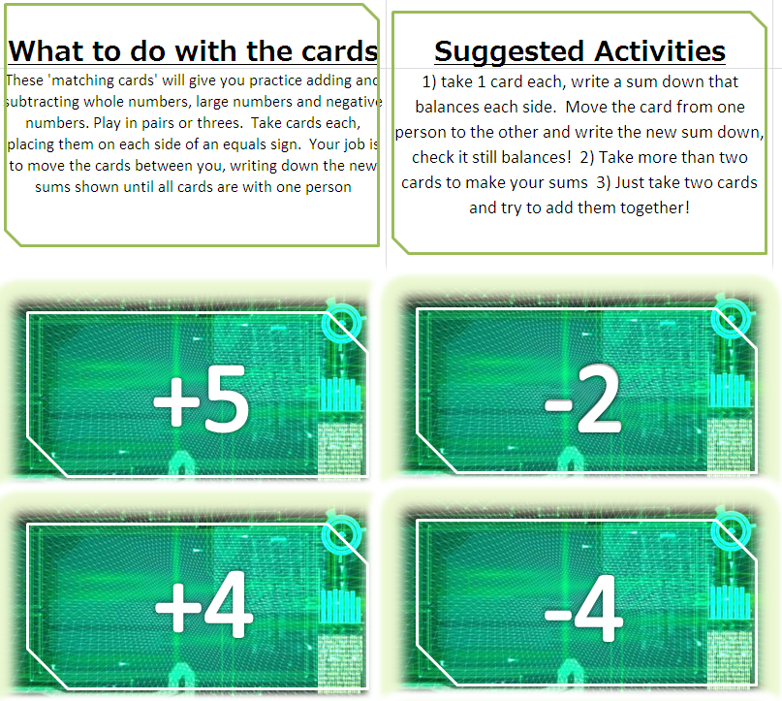

Lesson: Exploratory Activity A
Y
=
=
=

Slide 20


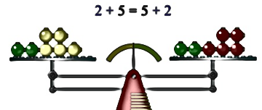

Lesson: Exploratory Activity B
Y
Add and Subtract Discussion
Take discussion cards one at a time
Talk about the topic/question posed on the card with each other
Find information on the internet if required
Focus on having an answer by the end of the discussion
Record interesting discussion points and any learning in your group for later feedback
-
+

Slide 21
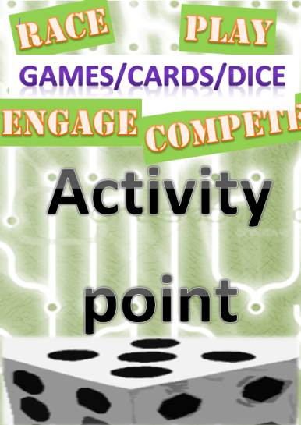

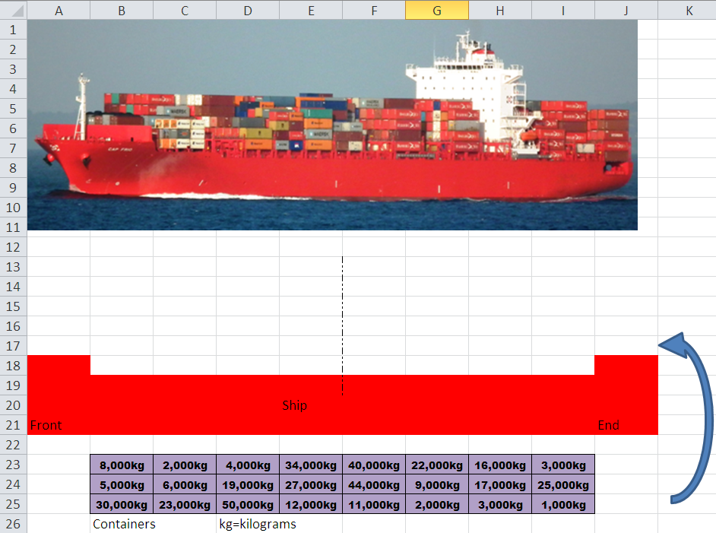

Lesson: Exploratory Activity C
Y
Balance the Container Ship !

Slide 22






Lesson: Exploratory Activity D
Y
10 holidays
£50,000 budget
10 items when redecorating
a room £10,000 budget
5 House prices
£1,000,000 budget

Slide 23


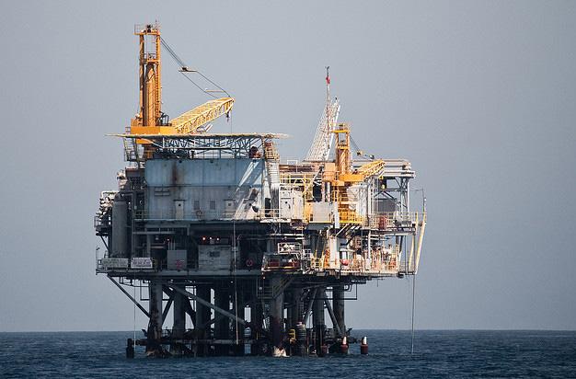
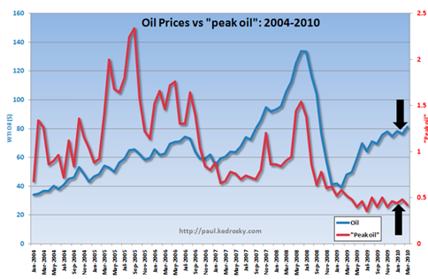
Lesson: Exploratory Activity E
Y
Graph Building
Sort the information on the cards in order
Plot the information on a graph

Slide 24

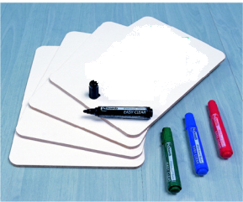

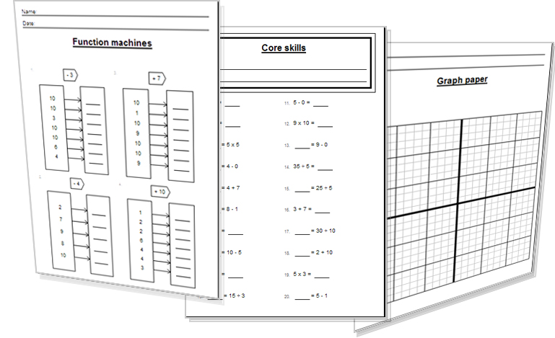


Lesson: Activity E
Try a variety of written practice
Worksheets
Workbooks
Practice Exam Papers
Maths Problems
Tutor Explanations
Tutor

Slide 25

Lesson: Practice – just the numbers
Add the following numbers together
54 and 63
126 and 479
4,762 and 8,920
362,874 and 115,252
11,430,080 and 6,031,555
Subtract the smaller from the larger
22 from 110
890 from 1,205
450 from 2,000
2,960 from 884,062
18,400 from 10,000,000
Add the following
23K + 49K
550M + 230M
780B + 39B
4.2M + 1,300K
630M + 1.5B
Use addition and subtraction to find the answer
2 + 3 – 7
18 -50 +13
(-4) + 8 – (-6)
14 – 20 – 5 – (-8)
(-500 -300) – 150 + 700
79 + 84 – 32
-18 +23 -44
125 – 600 – (-350)
(-457) – (-512)
5 – (-8 -7) – (+3-12) +9
2k – 16K +4k
42M + (-2M)
-13B + 4B + (-10B)
-420K + 1.2M
-(500M – 200M) + ( -1.2B)
Subtract the following
820M – 350M
14B – 180M
2M – 1,590K
1.6B – 980M
47M – 20K
Add the following
4 + (-2)
16 + (-5)
230 + (-150) + 75
(-50) + (-3710) + 800
3,950 + 1200 + (-4800)
Subtract the following
12 – 15
89 – 129
420 – (-800)
1,900 - 35,000
16,500 – (-15,900) – 4,700

Slide 26


Lesson: Practice – word problems
Y
Q1 A computer has more memory added to its 400GB hard drive. It now has 950GB. How much more memory was added?
Q4 A company made a profit of £16,200 in January, £11,900 in February and loss of -£6,500 in March. What is the overall profit or loss for this first quarter (first 3 months) ?
Q2 A rocket is fired from a height which is given zero as its starting value. The rocket rises 2,500metres before falling a total distance of 3,200 metres. How far below its initial starting level has the rocket fallen?
Q5 I travelled from the UK 7,820km to America, then 15,900km from America, back past the UK to Russia. How far is the journey from Russia back to the UK assuming America – UK – Russia are all in a straight line?
Q3 I scored 15 points in one game, minus 3 points in a second game, then 7 points in the final game. What was my total score for the three games?

Slide 27
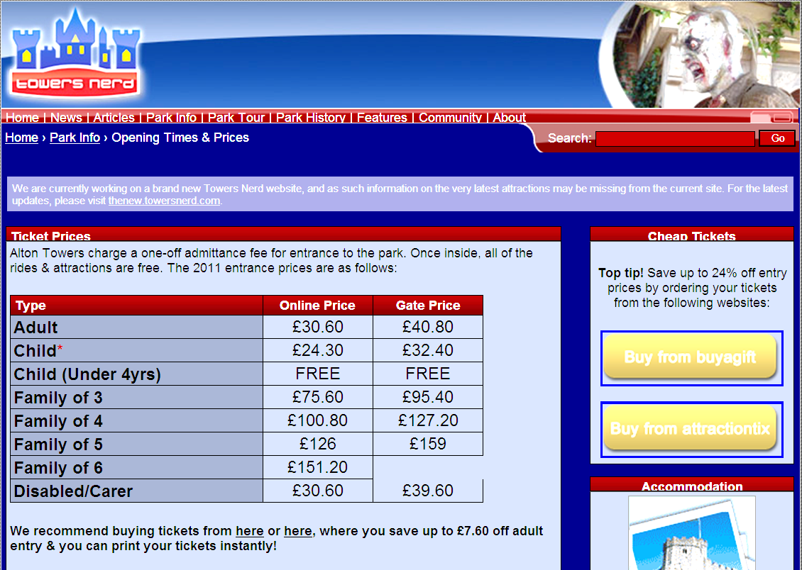
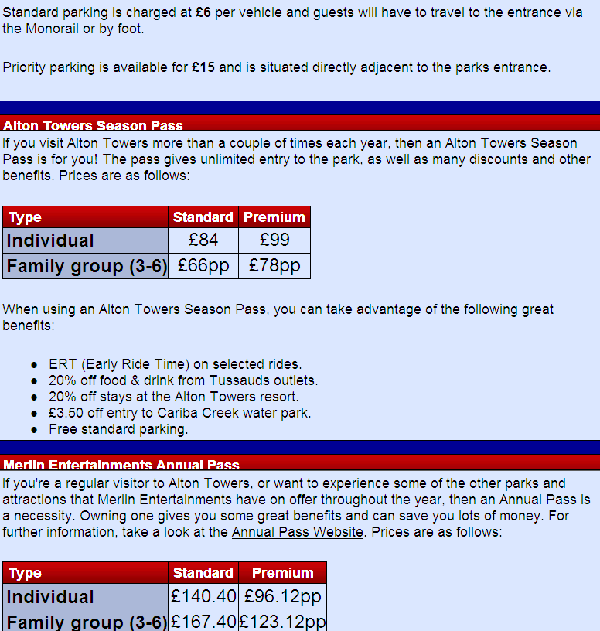

Lesson: Practice – Making it Functional
Y

Slide 28

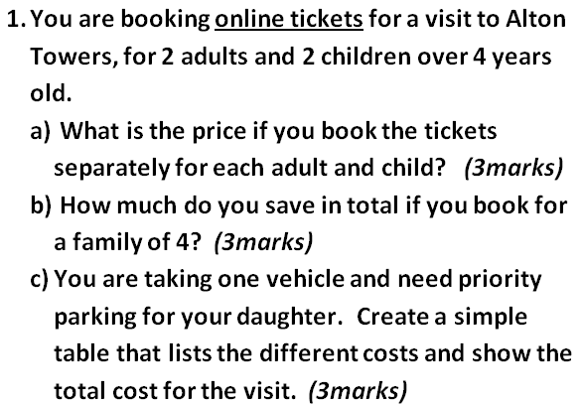
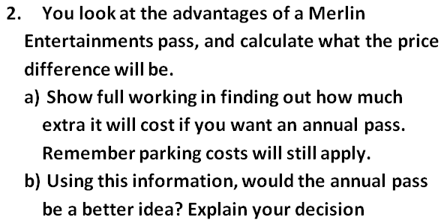

Lesson: Practice – Making it Functional
Y

Slide 29
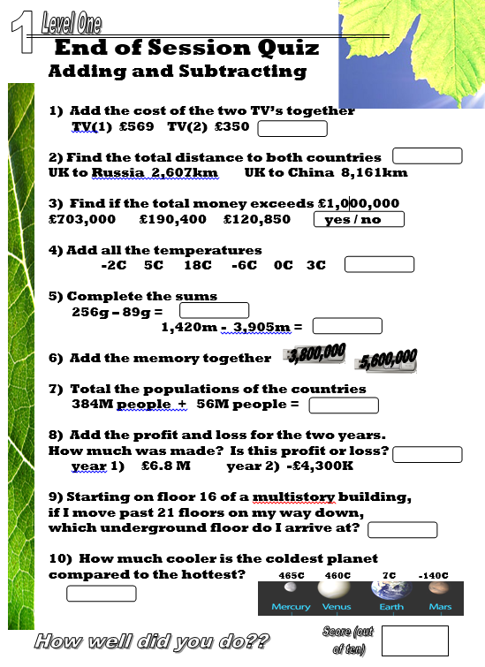
Quiz to assess LEVEL 1

Slide 30
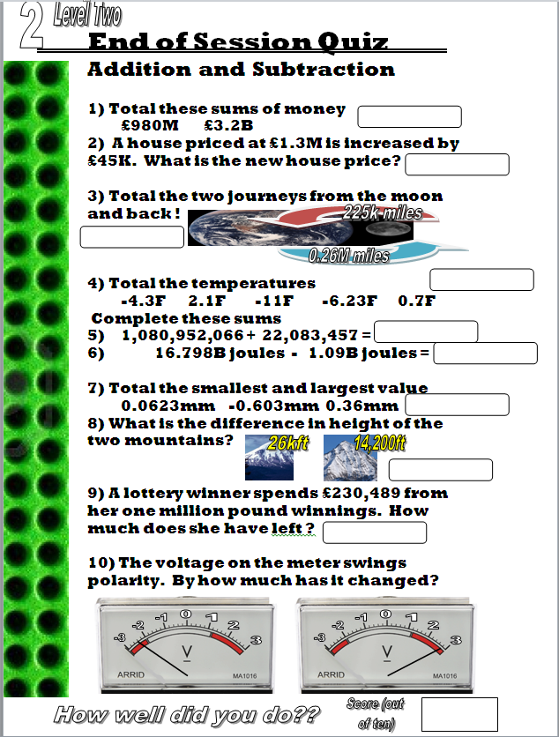
Quiz to assess LEVEL 2

Slide 31
TOPIC ANSWERS
Block 1 – Answers
137
1,497
9,025
15
284
-21
Block 2 – Answers
7) 4
499,598
140,628
12
a) 10, b) 100, c) 1,000
a) 138 b) 1380 c) 13,800
Block 3 – Answers
13) 2570
340,700,000
-3,182,000
-2,400,000
4,879,002,380
-97,879,959

Slide 32
TOPIC ANSWERS
Add the following
2
11
155
-2,960
350
Subtract the following
-3
-40
1,220
-33,100
27,700
Lesson Practice: word problems
Q1) 550 GB
Q2) 700m below zero
Q3) 19
Q4) £21,600
Q5) 8,080km
Making it Functional
Q1) a) 2 x £30.60 for the adults + 2 x £24.30 for children = £109.80
Family of 4 ticket is £100.80, so £109.80 - £100.80 = £9 therefore you can save £9
Tickets £100.80
Parking £15
Total £115.80
Q2) a) Merlin pass for family of 4 is £167.40, parking is £15. Difference is £167.40 + £15 – £115.80 = £66.60
b) As the annual merlin pass is dearer by £66.60 it is better to not buy the annual pass on this occasion.
Just the numbers
Add the following numbers together
117
605
13,682
478,126
17,461,635
Subtract the smaller from the larger
88
315
1,550
881,102
9,981,600
Add the following
72k
780M
819B
5,500k or 5.5M
2,130M or 2.13B
Subtract the following
470M
13,820M
410K
620M
46,980k
Use addition and subtraction to find the answer
-2
-19
10
-3
-250
131
-39
-125
55
38
-10,000
40M
-19B
780k
-1,500M or -1.5B

Slide 33

TOPIC ANSWERS 2
End of Session Quiz Add and Subtract
Level 1
£919
10,768 km
Yes (total is 1,014,250 )
18C
167g and -2,485 m
9,400,000
440M people
£2.5M therefore profit
Floor (– 5)
605C
End of Session Quiz Add and Subtract
Level 2
£4.18 B
£1,345,000
485,000 miles
-18.73 F
1,103,035,523
15.708 B joules
-0.243mm
11,800 ft
£769,511
5.2 volts

Slide 34
Progress Checker 2
What do you now know about addition and subtraction ? What did you learn in the session?
How would you now rate your skills in adding and subtracting?
Excellent ability
Good ability, but working to improve
Ok, making a start but I know I have lots to still learn
The date I finished studying : delete any aims below you have achieved …
A Discover a method to add two values of any size, including large numbers, decimals and negatives
B Discover a method of subtracting two values of any size, large / decimal / negatives
C Balance equations by adding and subtracting

Slide 35
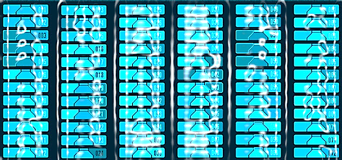

Continuing to Study and Learn
What else can you do to help yourself to learn and practice? Here are ten suggestions, record which you do each week and also record your progress.
Internet websites
Repeat the lesson, make notes, organise a folder, revise
Own maths workbook
Study together with a friend or family member
Finish activities in this book
Complete class handouts or tasks
Practice exams / past papers
Use maths skills learnt at home or at work in real situations
Play games
Experiment yourself, try new things ask yourself questions
Try making a graph of number of practice methods you use against your progress score in each topic. Are you showing more practice gives better results?

