Slide 1
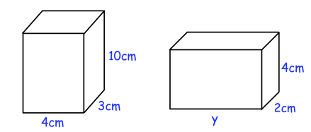
SEQUENCES
Learning Objectives
To be able to:
Recognize and use sequences:
triangular, square and cube numbers and simple arithmetic progression
Calculate the nth term of a sequence
James makes two cuboids out of clay. Both cuboids have the same volume. Find y.
10cm
4cm
3cm
2cm
4cm
y

Slide 2
STARTER
Triangular, Square and Cube Numbers
Geometric Progression
1, 2, 4, 8, 16, …
a) Find the next term of the sequence.
b) What is the term-to-term rule?
List the first five triangular, square and cube numbers.
Fibonacci Sequence
Arithmetic Progression
0, 1, 1, 2, 3, 5, 8, …
Find the next three terms of the sequence.
21, 17, 13, 9, 5, …
a) Find the next term of the sequence.
b) What is the term-to-term rule?
nth Term
6, 11, 16, 21, 26, …
a) Find the nth term of the sequence.
b) What is the 100th term?

Slide 3
ARITHMETIC AND GEOMETRIC PROGRESSION
Here are the first four terms of an arithmetic sequence.
11, 15, 19, 23, …
Write down the next term of the sequence.
Explain how you found your answer.
The 100th term of the sequence is 407. Work out the 99th term of the sequence.
Here are the first four terms of a geometric sequence.
1, 5, 25, 125, …
a) Write down the next two terms of the sequence.
b) Explain how you find the next term of the sequence.

Slide 4
Your turn…
Here are the first five terms of a sequence.
9, 15, 21, 27, 33, …
Write down the next term of the sequence.
Explain how you found your answer.
Write down the 9th term of the sequence.
302 is not a term in this sequence. Explain why.
Find the next two terms for each of the following geometric progressions.
2, 6, 18, 54, …
256, 128, 64, 32, …
2, -4, 8, -16, …

Slide 5
FIBONACCI SEQUENCE
Find the next three terms of the sequence.
2, 4, 6, 10, …
Find the next three terms of the sequence.
a, 4a, 5a, 9a, …

Slide 6

Your turn…
Find the next three terms of the following Fibonacci-style sequences.
-3, 5, 2, 7, …
-1, -3, -4, -7, …
6$a$, -2$a$, 4$a$, 2$a$, …
-$x$, $x$ + $y$, $y$, …
1) Here are the fourth and fifth terms of a Fibonacci-type sequence.
…… , …… , …… , 28 , 43
Each term is a sum of the previous two terms. Show that the first term is 2.
2) Here are the first and third terms of a different Fibonacci-type sequence.
a , …… , b , …… , ……
Each term is the sum of the previous two terms. Work out an expression in terms of a and b for the fifth term.

Slide 7
NTH TERM
Work out an expression for the nth term of the sequence.
5, 8, 11, 14, …
Work out an expression for the nth term of the sequence.
10, 7, 4, 1, …

Slide 8
Your turn…
Work out an expression for the nth term for the following sequences:
9, 14, 19, 24, …
12, 22, 32, 42, …
1, 3, 5, 7, …
2, 9, 16, 23, …
Work out an expression for the nth term for the following sequences:
6, 4, 2, 0, …
22, 15, 8, 1, …
4, 1, -2, -5, …
-7, -12, -17, -22, …

Slide 9
NTH TERM
Here are the first five terms of a sequence.
2, 9, 16, 23, 30, …
Find an expression for the nth term of the sequence.
Find the 100th term in the sequence.
The nth term of a sequence is 6n + 3.
Find the first four terms of this sequence.
Sara says that 1008 is a term in this sequence. Explain why she is wrong.

Slide 10
Your turn…
The nth term of a sequence is 5n + 2. Find the first three terms of this sequence.
The nth term of a sequence is 5 – 3n. Find the first three terms of this sequence
1) The nth term of a sequence is n² + 3.
Find the first three terms of this sequence.
Work out the difference between the 5th and 10th terms in the sequence.
2) The nth term of a sequence is 4n – 7.
Find the first three terms of this sequence.
What is the difference between the 50th and 51st terms?
Does the number 393 appear in the sequence?

Slide 11

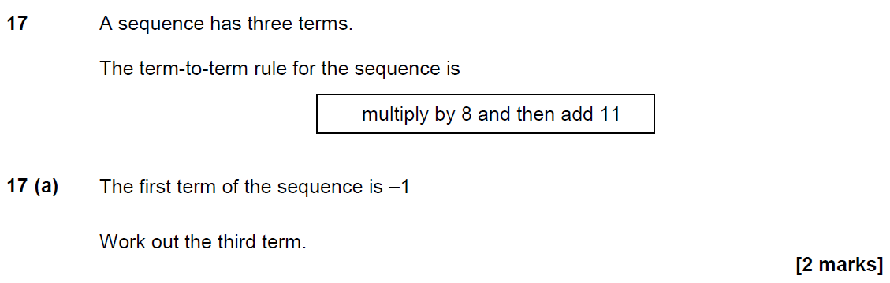
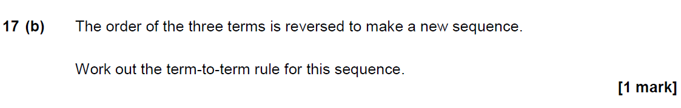
November 2017 Paper 1

Slide 12
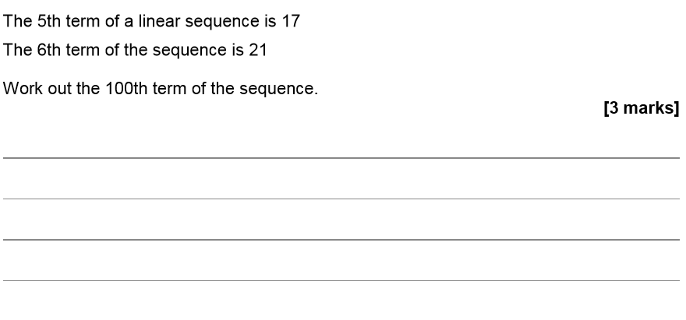
November 2019 Paper 2

