Slide 1
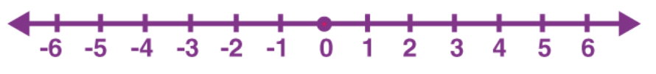
INDICES
Learning Objectives
To be able to :
- use the rules of indices
- calculate with roots, and with integer indices
Recap
1) Solve 2x + 4 = 16
2) Solve 8 ( 3 + a ) = 11a
3) Show x < 6-x below

Slide 2


STARTER
Indices law questions ..
5⁰ =
4² x 4⁴ =
3) Simplify
4) Simplify $\sqrt{25} x \sqrt{100}$
$$\frac{5^{7}}{5^{3}}$$

Slide 3
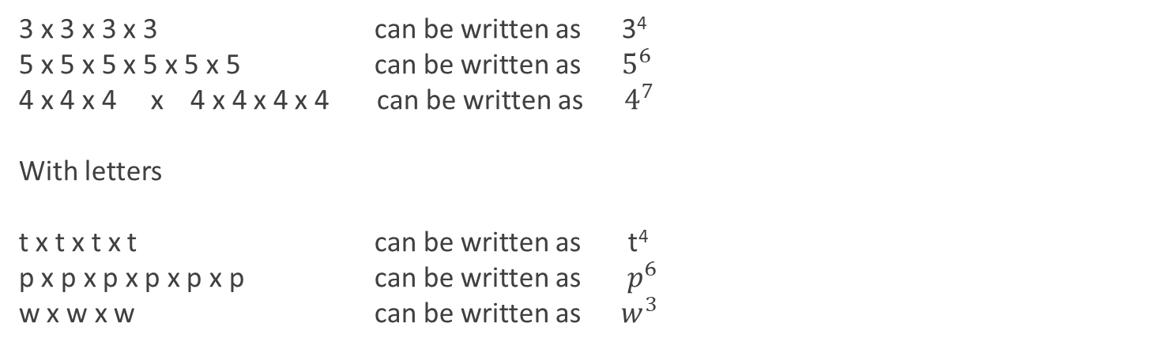
Simplifying Indices
3 x 3 x 3 x 3 can be written as 3⁴
5 x 5 x 5 x 5 x 5 x 5 can be written as $5^{6}$
4 x 4 x 4 x 4 x 4 x 4 x 4 can be written as $4^{7}$
With letters
t x t x t x t can be written as t⁴
p x p x p x p x p x p can be written as $p^{6}$
w x w x w can be written as ${ w}^{3}$
Write 2 x 2 x 2 x 2 x 2 x 2 x 2 x 2 x 2 x 2 in indice format
Write n x n x n x n in indice format

Slide 4
Your turn…
Extension:
Re-write in indice form:
(3x3) x (3x3x3)
5 x (5x5) x (5x5)
t x t x k x k x k x k
u x u x 3u x 2u
Re-write in indice form:
8 x 8 x 8
7 x 7 x 7 x 7 x 7
12 x 12
E x E x E x E
g x g

Slide 5
Multiplication and Indices
t² x t³ can be written as.. t²⁺³ = t⁵
v⁴ x v² =
n⁶ x n⁸ =
m⁵ x m² x m =
Worked example
Simplify j x j x j x j² x j⁵ x j

Slide 6
Your turn…
Extension:
Simplify:
h ( h³) x h
5 x t⁵ x t x t⁵
g⁸ x g⁻³
w ( w⁴ ) x w⁻⁷
Simplify:
b⁷ x b⁸
5² x 5³ x 5²
M x M⁹ x M
E¹⁰ x E³
k¹⁴ x k³ x k

Slide 7


Division and Indices
Rule…
What happens to the power numbers when dividing? Example…
$$\frac{m^{13}}{m^{2}} =$$
Worked example
Simplify
$$\frac{x^{20}}{x^{5}} =$$

Slide 8
Powers of Indices
Rule…
How do we take a power of a power? Example…
(y³)⁴
Worked example
Simplify h x (h⁹)² x h³

Slide 9




Your turn.. Mixed…
Extension:
Simplify:
e)
10⁻³ ( 10⁻²)²
Simplify:
f² x f⁹
4⁴ x (4²)⁷
If a=3 and b=2 Find…
2ª x 2^{2b}
$$\frac{r^{6}}{r^{−2}}$$
$$\frac{m^{7}}{m^{2}}$$
$$\frac{m^{7}}{m^{2}}$$
$$\frac{{\left(w^{6}\right)}^{4}}{{\left(w^{4}\right)}^{2}}$$

Slide 10
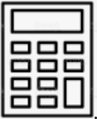
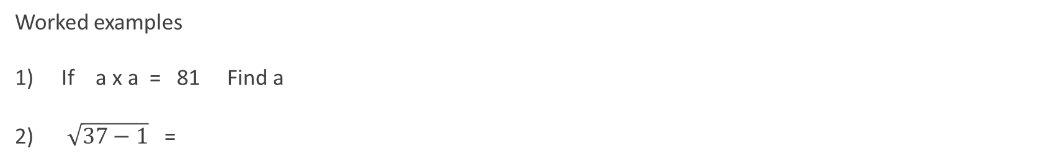
Calculations with roots
If 3 x 3 = 9 what is $√9$ ?
Worked examples
If a x a = 81 Find a
$\sqrt{37−1}$ =

Slide 11




Your turn.. roots…
Extension
Simplify:
a) 2 $\sqrt{16}$ + $\sqrt{100}$
b) $\sqrt{144}$ x $\sqrt{144}$ x $\sqrt{144}$
c) $\sqrt{ 10+4}$ + $\sqrt{50 −1}$
d) $\sqrt{4^{2}}$ - $\sqrt{{16}^{2}}$
Simplify:
a) $\sqrt{81}$ + $\sqrt{49}$
b) $\sqrt{121}$ - $\sqrt{9}$
c) 3 $\sqrt{9}$
d)
$$\frac{\sqrt{36}}{}$$
$$\frac{\sqrt{36}}{\sqrt{35}}$$

Slide 12

  Work out 81 as a power of 3
Circle your answer
3³ 3⁴ 3⁵ 3⁶
[ 1 Mark ]

Slide 13
  18. Solve x² = 30.25
[ 2 Marks ]

Slide 14

  27. Noah is using this formula. y is larger than x.
  √ (y² – x²) =
  Tick the correct statement
  The answer will always give an answer which is a whole number
  The answer will sometimes give an answer which is a whole number
  The answer will never give an answer which is a whole number
You must show your workings.
[ 2 Marks ]

Slide 15


    Simplify 3 x a x 3 x a
    Circle your answer
    9a 6a² 9a² 6a
[ 1 Mark ]

Slide 16

    22. Work out the value of (√5)² + (√6)² – (√7)²
  You must show your working.
[ 1 Mark ]

