Slide 1

Welcome to
Milton Keynes College
Setting the highest expectations for every individual…

Slide 2
Malcolm Cooke Functional skills and GCSE maths Room F27 Malcolm.Cooke@mkcollege.ac.uk

Slide 3
College Tour
Digital Learning Session
PD - Hopes
Student Voice
Code of Conduct
PD – Our Values
PD – E Safety
Your Course – Maths at the college

Slide 4
Your Values link
https://sway.office.com/XECWBamoHfqRPHHq?ref=Link&loc=play

Slide 5
Introduction to E-Safety
https://sway.office.com/M1fQ29YFhxkAGqTL?ref=Link&loc=play

Slide 6
Introduction to Prevent & Radicalisation
https://sway.office.com/GygFMHlxJh3uVVAw?ref=Link&loc=play

Slide 7
Introductions to Healthy Relationships link
https://sway.office.com/DrmQo7YnKa2RpGUE?ref=Link&loc=play

Slide 8


Maths at MK College 2021/2022
Room F27 Chaffron Way
Functional skills and Gcse MATHS

Slide 9





This academic year will be A Challenge for everyone…

Slide 10

Milton Keynes College Staff
Tom Heath -Head of Maths
tom.heath@mkcollege.ac.uk
James Dawson –Curriculum Innovator
James.dawson@mkcollege.ac.uk
Kat McKiernan – Deputy Head of School: Adult English & Maths
kat.mckiernan@mkcollege.ac.uk
?– Administrator: English & Maths
adulteandm@mkcollege.ac.uk
If you are going to be late or absent for a lesson, please use the adulteandm@mkcollege.ac.uk email address.
Room G34

Slide 11
Subject Leaders YOUR SUBJECT TUTOR
Maths
Malcolm Cooke
malcolm.cooke@mkcollege.ac.uk
Keith McCarthy
keith.mccarthy@mkcollege.ac.uk
Debbie Rice
debbie.rice@mkcollege.ac.uk
English
Anne-Marie Horrocks
anne-marie.horrocks@mkcollege.ac.uk
Josie Spencer
Josie.Spencer@mkcollege.ac.uk
Victoria Curtis
Victoria.Curtis@mkcollege.ac.uk
Colette Tighe
Colette.tighe@mkcollege.ac.uk

Slide 12


Additional support
Staff to support you in lessons if needed.
Student Voice.. Lets decide now..
Drop-in sessions available for all.
We can make special Exam Arrangements for anyone in need of additional support. Please let your tutor know if you require any arrangements. Let’s do this now….. !
Meet our class TSA

Slide 13
Progression Levels
The government will only fund one L2 qualification
Level 3 A Levels and NVQ’s L3
Level 2 (C (4-5) at GCSE)- NVQ’s L2 or GCSE Foundation up to 5 (C+)
Level 1 (D (3) at GCSE) – NVQ’s L1
E3 Highest pre GCSE level
E2 Intermediate level, below GCSE
E1 Beginners level, below GCSE

Slide 14

The Four Areas in Numeracy
1) Numbers
- Whole Numbers
- Parts of a Whole
Measure, Shape and Space
Algebra
Data Handling

Slide 15
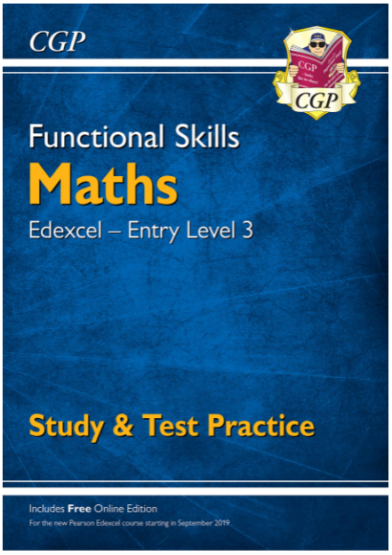
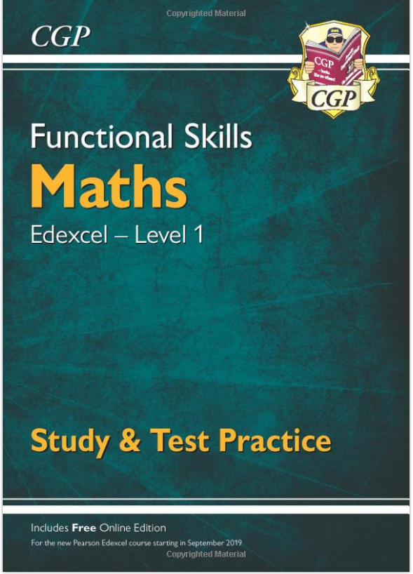



Course Workbook

Slide 16
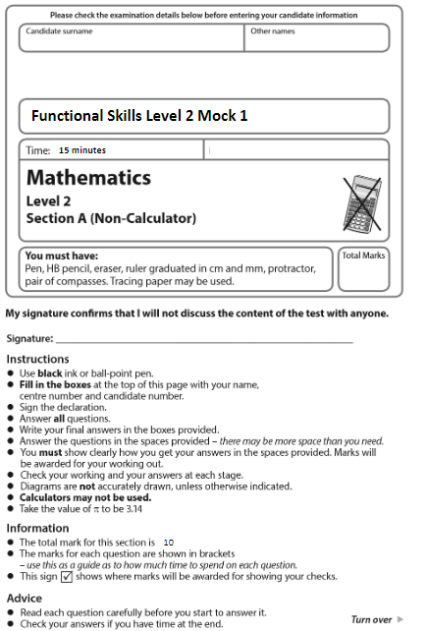


Level 2 Exams
1 x Non- Calculator Paper $\sim$15mins
1 x Calculator Paper $\sim$1hr

Slide 17




Slide 18
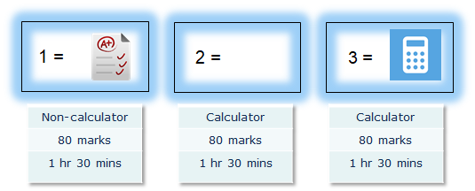

GCSE maths foundation paper

Slide 19
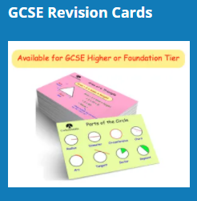

Revision starts now!
Corbett maths
https://corbettmaths.com
Maths genie
https://www.mathsgenie.co.uk/
Khan academy
ps://www.khanacademy.org/math
BBC GCSE Bitesize
https://www.bbc.co.uk/bitesize/subjects/z6vg9j6

Slide 20
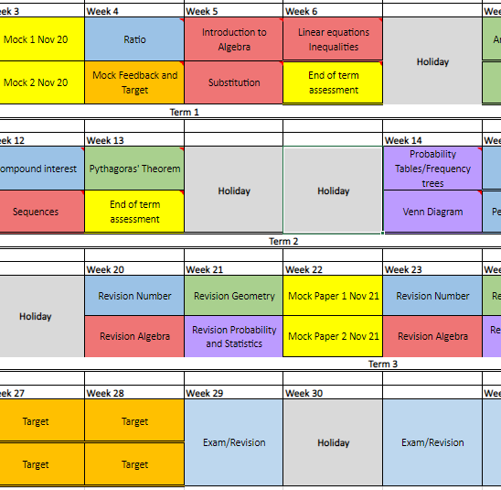



Lesson Structure
Assess feedback
Lesson Content
Activities
Lesson ppt/practice
DIRT
Assess
Your lessons will be accompanied by an Exercise book and an Exam Question Booklet.
You will be required to hand in your Workbook and Revision Booklet at regular intervals for marking. Your tutor will notify you of when and where.
The SOW is designed to support your individual needs and will allow for independent target work.
Microsoft TEAMs will still be used for easy access to chat and group info.
NETBOARD will allow you to follow all your classes easily and access past and future materials

Slide 21

Independent work
Diagnostic and mock assessments will be used in a developmental capacity. We will set each individual TARGETS to work on.
There are planned Target lessons embedded in the SOW throughout the year to encourage personal progress.
You will have access to Diagnostic Questions and Homework Booklets (half termly) for homework and access to BKSB for independent target work.

Slide 22



You will be provided with…
Digital…
Microsoft office student account
Student email address
Access to all class materials 24/7
Safe forum to chat with peers
Actual...
Exercise book with squared paper
Booklet to keep useful information together
Printed class work
Exam questions book
……@edu.mkcollege.ac.uk

Slide 23


Maths Drop-in sessions
Tuesday 13:15-16:30 Debbie Room F14
Thursday 13:15-16:30 Malcolm Room F27
Thursday 13:15-16:30 Keith Room F20
…and on Teams-Please message me to add you to the Teams call.

Slide 24








What will help you…
College Expectations…
Attend all lessons
and be on time
Correct Maths
equipment in
lesson
Respect environment and each other
Be ready to answer Qs and demo
Engage in all activities,
don’t be afraid to ask
Questions
Badges on at all times
Keep college login info
safe and to hand
Phones and headphones away/no charging
No food/water only
No hats/hoodies/coats
No leaving early
Talk to me before the lesson to highlight (phone call/drs etc) proof required

Slide 25
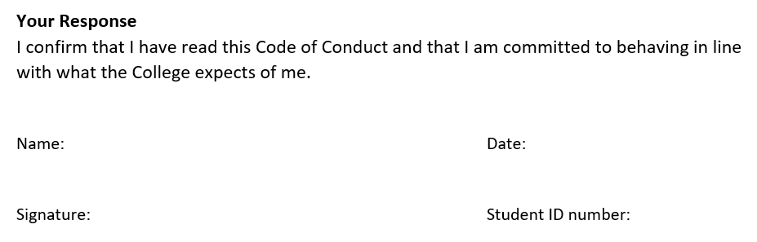
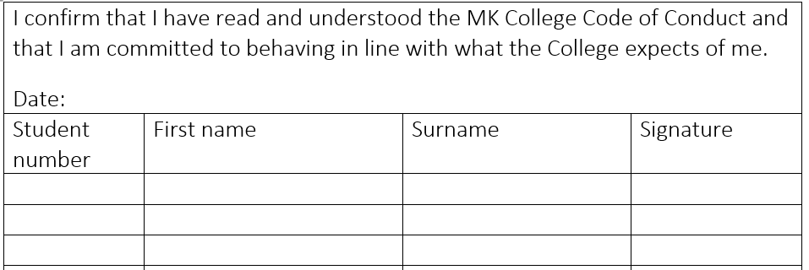

Slide 26

For more information about MK college, take a look at our website or download our app. https://www.mkcollege.ac.uk/about-us/ MyMKC app

Slide 27

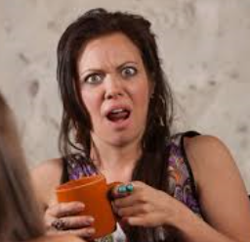
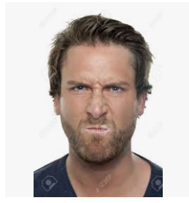
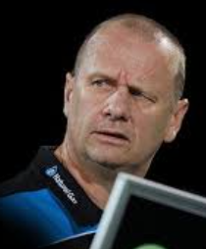
Diagnostic assessment
What!
We have just started and you are making us do a test!
Why?
Next week!

Slide 28
Why?
It is our job at Milton Keynes college to make sure you are on the right course and the right level.
We need to do this as soon as possible, we only have a two week window to move people around.
You have completed an assessment but that is just a starting point.

Slide 29
Why?
This diagnostic will give us an additional opportunity to assess your level.
This diagnostic will help you see where your weaknesses are so we can start to concentrate on those areas. (Target setting)
Your progress will be monitored throughout the course through exam style questions. This means that you know what your live assessment will look like from week 1.

Slide 30




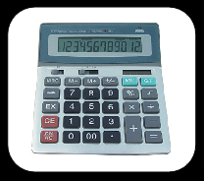
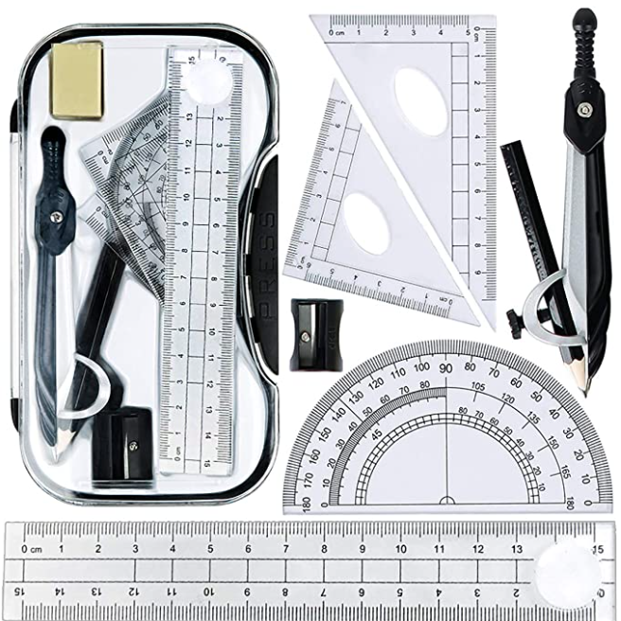


What you will need every week….
Calculator (not your phone)
Black pens
Pencil and rubber
Ruler
Highlighter
Maths set (optional)
IT equipment
Square / graph paper

