Slide 2
Using the slides
Simply display a photograph
Ask “Where is the Maths in that?”
Let the ideas flow!
Hidden slides have some suggestions
The suggestions are in no way exhaustive. They also range in complexity and so you may consider some to be beyond what you would like to use with your students. Use as many or as few as you wish.

Slide 3
Using the slides
Aim to show…
Maths is all around is
Maths is creative
Maths is not always about being right or wrong
Emphasise…
Nobody can be wrong
Just explain your thoughts
Going further…
Why not use your own or your students’ photographs?

Slide 4
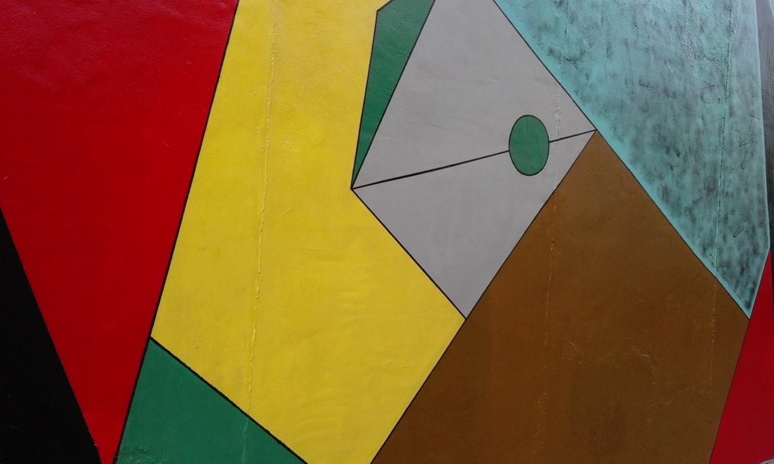
Where is the Maths in that?
Notes:
Photo taken by and property of Cath Moore – permission granted to use.

Slide 5
Suggestions
Name different shapes
Notice they fit together - why?
Different angles?
Minimum number of colours required
to colour the shapes in the picture so that no two adjacent shapes are the same colour.
Area - of the whole thing?
Can you find area of each shape?
Lesson idea: 4 colour map theorem https://www.youtube.com/watch?v=ANY7X-_wpNs
What do you notice? What do you wonder?

Slide 6
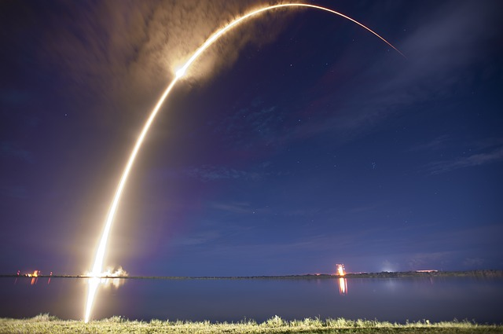
Where is the Maths in that?
Notes:
https://pixabay.com/photos/rocket-launch-night-trajectory-693239/

Slide 7
Suggestions
The picture is of a rocket launch
Speed
Trajectory
Orbits – ellipses? Circles?
Spheres, spherical geometry
Curve, parabola, quadratic..
Gravity…..forces….maths in space
Try https://www.mathscareers.org.uk/article/escape-velocities/
What do you notice? What do you wonder?

Slide 8

Where is the Maths in that?
Notes:
https://pixabay.com/photos/water-drop-liquid-splash-wet-1759703/

Slide 9
Suggestions
Symmetry
Circles
Formulae
Look at pattern in sizes
Ratio of radii of the increasing circles
Ratio of perimeters of the increasing circles
Ratio of areas of the increasing circles
How long will the ripples continue for?
Does how high the water drop from make a difference?
Reflection
Waves – wavelength, speed….
Surface tension
Try: Waves and ripples: maths applied on holiday
https://timreis.org/2017/08/04/522/
What do you notice? What do you wonder?

Slide 10

Where is the Maths in that?
Notes:
https://pixabay.com/photos/iphone-smartphone-apps-apple-inc-410311/

Slide 11
Suggestions
Coding
Statistics in design
The right size for your hand
Screen time data
Today
Last 7 days
Battery symbol – visual percentages
Lesson idea: Try https://soundcloud.com/uniofbath/maths-and-the-making-of-the-modern-world Public talks, lectures and workshops: https://people.bath.ac.uk/mascjb/
What do you notice? What do you wonder?

Slide 12
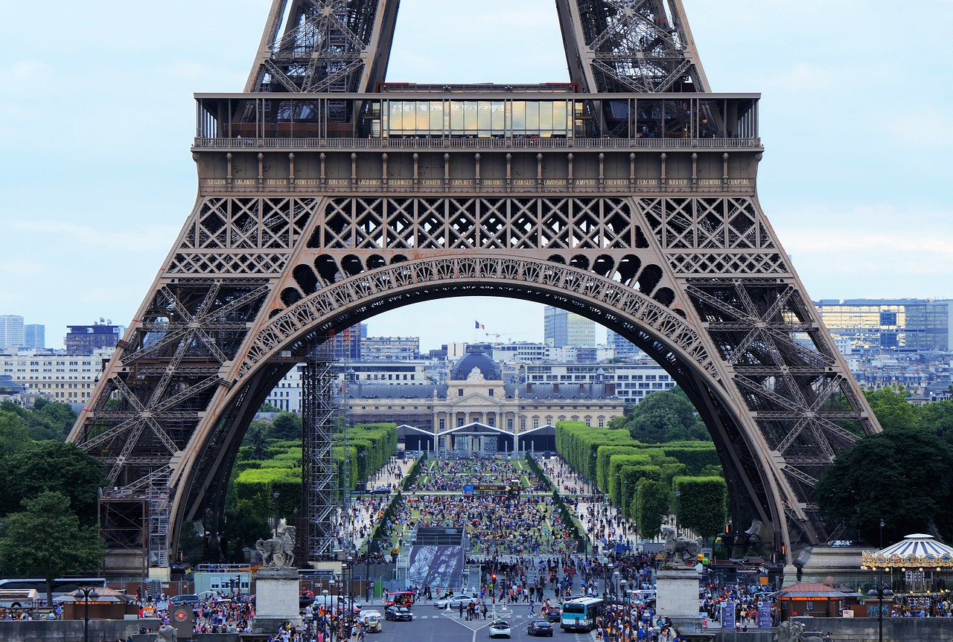
Where is the Maths in that?
Notes:
https://pixabay.com/photos/eiffel-tower-arch-tourism-crowd-4416700/ Image by Phil Riley from Pixabay

Slide 13
Suggestions
Shapes
Triangles? Semi Circles?
How many can you see?
Estimate
How many people are in the photograph?
Visit in a year…. a day……. an hour?
How much money taken in a year … a day……an hour?
Crowds
Density of people per m²
Flow (*Fluid Dynamics)
Look up Dr Aoife Hunt – Associate Director of Movement Strategies
What do you notice? What do you wonder?

Slide 14
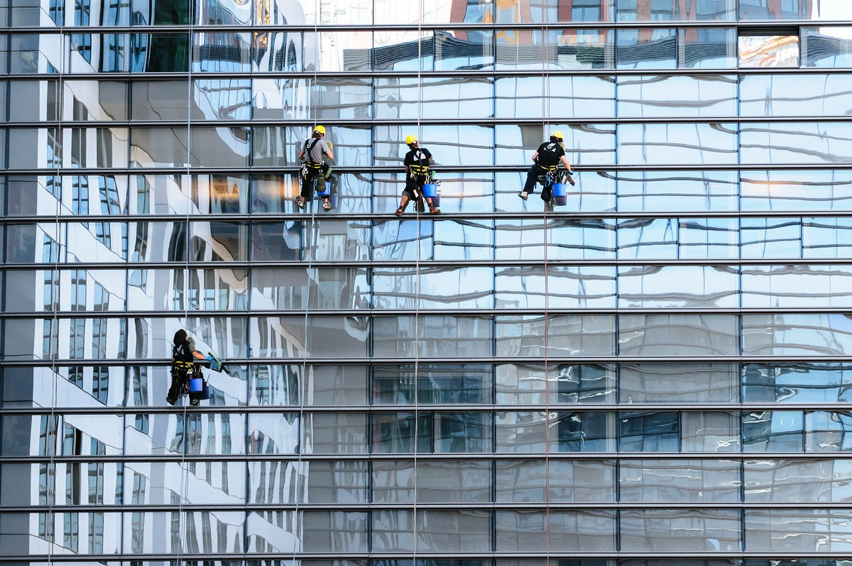
Where is the Maths in that?
Notes:
https://pixabay.com/photos/glass-facade-window-cleaner-facade-817732/ Image by Gerhard Bögner from Pixabay

Slide 15
Suggestions
Rectangles
Tessellation
Reflection
Translation
Amount of water needed?
Cost to clean?
How are the cleaners being held up?
Force
Tension
Mass
What do you notice? What do you wonder?

Slide 16

Where is the Maths in that?
Notes:
https://pixabay.com/en/curve-background-gradient-color-2822641/

Slide 17
Suggestions
Colours - RGB make up
Parabolas
Quadratics – What equations would create the pattern?
Could you draw this on GeoGebra? Desmos? etc..
Find the areas of each colour?
What do you notice? What do you wonder?

Slide 18
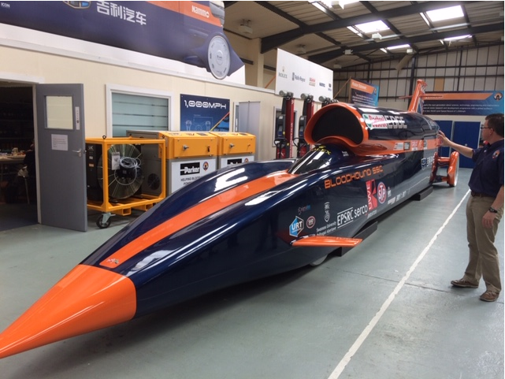
Where is the Maths in that?
Notes:
Photo taken by and property of Rachel Beddoes – permission granted to use
*You could replace this photo with one of Bloodhound with the new livery if you wish

Slide 19
Suggestions
Bloodhound SSC
World speed records? Compare….
Human
Animal
Land
Water
Air ………
How fast can it go? Mph? Different units?
Aerodynamics?
Cost of project?
What do you notice? What do you wonder?

Slide 20
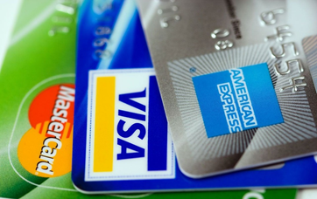
Where is the Maths in that?
Notes:
https://pixabay.com/en/american-express-cards-credit-89024/

Slide 21
Suggestions
What is credit? How does a credit card work?
Complete an example
Percentages? APR?
Security
How many combinations
Pin number (4 digits)
Security code (3 digits)
Encryption
Prime Numbers and cryptography
Try https://www.youtube.com/watch?v=56fa8Jz-FQQ
What do you notice? What do you wonder?

Slide 22

Where is the Maths in that?
Notes:
https://pixabay.com/illustrations/earth-protection-environment-globe-1987763/

Slide 23
Suggestions
Sphere
Volume
Surface area
Scale
To real size hands – diameter of earth?
To real size earth – length and width of hand?
Percentage of water?
What do you notice? What do you wonder?

Slide 24
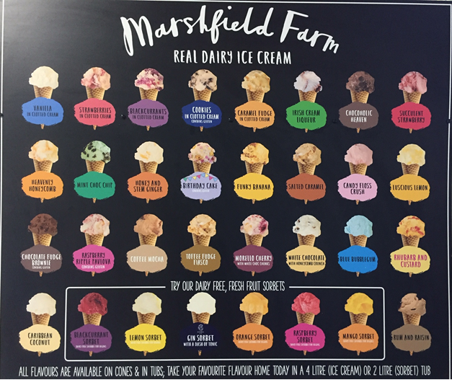
Where is the Maths in that?
Notes:
Photo taken by and property of Rachel Beddoes – permission to use

Slide 25
Suggestions
Cones – volume and net
Hemispheres
Combinations of flavours
Two scoops
Three scoops …..
Pricing structure
Sketch a graph of sales.. in a year?
Most popular flavours?
Do a class survey
Analyse results
What do you notice? What do you wonder?

Slide 26
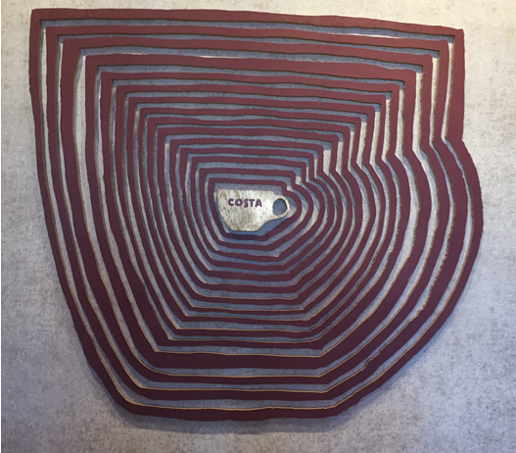
Where is the Maths in that?
Notes:
Photo taken by and property of Rachel Beddoes – permission to use

Slide 27
Suggestions
Enlargement
Scale factor in length, area, volume
Area
How many cups of coffee to fill the biggest cup compared to the original cup?
Cost of filling the biggest cup compared to the original cup?
Number of beans needed to fill the biggest cup compared to the original cup?
What do you notice? What do you wonder?

Slide 28
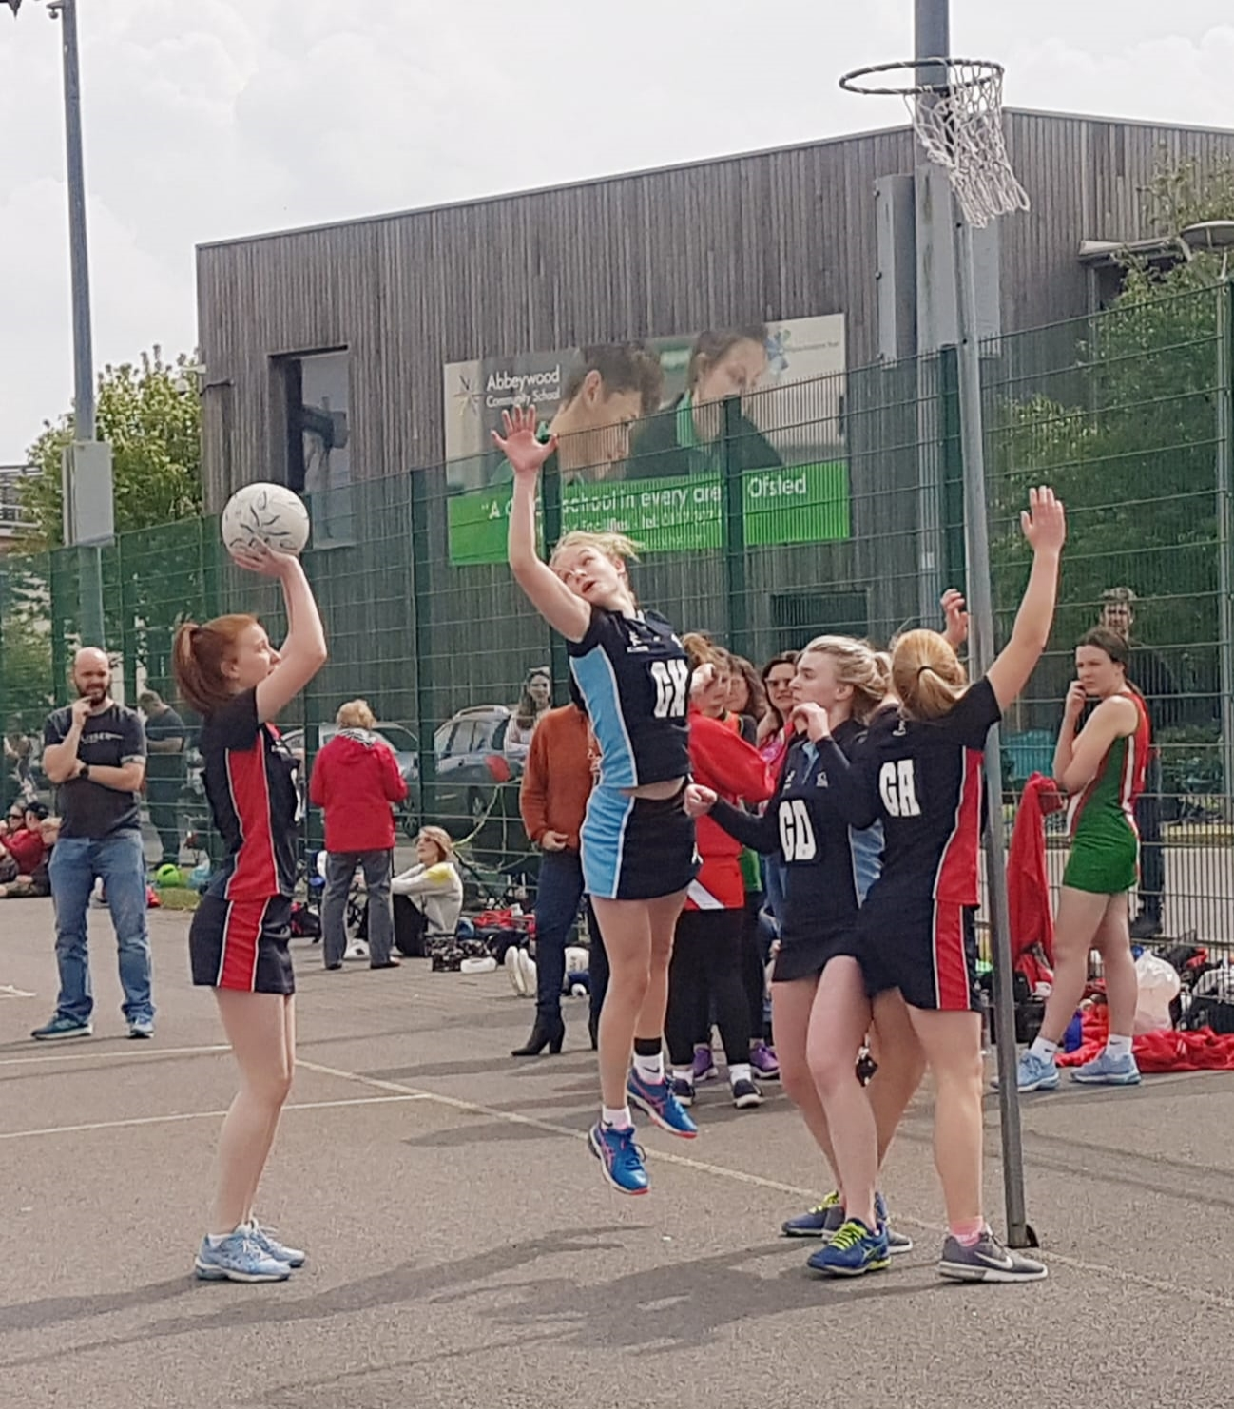
Where is the Maths in that?
Notes:
Photo property of Rachel Beddoes – permission to use granted

Slide 29
Suggestions
No of passes
No of routes to goal
Percentage of possession, passes made…
Projectiles
Parabolas
Modelling – what equation curve would fit to this?
Try: https://blog.mrmeyer.com/2016/updated-will-it-hit-the-hoop/
What do you notice? What do you wonder?

Slide 30
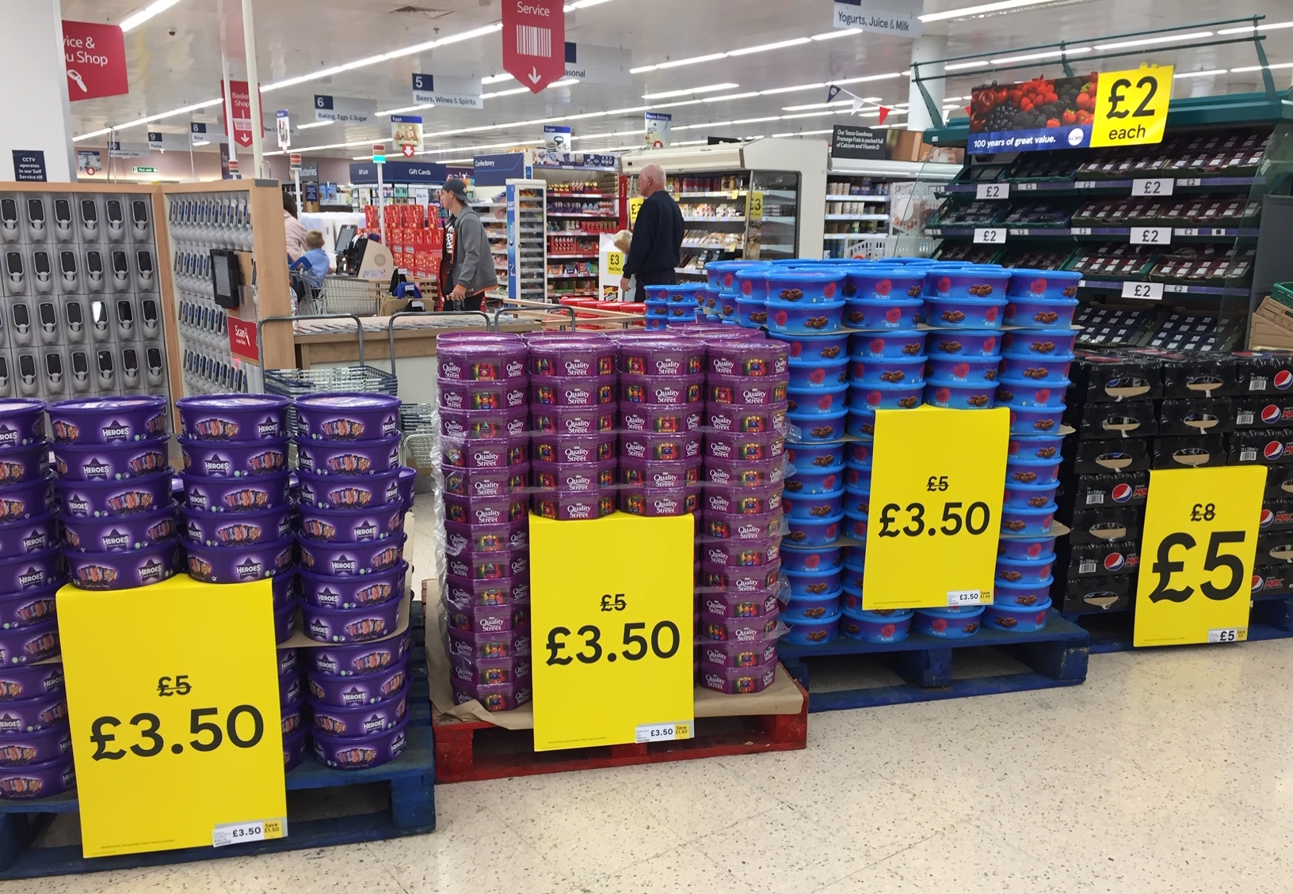
Where is the Maths in that?
Notes:
Photo taken by and property of Rachel Beddoes – permission to use

Slide 31
Suggestions
Estimation of…
No of tubs
Total cost of all goods on display
Total amount saved (with discount)
Per tub, per chocolate, per gram of chocolate?
No of sweets in a tub? All the tubs?
Amount of sugar on display
How much chocolate is eaten over the Christmas period?
Percentage discount
Ideas to develop further (poss into a lesson) on next 3 slides
What do you notice? What do you wonder?

Slide 32
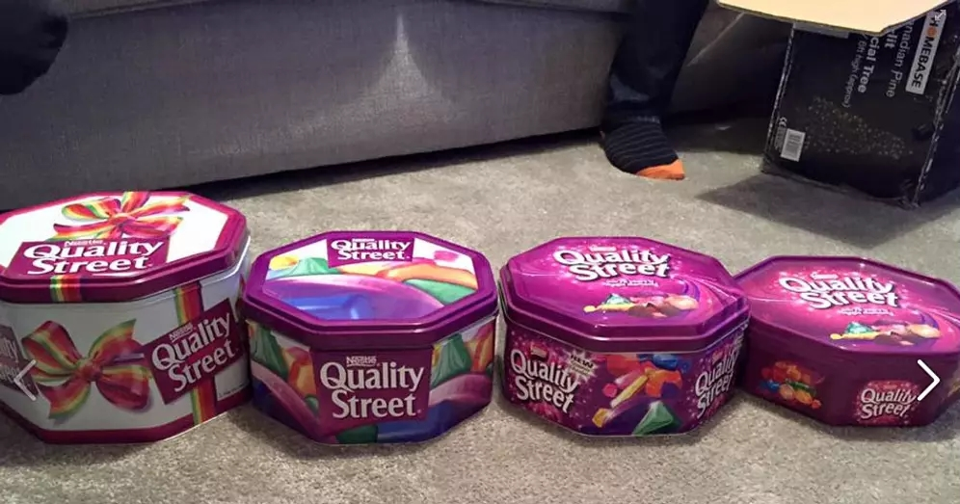
Making the Headlines!
How about ‘doing some maths’ on this data and turning it into a newspaper headline or story?
2015
780g
1985
1.7kg
2017
750g
2015
780g
2018
720g
2019
629g
Notes:
This is just an example you can use to a quick bit of maths to check their understanding of percentage change e.g size of tin shrunk by 54% or over 50% from 1985 – 2015. There is more data you can use on the following two slides and students could come up with their own investigations/presentations of the data.

Slide 33
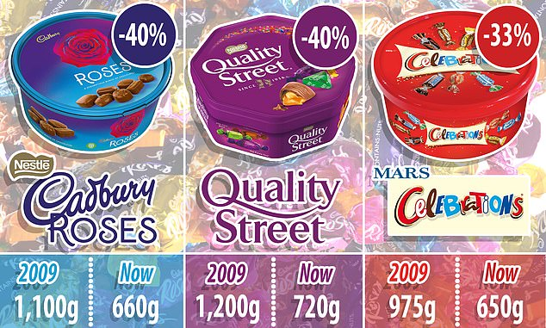
Quality Street, Celebrations and Roses tins shrink AGAIN: Size of Christmas favourites has fallen by 40 per cent in past decade despite price staying almost the same
PUBLISHED: 16:03, 9 December 2018
To read the article click on the date
2018
2018
2018
2019 – 620g
2019 – 629g
2019 – 650g
Continued on next slide
Notes:
https://www.dailymail.co.uk/news/article-6476653/Quality-Street-tins-shrink-Size-Christmas-favourites-fallen-40-cent-decade.html#i-1356ddd4149bfde

Slide 34
From Christmas 2017 to 2018 -The standard size tub of Quality Street has been reduced from 750g to 720g and Celebrations tins have shrunk from 680g to 650g.
The company said the equivalent was three sweets.
How many sweets have been lost between Christmas’ …
2018 to 2019?
2017 to 2019?
2015 to 2019?
1985 to 2019?
What other questions would you like to find the answers to?
How are you going to present your findings?

Slide 35
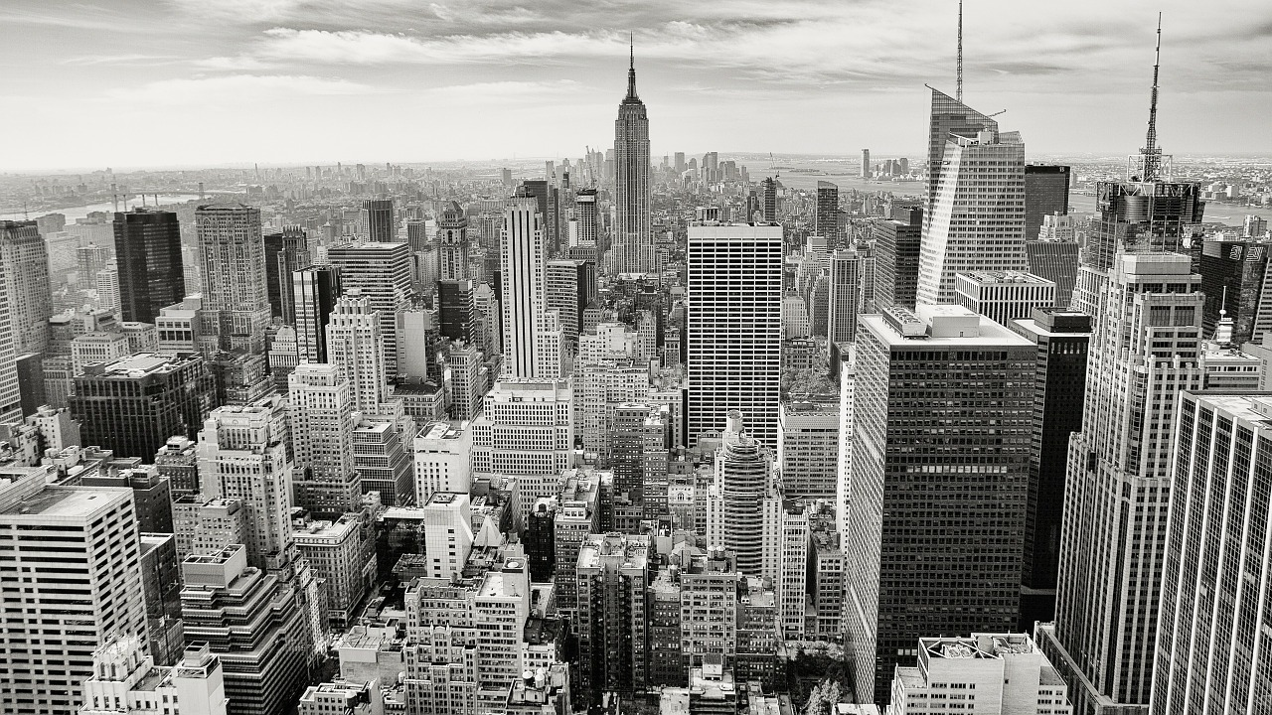
Where is the Maths in that?
Notes:
https://pixabay.com/photos/manhattan-empire-state-building-336708/

Slide 36
Suggestions
How many:
Buildings
rooms are there in the buildings you can see?
What is the height of the tallest building?
Estimate vs actual? In non-standard units e.g.buses?
How many people work in these buildings?
What area do the buildings cover?
How long do you think it would have taken to build all of them?
What do you notice? What do you wonder?

Slide 37
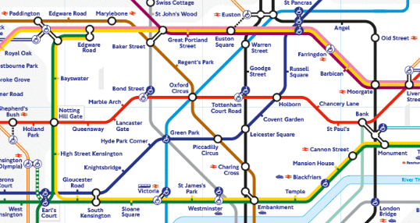
Where is the Maths in that?
Notes:
https://www.flickr.com/photos/anniemole/5574625240
Usage rights: free to use or share

Slide 38
Suggestions
Scale
How many routes from A to B?
Can you get from A to B without changing trains?
What is the quickest way from A to B?
What do you notice? What do you wonder?

Slide 39
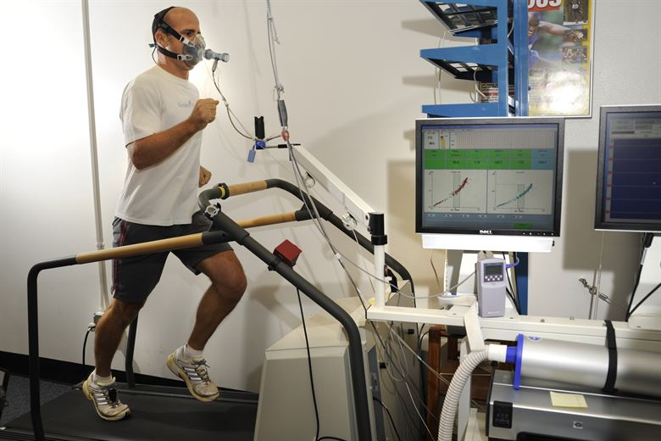
Where is the Maths in that?
Notes:
https://images.app.goo.gl/VL7Ab5QFnyeukmi97
Usage rights: Free to use, modify or share freely

Slide 40
Suggestions
Using data to measure fitness, improve performance
Units
Graphs
Average heart rate, oxygen levels – compare levels of athletes
Steps per day – how far do you travel on 10,000 steps?
What do you notice? What do you wonder?

Slide 41
About the AMSP
A government-funded initiative, managed by MEI, providing national support for teachers and students in all state-funded schools and colleges in England.
It aims to increase participation in AS/A level Mathematics and Further Mathematics, and Core Maths, and improve the teaching of these qualifications.
Additional support is given to those in priority areas to boost social mobility so that, whatever their gender, background or location, students can choose their best maths pathway post-16, and have access to high quality maths teaching.

Slide 42




Contact the AMSP
01225 716 492
admin@amsp.org.uk
amsp.org.uk
Advanced_Maths

