Slide 1
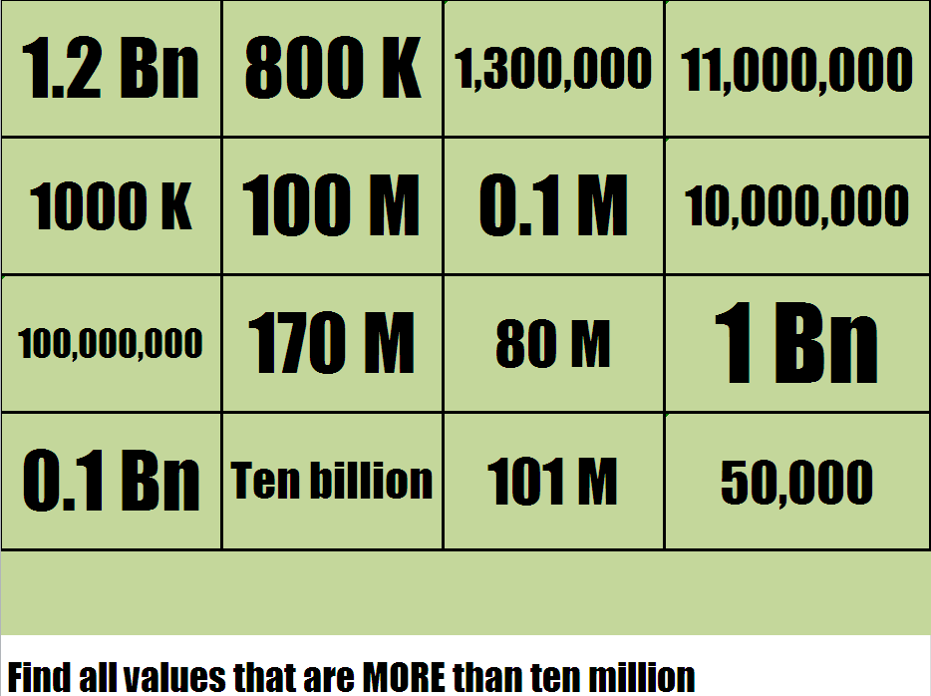
GAME 1 – LEVEL ONE

Slide 2
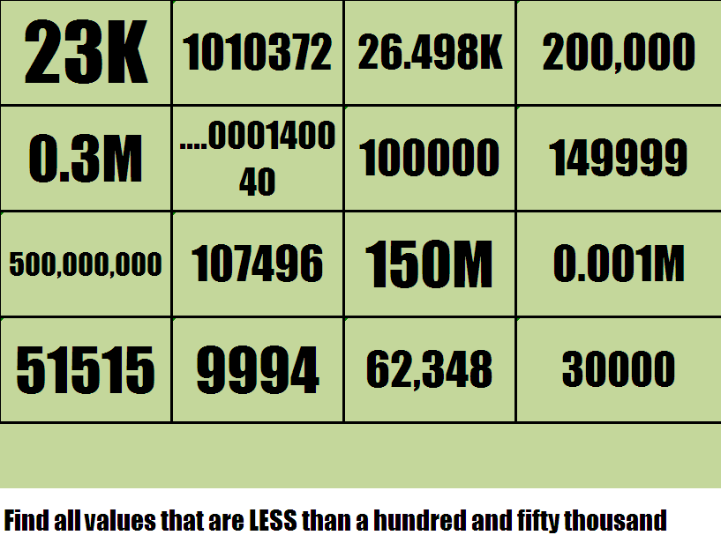
GAME 2 – LEVEL ONE

Slide 3
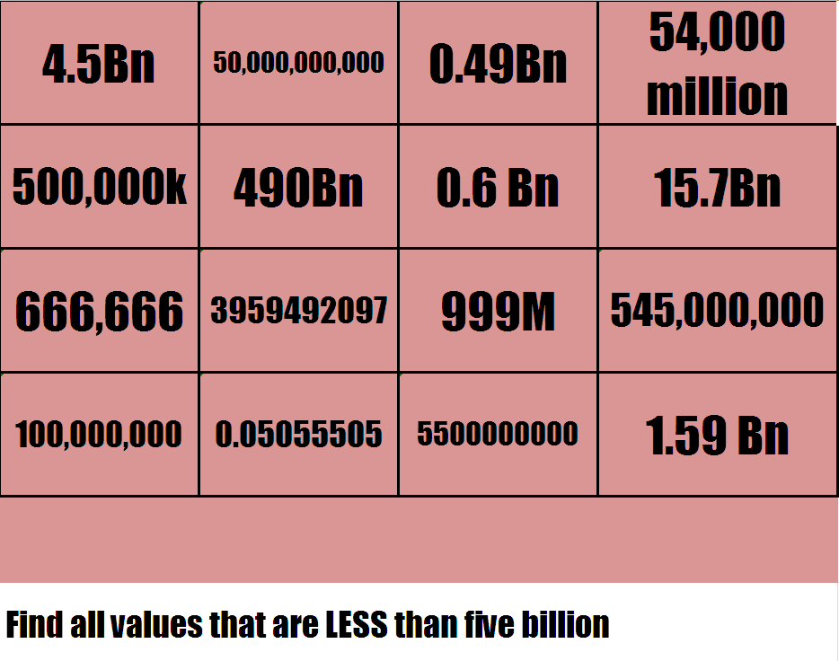
GAME 1 – LEVEL TWO

Slide 4
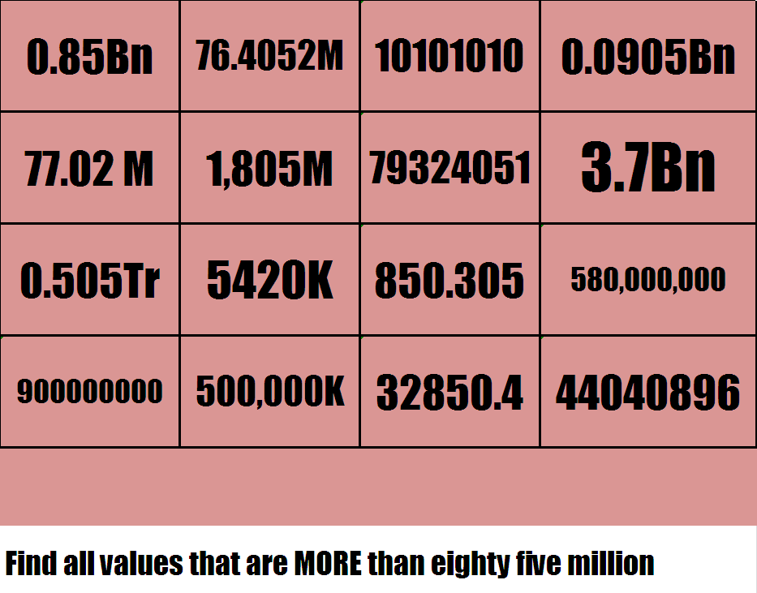
GAME 2 – LEVEL TWO

Slide 5
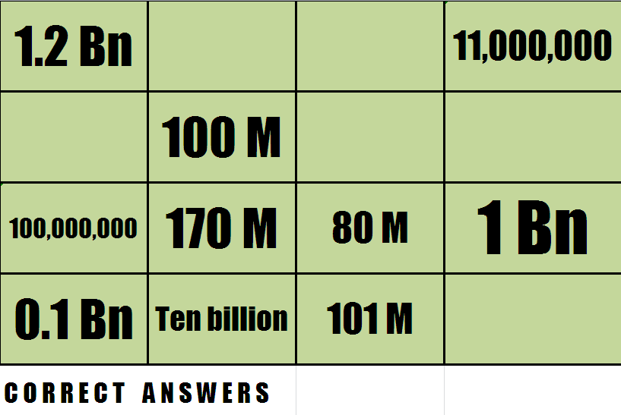
GAME 1 – LEVEL ONE

Slide 6
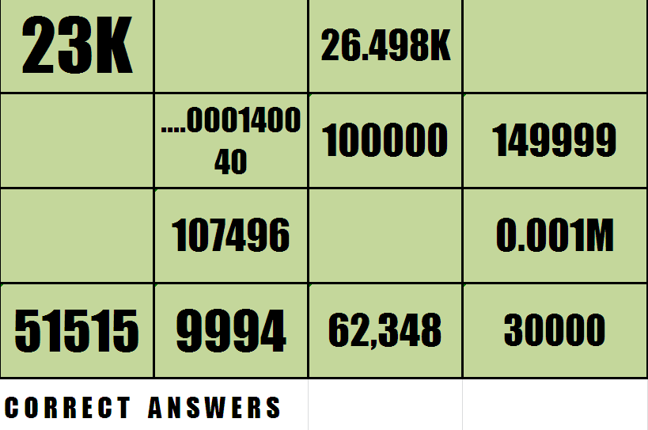
GAME 2 – LEVEL ONE

Slide 7
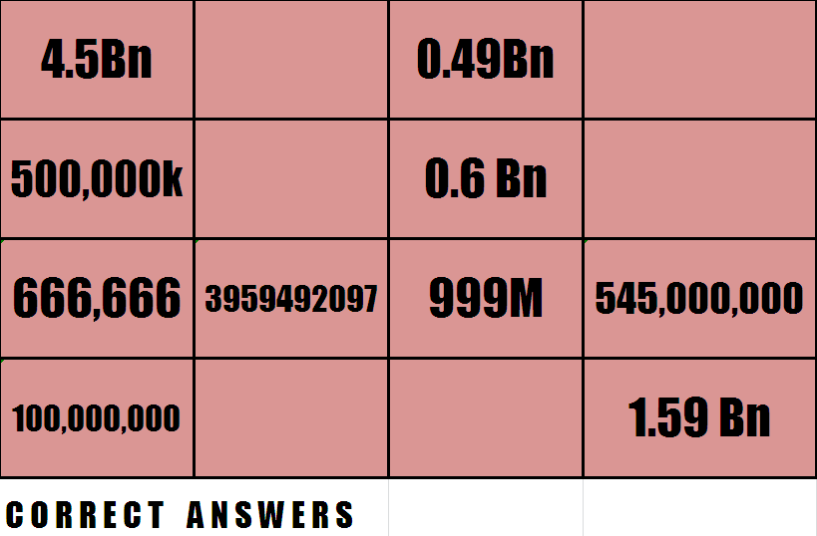
GAME 1 – LEVEL TWO

Slide 8
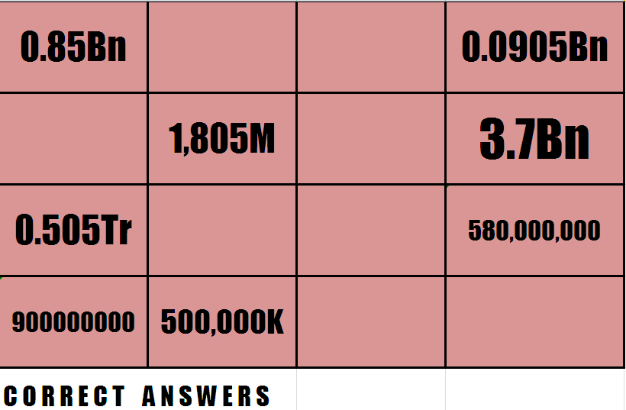
GAME 2 – LEVEL TWO

