Slide 1
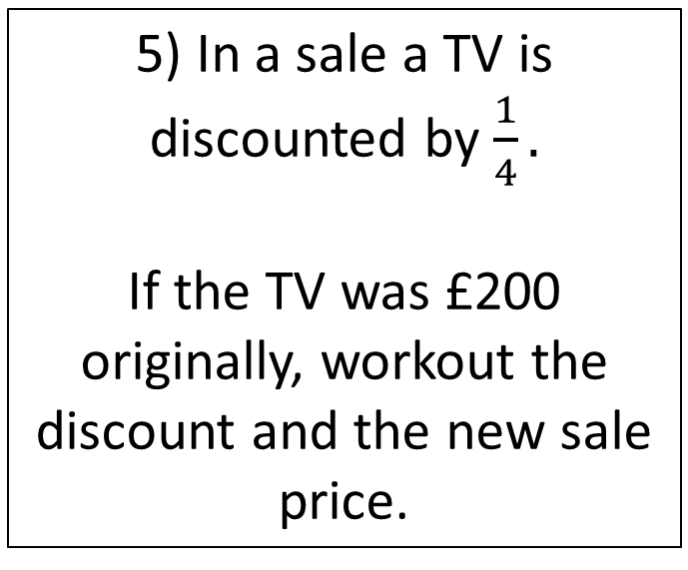
Starter
1) Workout 9² + 3²
4) 15 - 24 ÷ 3
5) In a sale a TV is discounted by $\frac{1}{4}.$
If the TV was £200 originally, workout the discount and the new sale price.
2) Write 16.99 correct to 1 decimal place
3) Share £85 in the ratio 2:3

Slide 2
DECIMALS
Learning Objectives
To be able to :
Order and compare decimals up to three decimal places
Add, subtract, multiply and divide decimals up to two decimal places.

Slide 3
Order and compare decimals
Write the following numbers in order of size. Start with the smallest number.
0.2, 0.221, 0.21, 0.202, 0.211
Put the correct inequality sign in between the decimals.
3.1 3.3
0.8 0.81
0.153 0.2
0.8 0.79

Slide 4
Your turn…
Arrange the numbers in order of size, starting with the smallest.
4.11 4.1 4.0 4.011 4.001
7.06 70.06 7.606 77.06 7.066
9.08 9.16 9.12 9.09 9.999
0.8 1.8 1 1.1 1.008
2.47 2.407 2.04 27.4 2.740
Write the correct sign > or < in each box
1.1 1.3
9.4 9.14
3.653 3.7
6.1 6.09
3) Five boys take part in a long jump competition
5.31m 5.08m 5.1m 5.093m 5.51m
a) Write down the distance of the longest jump
b) Put the jumps in order, starting with the shortest

Slide 5
Add and subtract decimals
Nella buys a gift which costs £38.20 She pays with 2 x £20 note.
How much change does she receive?
1) 24.13 + 11.49
2) 12.7 – 6.8

Slide 6
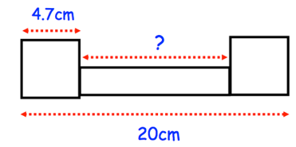
Your turn…
1) a) 14.94 + 4.79
b) 12.49 +15.56 + 11.6
c) Add together 4.8, 8.113, 3.438
1) Bella had £20 with her when she went shopping. She bought
4 pens at £1.75 each
1 ruler at £0.50
1 pack of 10 coloring pens at £3.50
How much money did she have left after she bought these goods?
2) Two identical squares and a rectangle are drawn below
Find the length of the rectangle.

Slide 7
Multiply and divide decimals
A recipe for boiling pasta recommends using 1.5 litres of water per 200g of pasta. How many litres of water is needed to make 1kg of pasta?
Tam paid £436.80 for electricity in a year. He paid in twelve equal monthly instalments. How much did he pay for electric each month?

Slide 8
Your turn…
3) Chloe is painting a wall in her house. The paint she’s using costs £5.20 per litre. The wall will need 5 litres of paint.
Work out the total cost of paint
1) Four friends shared the cost of a meal. The bill came to £98.20.
How much did they each pay?
2) A shop sells cans of drink for 92p each. Thomas buys seven cans and pays for them with a £10 note.
What change should he get?

Slide 9

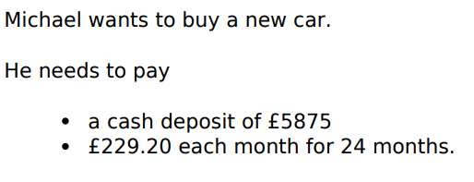
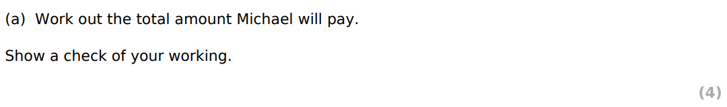
July 2018

Slide 10

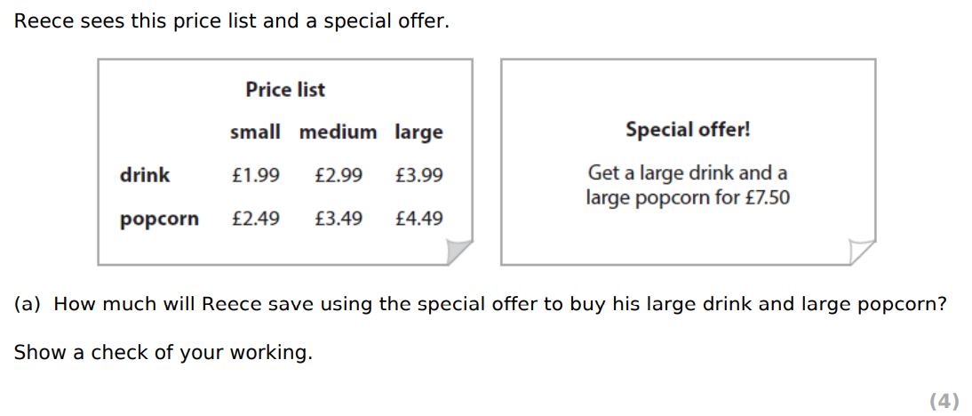
Mar 2018

Slide 11
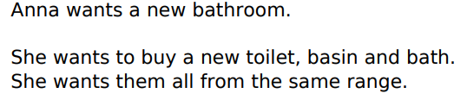
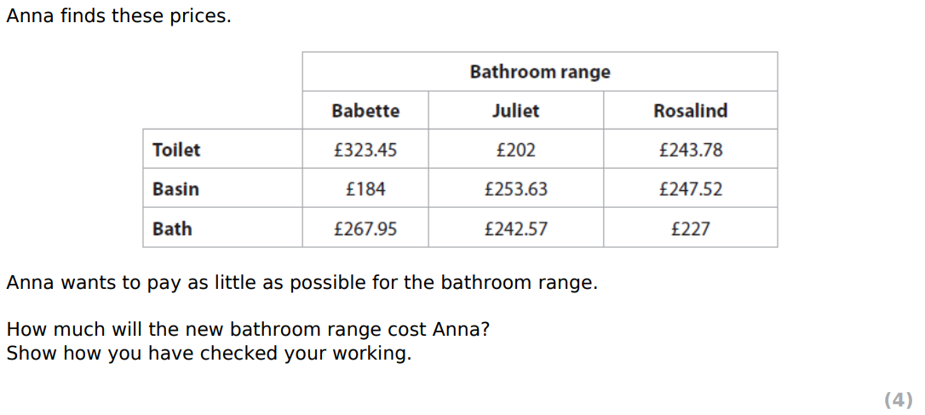
July 2015

