Slide 1
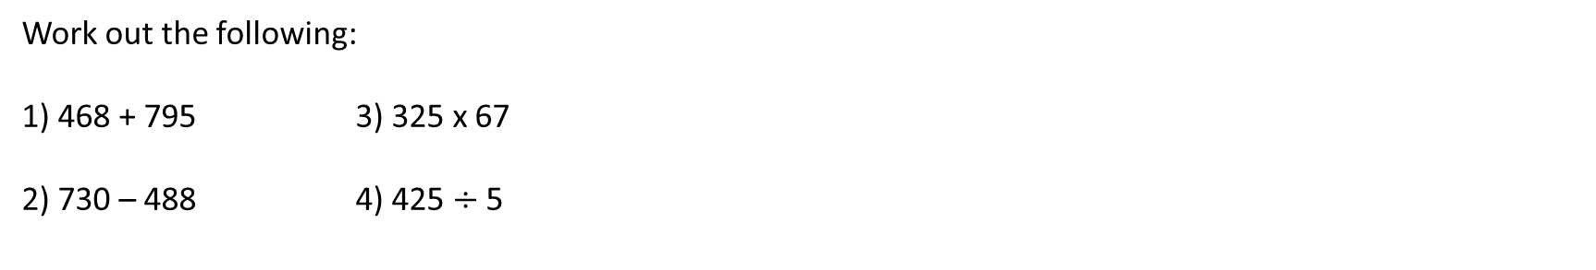
INTRODUCTION TO NUMBER
Learning Objectives
To be able to :
Identify factors and multiples of two or more numbers
Round numbers to 1, 2 and 3 decimal places
Round numbers to 1, 2 and 3 significant figures
Use standard units of mass, length, time, money and other measures (including standard compound measures) using decimal quantities where appropriate
Work out the following:
1) 468 + 795 3) 325 x 67
2) 730 – 488 4) 425 $÷$ 5

Slide 2

STARTER
Factor
BIDMAS
1a) Write down all the factors of 16
1b) Find the highest common factor of 16 and 30
4a) Work out 2 + 3 x 4 – 4
4b) Work out 1 – 5 + 5 x (3 + 5)
Multiple
Prime
2a) Write down the first 5 multiples of 3
2b) Find the lowest common multiple of 3 and 12
5a) Write down the first 3 prime numbers
5b) Write 36 as a product of its prime factors
Rounding
Converting Units
3a) Round 2.3473 to 2 decimal places
3b) Round 356.34 to 3 significant figures
6a) Convert 3 metres into centimetres 6b) Convert 350 millilitres into litres
Notes:
To check understanding of topics being covered in the lesson. Some classes will know how to do majority of these, therefore you can skip some bits out and spend time on what your students need help with the most. ------ TARGET OPPORTUNITY

Slide 3
Prime Numbers/Prime Factorisation
List all the prime numbers less than 20.
Express 42 as a product of its prime factors.

Slide 4
Your turn…
Here is a list of numbers
10 11 16 24 30 40
Write down a multiple of 20
Write down a factor of 12
Write down a prime number
Express 100 as a product of its prime factors.
Express 75 as a product of its prime factors.
Express 108 as a product of its prime factors. Give your answer in index form.
2) Here is a list of numbers
16 17 18 20 22 24 29
Write down the prime numbers
Write down a factor of 30
Write down an even multiple of 3

Slide 5
LCM and HCF
Find the LCM of 12 and 8.
Find the HCF of 32 and 56.

Slide 6
Your turn…
Find the LCM of the following:
4 and 5
8 and 12
6 and 9
12 and 15
5, 8 and 10
4, 7 and 9
Find the HCF of the following:
18 and 28
16 and 40
42 and 90
40 and 63
20, 64 and 108
54, 90 and 162
20
2
24
8
18
6
60
1
40
4
252
18

Slide 7
Rounding to Decimal Places
1 d.p
2 d.p
3 d.p
2 . 6 3 8 5 3
2 . 6 3 8 5 3
2 . 6 3 8 5 3

Slide 8
Rounding to Significant Figures
1 s.f
2 s.f
3 s.f
2 . 6 3 8 5 3
0 . 4 6 8 5 3
8 . 6 5 4 5 3

Slide 9
Your turn…
Complete the table below:
Number | 2d.p. | 2s.f | 1d.p. | 1s.f
623.819
0.214
0.04383
346.965
6438.846

Slide 10
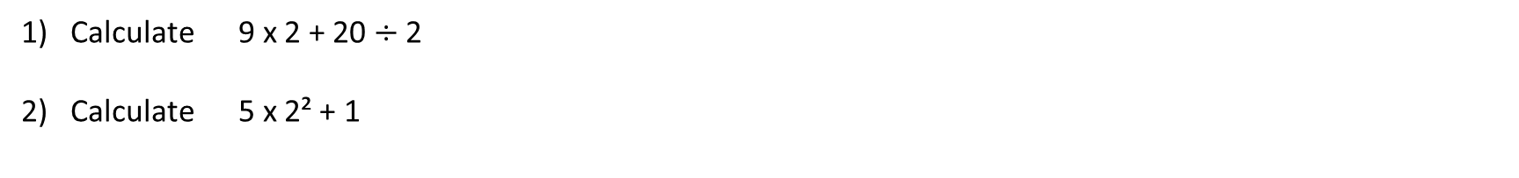
BIDMAS
What does BIDMAS stand for?
Calculate 9 x 2 + 20 $÷$ 2
Calculate 5 x 2² + 1

Slide 11
Your turn…
16 – 5 x 2
10 – 3²
8 + 3(5 – 1)
2³ + 3²
(2 + 5)²
Joey thinks the answer to 16 + 4 x 2 is 40. Albert thinks the answer to 16 + 4 x 2 is 24. Who is correct? Explain your answer.
Put brackets in the following statements to make them true.
6 x 7 + 3 − 8 = 52
4 + 3 x 7 − 1 = 42

Slide 12
Converting Units
m
ml
1 km =
1 m =
1 cm =
1000
100
10
1 litre =
1000
cm
1000
1 kg =
g
mm
Convert 2km into m.
Convert 500g into kg.

Slide 13
Your turn…
Convert 2cm into mm.
Convert 70cm into m.
Convent 6400m into km.
Convert 1.5kg into g.
Convert 1035ml into l.
Convert 4km into cm.
Jack is 1.36 metres tall. His friend Ian is 5 centimetres taller than Jack. What height is Ian? Give your answer in metres.
Mary runs 600m every day. Work out how far Mary runs in one week. Give your answer in kilometres.
James and Gareth buy a 3 litre carton of orange juice. Each boy drinks 650 ml of orange juice. How much orange juice is left? Give your answer in litres.

Slide 14

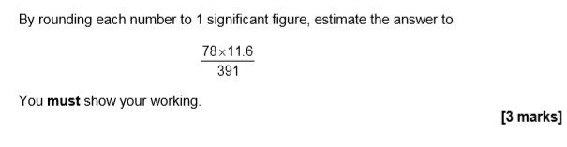
Set 3 paper 1

Slide 15
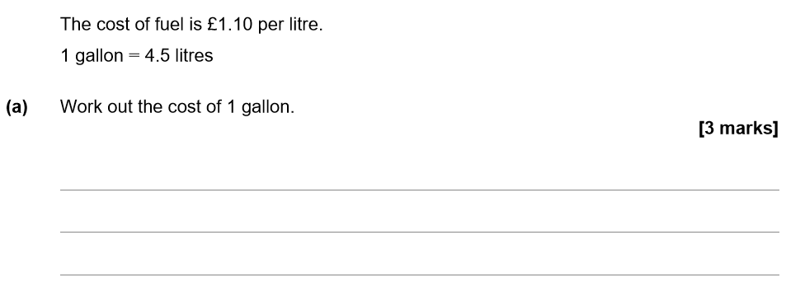
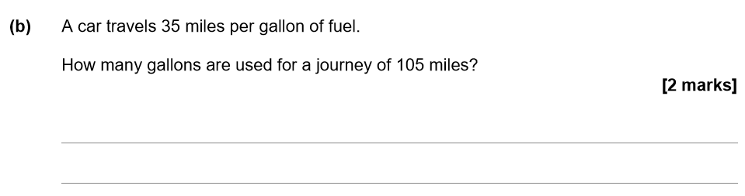
Set 4 paper 1

