Slide 1
Starter
Find the area of this trapezium:
3) a) Write 0.032 in standard form.
b) Write 2.8 x 10³ as an ordinary number.
6cm
5cm
4) A shape has an exterior angle of 30 degrees. How many sides does it have?
10cm
2) There are 7 balls in a bag. 3 are blue, the rest are yellow. What’s the probability of getting a yellow?
5) Explain what volume is.

Slide 2
Pythagoras’ Theorem
Learning Objectives
To be able to :
To be able to know and use the formula for Pythagoras’ Theorem
This is a sequence:
-4, 3, 10, 17….
Find the next term.
Find the nth term of the sequence.
Find the 20th term of the sequence.

Slide 3



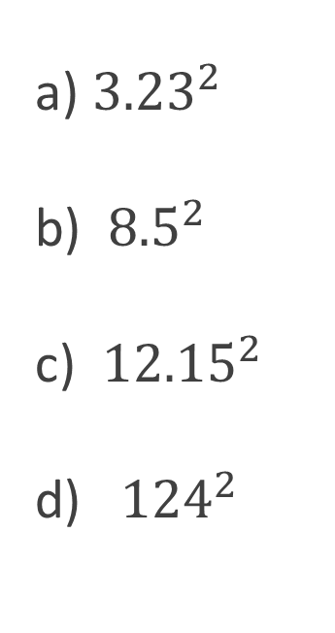

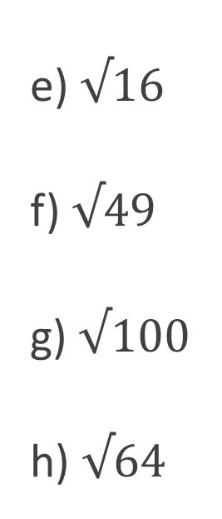
Recap…
Work out each of the following:
a) $3^{2}$
b) ${ 8}^{2}$
c) ${ 12}^{2}$
d)${ 21}^{2}$
Work out each of the following:
e) $√16$
f) $√49$
g) $√100$
h) $√64$
a) ${3.23}^{2}$
b) ${ 8.5}^{2}$
c) ${ 12.15}^{2}$
d) ${ 124}^{2}$
e) $√20$
f) $√87$
g) $√29.14$
h) $√56$
4
7
10
8
10.4329
72.25
147.6225
15376
4.5
9.3
5.4
7.5
9
64
144
441

Slide 4




FINDING THE LONGEST SIDE
$x cm$
$x cm$
$x cm$
$x cm$
12cm
15cm
9cm
27cm

Slide 5
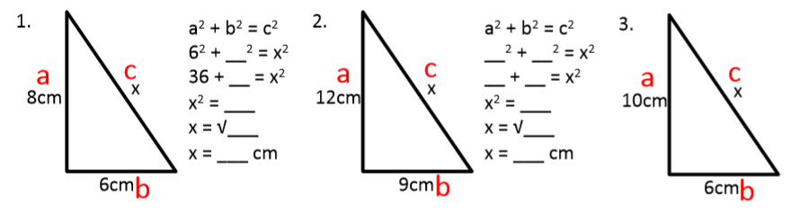
Your turn…

Slide 6
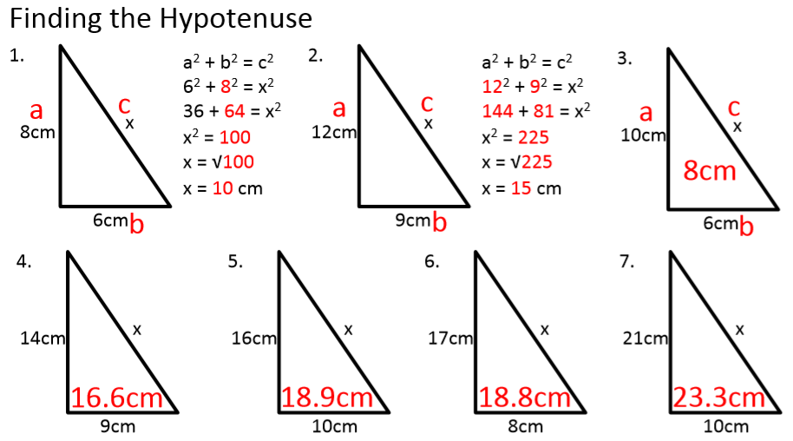
11.7cm

Slide 7

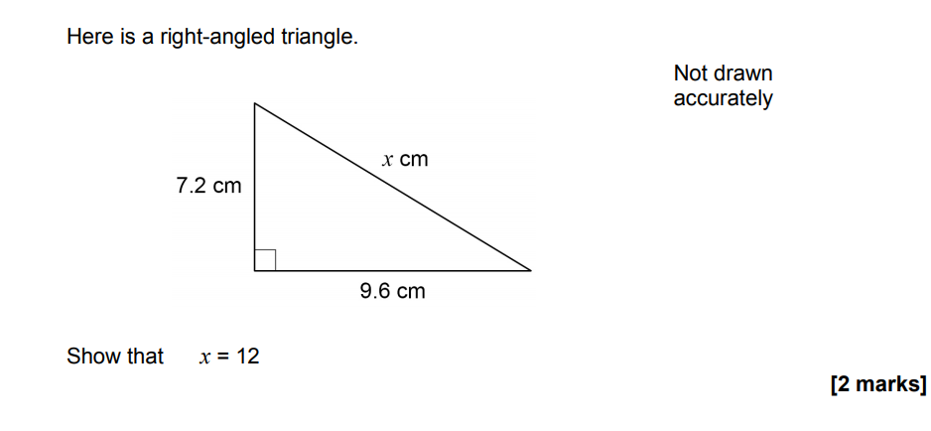
November 2018 Paper 2

Slide 8
FINDING A SHORTER SIDE
13cm
25cm
$x cm$
$x cm$
5cm
20cm
x cm
x cm

Slide 9
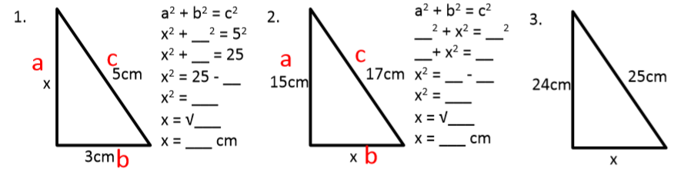
Your turn…

Slide 10
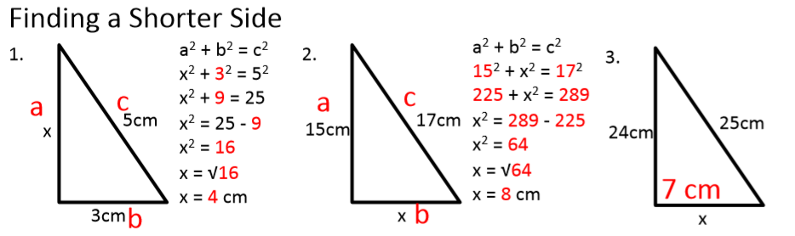

Slide 11
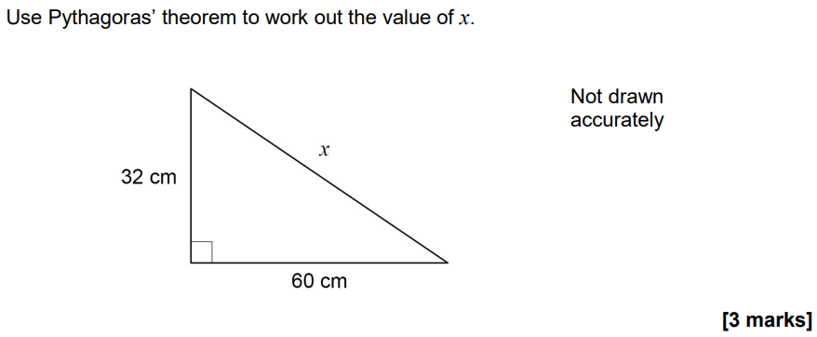
November 2020 Paper 3

Slide 12
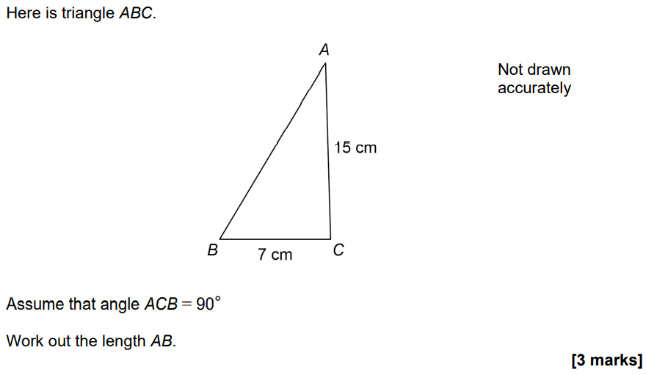
November 2021 Paper 2

Slide 13
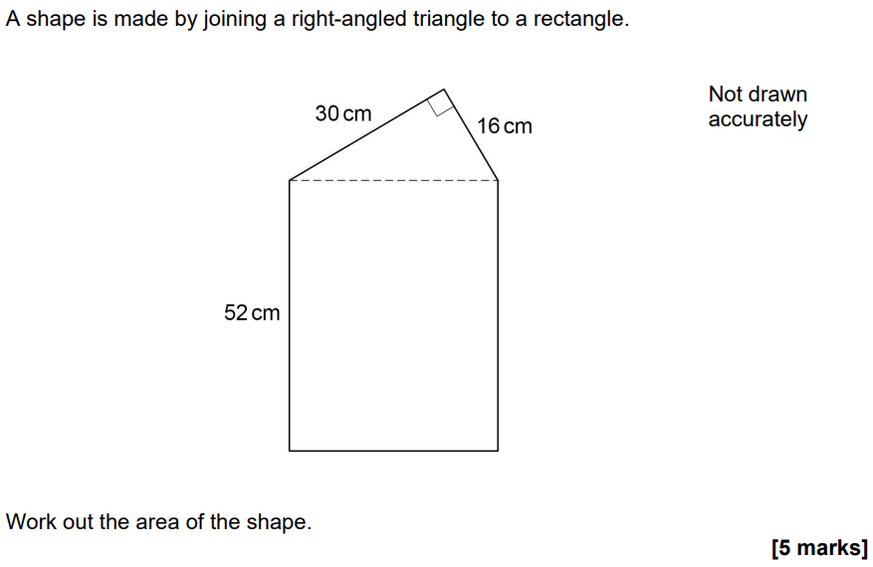
June 2022 Paper 2

