Slide 1
Charts & Graphs
Learning Objectives
To be able to:
Interpret and construct tables, charts and diagrams
Recognise correlation
A bus travels 222 miles in 6 hours. What was the average speed of the bus?
2. Thomas drives at an average speed of 40 mph for 1 hour 30 minutes. Work out the distance he travels.

Slide 2

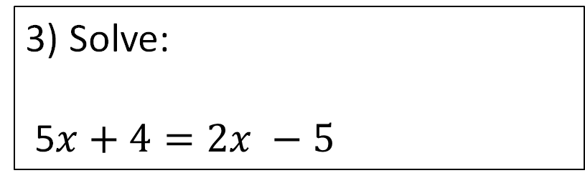
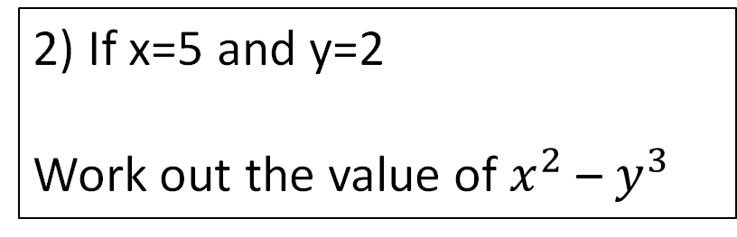

Starter
10 mins
1) Find 17% of 90
5) Find the volume of this shape, where the ends are square shaped:
2) If x=5 and y=2
Work out the value of $x^{2}$ – $y^{3}$
14cm
3) Solve:
5$x+4=2x −5$
8cm
4) Work out $\frac{6}{7}$ - $\frac{1}{3}$

Slide 3
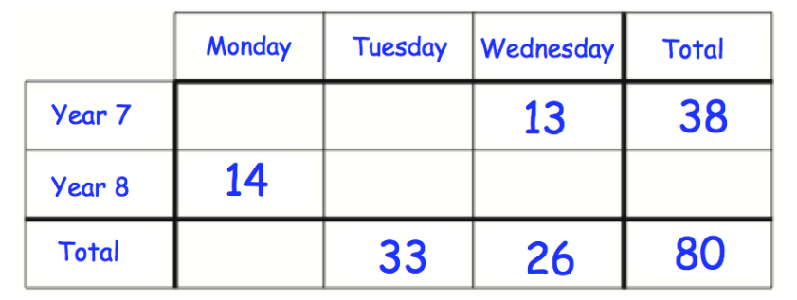
Two Way Tables
80 students visited the library over three days.
The two-way table shows some information about these students.
Complete the two-way table.
One of these students is picked at random to win a prize.
Write down the probability that the student is in Year 7.

Slide 4
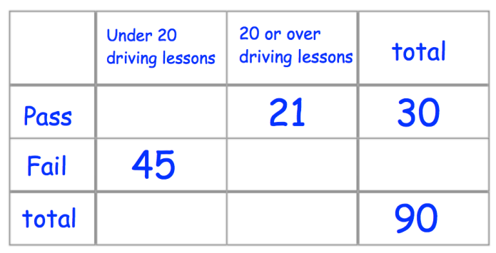
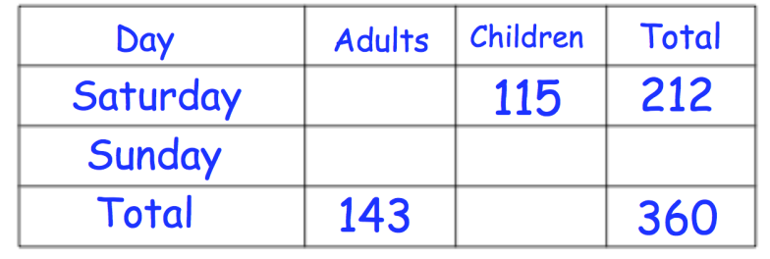
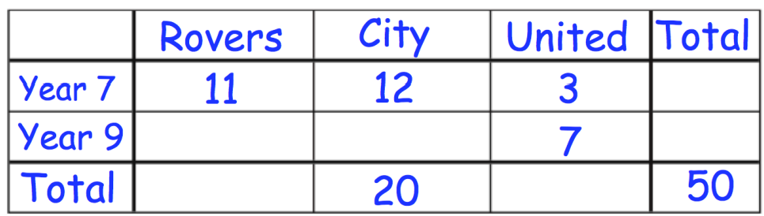
Your turn…
Fill in the missing values on these two way tables.
9
97
15
60
46
102
148
54
36
217
Complete this two way table.
How many people who had 20 or over driving
lessons didn’t pass their driving test?
(c) What fraction of people failed their driving test?
(d) Alfie says having “20 or over driving
lessons helps you pass your driving test.”
Explain why Alfie is correct.
15
60/90 = 2/3
26
9
8
24
20
10
21 people passed, whereas only 9 passed with under 20 driving lessons.

Slide 5

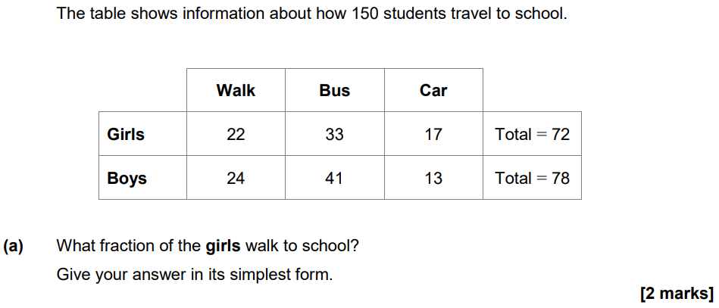
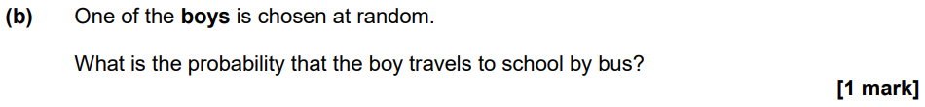
November 2020 Paper 1

Slide 6
Pie Charts
Draw a pie chart to show the favourite colour of 60 year 7 pupils.
Colour | Frequency
Red | 17
Green | 8
Blue | 21
Yellow | 3
Other | 11
Total | 60

Slide 7
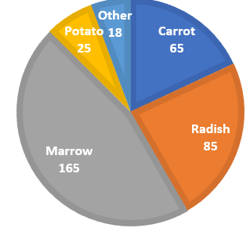
Your turn…
Draw a pie chart representing this data:
Vegetable | Frequency
Carrot | 13
Radish | 17
Marrow | 33
Potato | 5
Other | 4
Total | 72
On a pie chart representing people’s favourite colours, red is represented by 30˚. 5 people said red was their favourite colour.
How many people were asked in total?
Blue on the pie chart is 60˚. Write down the probability that someone selected at random has blue as a favourite colour.
60
1/6

Slide 8
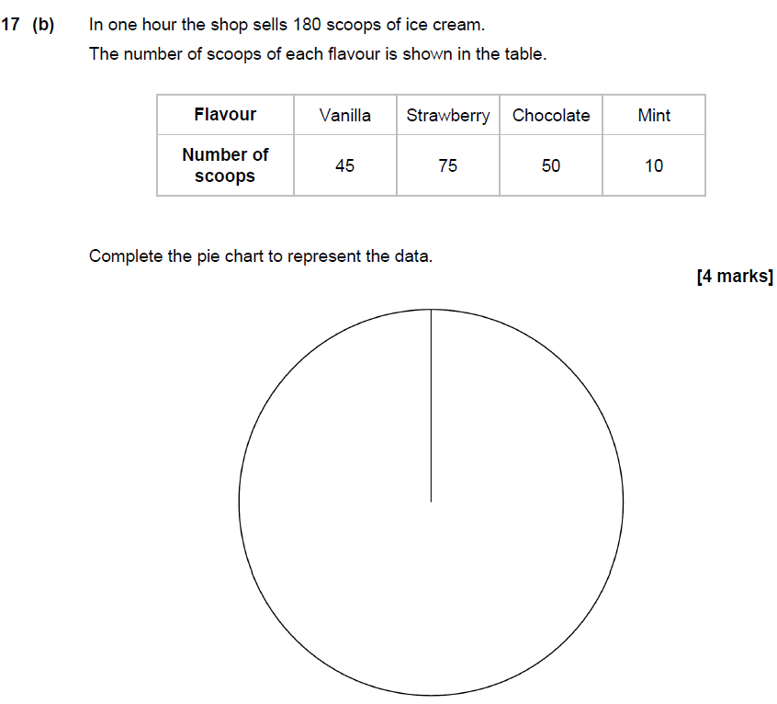
June 2019 Paper 3

Slide 9
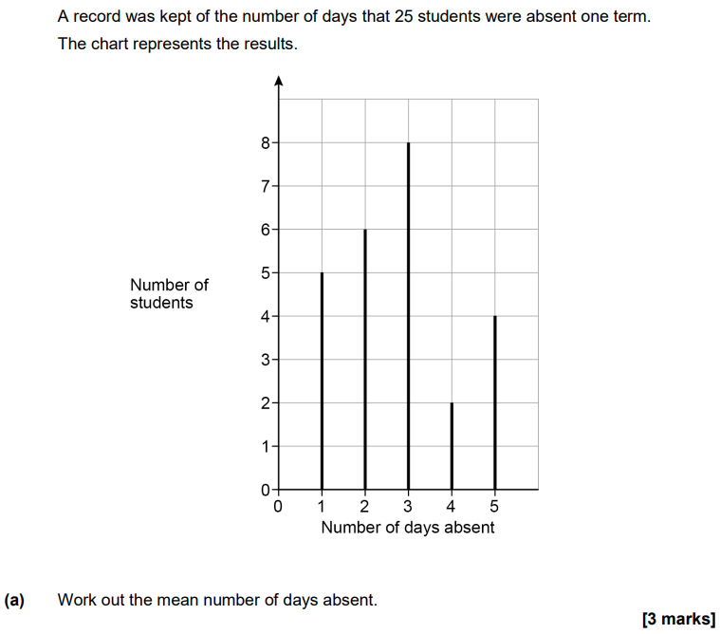

Vertical Line Diagram

Slide 10
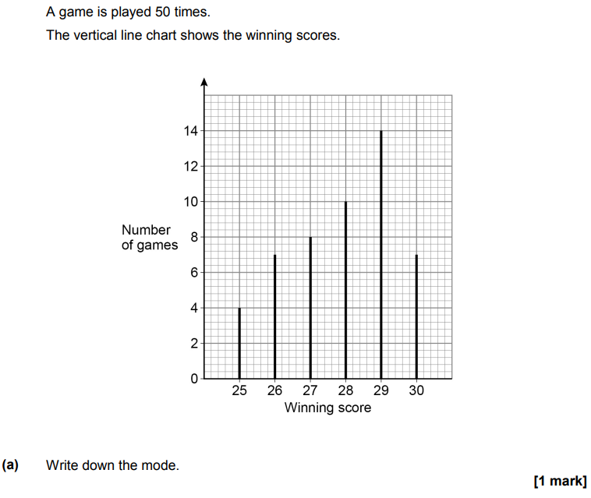
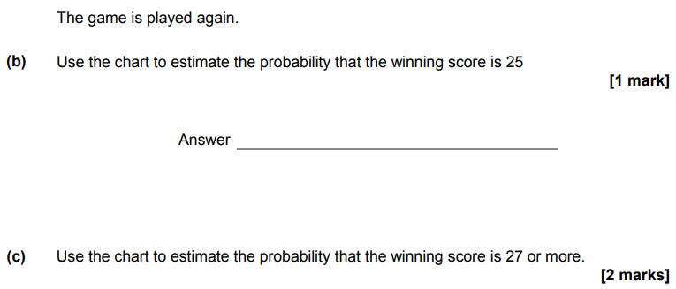
Your turn…

Slide 11
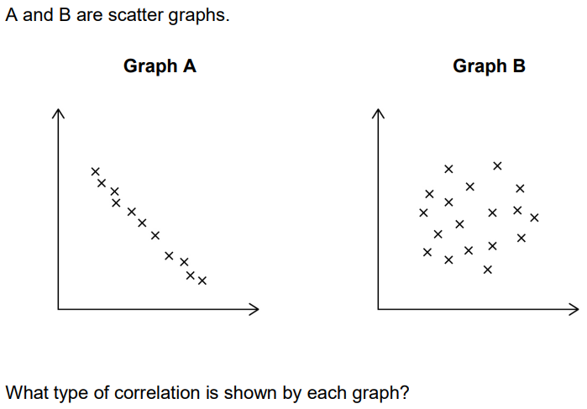
Scatter Graphs – Describe the Correlation

Slide 12
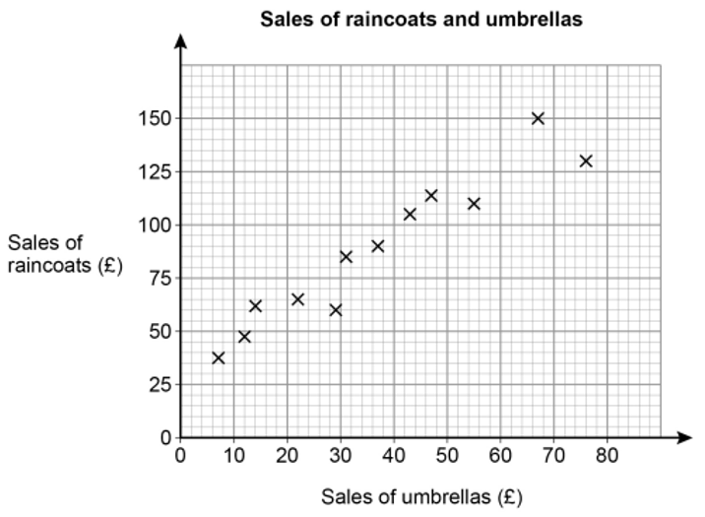
Your turn…
A shop sells raincoats and umbrellas.
The scatter graph shows the monthly sales for 12 months.
Write down the type of correlation shown by the graph.
The manager expects the sales of umbrellas next month to be £60. Draw a line of best fit to estimate the sales of raincoats next month.

Slide 13
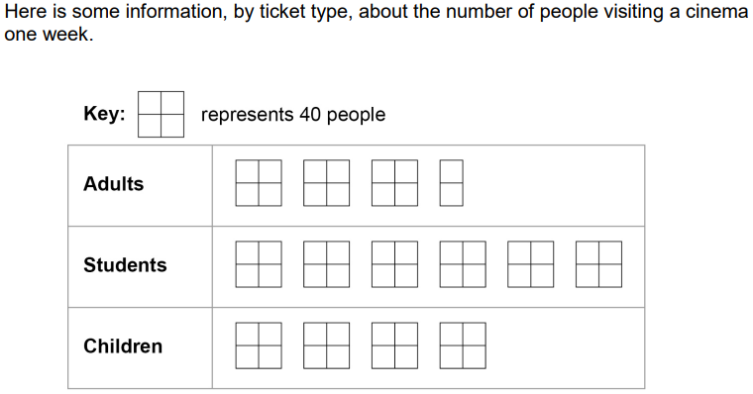
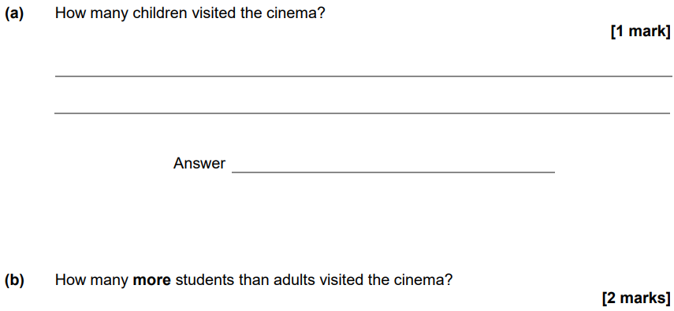
Pictograms

Slide 14
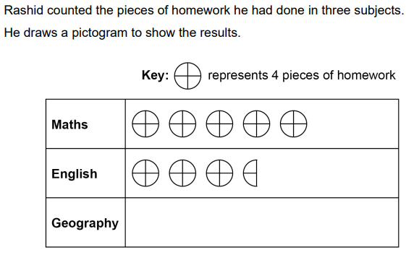
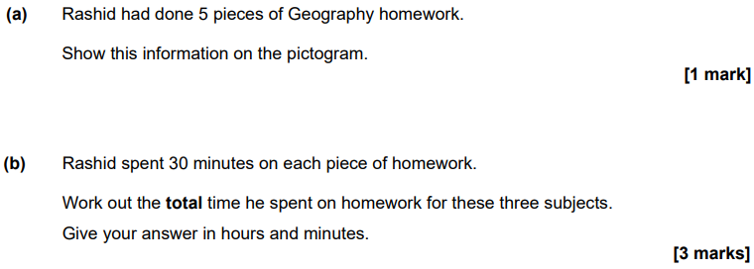
November 2021 Paper 1

Slide 15
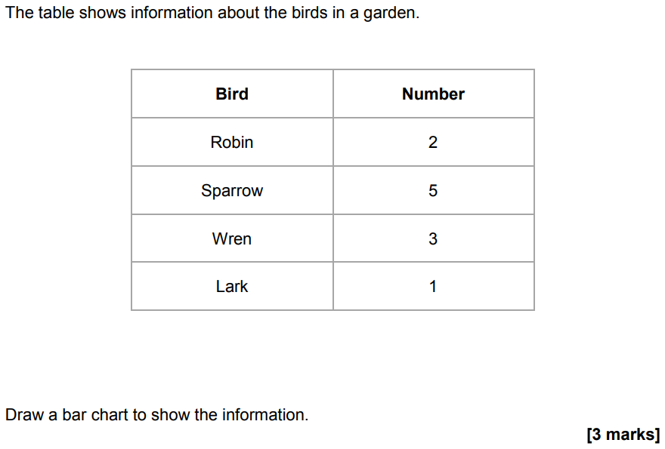
Bar Charts

Slide 16
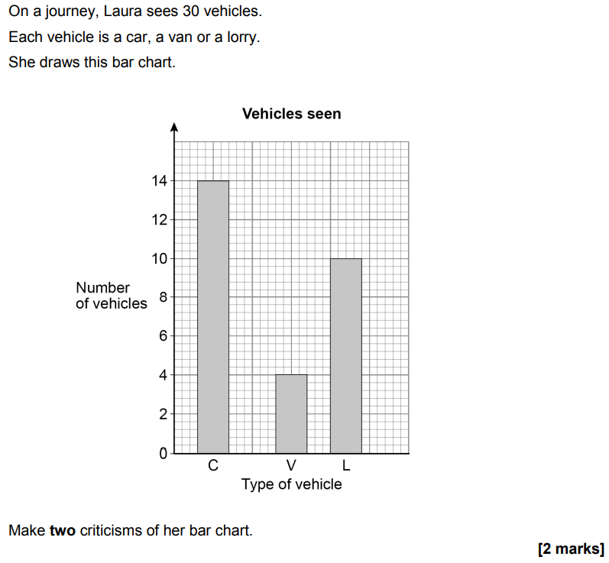
June 2019 Paper 2

