Slide 1
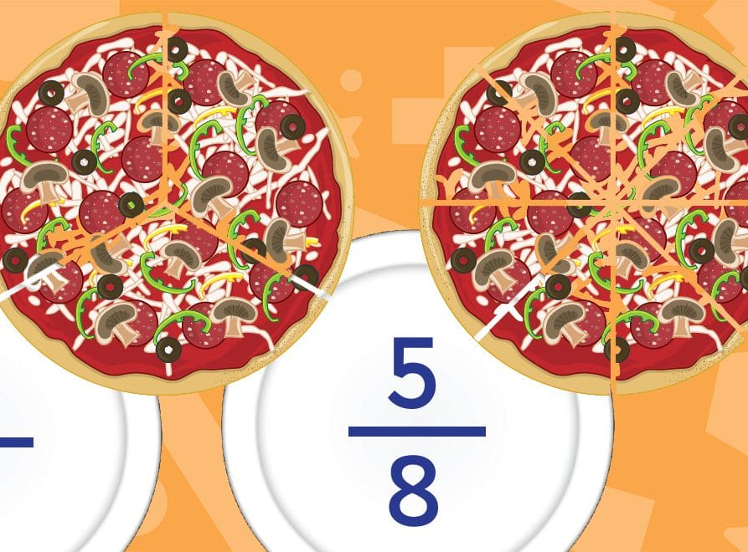
Fractions
Level Two

Slide 2
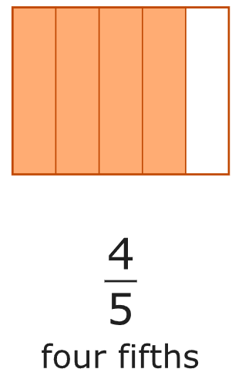
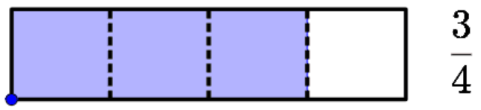
Task 1 –
Show how to find
a fraction of
a value using the
bar/s

Slide 3
Task 2 –
Show equivalent fractions

Slide 4
Task 3 –
Show Simplifying fractions

Slide 5
Task 4 –
Show adding/subtracting
fractions

Slide 6
Task 5 –
Show Multiplying
fractions

Slide 7
Task 6 –
Show Dividing
fractions

