Slide 1

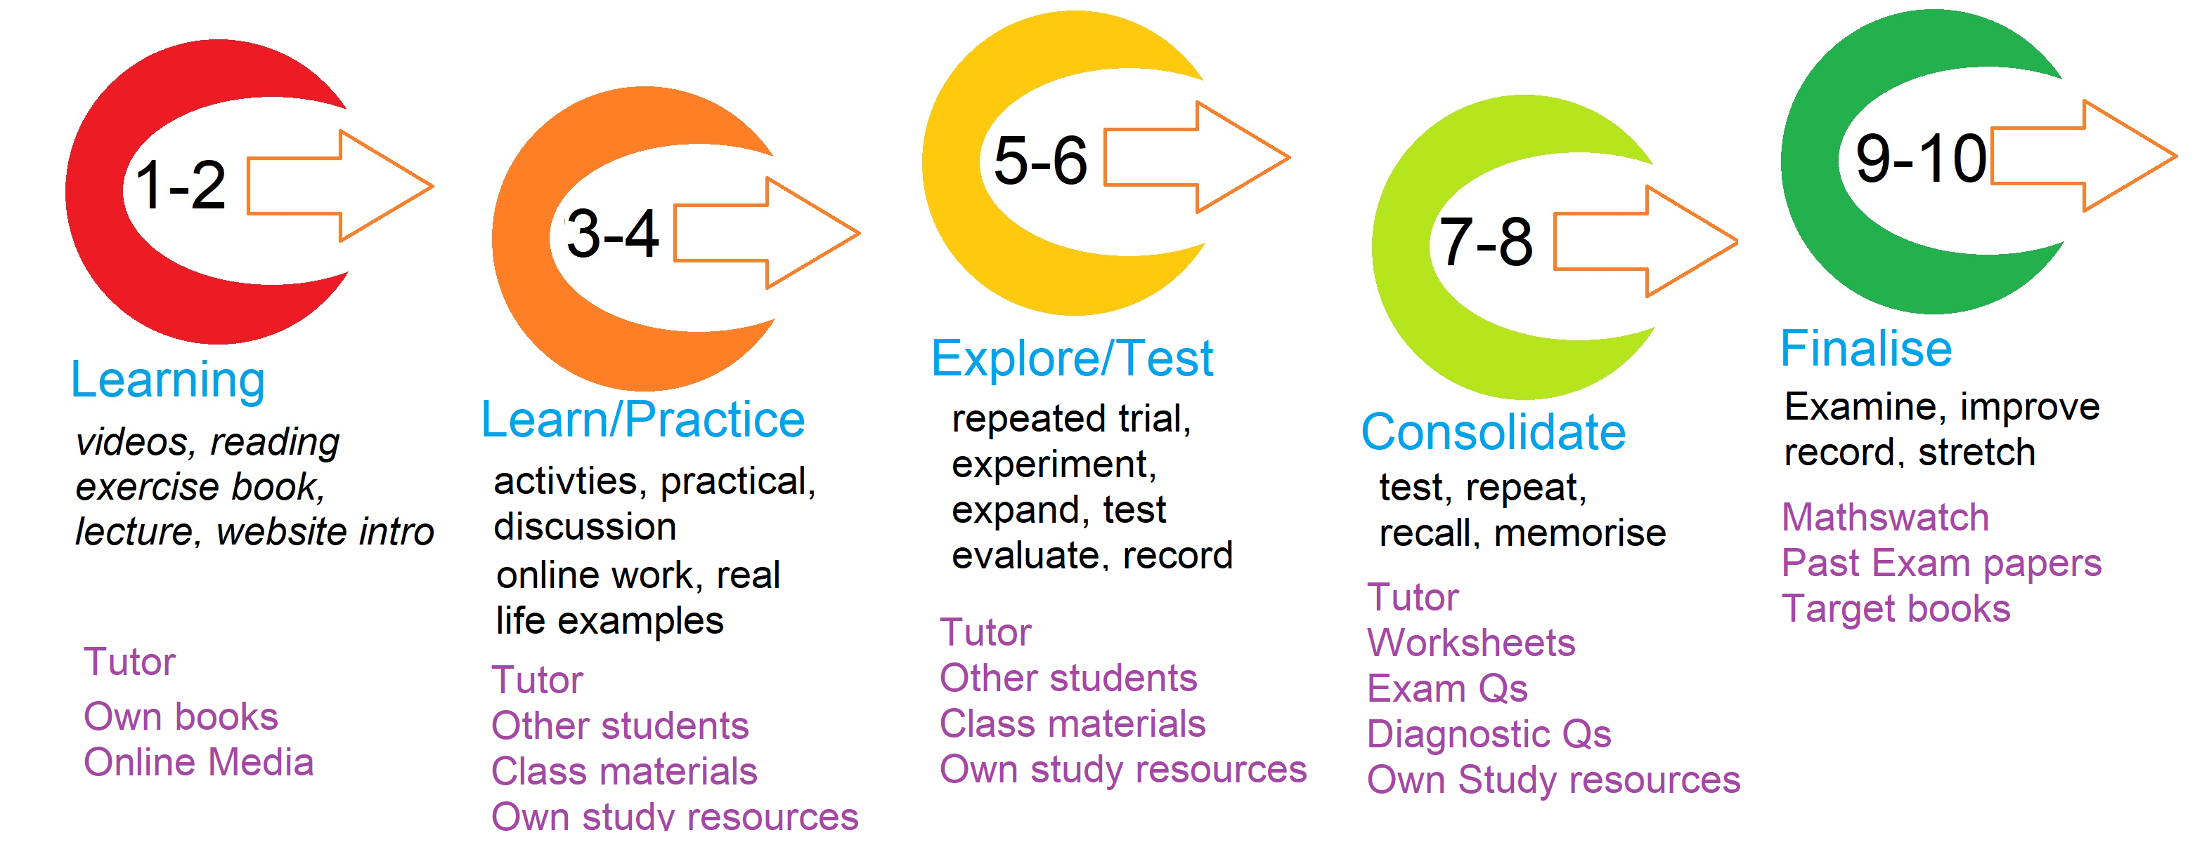
Assessment outcome – lesson strategy

