Slide 1
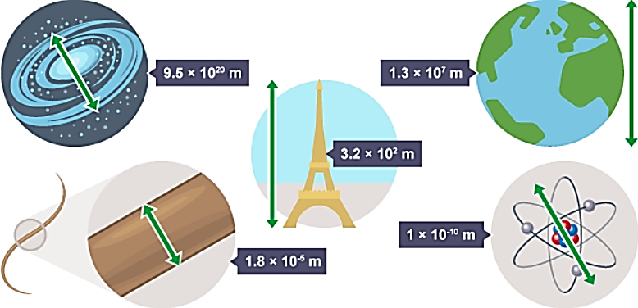
Indices (powers) and Standard Form

Slide 2
Session Aims
Recognise place values as multiples of ten
Write a decimal number as a power of ten (standard form)
Shorten large multiplication sums into index form
Multiply and divide numbers when in index form or standard form
Eg.. Thousands is 10³
Eg.. 3000 = 3x10³
Eg.. 5x5x5x5 = 5⁴
Eg.. 10⁸
10⁶
=10²

Slide 3
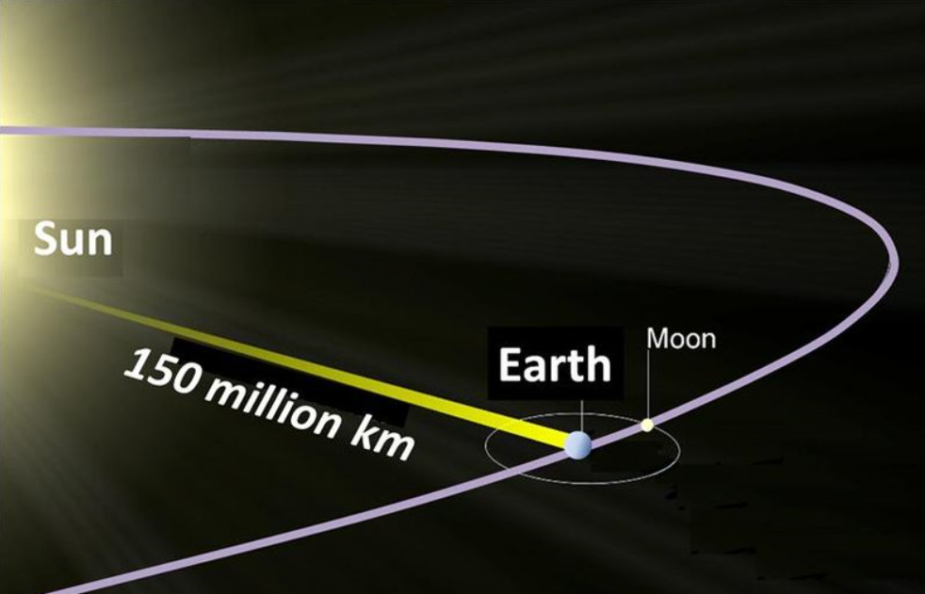

Slide 4
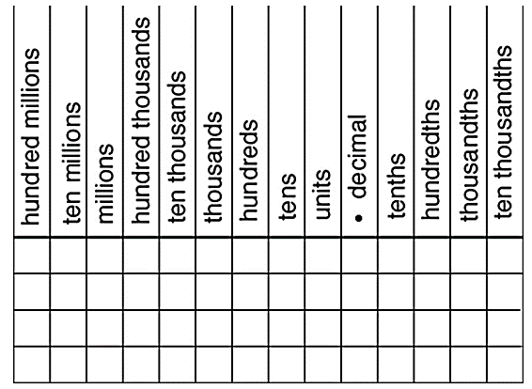

Slide 5


