Slide 1




Slide 2







Whole Number and Functions
Add and Subtract

Slide 3












Course Content: Choose your topic …
Whole Number and Functions
place
value
add and
subtract
multiply
divide
round
numbers
fraction
decimal
numbers
MATHS E1 E2 E3
Parts of a whole
Time
temperature
2d and 3d Shapes
metric
measure
money
charts
data
Measure and Shape
Handling Data

Slide 4













Home Revision Progress Check 1 Video/Discuss Vocab / jobs Lesson Activities Quizzes Topic Answers Progress Check 2 Cont. Learning
Topic Introduction : Add and Subtract
The first two maths functions that change a number to another. These functions allow you to find the total of two or more values by combining them (adding) or to reverse that process, separating combined values back into their original values.
These two topics at first appear different and are often taught separately and using different methods, however they are strongly related and therefore should be worked on at the same time to make the connection between them.
Choose an icon to select where to start
Add and
Subtract

Slide 5



Warm up exercises 1
Lets start today by revising ! Complete the above sums and multiplication grid

Slide 6



Warm up exercises 2

Slide 7

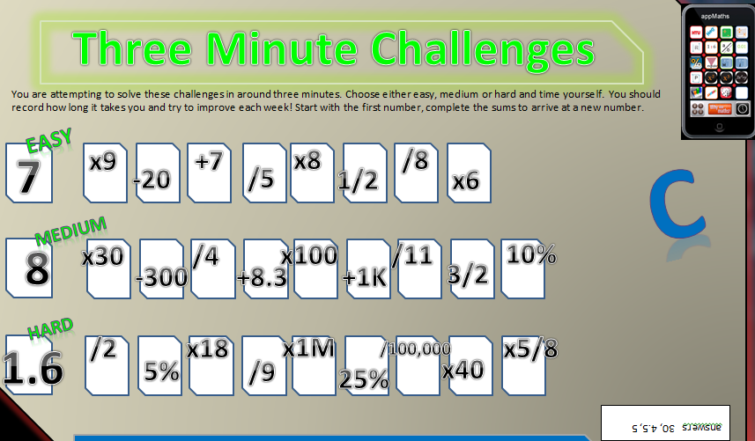

Warm up exercises 3

Slide 8

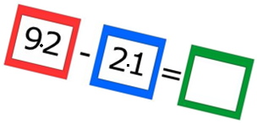
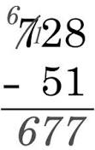
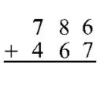

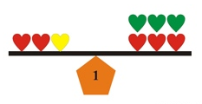
Progress Checker 1
What do you already know about addition and subtraction ? What did you learn during the week? Examples…
How would you rate your skills in adding and subtracting?
Excellent ability
Good ability, but working to improve
Ok, making a start but I know I have lots to still learn
The date I started studying: My aims are…
A Discover a method to add or subtract two values under a hundred thousand to each other
B Relate Subtraction back to Addition and select a preferred method
C Solve real life problems involving adding and subtracting

Slide 9

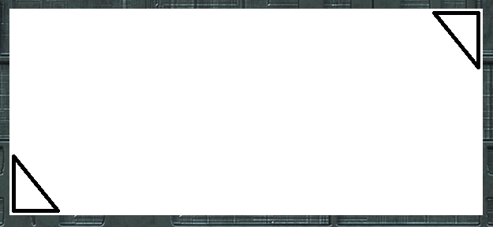


Introductory Video and Discussion
KHTU.
Does adding always make a number bigger ?
Does the order in which you add and subtract matter ?
Can you subtract a big number from a smaller one ?
Which is better, add in your head, on paper, on calculator?
Is there a best method for adding and subtracting?
Does a ‘Decimal point’ affect adding or subtracting?
Watch the introductory video and then discuss the above
Your thoughts..

Slide 10


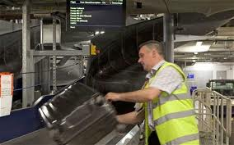
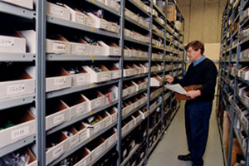
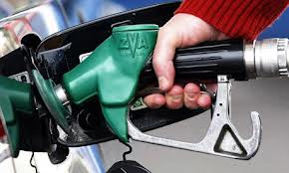

Vocabulary and Jobs
Addition
Subtraction
Take away
Total
Sum
Minus
Less
Difference
Traditional Method
Lining up
Number Line
These are the words you will use in this topic
Accountants
Stock Control
Mobile phone usage
Petrol pump manager
Car Sales
Estate Agent
Secretary
Baggage Handler
Driver …. Can you think of more?
…………………………………
…………………………………

Slide 11

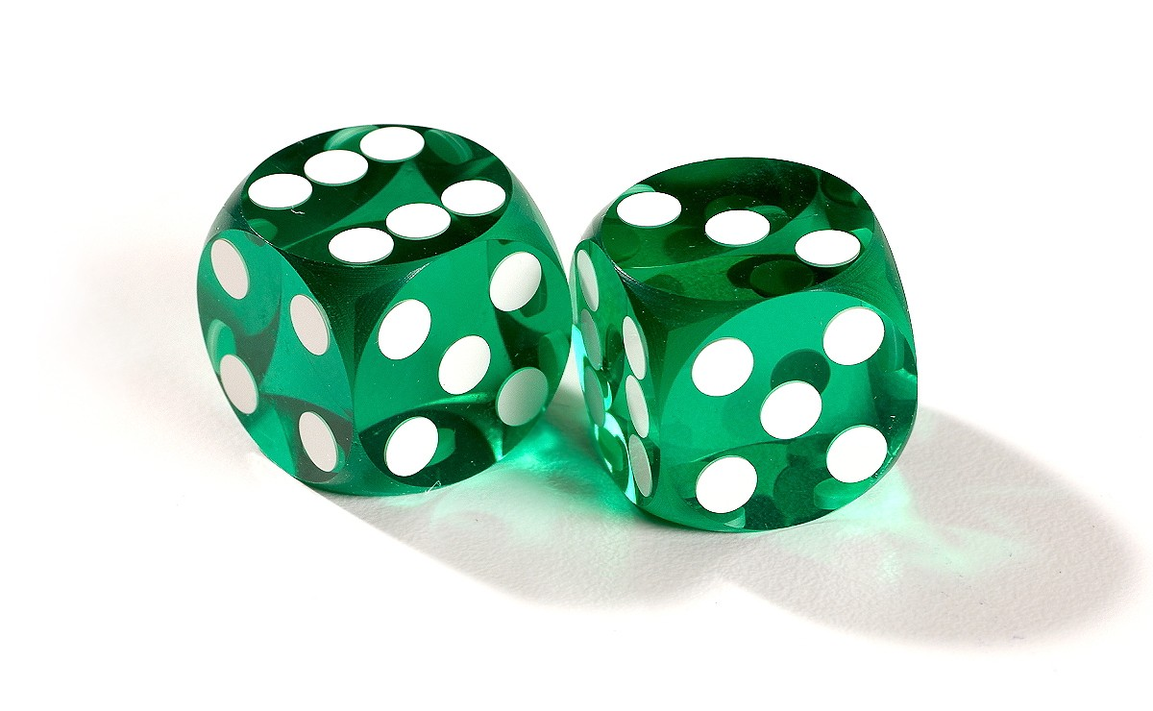
Lesson: Concept Activity
1) Roll two die and record the score, roll again and add to your score, repeat until you pass 100. How many throws did it take?
Now roll two die and start subtracting from your final score, roll, repeat until you pass zero. How many throws did it take?
Record the total number of throws it took you to past 100 and how many to go back past zero. What do you notice? What do you notice about other learners total number of throws?

Slide 12

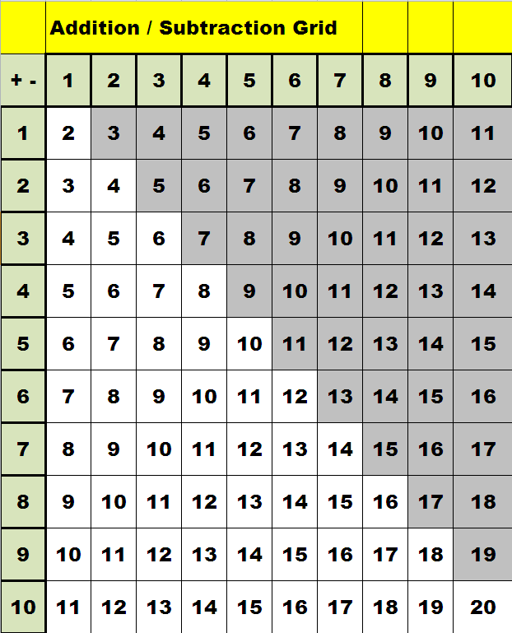

Lesson: Main Teach
Y
This is the essential addition and subtraction grid you need for looking up any sum where you have to take away a number from another or add to a number.
The grid is read like a table (bit like a bus timetable!) where you read across the top row and find the number you are adding to, then look down the column to the row that shows the number you are adding. The answer to the add sum is in the box where column and row meet
for example 6 + 7 = ?
look at column 6 on the top row
look down 7 rows
the answer in box is …..13 !
As you will notice when studying this topic, it will not matter in which order you add numbers together and so half of the answers and ‘greyed out’ as they are repeats of the same sums on the left hand side.
Important learning point !
Learn all of these answers off by heart

Slide 13
Lesson: Main Teach
A way of looking at addition and subtraction is on a number line, this is a line starting with a zero and numbers counting on one at a time to the right. You can use different labelled number lines to aid in visualising the processes of adding and subtracting.
Y
o
1
2
3
4
5
6
7
8
9
10
11
12
13
14
larger
A D D I N G is moving from a starting value in the positive direction a number of steps, example
7 add 5 this means you have seven units and want add another five more units.
1
2
3
4
5
6
7
8
9
10
11
12
13
14
+5
larger
In this example the answer is twelve. This answer is the number you land on when you start on seven and ‘MOVE’ five steps to the right (in the positive direction). Twelve is a ‘Larger’ value than seven, therefore you have increased your value (you have more now than when you started.
Try………… move from number two, six steps to the right, where do you land ?? That’s right, you should be on number eight !
move from 6, seven steps to the right , where are you now?? That’s good, you are on number 13 !
Move from three and add until you get to number fourteen. How many steps did you move?? Excellent, you moved eleven steps !

Slide 14
Lesson: Main Teach
Subtraction is just MOVING but in the opposite direction on the number line.
Y
smaller
o
1
2
3
4
5
6
7
8
9
10
11
12
13
14
Example, 9 take away five. Here you are starting with nine units and want to take five of them away (9-5=?) . This is just a movement of five steps away from 9 but this time in the negative direction.
o
1
2
3
4
5
6
7
8
9
10
11
12
13
14
-5
Try…….. 7 minus 4. Good 7-4 is three !
13 take away 8. Yes, you arrive at 5 !
14 minus 13. Well done if you got 1 !
A point to remember….make sure you do not start to count until you have moved position on the number line !!
NEXT : what about larger numbers ??

Slide 15


Lesson: Main Teach
Y
Ten thousand
unit
tenth
For adding and subtracting of larger numbers you will need to go back to the place value columns learnt in the first topic
Place the larger number in the correct column at the top
Write in the second (smaller) number below the first
See the rules below for add and subtract
ten
hundred
thousand
,
Decimal
point
K
U
Decimals
Main addition rule for larger numbers Main rule for subtracting of larger numbers
Traditional method – add each place value and Traditional method – take each place value away in columns
carry over any sets of ten made in each column If a column does not have enough in it, take one set of ten from
the column on the left ………….. 549 – 487 =
5 4 9
4 8 7 + 5 4 9
1 0 3 6 4 8 7 -
0 6 2
4
1
Now watch the tutor video

Slide 16


Lesson: Try out
Block 1 : Watch tutor led demo (in class or on video)
Try these, 1) add 3 and 7 2) add 9 and 8 3) add 2 and 6 4) add 4 and 5
5) subtract 5 from 8 6) subtract 2 from 7 7) subtract 4 from 10 8) subtract six from nine
Block 2 : Watch tutor led demo (in class or on video)
Try these, 9) 12 + 23 10) 14 + 31 11) 24 + 17 12) 74 + 15
13) 24 – 16 14) 44 – 36 15) 99 – 64 16) 49 - 37
17) 240 + 107 18) 526 + 341 19) 609 + 121 20) 377 + 428
21) 429 – 117 22) 903 – 655 23) 150 – 75 24) 912 - 287
Block 3 : Watch tutor led demo (in class or on video)
Try these, 25) 1,704 + 2,009 26) 7,020 + 4,450 27) 9,111 + 3232
28) 648 more than 5,270 29) 26,999 – 13,456 30) 89,231 – 74, 898 31) 16,000 – 4,728

Slide 17
Lesson: Websites and links
http://gamelicker.com/arcade-game-rapid-math-2647
Fast game of typing answers to single digit sums
Game of ‘Count down’ as per tv show, add and subtract to arrive at a final total
http://www.subtangent.com/maths/flash/numbers-and-letters.swf
Addition of two digit numbers
http://www.mymaths.co.uk/samples/sampleLessonAdding2digitNumbers.swf
Addition of numbers in place values to 1000
http://www.harcourtschool.com/activity/elab2004/gr3/3.html
Whole page on adding and subtracting worksheets and information
http://www.aaamath.com/add.htm
http://www.ictgames.com/button%20only.html
Add and Subtract on a number line
Subtraction methods website
http://www.bbc.co.uk/skillswise/worksheet/ma09subt-e3-w-subtraction-methods
Create your own add/subtract worksheets
http://www.aplusmath.com/Worksheets/index.html

Slide 18

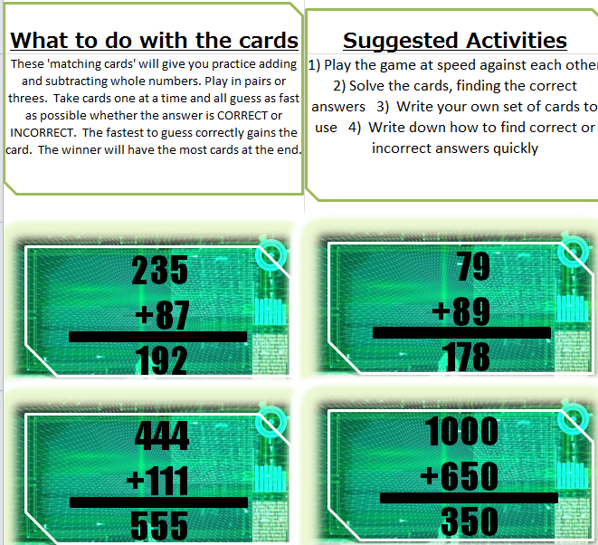

Lesson: Exploratory Activity A
Y
=
True??
False??
=
=

Slide 19


Lesson: Exploratory Activity B
Y
Finance Game
Two players
Take a random expense card each and both start with a budget of £1000
Answer questions
Correct gains an income, incorrect gains an expenditure
Total your budget when the cards run out
WINNER is the player with the best budget (highest value at the end of the game)
Start with
£1000 each

Slide 20

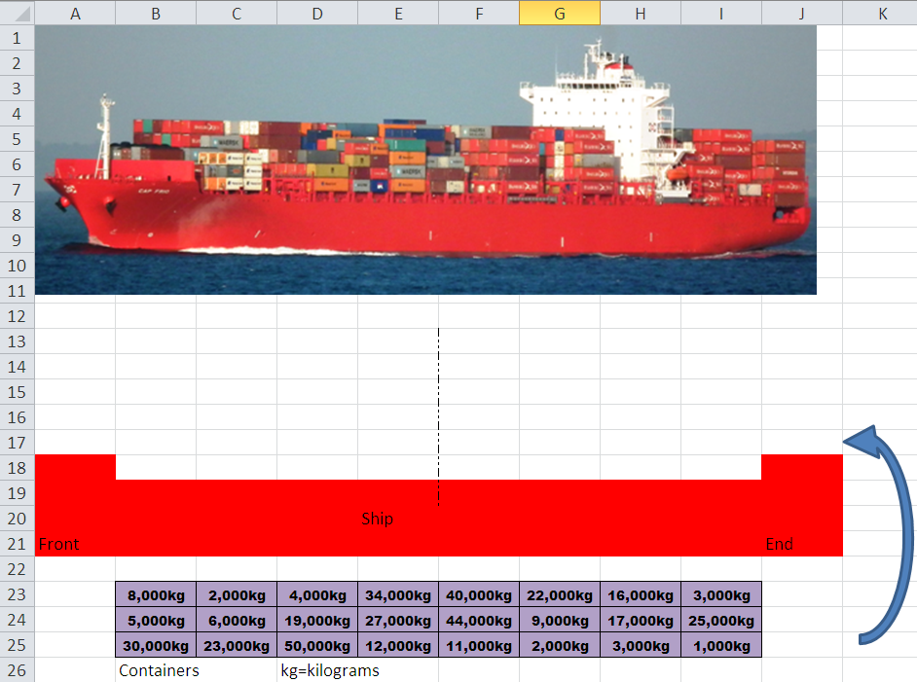

Lesson: Exploratory Activity C
Y
Balance the Container Ship !

Slide 21





Lesson: Exploratory Activity D
Y
10 items for a holiday
10 items when redecorating
a room
10 Birthday
party items
Start with £1000

Slide 22

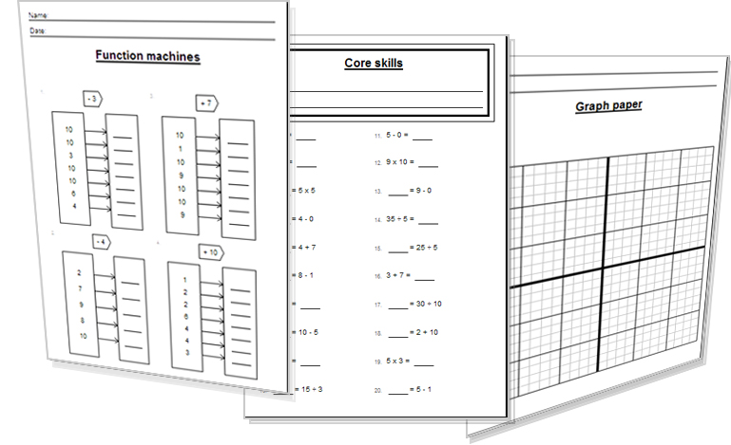

Lesson: Activity E
Try a variety of written practice
Worksheets
Workbooks
Practice Exam Papers
Maths Problems

Slide 23
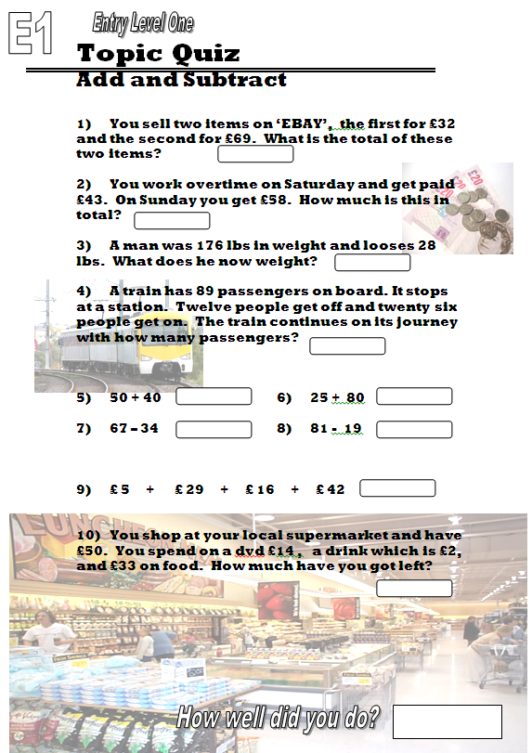
Quiz to assess Entry 1

Slide 24
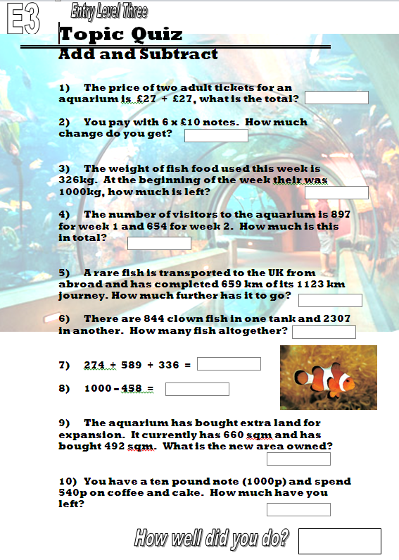
Quiz to assess Entry 3

Slide 25
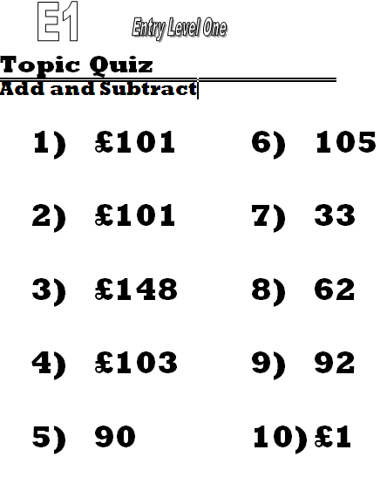

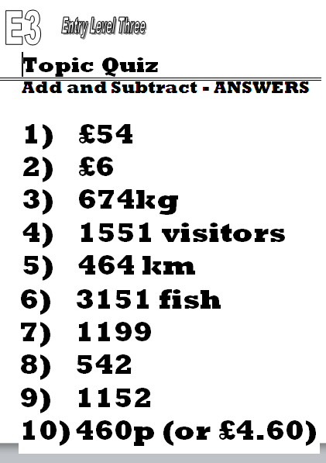
TOPIC ANSWERS 2

Slide 26
Progress Checker 2
What do you now know about addition and subtraction ? What did you learn during the session? Examples…
How would you now rate your skills in adding and subtracting?
Excellent ability
Good ability, but working to improve
Ok, making a start but I know I have lots to still learn
The date I finished studying: My aims were…
A Discover a method to add or subtract two values under a hundred thousand to each other
B Relate Subtraction back to Addition and select a preferred method
C Solve real life problems involving adding and subtracting

Slide 27
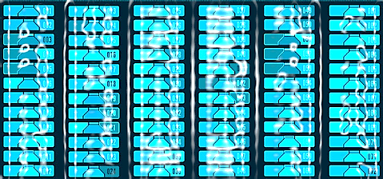

Continuing to Study and Learn
What else can you do to help yourself to learn and practice? Here are ten suggestions, record which you do each week and also record your progress.
Internet websites
Repeat the lesson, make notes, organise a folder, revise
Own maths workbook
Study together with a friend or family member
Finish activities in this book
Complete class handouts or tasks
Practice exams / past papers
Use maths skills learnt at home or at work in real situations
Play games
Experiment yourself, try new things ask yourself questions
Try making a graph of number of practice methods you use against your progress score in each topic. Are you showing more practice gives better results?

