Slide 1
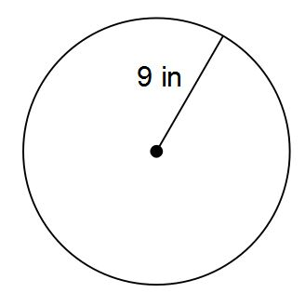
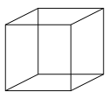
COMPOUND INTEREST
Learning Objectives
To be able to set up, solve and interpret compound interest problems
1) Find the area of this triangle.
2) Find the area and
circumference of this circle.
3) Find the Surface Area
of this shape.
3cm
5cm
8cm

Slide 2
STARTER
Multipliers
Compound interest
Find the percentage multiplier for:
20% increase
70% decrease
5% increase
Sally bought a piano for £2200. In each year the value of the piano increases by 11% of its value at the start of that year.
Find the value of the piano after one year.
Find the value of the piano after four years.
Depreciation
A car was bought for £18000. Its value depreciated by 15% each year for the first three years. What was its value at the end of the three years?

Slide 3
MULTIPLIERS
Write down the multiplier that is used to calculate:
4% increase
Write down the multiplier that is used to calculate:
12% decrease

Slide 4
Your turn…
×
×
Percentage multiplier for 10% decrease
× 1.1
Percentage multiplier for 15% increase
Percentage multiplier for 10% increase
Percentage Multiplier
Percentage multiplier for 40% decrease
Percentage multiplier for 12.5% increase
Percentage multiplier for 9% increase
×
×
×

Slide 5
COMPOUND INTEREST
Sebastian leaves £3000 in the bank for two years. It earns compound interest of 2% per year. Calculate the total amount Sebastian has in the bank at the end of the two years.
£14,000 is invested at 7.5% per annum compound interest. Find the total amount at the end of twelve years.

Slide 6
Your turn…
Fiona leaves £1600 in the bank for four years. It earns compound interest of 4% each year. Calculate the total amount Fiona has in the bank at the end of the four years.
Gareth invests £4000 for 3 years at 3% per annum compound interest. Calculate the value of his investment, correct to the nearest penny, at the end of the three years.
Natalie invests £600 for two years at 10% per year compound interest. How much interest does she earn?
Jenny invests £400 for two years at 5% compound interest, paid yearly. Tim says that the interest Jenny will receive will be £40. Is Tim right? Explain your answer.

Slide 7
DEPRECIATION
Sharon pays £3500 for a secondhand car. The annual rate of depreciation of the car is 24%. How much will it be worth four years after she has bought it?
A company bought a van that had a value of £12000. Each year the value of the van depreciates by 25%. Work out the value of the van at the end of three years.

Slide 8
Your turn…
The value of a car depreciates by 35% each year. At the end of 2007 the value of the car was £5460. Work out the value of the car at the end of 2006.
The rate of depreciation of a particular brand of computer is 65% per year. If the cost of the computer when new is £650 how much is it worth after two years?
A fish tank has sprung a leak, at the base of the tank. 5% of the water is lost every minute. How much water is lost from the tank after ten minutes?
James weighed 100kg. His target was to weigh 80kg or less. His weight decreased by 3% each month. Has he achieved his target after six months? Show your workings.

Slide 9

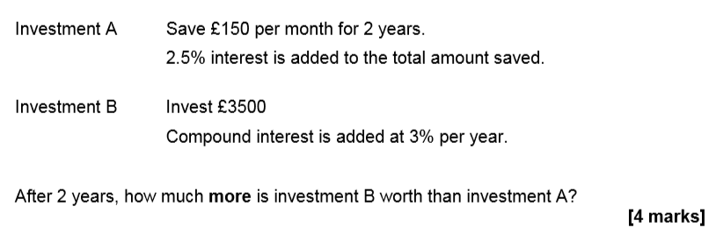
June 2018 Paper 3

Slide 10
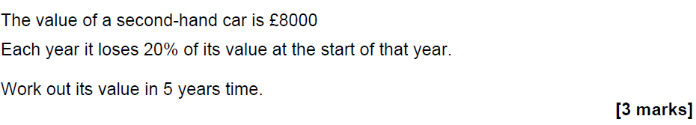
Practice Paper Set 1 Paper 2

