Slide 1


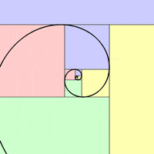
PREPARING FOR FUNCTIONAL SKILLS MATHS
2022 – 2023 Milton Keynes College

Slide 2

Week 1 - Intro
Welcome to the college and your tutor
BKSB Assessment
Course Overview
Topics and Targets

Slide 3
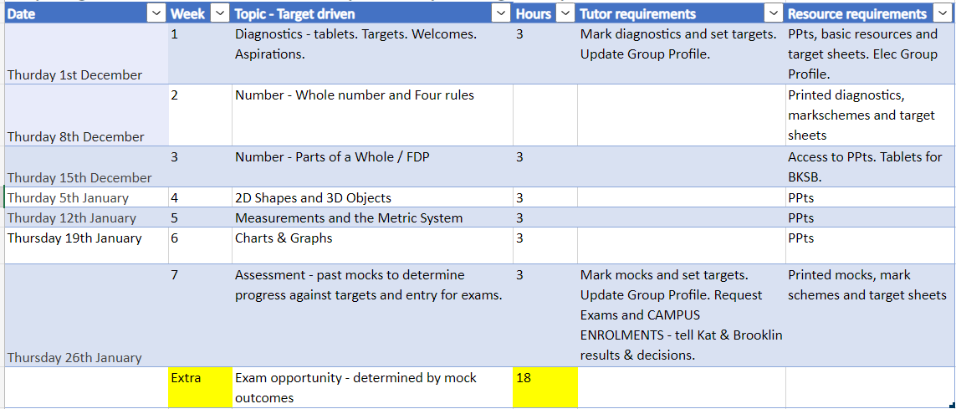
Scheme of work

Slide 4
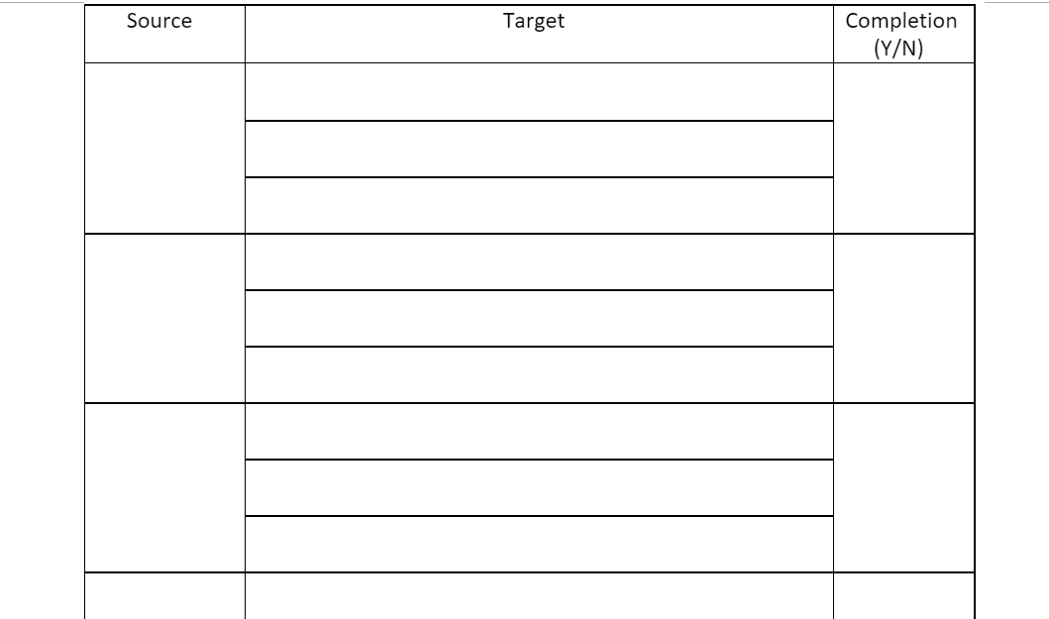
Individual targets

