Slide 1


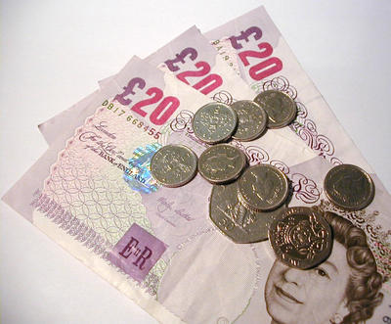
Intro slide
Managing your
Money !!

Slide 2
Week 1
Managing your
Money !!
Welcome 10 mins
Ice Breaker – names 10 mins
Numeracy topics, course materials 10 mins
Needs vs Wants 20 mins
Recognising Money to £9,999 30 mins
BREAK 15 mins
Budgeting – Produce a budget
Adding and Subtracting Skills

Slide 3



College Rules & Health & Safety
Managing your
Money !!

Slide 4

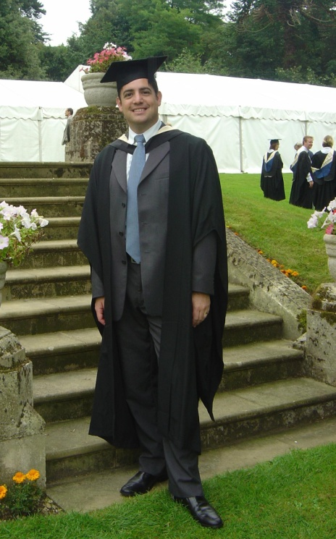
Week 1
Managing your
Money !!
Mr MALCOLM R.COOKE
Course Team Leader- Numeracy
email malcolm.cooke@mkcollege.ac.uk
Admin Brooklin.warner@mkcollege.ac.uk

Slide 5
Levels…..
Managing your
Money !!
Entry Level Numeracy
E1 Beginners level, below GCSE
E2 Intermediate level, below GCSE
E3 Highest pre GCSE level
Level 1 (D at GCSE) – NVQ’s L1 – grade 3
Level 2 (A-C at GCSE) – NVQ’s L2 – grade 4+
Level 3 are AS, A2 and NVQ’s L3

Slide 6

Getting to know you !!
Managing your
Money !!
Name
Course Aspirations
Level of maths
Progression…

Slide 7

Q Think of something where
your number skills match your
budgeting skills, in these 3 areas
Managing your
Money !!
1) Numbers
- Whole Numbers
- Parts of a Whole
2) Measure, Shape and Space
3) Data Handling, charts
and Averages

Slide 8
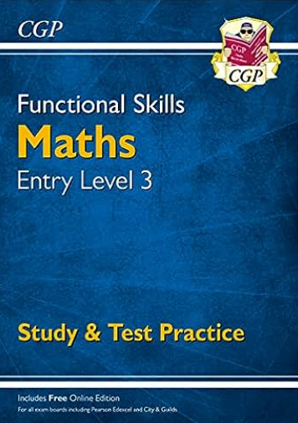

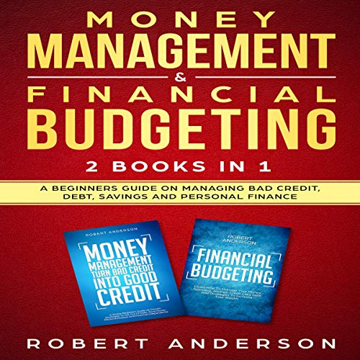
Course Workbook
Managing your
Money !!

Slide 9
Individual Learning Plans
Managing your
Money !!
Your ILP is for your use each session.
Why are you on the course?
What can you do to improve you chances or staying on the course and passing?
What did you do each session?
How did you feel about it?
What will you be doing next session?

Slide 10

Needs vs wants
Managing your
Money !!
Needs vs Wants
Write a list of desert island needs.. Should you luckily find yourself washed up on a beautiful beach..!

Slide 11
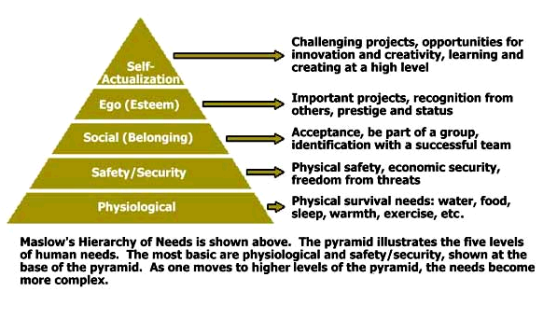
Maslows Hierarchy of Needs
Managing your
Money !!

Slide 12
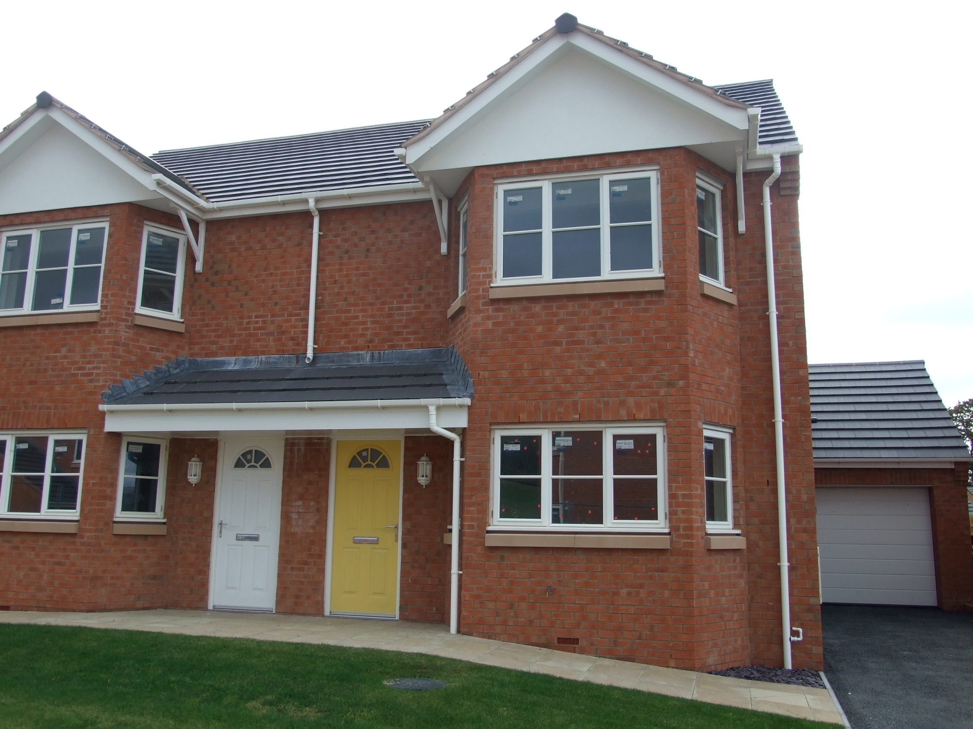
House budgeting
Managing your
Money !!
Needs vs Wants

Slide 13
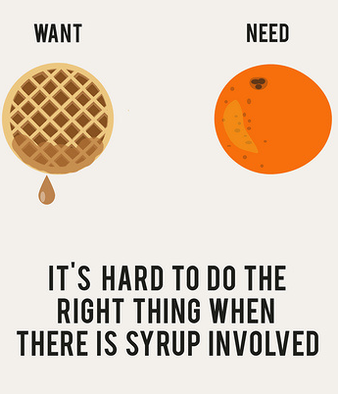
Need or want - Card Set
Produce a set of cards that show essential needs
Separate out things you might ‘just want’ if you can afford it

Slide 14
Session Aims
Entry level two (E2)
Recognise, read and write numbers to 100
Plot numbers on a simple number line
Read and write scales in practical situations
Entry level three (E3)
As above and…
Recognise, read and write numbers up to 1000⁺
Plot numbers on a variety of number lines styles including temperature
Use a variety of scales to read measurements in different contexts

Slide 15
NUMBERS

Slide 16


£

Slide 17
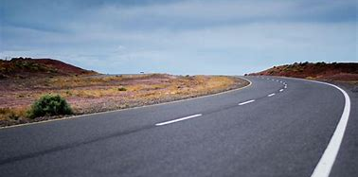

Slide 18
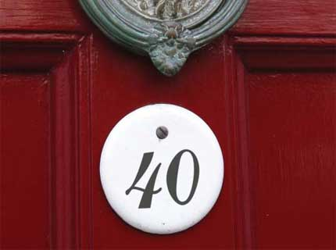
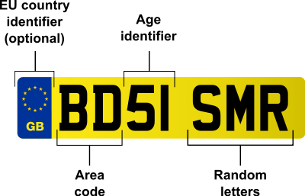


Slide 19
NUMBER LINES

Slide 20
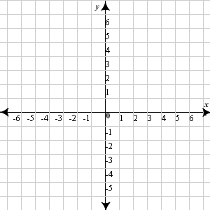

Slide 21
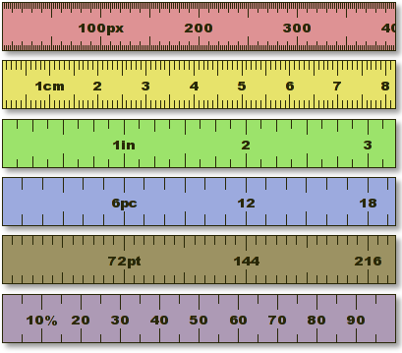

Slide 22
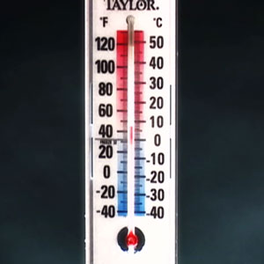

Slide 23
S C A L E S

Slide 24
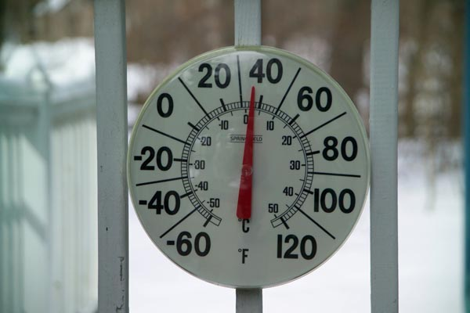
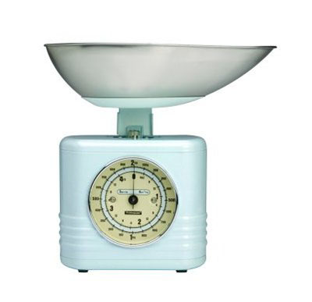
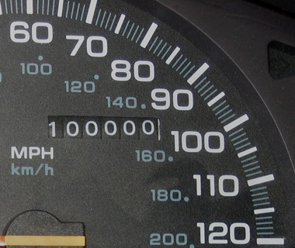

Slide 25
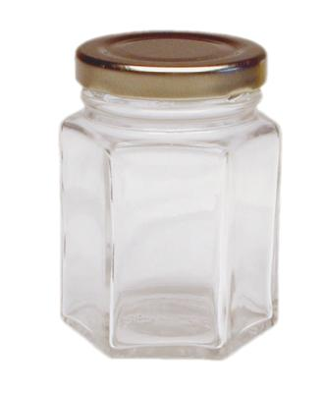
Place Value….
Managing your
Money !!
Place Value
K
H
T
U
1000
100
10
1

Slide 26
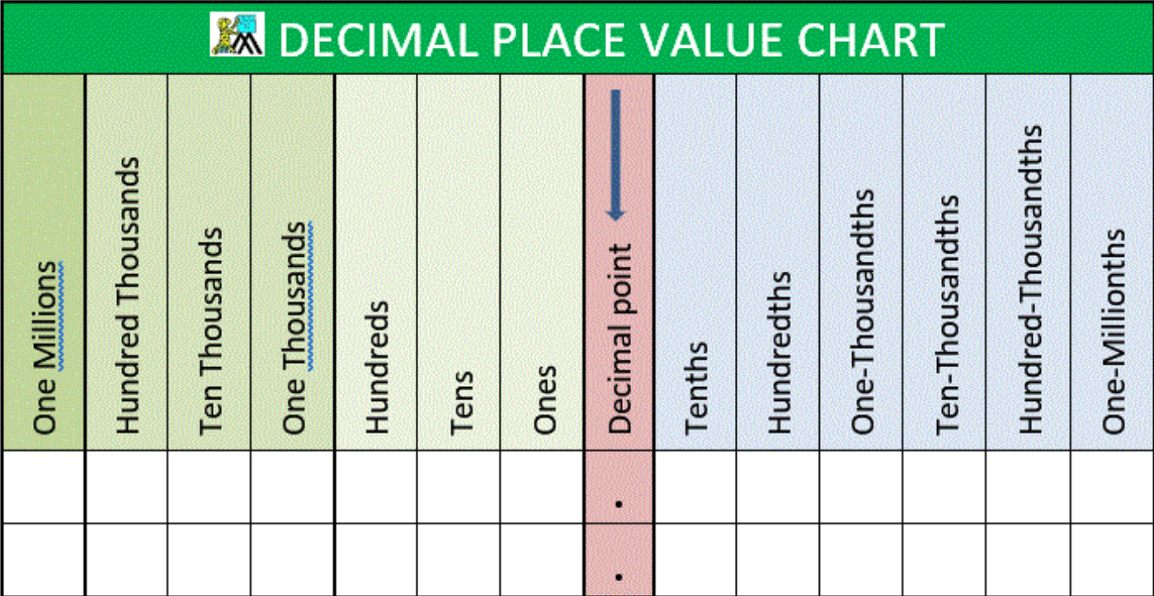
3) S K I L L S C H E C K
WHAT DO YOU ALREADY KNOW??

Slide 27
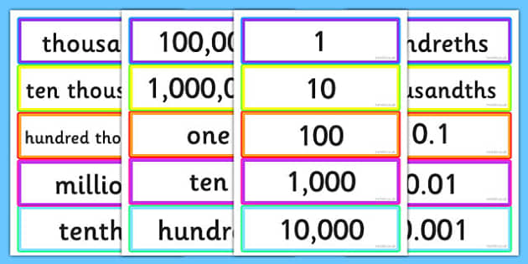
5) T A S K S
PRACTICE A REALISTIC ACTIVITY
Match the place value cards

Slide 28
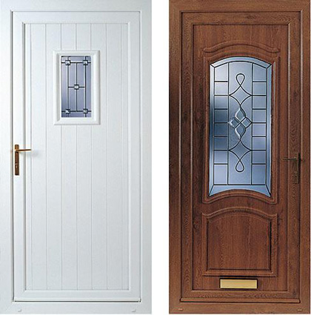
EXAM STYLE PROBLEM 1
Place these house numbers in order. Which answer shows these houses in the correct order from lowest to highest?
25 17 84 48
A) 48, 84, 25, 17 B) 17, 25, 48, 84
C) 17, 84, 25, 48 D) 84, 48, 25, 17

Slide 29
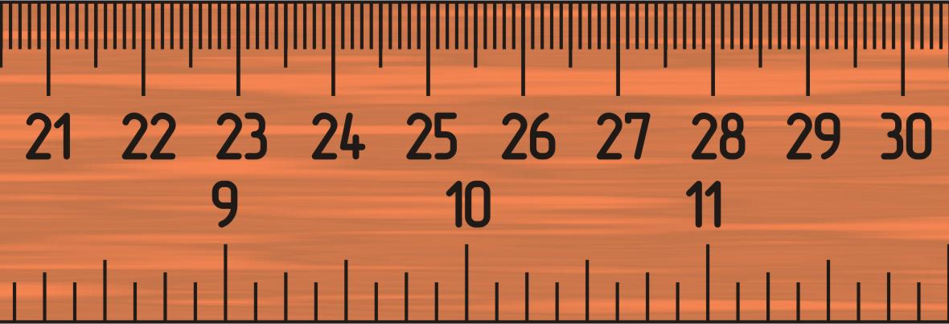
EXAM STYLE PROBLEM 2
On the ruler below, which letter is in the wrong place?
A= twenty
one cm
B= twenty
four cm
C= twenty
five cm
D= twenty
seven cm
E= twenty
nine cm

Slide 30
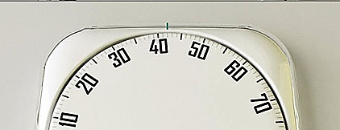
EXAM STYLE PROBLEM 2
What is the reading on these bathroom scales?
A) 45 Kg B) 65 Kg
C) 55 Kg D) 60 Kg

Slide 31
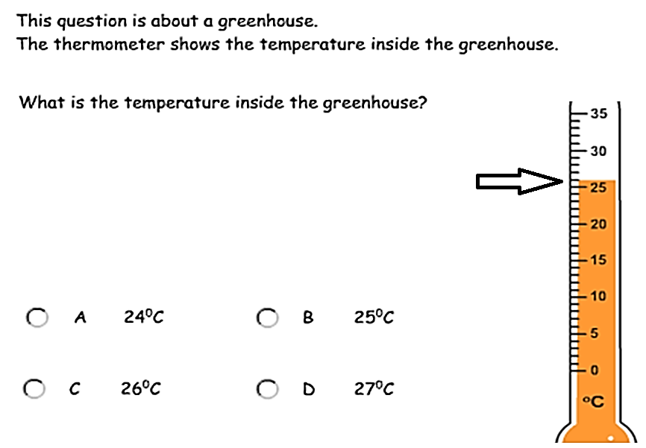

Slide 32

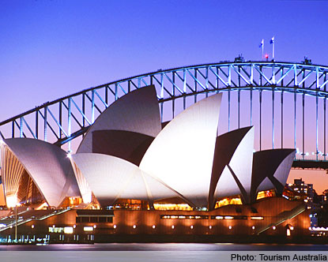


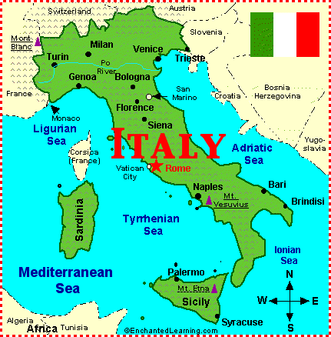
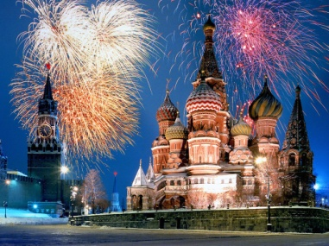
Exam style question – E3
Place these holiday prices in order starting with the highest.
USA £1,980
Africa £1,890
Greece £890
Australia £2,980
Italy £980
Moscow £2,890

Slide 33
Exam style question – E3
You have budgeted £1500 for you holiday. Which destinations can you afford?
USA £1,980
Africa £1,890
Greece £890
Australia £2,980
Italy £980
Moscow £2,890

Slide 34
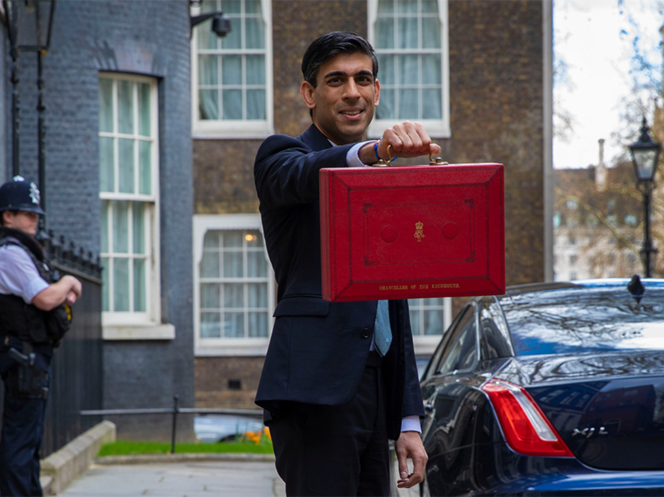
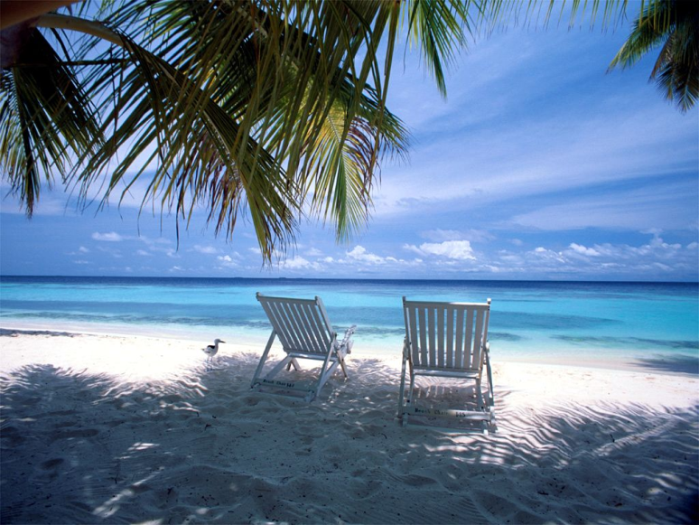
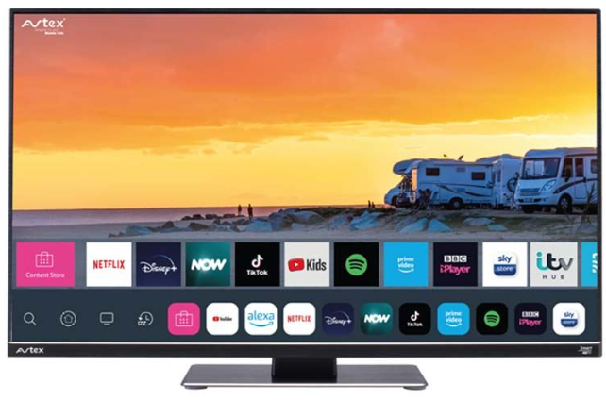
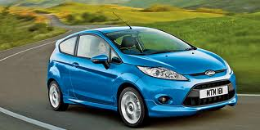
Reasons for a budget

Slide 35
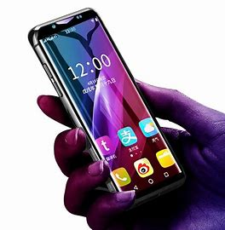
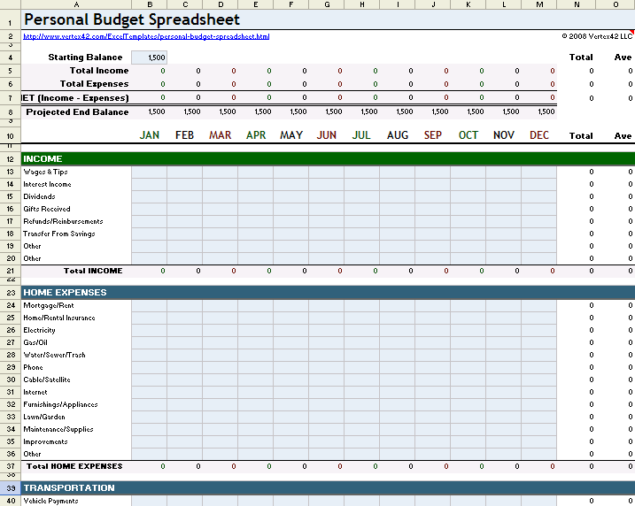
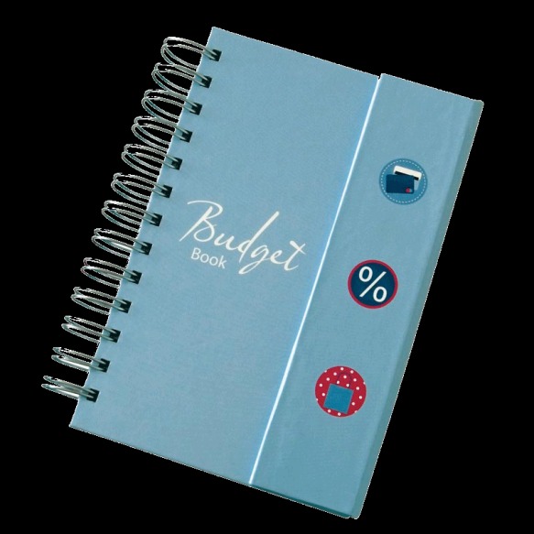
Managing your
Money !!
Create your own budget
Choose a preferred method for recording incomes and outgoings
Add and Subtract confidently using numbers to £1000

Slide 36
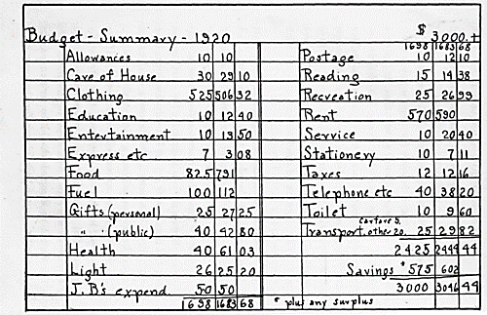

Slide 37
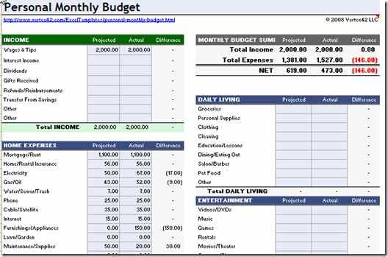

Slide 38
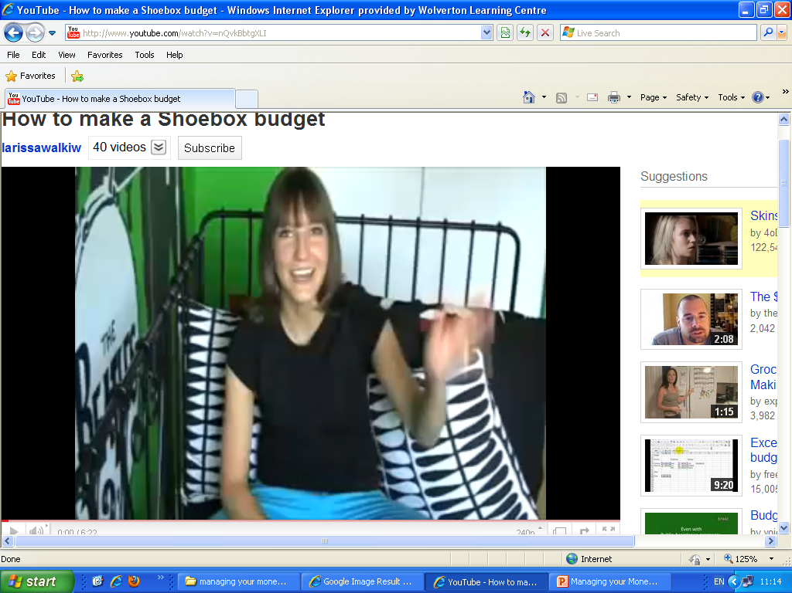

Slide 39
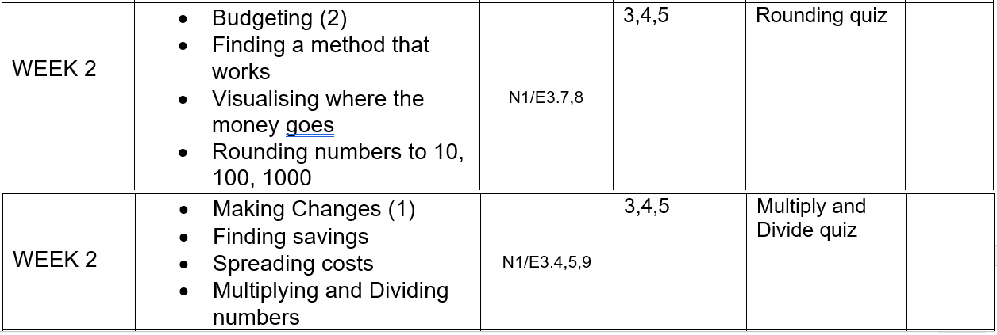
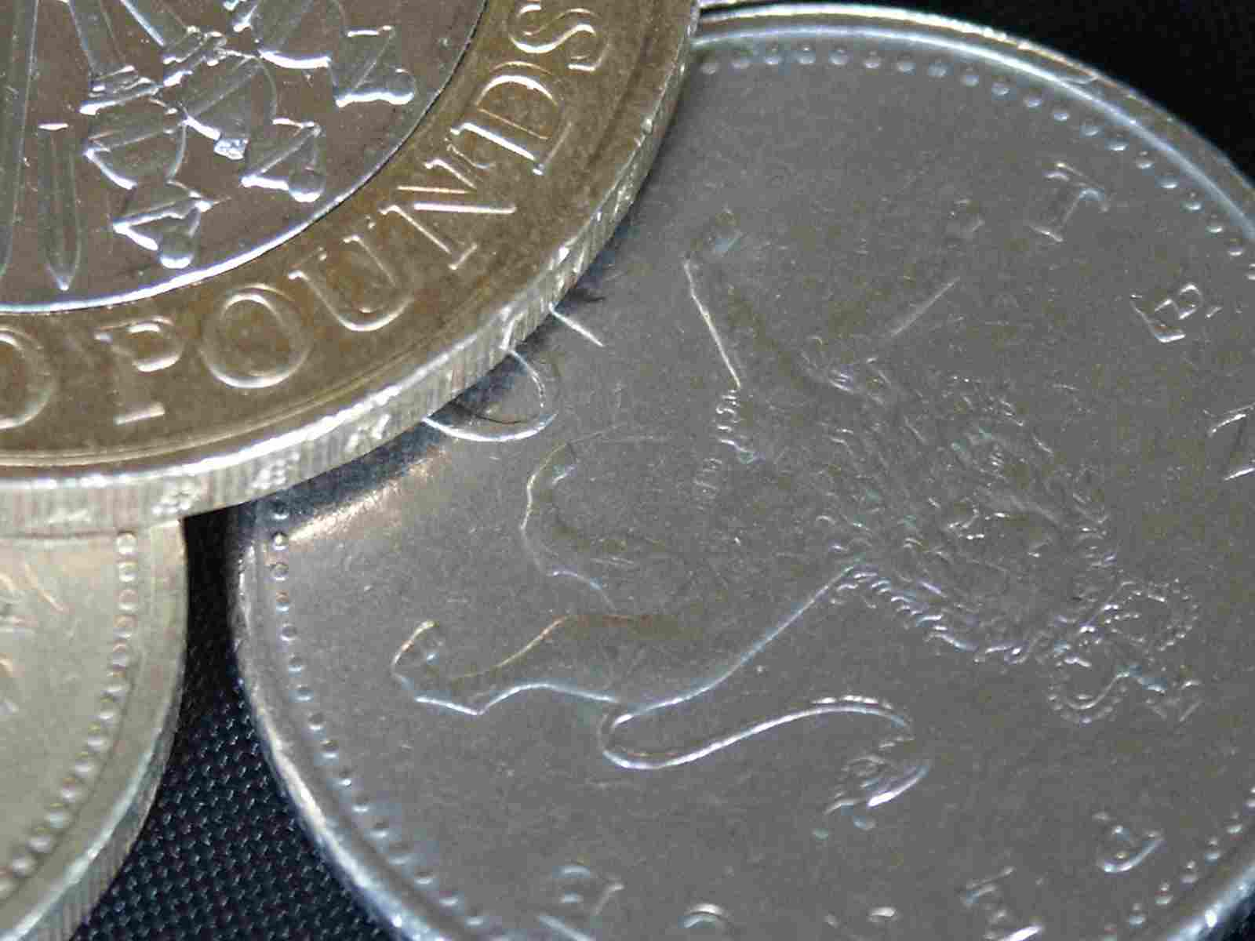
Next Session
Managing your
Money !!

