Slide 1
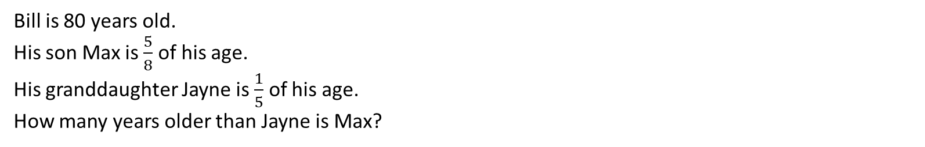
Volume
Learning Objectives
To be able to:
Calculate the volumes of spheres, pyramids, cones and composite solids.
Bill is 80 years old.
His son Max is $\frac{5}{8}$ of his age.
His granddaughter Jayne is $\frac{1}{5}$ of his age.
How many years older than Jayne is Max?

Slide 2
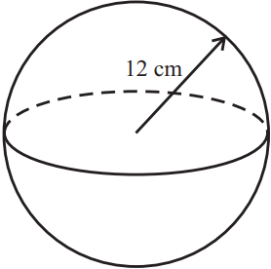
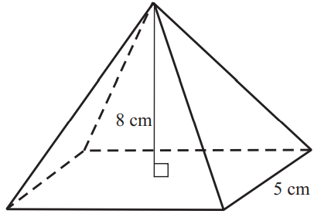
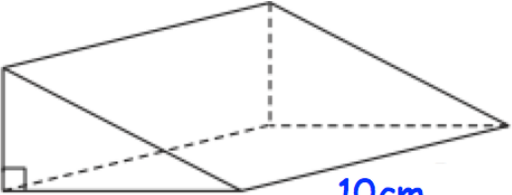
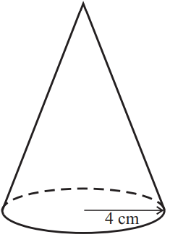

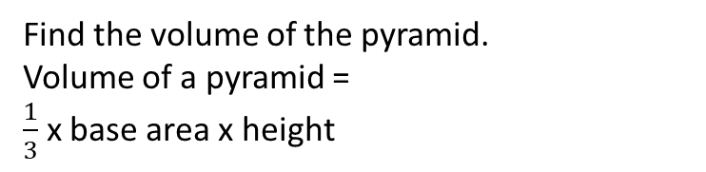

STARTER
Volume of a Cube/Cuboid
Volume of a Sphere
12cm
Find the volume of the cuboid.
Find the volume of the sphere.
Volume of a sphere = $\frac{4}{3}πr^{3}$
7cm
3cm
9cm
Volume of a Triangular Prism
Volume of a Pyramid
Find the volume of the triangular prism.
Find the volume of the pyramid.
Volume of a pyramid = $\frac{1}{3}$ x base area x height
4cm
8cm
7cm
10cm
5cm
7cm
Volume of a Cylinder
Volume of a Cone
5cm
Find the volume of the cylinder.
Find the volume of the cone.
Volume of a cone = $\frac{1}{3}πr^{2}h$
10cm
9cm
4cm

Slide 3
Volume of Cubes/Cuboids
5cm
5cm
5cm
7cm
3cm
4cm

Slide 4
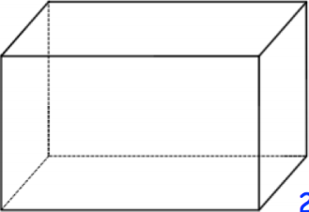
Your turn…
1) Work out the volume of the cuboid.
1) The volume of the cuboid is 105cm³. Find y.
2.5cm
y
1.8cm
4.2cm
3cm
7cm
2) Work out the volume of the cuboid. Give your answer in centimetres.
2) An empty swimming pool is going to be filled with water. The swimming pool is a cuboid, that is 25m long, 10m wide and 2m deep. It is being filled at a rate of 800 litres per minute. Given 1m³ = 1000 litres, how long will it take to fill the swimming pool? Give your answer in hours and minutes.
30cm
20cm
0.9m

Slide 5
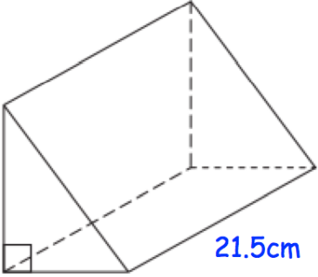
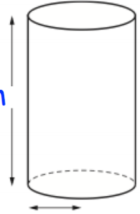
Volume of Prisms
5cm
12cm
4cm
9cm
2cm

Slide 6
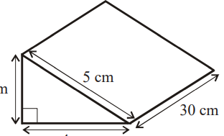
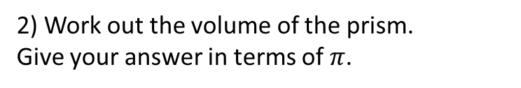
Your turn…
1) Work out the volume of the prism.
Timothy is filling cups with orange juice. Each cup is a cylinder with radius 3cm and height 7cm. Timothy has 2 litres of orange juice. 1 litre = 1000cm³ How many cups can be filled?
5cm
3cm
30cm
4cm
3cm
2) Work out the volume of the prism.
Give your answer in terms of $π$.
8cm
7cm
10cm

Slide 7
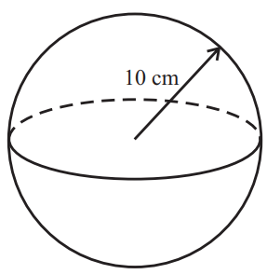
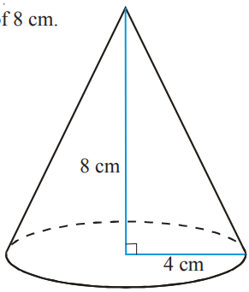



Volume of Spheres/Pyramids/Cones
2)
Find the volume of the following shapes:
1)
9cm
10cm
6cm
8cm
Volume of a pyramid = $\frac{1}{3}$ x base area x height
3)
Volume of a sphere = $\frac{4}{3}πr^{3}$
8cm
4cm
Volume of a cone = $\frac{1}{3}πr^{2}h$

Slide 8
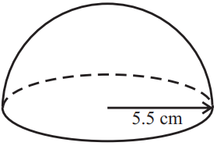
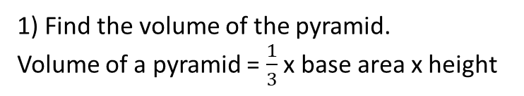
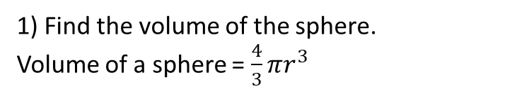
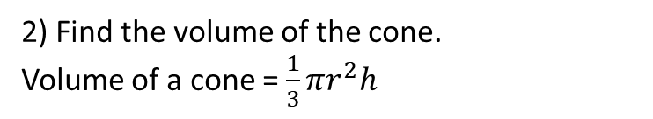
Your turn…
1) Find the volume of the pyramid.
Volume of a pyramid = $\frac{1}{3}$ x base area x height
1) Find the volume of the sphere.
Volume of a sphere = $\frac{4}{3}πr^{3}$
7cm
6cm
3cm
4cm
2) Find the volume of the cone.
Volume of a cone = $\frac{1}{3}πr^{2}h$
2) Find the volume of the solid hemisphere.
3cm
12cm
5cm

Slide 9

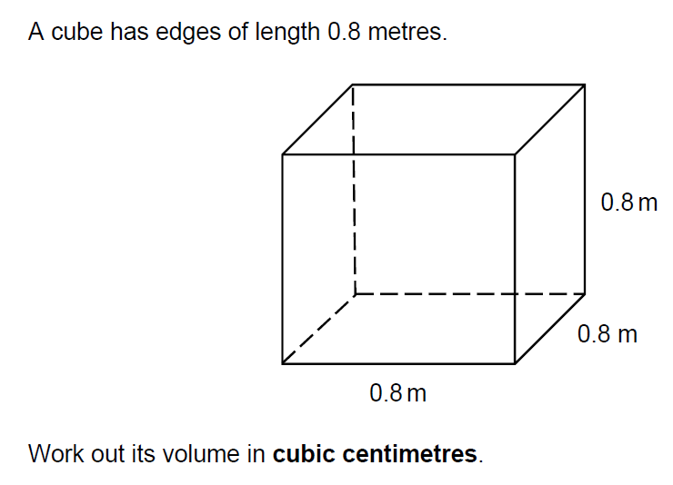

Set 1 Paper 2

Slide 10
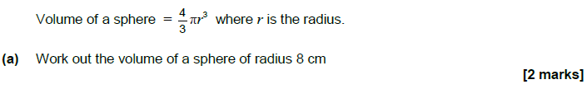
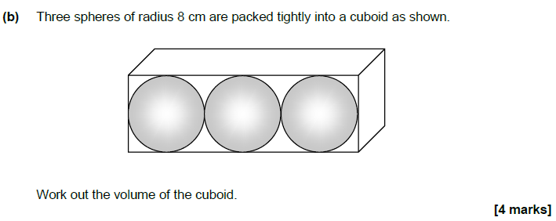
Set 2 Paper 2

