Slide 1
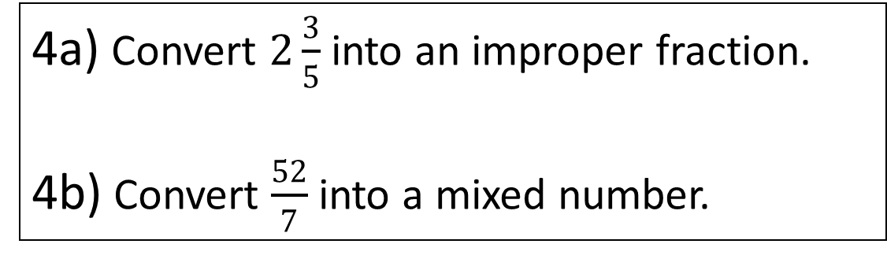
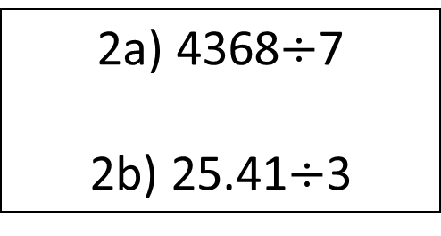
Starter
1a) 65 x 42
1b) 6.5 x 4.2
3a) Find 20% of 420.
3b) Find 120% of 420.
4a) Convert $2\frac{3}{5}$ into an improper fraction.
4b) Convert $\frac{52}{7}$ into a mixed number.
2a) 4368$÷$7
2b) 25.41$÷$3

Slide 2
INTRODUCTION TO ALGEBRA
Learning Objectives
To be able to :
simplify algebraic expressions
expand single brackets
factorise single brackets
Chris and Molly win money in a competition.
They share the money in the ratio 2 : 3
Molly receives £240.
How much money does Chris receive?
How much money did they win in the competition?

Slide 3
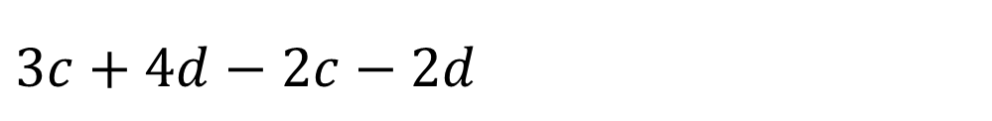
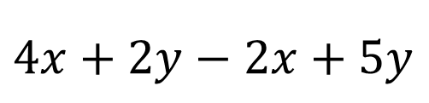
COLLECTING LIKE TERMS
$$4x+2y−2x+5y$$
2x+ 7y
C+2d
$$3c+4d−2c−2d$$

Slide 4
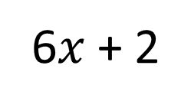

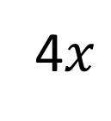
Your turn…
$2c+4+c+7$
$6x+2−3x+6$
$5y+12−9y−7$
$x+7+4x+y+5$
$16p+4q+4−2p+3q−8$
$x^{2}+4x+1+3x−3$
Find an expression for the perimeter.
3c + 11
3x + 8
6$x$ + 2
-4y + 5
5x + y + 12
4$x$
14p + 7q - 4
x² + 7x - 2
20x + 4

Slide 5

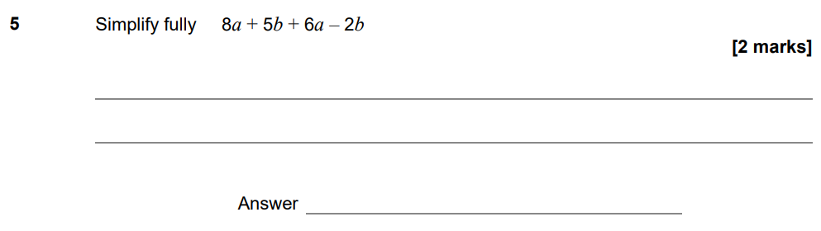

1st Nov 22 Paper 1

Slide 6
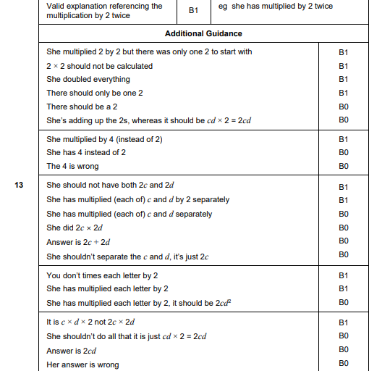
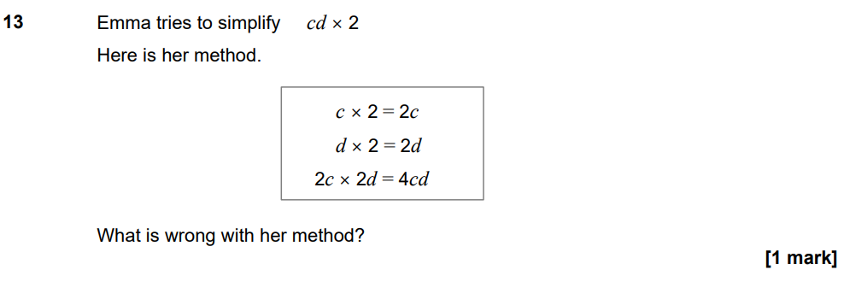
1st Nov 22 Paper 1

Slide 7

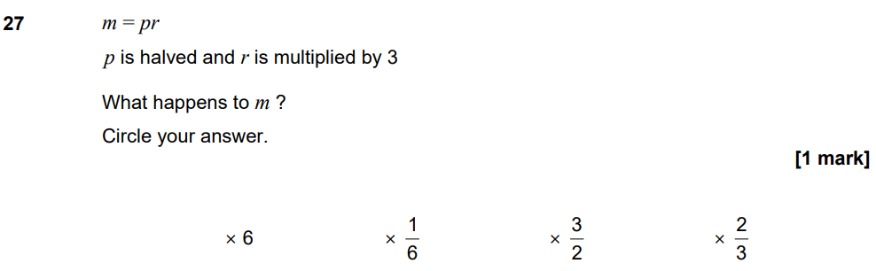
7th 2022 Paper 3
November 2017 Paper 2
y^2
4a+11

Slide 8
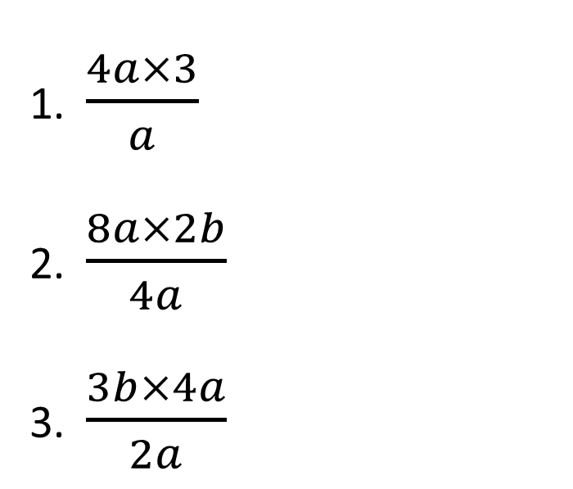

Your turn…
$4a×5a$
$8a×4b$
$3xy×2z$
$12a÷4a$
$20x÷5$
$10x^{2}y^{4}÷2xy²$
$\frac{4a×3}{a}$
$\frac{8a×2b}{4a}$
$\frac{3b×4a}{2a}$
20a²
12
4b
6b
32ab
6xyz
3
4x
5xy²

Slide 9
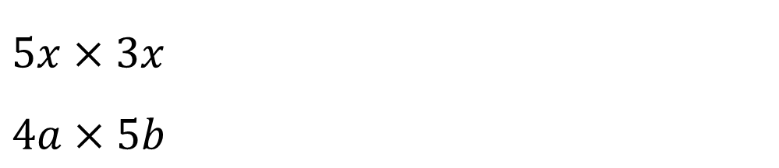
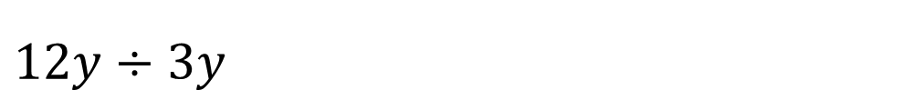

SIMPLIFY
$$5x×3x$$
$4a×5b$
$$15{xcm}^{2}$$
20ab
4
$$12y÷3y$$

Slide 10
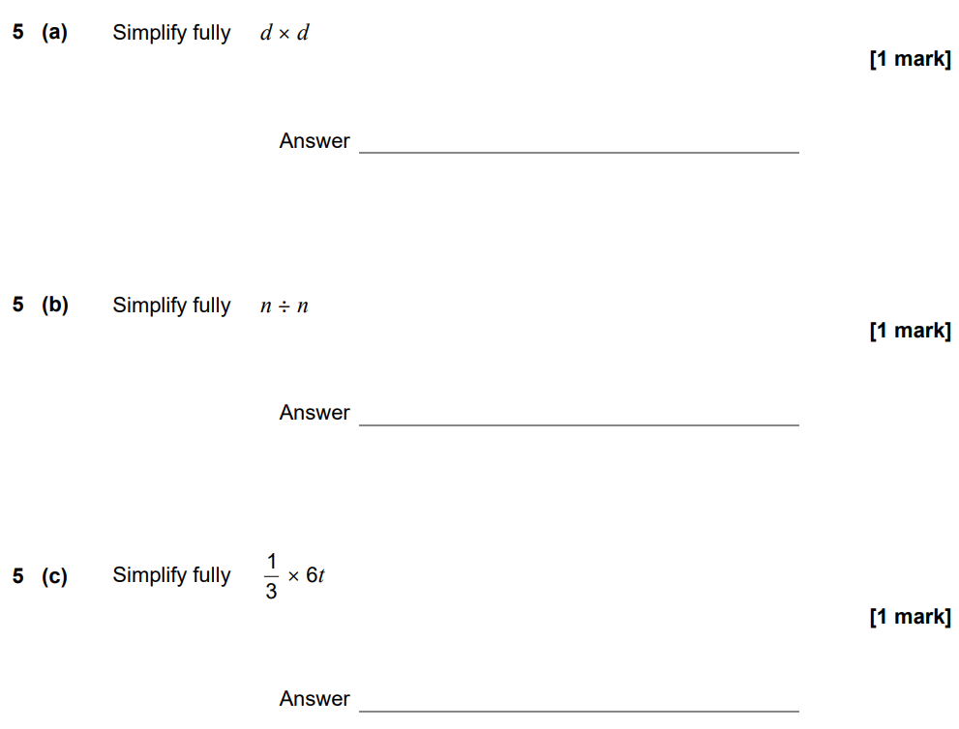

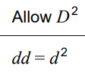


3rd Nov 22 Paper 2

Slide 11
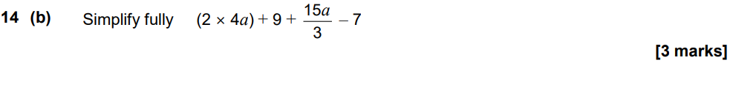
Nov 2020 Paper 1
13a + 2

Slide 12
June 21 Paper 3
3c + 13

Slide 13
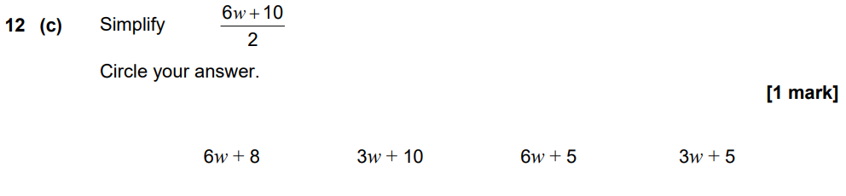
June 2022 Paper 3

Slide 14
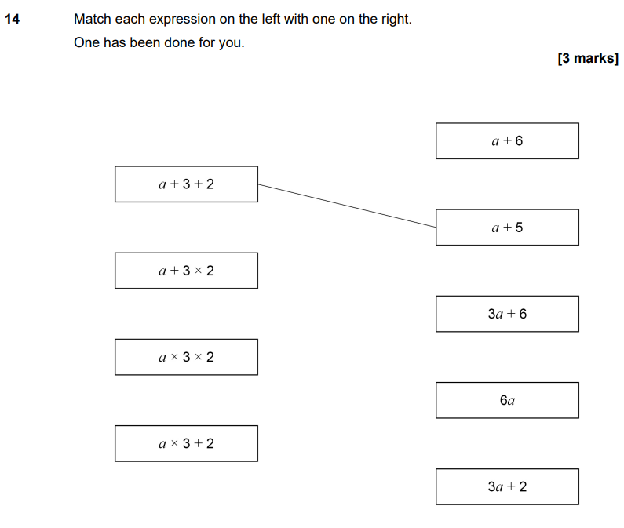
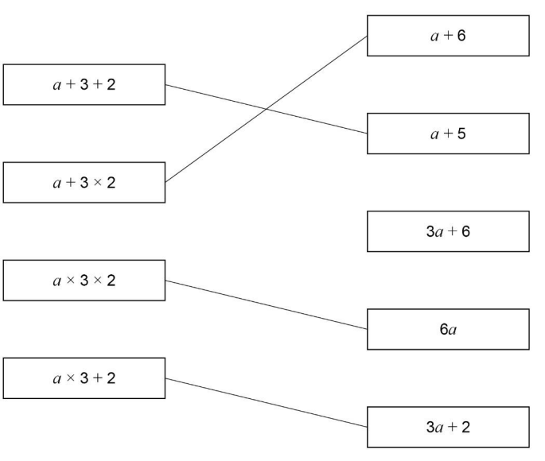
June 2022 Paper 3

Slide 15
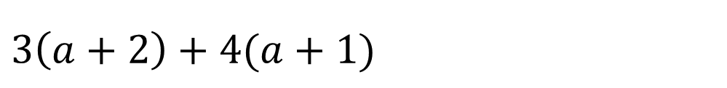
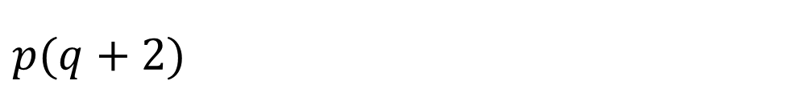

EXPAND
$$p(q+2)$$
$$pq+2p$$
$$7a+10$$
$$3\left(a+2\right)+4(a+1)$$

Slide 16


Your turn…
$3(u+8v)$
$t(t−14)$
$6(4x+5y)$
$−(n−11)$
$−y\left(2y+6\right)$
$−5p(q−7)$
$2\left(z+3\right)+4(z+2)$
$4\left(6b−5\right)+(b−2)$
$7\left(5x−3\right)−(x+2)$
$5\left(2q+5\right)−2\left(q−2\right)$
$4p\left(p+5\right)−3\left(p+1\right)$
$4\left(t+1\right)−7t(2t−8)$
3u + 24v
6z + 14
25b - 22
34x – 23
8q + 29
4p²+17p-3
-14t²+60t + 4
t² - 14t
24x + 30y
-n + 11
-2y² - 6y
-5pq + 35p

Slide 17
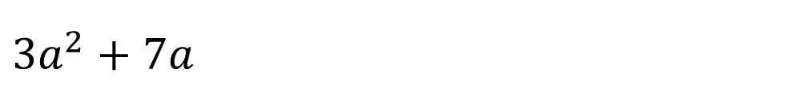
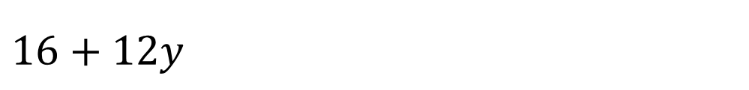

FACTORISE
$$16+12y$$
$$4 (4+3y)$$
$$a(3a+7)$$
$$3a^{2}+7a$$

Slide 18


Your turn…
$28+7v$
$5a+15b$
$12c−9d$
$6x+24y$
$21u−7v$
$3c−15d²$
$4b^{2}+9b$
$2x+7x^{2}$
$7y^{2}+15y^{3}$
$16z^{2}−8z$
$21q−14q^{2}$
$20uv^{3}−5v$
7 (4 + v)
b (4b + 9)
5 (a + 3b)
x (2 + 7x)
3 (4c – 3d)
y² (7 + 15y)
6 (x + 4y)
8z (2z – 1)
7 (3u – v)
7q (3 – 2q)
3 (c – 5d²)
5v (4uv² – 1)

Slide 19
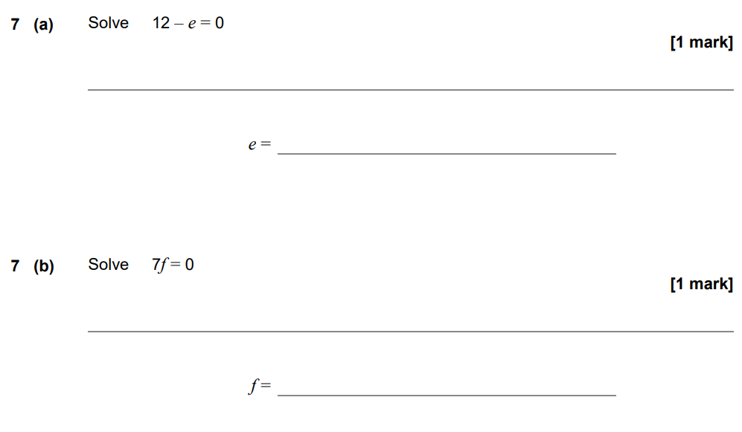
7th Nov 22 Paper 3
12
0

Slide 20
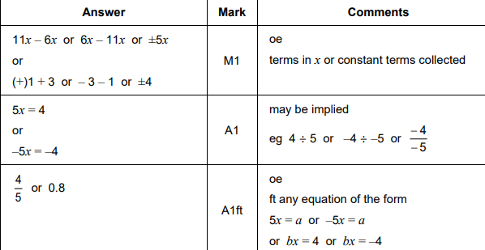
1st Nov 22 Paper 1

Slide 21
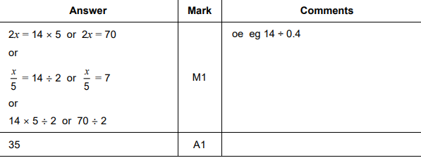
1st Nov 22 Paper 1

Slide 22
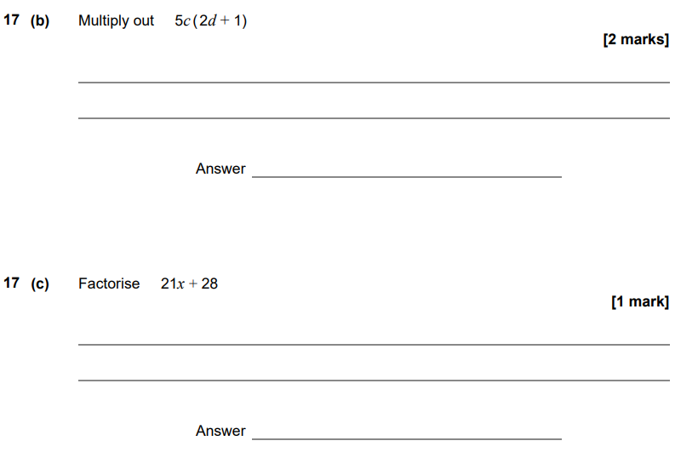
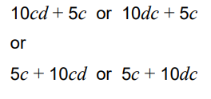

June 2022 Paper 3

