Slide 1

GCSE
revision

Slide 2

8.47 x 10⁶

Slide 3
140
Find the prime factors of 60

Slide 4
Find LCM
15 20

Slide 5
BODMAS
solve
21/3+ 5 x -2

Slide 6
4(6)²=
solve
3(8)³ =

Slide 7

simplify
2(√36)+1

Slide 8
2x2⁴x2³
2x2x2x2x2
simplify

Slide 9

Write the inequality for values from
-8 to 2 but not including 2

Slide 10
3 and 2/3
+
1 and 1/4

Slide 11
£400 + 2% for
5 years

Slide 12
9cm on a map
with scale
1cm=50km is how far?

Slide 13
16, 21, 26, 31..
Find the 10th
term

Slide 14
Find upper and
lower bounds
of 39.6 to 1dp

Slide 15
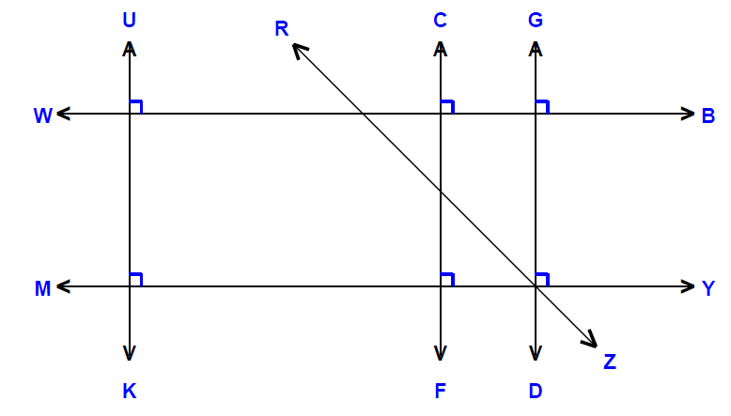
Identify any …Parallel lines
..quadrilateral shapes,…..triangles, …right angles etc

Slide 16

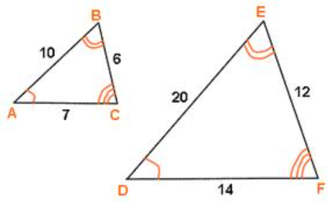
Describe how the
2 shapes are similar
SSS SAS ASA RHS ?

Slide 17

Where are the
Coordinates
(-3,7) and (2,-6)

Slide 18
Draw in a line of symmetry between the two triangles

Slide 19
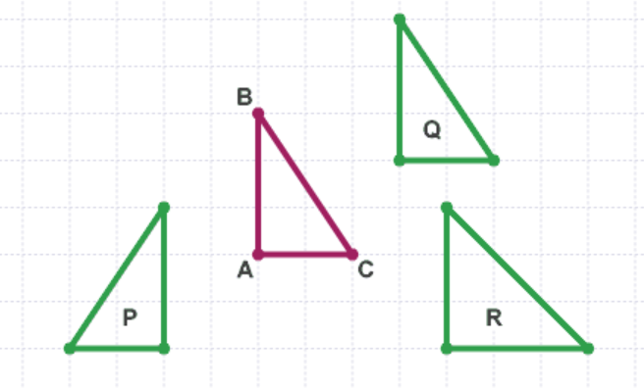
Choose which shape has
been ‘Translated’ from ABC and describe the translation

Slide 20
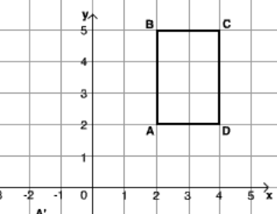
Rotate the shape 270º clockwise
about the point (1,2)

Slide 21
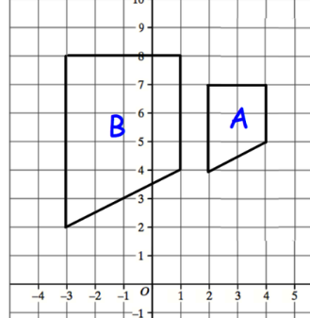
Describe the enlargement from A to B and find the point of enlargement

Slide 22

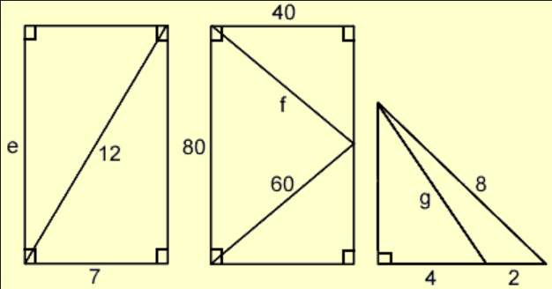
Find lengths e f and g using Pythagoras

Slide 23
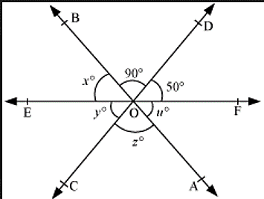
Find the missing angles, x, y, z and u

Slide 24
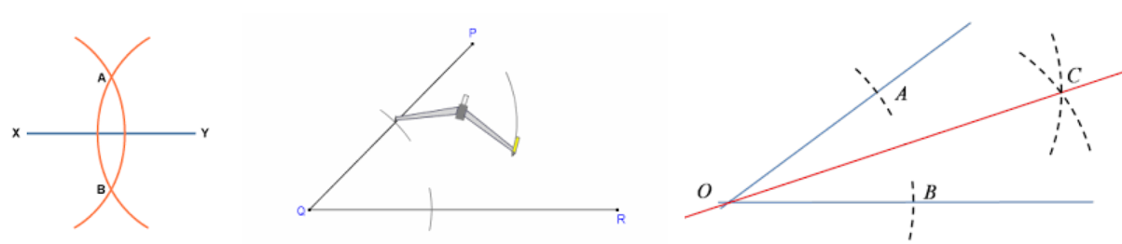
Bisect and angle of 50º to produce two 25º angles…
Bisect a line through its centre

Slide 25
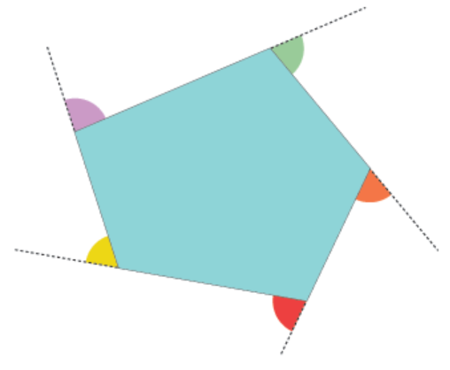
Calculate the interior and
exterior angles of a
seven sided shape

Slide 26
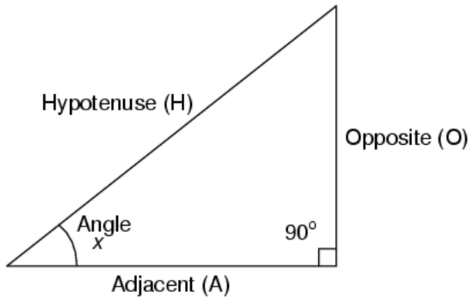
Find the angle x when opp=8 and hyp=10

Slide 27
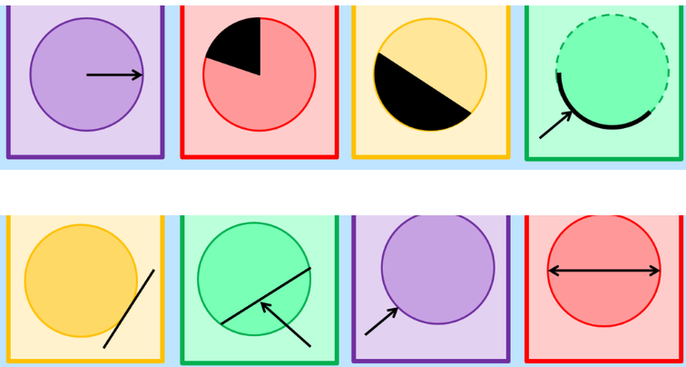
Name all the parts of the circles

Slide 28
Find the area of the circle..
Find the circumference
r=3.5

Slide 29


Find the total surface area of the prism net
5
5
5
6

Slide 30
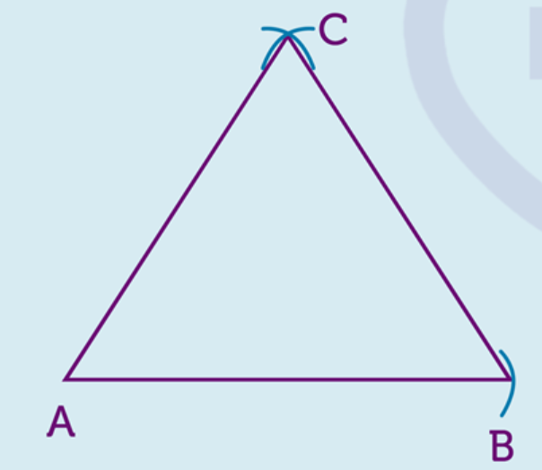
Shade the region closer to line AC than AB and nearer to C than line AB

Slide 31
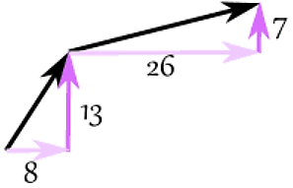
Write in vector notation then add to get the resultant vector

Slide 32

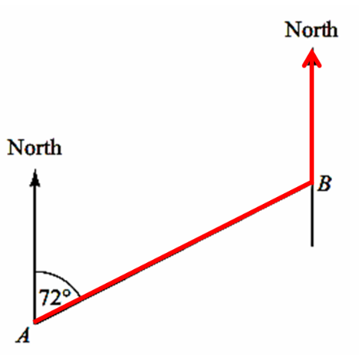
Find the bearing from B back to A

Slide 33

Change 328.064mm into centimeters then meters
Change 0.0067kg into grams and milligrams

Slide 34

Change 18lbs into kg
Change 200ml into flozs
Change 16miles to km

Slide 35
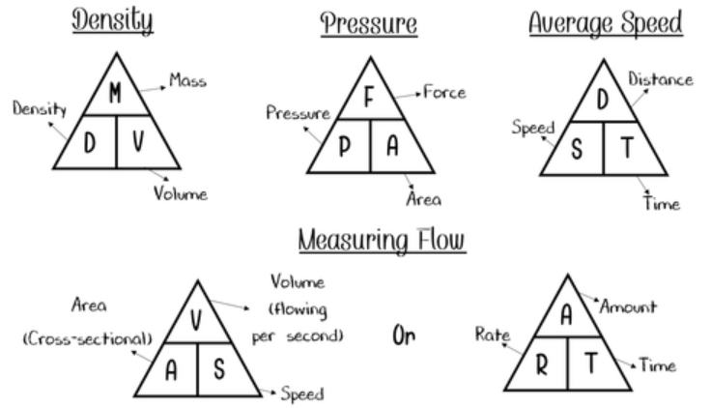
Find speed when distance=20miles and time = 15mins

Slide 36
Simplify
3x+9y-4x-7y+10x-5y

Slide 37
Factorise and solve
X² -7x -18=0

Slide 38

Simplify
3a²xb⁴xa⁻³xb⁻²

Slide 39

find C when x=2 and b=3
C=(1/2)(5b+3x-10)

Slide 40
Solve to find x
3x+5 = 2x-8

Slide 41
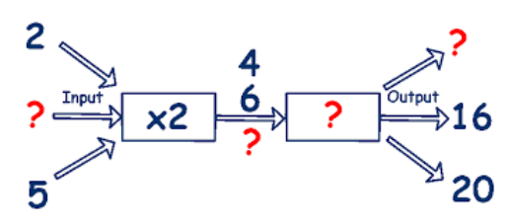
Discover all the missing
numbers in the number machine

Slide 42
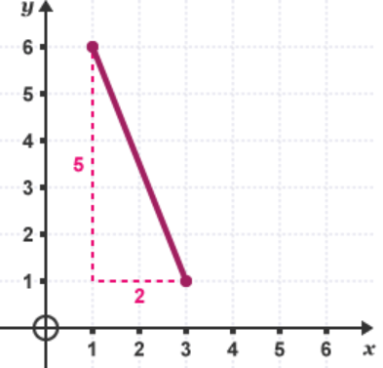
Find the line gradient then write the equation of the line

Slide 43
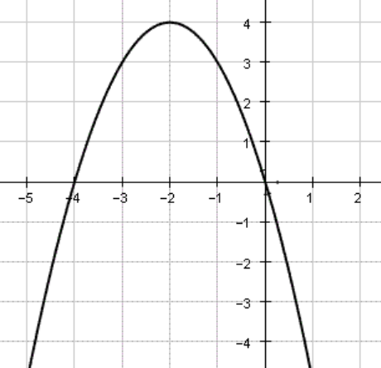
Find the roots of the graph
Find the equation of the graph

Slide 44
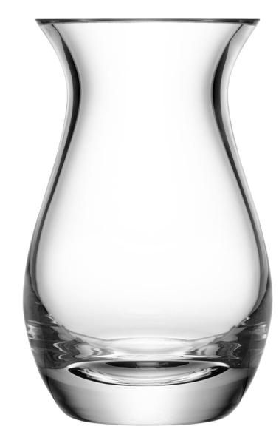
Draw a graph of the vase filling up with water at a constant rate

Slide 45
Solve the simultaneous equations for x and y
4x-2y=-14
3y=16x+1

Slide 46
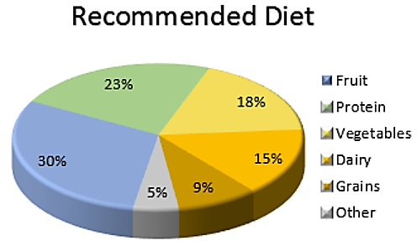
If fruit is 50 find out how much
each other section is worth

Slide 47
Find the MEAN MEDIAN
MODE and RANGE
15, 6, 9, 4, 6, 10, 12

Slide 48
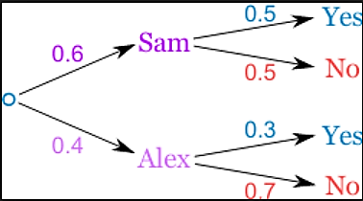
How more likely is it that Alex
says ‘No’ than Sam says ‘Yes’

Slide 49
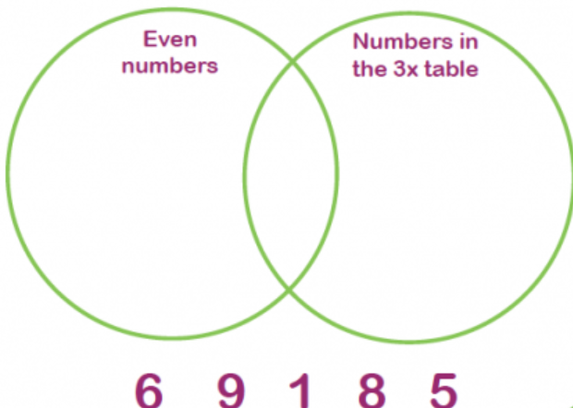
Put the numbers in the correct place on the Venn

