Slide 1
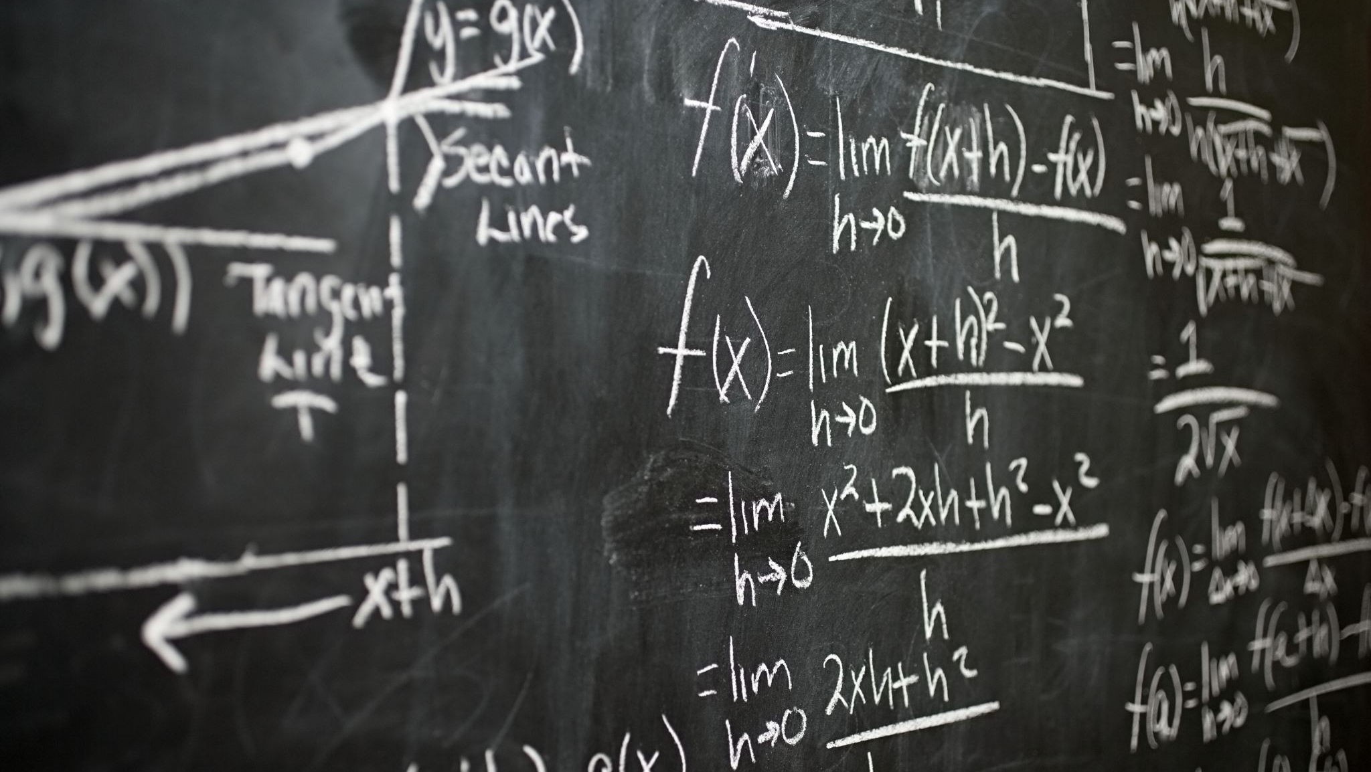
Maths Intro to Number

Slide 2
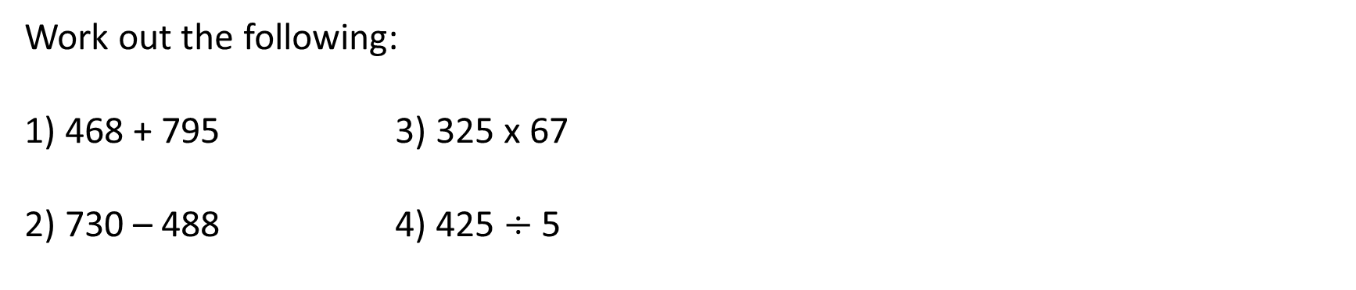
INTRODUCTION TO NUMBER
Learning Objectives
To be able to :
Identify factors and multiples of two or more numbers LCM HCF
Round numbers to 1, 2 and 3 decimal places
Round numbers to 1, 2 and 3 significant figures
BIDMAS Revision
Work out the following:
1) 468 + 795 3) 325 x 67
2) 730 – 488 4) 425 $÷$ 5

Slide 3
Prime Numbers/Prime Factorisation
List all the prime numbers less than 20.
Express 42 as a product of its prime factors.

Slide 4
Your turn…
Here is a list of numbers
10 11 16 24 30 40
Write down a multiple of 20
Write down a factor of 12
Write down a prime number
Express 100 as a product of its prime factors.
Express 75 as a product of its prime factors.
Express 108 as a product of its prime factors. Give your answer in index form.
2) Here is a list of numbers
15 16 17 18 20 22 24 29
Write down the prime numbers
Write down a factor of 30
Write down an even multiple of 3

Slide 5

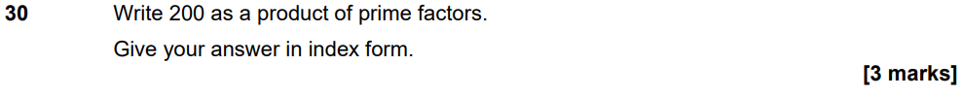
Nov 21 Paper 1

Slide 6
LCM and HCF
Find the LCM of 6 and 8.
Find the HCF of 32 and 56.

Slide 7
Your turn…
Find the LCM of the following:
4 and 5
8 and 12
6 and 9
12 and 15
5, 8 and 10
Find the HCF of the following:
18 and 28
16 and 40
42 and 90
40 and 63
20, 64 and 108
20
2
24
8
18
6
60
40
1
4

Slide 8
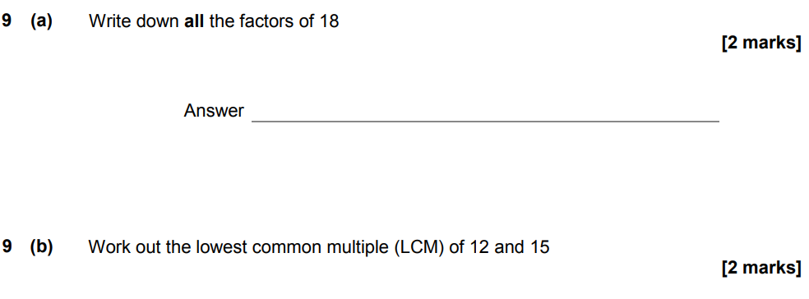
Set 4 Paper 1

Slide 9
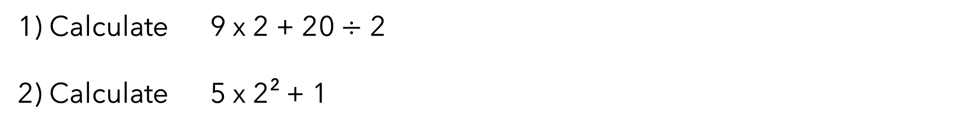
BIDMAS
What does BIDMAS stand for?
Calculate 9 x 2 + 20 $÷$ 2
Calculate 5 x 2² + 1

Slide 10
Your turn…
Joey thinks the answer to 16 + 4 x 2 is 40. Albert thinks the answer to 16 + 4 x 2 is 24. Who is correct? Explain your answer.
Put brackets in the following statements to make them true.
6 x 7 + 3 − 8 = 52
4 + 3 x 7 − 1 = 42
16 – 5 x 2
10 – 3²
8 + 3(5 – 1)
2³ + 3²
(2 + 5)²

Slide 11
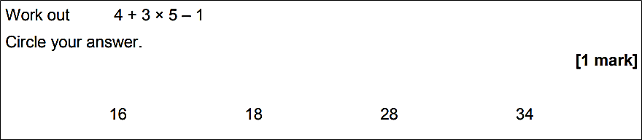
Set 4 Paper 1

Slide 12
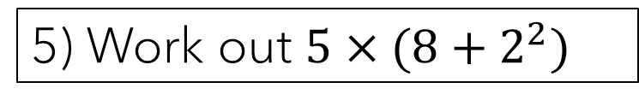
STARTER
1) Write 240 as a product of primes. Give your answer in index form.
4) Each member of a club is going to receive a badge. There are 140 members. The badges are sold in packs of 9. Work out the least number of packs of badges that need to be bought.
2) Find the lowest common multiple of 9 and 12.
3) Find the highest common factor of 30 and 18.
5) Work out $5×(8+2^{2})$
Notes:
To check understanding of topics being covered in the lesson. Some classes will know how to do majority of these, therefore you can skip some bits out and spend time on what your students need help with the most.

Slide 13
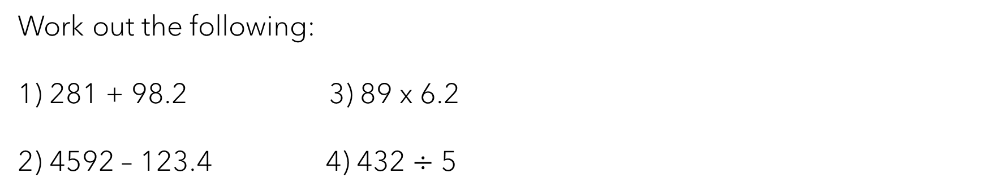
INTRODUCTION TO NUMBER
Learning Objectives
To be able to :
Round numbers to 1, 2 and 3 decimal places (estimating)
Round numbers to 1, 2 and 3 significant figures (estimating)
Complete error intervals
Work out the following:
1) 281 + 98.2 3) 89 x 6.2
2) 4592 – 123.4 4) 432 $÷$ 5

Slide 14
Rounding to Decimal Places
1 d.p
2 d.p
2 . 6 3 8 5 3
2 . 6 3 8 5 3

Slide 15
Rounding to Significant Figures
1 s.f
2 s.f
3 s.f
553
553
0. 6 5 4 5 3

Slide 16
Your turn…
Round 785 to the nearest ten
Round 785 to 1 significant figure
Round 623.819 to 1 decimal place
Round 623.819 to 1 significant figure
Round 0.214 to 2 decimal places
Round 0.2175 to 2 significant figures

Slide 17
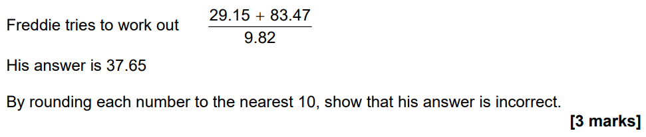
Nov 21 Paper 1

Slide 18
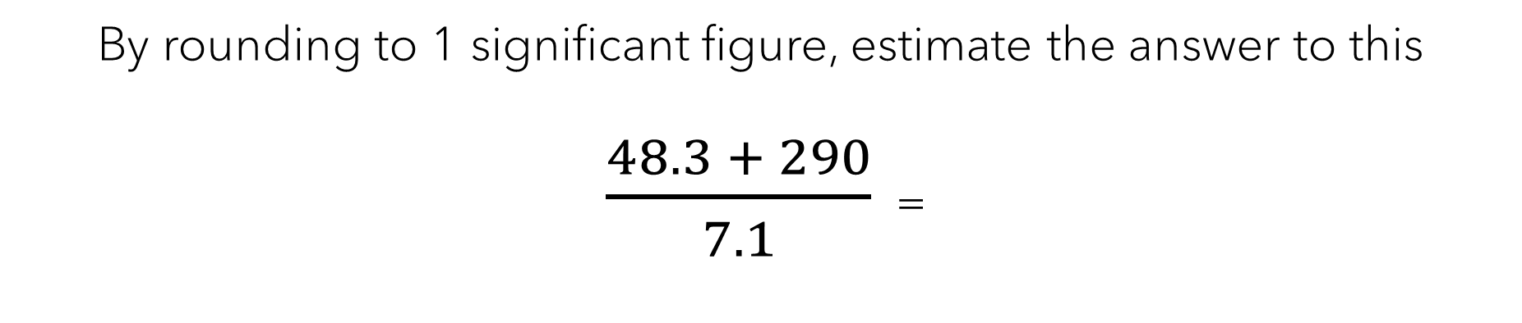
Estimation
By rounding to 1 significant figure, estimate the answer to this
482 x 12.2 =
By rounding to 1 significant figure, estimate the answer to this
$\frac{48.3 + 290}{7.1}$ =

Slide 19
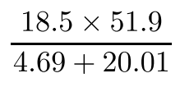
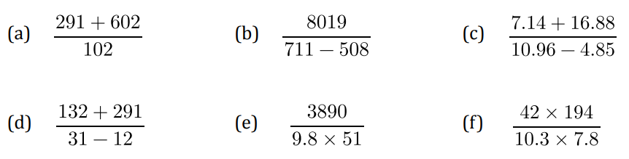
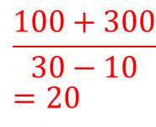
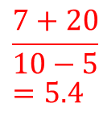
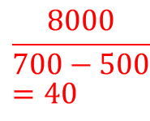
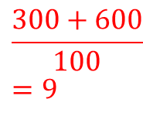
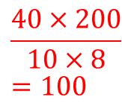
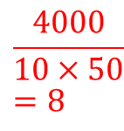
Your turn…
Work out an estimate for the following:
Work out an estimate for the following:
$$\frac{300+600}{100}=9$$
$$\frac{8000}{700−500}=40$$
$$\frac{7+20}{10−5}=5.4$$
$$\frac{100+300}{30−10}=20$$
$$\frac{4000}{10×50}=8$$
$$\frac{40×200}{10×8}=100$$

Slide 20
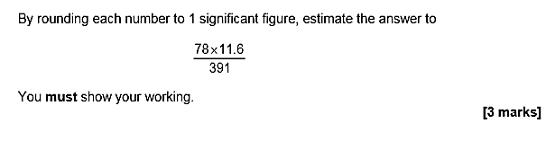
Set 3 Paper 1

Slide 21

Error Intervals
A number, when rounded to the nearest 10, is 50. What is the lower bound and what is the upper bound?
The mass of a coin is 8 grams to the nearest gram. Complete the error interval below.

Slide 22
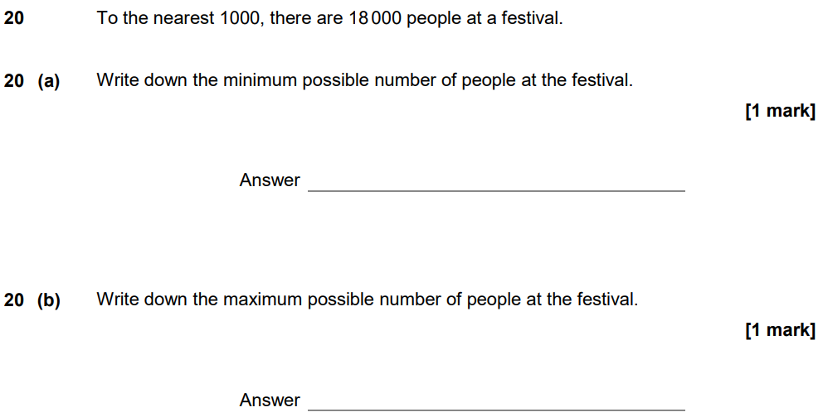
Set 4 Paper 1

