Slide 1
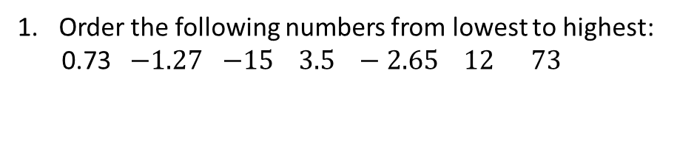
BIDMAS
Learning Objectives
To be able to :
Follow the order of precedence of operators, including indices
Recap
Order the following numbers from lowest to highest:
0.73 $−1.27$ −15 3.5 − 2.65 12 73
3.
A holiday costs £240 per person for a family of four. a) How much will the holiday cost in total?
b) Round your answer to the nearest hundred pounds
2.
There are 300 people who wish to go on the same coach trip. One coach can seat a maximum of 65 people.
a) How many coaches will be needed?
b) How many people will be seated on the last coach?
4. Work out 6²
Calculate $\sqrt{25 }$
5.

Slide 2
STARTER
BIDMAS
Indices
1. Work out the following:
a) 3 x (12 − 4)
b) (30 − 15) ÷ 3
c) 18 – 3 x 5
d 15 + 6 − 2 x 7
2. Work out the following:
2²
4²
3³
5³ + 2²

Slide 3
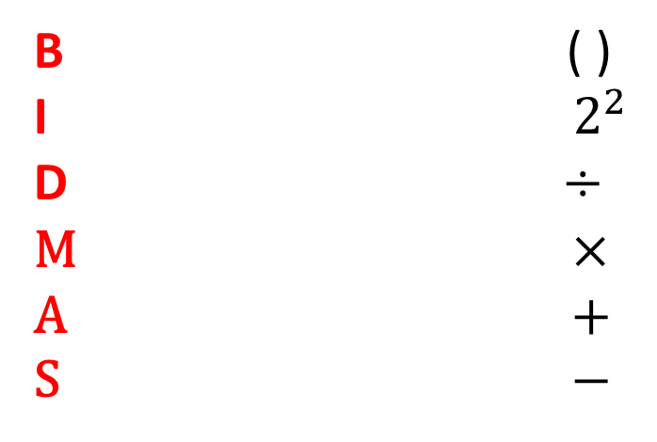
BIDMAS
B ( )
I $2^{2}$
D ÷
M ×
A +
S −
a) 5 - 1 + (7 x 5) b) 16 ÷ 4 + 5 x $3^{2}$

Slide 4

Your turn…
1. Work out the following:
a) (3 + 3) x 4
b) 4 x 2 − 5
5 + 7 ÷ 6
5 × 3 + 5
(9 − 4)² + 5
2 x (15 − 2)
(5 x 4) + 2²
( 8 + 2) ÷ 10
(1 + 14) − (5 x 3)
(10 + 6) ÷ (4 x 2)
1 + 2² x (6 − 3)
(7 x 2) ÷ (20 − 6)
3 − $\sqrt{36}$ + (18 − 6)
(9 x 4) − $\sqrt{(5 ×5)}$

Slide 5
INDICES
3² = 3 x 3 = 9
5³ = 5 x 5 x 5 = 125

Slide 6

Your turn…
Evaluate the following:
Find the value of:
4²
7²
2³
3³
2⁶
f) 6⁴
g) 8⁵
3² + 4³
i) $1^{2}$ + 2² + 3²
j) 3 x 2⁵
4² x 2²
l) 80 − 6⁶
5² − 2³

Slide 7



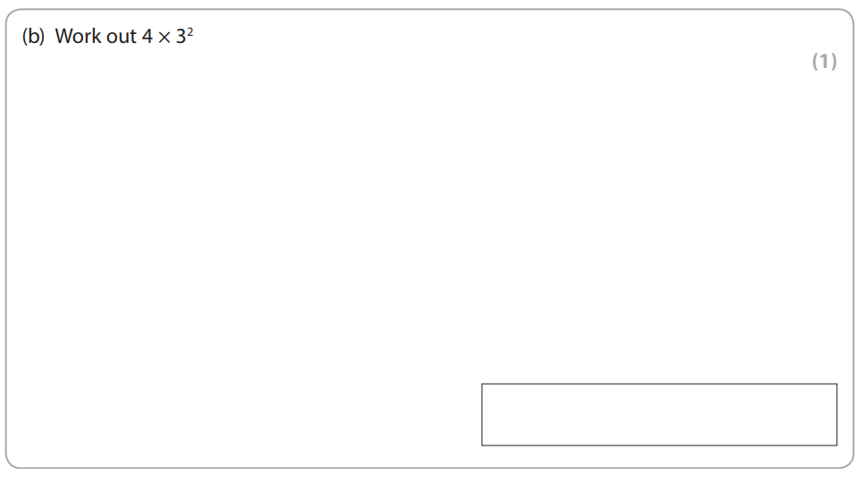

Slide 8

