Slide 1
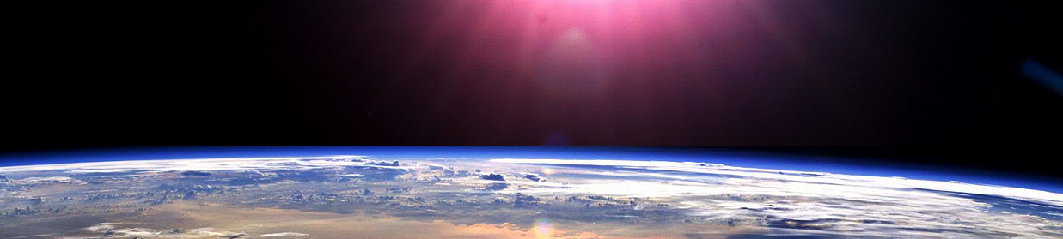



Slide 2







RATIOS AND SCALE

Slide 3



















Course Content: Choose your topic …
Whole Number and Functions
place
value
negative
numbers
add and
subtract
multiply
divide
round
numbers
ratio
scale
fraction
decimal
numbers
percent
percent
decimal
fraction
MATHS E3 to L2
Parts of a whole
metric
measure
imperial
measure
perimeter
area
volume
formulae
bodmas
charts
data
averages
prob-
ability
Measure and Shape
Handling Data

Slide 4





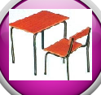







Home Revision Progress Check 1 Video/Discuss Vocab / jobs Lesson Activities Quizzes Topic Answers Progress Check 2 Cont. Learning
Topic Introduction : Ratios and Scale
Ratios allow you to relate quantities to each other. If you do something to one value then the same happens to the other the same number of times. This topic involves lots of multiplying and dividing as it often involves finding a value that relates the two quantities together and finding this amount usually starts by dividing.
This topic has many uses and other maths topics are combined with it. This can make this topic one to concentrate hard on, finding the relationships between seemingly separate topics that are in fact the same thing expressed differently.
Choose an icon to select where to start
Ratios and Scale

Slide 5



Warm Up Exercises 1
Lets start today by revising ! Complete the above sums and multiplication grid

Slide 6

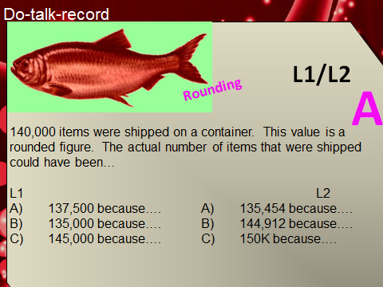

Warm up Exercises 2

Slide 7
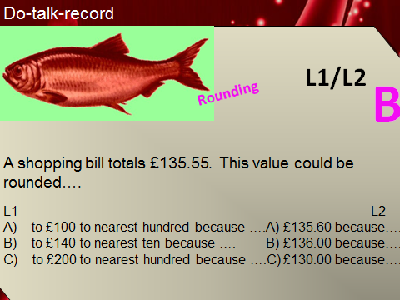
Warm Up Exercises 3

Slide 8

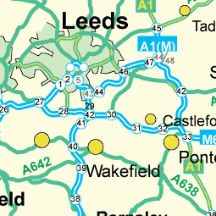
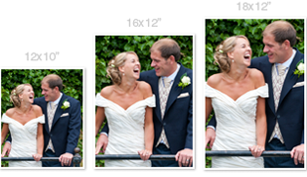
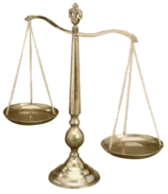
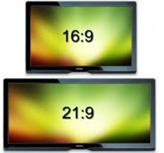
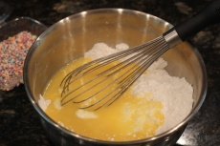
Progress Checker 1
What do you already know about ratios and scale ? What did you learn during the week? examples…..
How would you rate your skills in using ratios and scale ?
Excellent ability
Good ability, but working to improve
Ok, making a start but I know I have lots to still learn
The date I started studying: My aims for today are …
A To read and write quantities in ratio form
B Change ratio values to equivalent or simplest forms, keeping proportions correct
C Use ratios to solve problems, including splitting values up
1:10,000

Slide 9


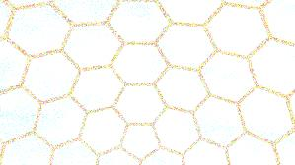

Introductory Video and Discussion
KHTU.
What is the difference between ‘ratio’, ‘scale’ and ‘proportion’ ?
What is the ‘Golden ratio’ and what uses are there for it ?
Why does a map scale always start with a 1 eg. 1:25,000 ?
Are fractions and ratios just the same thing written differently ?
Can you relate more than two quantities together in ratio form ?
How are ratios used in mixtures ?
Watch the introductory video and then discuss the above
Your thoughts..

Slide 10


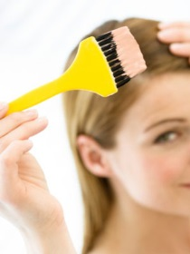
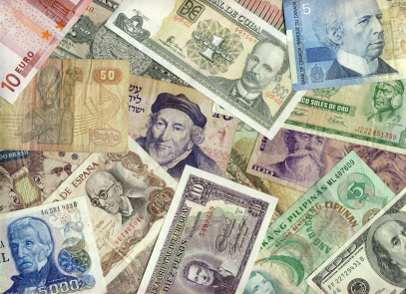
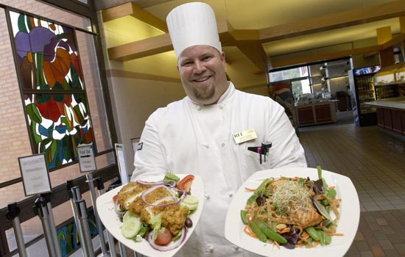

Vocabulary and Jobs
Ratio
Proportion
Scale
Enlarge/Enlargement
Reduce/Reduction
Equivalent
Simplest form
Golden ratio
Mixture
Composite
Chef
Hair dresser
Architect
Driver
Currency Exchange
Child Care
Shareholders
Building/Construction…. Can you think of more? ……………………
……………………………………
These are the words you will be using in this topic

Slide 11

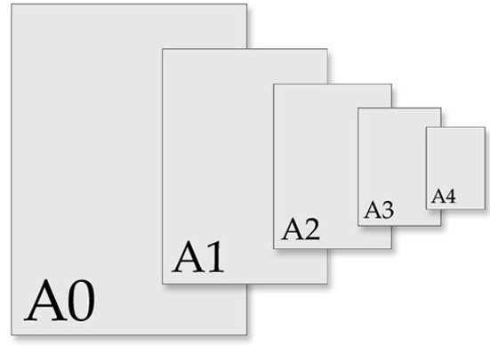
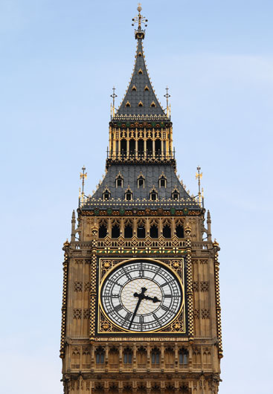
Lesson: Concept Activity
Draw Big Ben Clock Tower
Draw an ‘Enlarged image’ of the same picture
Draw a ‘reduced sized image’ of the same picture
Measure the size of the images
Can you find how much bigger and smaller the other images are to the original ??

Slide 12

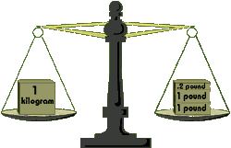
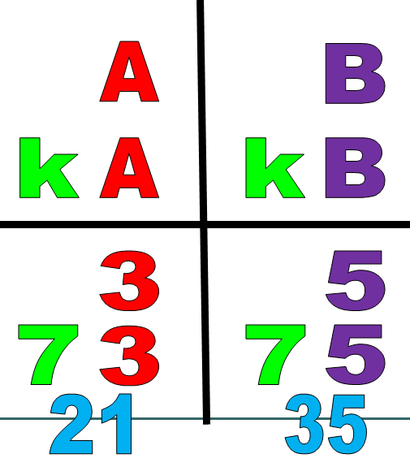
Lesson: Main Teach
A Ratio is a balancing of two values against each other.
When one value changes (gets larger or smaller by a number of times) the other value also changes by the same amount of times.
A Ratio Box can help to set out your problems

Slide 13

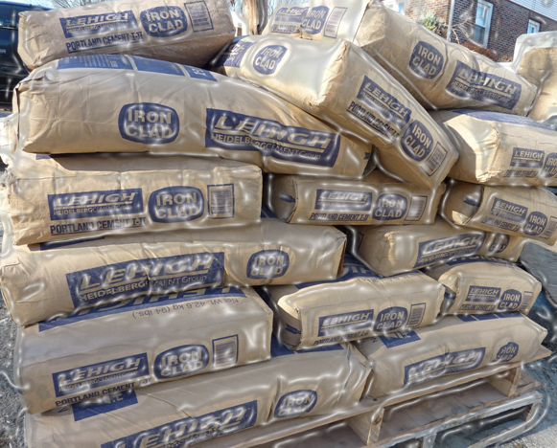

Lesson: Main Teach
Writing Ratios: an example……… “I have 10kg of sand and 15kg of cement”
1) To write a ratio find the two units that relate to each other
Eg Sand and Cement
2) Set up a box, writing the two units above the two columns
Eg Sand Cement
Place any original values that you know about the units (before they change) at the bottom of the box
Eg Sand Cement (Setting up this box is a very good check that
the values you are using are ‘ORIGINAL’ unchanged amounts)
Orginal Original
4) Place a colon between the two values…..from left to right this ratio now reads 10 kg : 15 kg
This is a ratio that means you for every 10kg of sand you need 15kg of cement.
IMPORTANT !! RATIOS ARE ALWAYS READ FROM LEFT TO RIGHT
10 kg
15 kg

Slide 14

Lesson: Main Teach
Changing Amounts: an example……. “A ticket costs £6. How many tickets can I buy for £24 ?
Find the two units that relate to each other
Eg Tickets and Pounds
2) Set up a box, writing the two units above the two columns
Eg Tickets Pounds
Write the ORIGINAL values at the bottom in the correct columns, write any new CHANGED amounts above.
Eg Tickets Pounds
New New
Orginal Original
Find out by how much one of the values has changed by DIVIDING the NEW by the ORIGINAL
Ratio Change Formula: Scale Factor = New / Original Eg (this means the cost of the tickets
is 4 times larger)
MULTIPLY the other value by this scaling factor to find the other new value
Eg
6) The answer is …”you can buy 4 tickets (for £24)”
24
1
6
24 / 6 = 4
24
1 x 4 = 4
4
x4
1
6

Slide 15

Lesson: Main Teach
Equivalent Ratios: an example……. “Simplify 250mm : 750mm”
1) Set up a box, writing the two values at the TOP
Eg
New New
Find a ‘FACTOR’ of both numbers and divide them both by this factor
(reminder: the word ‘Factor’ means a number that another number can be divided by, eg 6 is a factor of 12 because 12 can be divided by 6)
Eg
New simplified ratio is 25 : 75…….this can continue to 5 : 15, then 1 : 3
Continue to find factors of the two numbers and dividing them both each time until one of the values becomes a PRIME number, the number ONE or both numbers can no longer be divided by a same value.
250
750
250
750
/10
/10
25
75
Now watch the tutor video

Slide 16

Lesson: Try out
Block 1 : Watch tutor led demo (in class or on video)
Try these, 1) Write “five people have ten pounds” as a ratio 2) Write “picture width is 10cm and length 30cm” as a ratio 3) Write “three companies have £1M” as a ratio 4) Write “ five pounds is worth seven dollars” as a ratio
5) Write “one and a half hours per movie” as a ratio 6) Write “an equal share between two” as a ratio !
Block 2 : Watch tutor led demo (in class or on video)
Try these, 7) Use a ratio of 1 : 2 to increase £600 8) Use a ratio of 3 : 2 to decrease 150g
Use a ratio of 10 : 7 to decrease 1000ml 10) Write a ratio that increases a score from 60% to 70%
Find the missing values 11) 12) 13) 14)
Block 3 : Watch tutor led demo (in class or on video)
Try these, 15) Simplify 8 : 10 to its lowest terms 16) Reduce to its simplest form 20 : 5
Simplify 10% : 15% 18) Make a 1 : ?? ratio from… 0.2 : 3 19) Share £400 in a ratio 3 : 1
20) 1/3 : 2 = 1 : ?? 21) A map scale is 1 : 400,000, how far is 6cm on the map in km (100,000cm=1km)?
10
9
1
20
12
240
5
20
18
6
4
20

Slide 17
Lesson: Websites and links
Ratio Fruit Machine practice, hold and nudge ratios to score points
http://www.mymaths.co.uk/samples/sampleGameFruitRatio.swf
Divide numbers up into their factors to help practice find simplified ratios
http://illuminations.nctm.org/ActivityDetail.aspx?ID=64
Blast equivalent ratios in this fun game
http://www.mathplayground.com/ASB_RatioBlaster.html
Motor bike race while practicing equivalent ratios
http://www.arcademics.com/games/ratio-stadium/ratio-stadium.html
Bitesize website video and ratio instructions, examples and visuals
http://www.bbc.co.uk/schools/gcsebitesize/maths/number/ratiosact.shtml
Variety of word problems with visuals and guidance on solving
http://www.thinkingblocks.com/ThinkingBlocks_Ratios/TB_Ratio_Main.html
BBC bitesize website’s help with methods, activities and practice
http://www.bbc.co.uk/bitesize/ks3/maths/number/ratio/revision/4/
Wiki’s simple guide to the basics of ratios, stating methods and video instruction
http://www.wikihow.com/Calculate-Ratios
Examples of splitting up values into ratios
http://www.mathsteacher.com.au/year10/ch17_variation/03_dividing/25div.htm

Slide 18

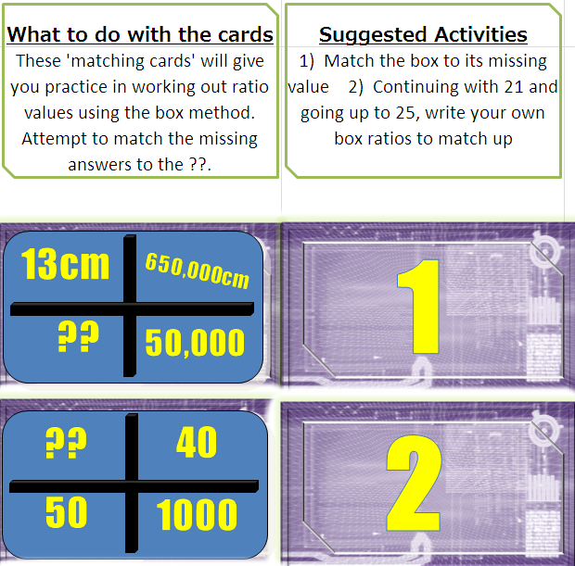

Lesson: Exploratory Activity A

Slide 19
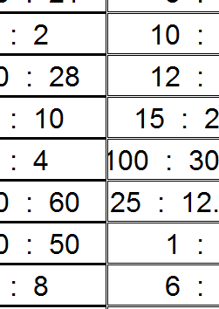
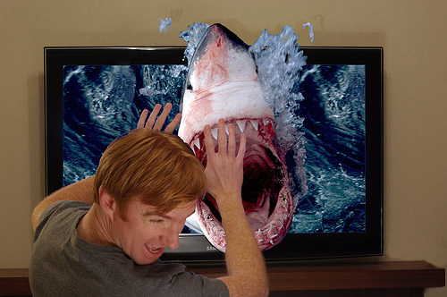
Lesson: Exploratory Activity B
Pictionary Game !
Split into teams and pick 3 green ratio cards at random
Choose a drawer from each team to start and which team goes first
Pick a card and draw the object/item, your team needs to guess what you are drawing within 1 minute
If your team guesses correctly they can either pick another green ratio card or discard one they do not want to another team
If your team does not get it correct the other team get a chance to guess and if correct discard or choose a new green ratio card
Play for 20 minutes
After 20 minutes both teams start with 1 point and then arrange their remaining green ratio cards to create a winning score
Scoring Multiply each ratio by the next in sequence
Eq Team 1 starts with score 1, then has ratio cards 1 : 6, 3 : 1 and 1 : 10
So 1 x 6 = 6 now use 6 as new score so 6 x (1/3) = 2
lastly use 2 as new score for the final ratio so 2 x 10 = 20
Team 1 scores 20 points !!

Slide 20
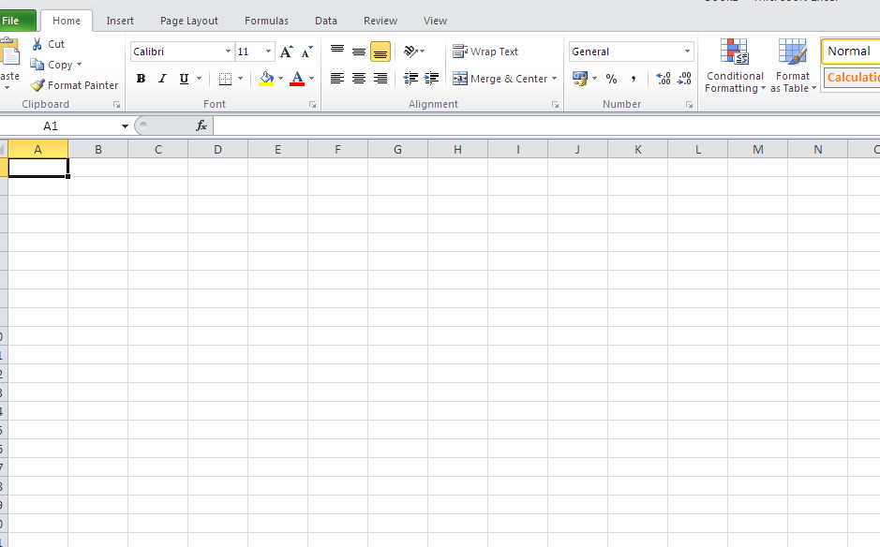

Lesson: Exploratory Activity C
Computer Activity
Create a ‘Ratio Box’ on a spreadsheet
Create formulae that will allow the computer to solve ratio problems for you
Use your computer ratio boxes to check your work on other games/sums/
worksheets/ books
Y

Slide 21
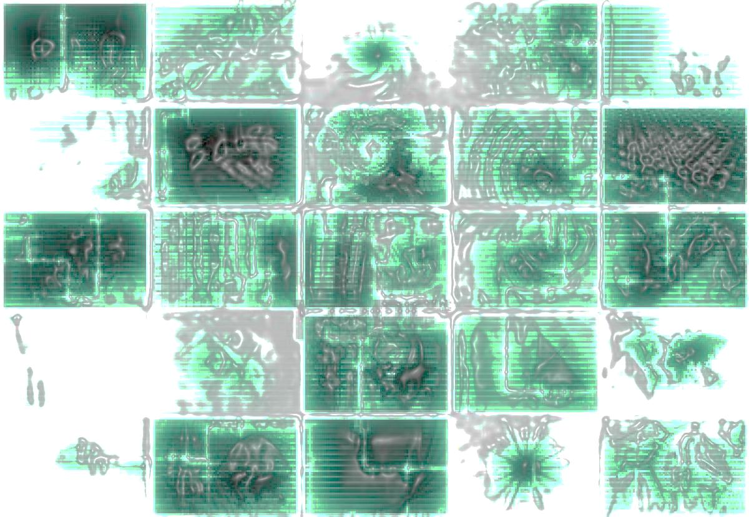
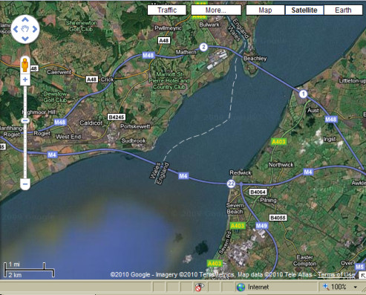
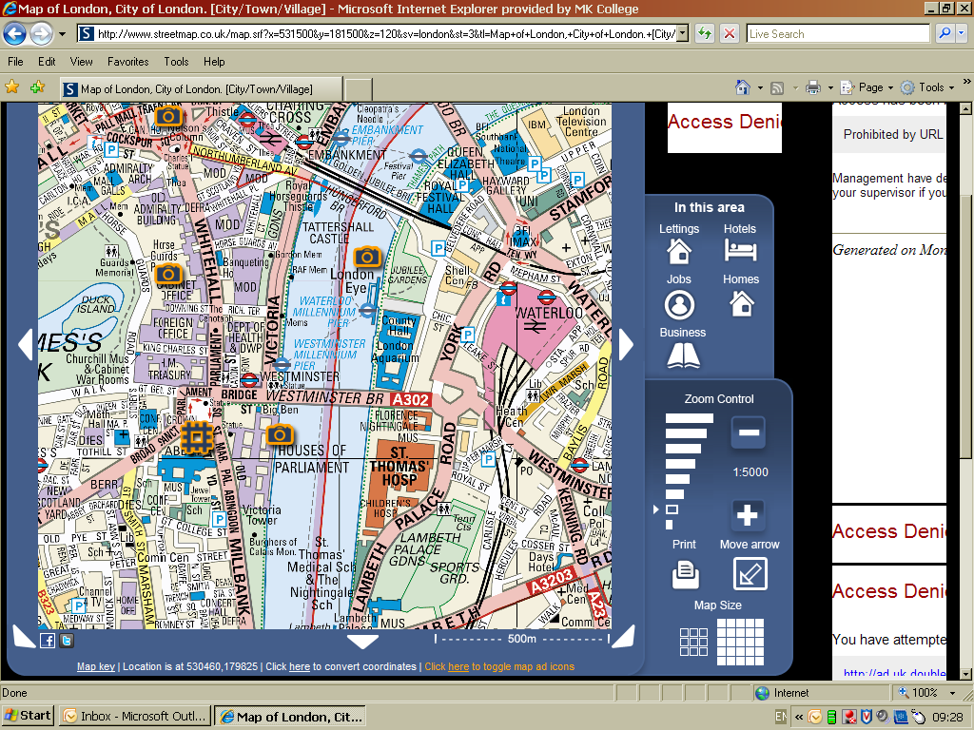
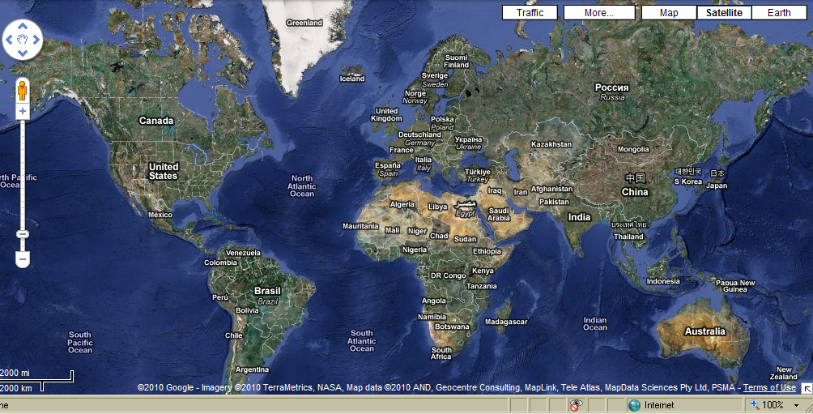
Lesson: Exploratory Activity D
Use the maps and question sheets to answer the functional skills questions. Don’t forget to lay out your workings to show how you solved the problems

Slide 22


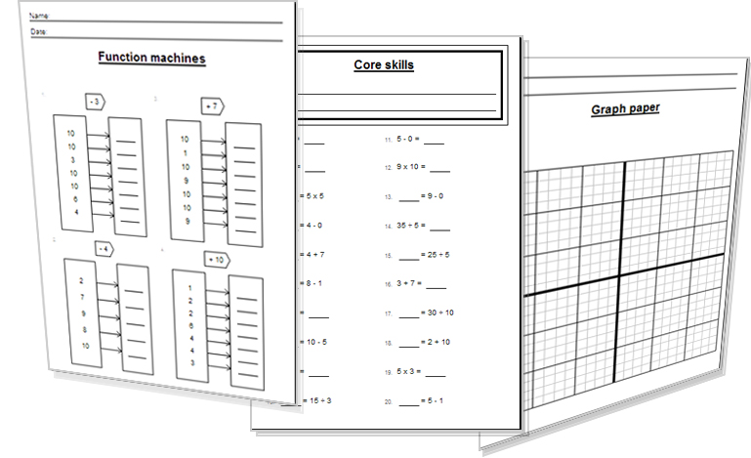
Lesson: Activity E
Try a variety of written practice
Worksheets
Workbooks
Practice Exam Papers
Maths Problems

Slide 23


Lesson: Practice – just the numbers
A Write what each ratio means
Eg: 1 : 2 means x2 bigger
1 : 3 …………………………………..
1 : 5 ……………………………………
4 : 1 ……………………………………
11 : 1 …………………………………..
2 : 8 …………………………………..
7 : 1 …………………………………….
10 : 1 ………………………………….
1 : 50 …………………………………
2 : 100 ………………………………
15 : 5 ………………………………..
C Simplify these ratios
Eg : 3 : 6 = 1 : 2
18) 4 : 2 ………………………………
16 : 8 …………………………….
18 : 6 ……………………………..
10 : 100 …………………………
4 : 20 …………………………….
63 : 9 ……………………………
7 : 56 ………………………………
D Simplify these ratios
Eg : 3 : 6 = 1 : 3
45 : 9 …………………………….
300 : 15 …………………………
1K : 500 …………………………
80% : 15% ……………………
1/5 : 4/5 ………………………
£3M : £2K …………………….
2cm : 50mm ………………..
240 : 80 ………………………..
E Increase or decrease the values shown using the ratio given
Eg: £400 by 1 : 3 = £400 x3 = £1200
2 by 1 : 10 =
9 by 1 : 5 =
10 by 1 : 4 =
25 by 5 : 1 =
18 by 3 : 1 =
16 by 2 : 3 =
30 by 6 : 5 =
19 by 1 : 6 =
40 by 4 : 2 =
300 by 15 : 1 =
£2.50 by 5 : 6 =
20 miles by 10 : 15 =
F Split these values up in the given ratios
Eg: 200g, 1 : 2 : 2 (1+2+2 =5 parts so 200g/5 =40g) 40 : 80 : 80
£300 , 1 : 3 : 5 =
500 , 2 : 1 : 2 =
600m 40 : 20 =
B Write what each ratio means
Eg: 1 : 2 means x2 bigger
3 : 2 ……………………………………
3 : 9 ……………………………………
10 : 2 ………………………………....
60 : 40 ……………………………….
½ : 4 ………………………………….
50% : 25% …………………………
0.3 : 0.03 …………………………

Slide 24

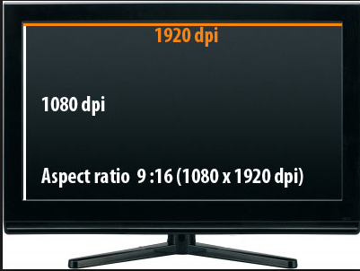
Lesson: Practice – word problems
Q1 A boxer wins 1:2 of his fights. In his career he has 60 professional fights. How many does he win?
Q2 To place a pic on Facebook I need to reduce its memory size in a 4 : 1 ratio. The original pic has 2MB (two million bytes of memory). What is the memory size of the reduced pic ?
Q3 A TV has a screen ‘Aspect Ratio’ of 4 : 9. If the
actual length of the screen is 45cm, how tall is it ?
Q4 A map scale is 1 : 60,000. A distance measured on a map is 3cm. How
far is the real distance ?
Q5 Sales of shoes to clothes in a shop are at 2 : 7. If one million pairs of shoes are sold, how many items of clothing are sold?
Q6 A mixture for a drink is made with concentrate 1 part and water 5 parts. I want to make three litres of drink. How much water do I need. Clue..1000ml is 1 litre
Q7 Two companies make the following losses during the year. What is the ratio of losses between company A and B in its simplest terms ? Company A - £ 24 Company B - £ 6

Slide 25
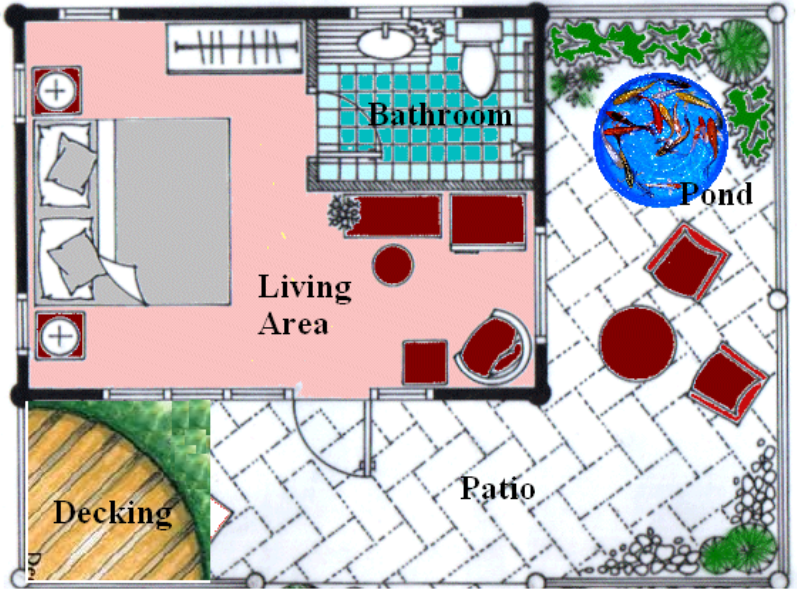
Lesson: Practice – Making it Functional
Answer the questions relating to this picture, on the next page

Slide 26


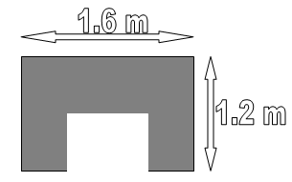
Lesson: Practice – Making it Functional
The width of a chair in the garden is 1 metre. Measure the chair in the drawing and work out a scale for the drawing.
Using your scale work out how long the actual length of the bed is.
How long is the actual length of the garden?
Draw a BBQ onto the drawing in the garden that has the following actual dimensions…

Slide 27
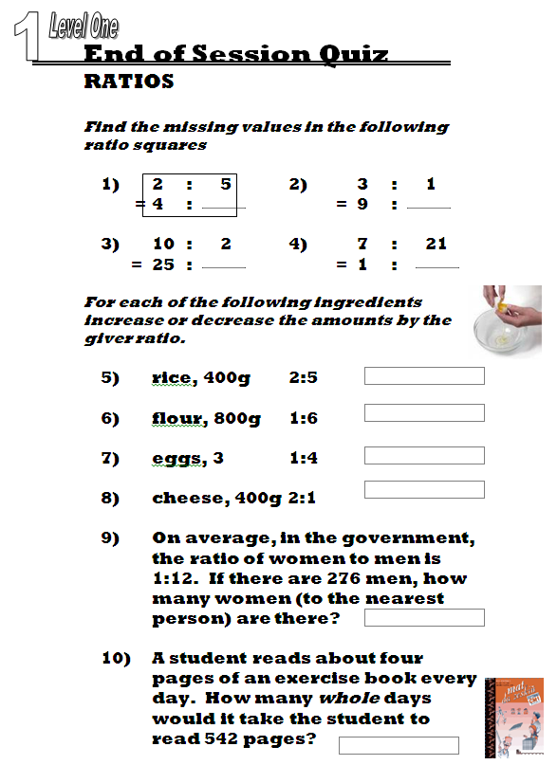


Homework: Quiz to assess LEVEL 1

Slide 28
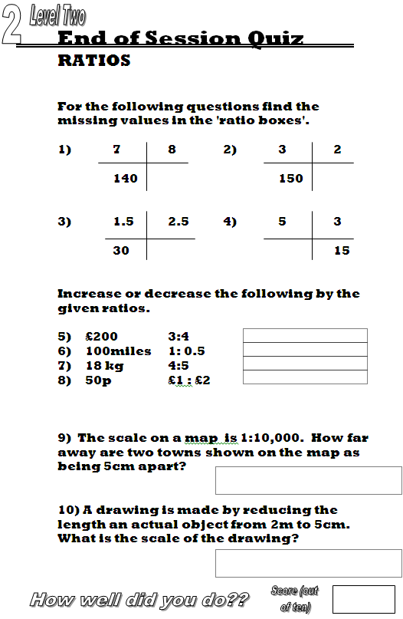
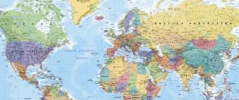

Homework: Quiz to assess LEVEL 2

Slide 29
TOPIC ANSWERS 1
E cont.
5
6
24
25
114
20
20
£3
30 miles
F
£33 : £99 : £166
200 : 100 : 200
400m : 200m
Word Problems
Q1 boxer wins 20 fights
Q2 500kb memory, (500,000)
Q3 20 cm tall
Q4 180,000cm which is 1800m or
1.8 km
Q5 3.5M
Word Problems cont.
Q6 2.5 litres of water (which is 5/6 of 3 litres
Q7 4 : 1
Functional Skills Q’s
Your answer will be around 2cm wide for the chair if you view it on a laptop screen or print on A4 paper so… 1m = 2cm, or the map scale is 1cm = 50cm, 1:50 (or thereabouts)
The ben in the picture is 5cm long on an A4 sheet of paper, so…. using 1:50, 5cm x 50 = 250cm long (which is 2.5m long)
The garden is 20cm long on A4, so using the scale 1:50 again, 20cm x 50 = 1000cm (or 10m)
4 The BBQ is 1.6m an 1.2m so using the scale 1:50 you need to draw them x50 smaller. 1.6m / 50 = 3.2cm long and 1.2m / 50 = 2.4cm wide
Just the sums
A
Three times bigger
Five times bigger
Four times smaller
Eleven times smaller
Four times bigger
Seven times smaller
Ten times smaller
Fifty times bigger
Fifty times bigger
Three times smaller
B
11) One third smaller
12) Three times bigger
13) Five times smaller
14) One third smaller
15) Eight times bigger
16) Half times smaller
17) Ten times smaller
C
18) 2 : 1
19) 2 : 1
20) 3 : 1
1 : 10
1 : 5
7 : 1
1 : 8
D
5 : 1
20 : 1
2 : 1
16 : 3
1 : 4
1500 : 1
2 : 5
3 : 1
E
20
45
40

Slide 30
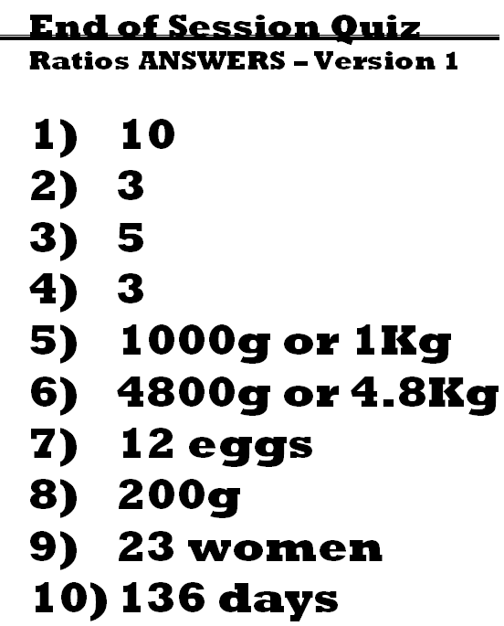
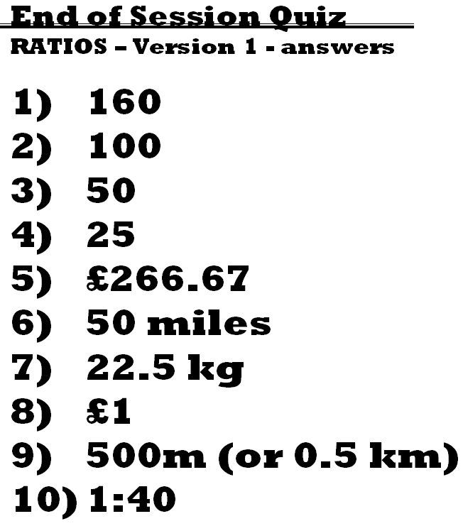
TOPIC ANSWERS 2

Slide 31
Progress Checker 2
What do you now know about ratios and scale ? What did you learn in the session? Examples…
How would you now rate your skills in using ratios and scale ?
Excellent ability
Good ability, but still working to improve
Ok, made a start but I know I have lots to still learn
The date I finished studying: My aims were…
A To read and write quantities in ratio form
B Change ratio values to equivalent or simplest forms, keeping proportions correct
C Use ratios to solve problems, including splitting values up
1:10,000

Slide 32


Continuing to Study and Learn
What else can you do to help yourself to learn and practice? Here are ten suggestions, record which you do each week and also record your progress.
Internet websites
Repeat the lesson, make notes, organise a folder, revise
Own maths workbook
Study together with a friend or family member
Finish activities in this book
Complete class handouts or tasks
Practice exams / past papers
Use maths skills learnt at home or at work in real situations
Play games
Experiment yourself, try new things ask yourself questions
Try making a graph of number of practice methods you use against your progress score in each topic. Are you showing more practice gives better results?

