Slide 1
ANGLES IN POLYGONS
Learning Objectives
To be able to :
To be able to deduce and use the angle sum in a polygon, and to derive properties of regular polygons
A box of pens contains three different colours, red, blue and green.
The probability of picking a red pen is 10%.
Three quarters of the pens are blue.
What is the probability of picking a green pen?

Slide 2
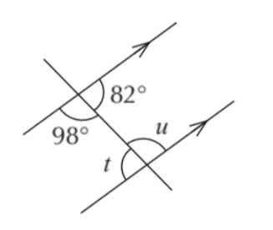
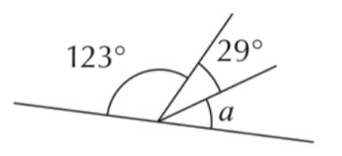
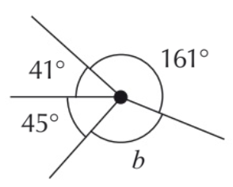
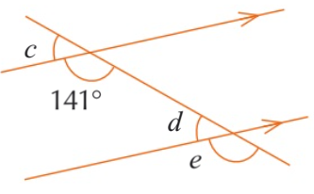
STARTER
Straight line & around a point
Angles in parallel lines
Find the size of the angle marked with a letter
Find the size of the angles marked with a letter

Slide 3
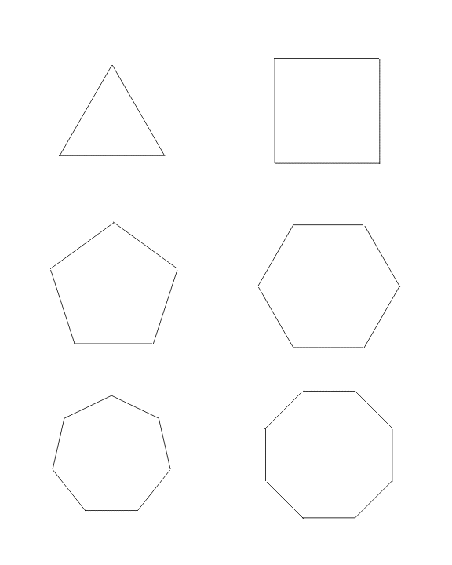
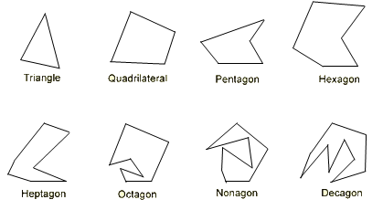
What is the difference between Regular and Irregular Polygons?
Regular Polygon
Irregular Polygon

Slide 4
Angle Sum of Polygons
Number of Sides | Name of Shape | Angle Sum
3 | Triangle
4 | Quadrilateral
5 | Pentagon
6 | Hexagon
7 | Heptagon
8 | Octagon

Slide 5
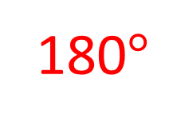
What do the angles in a triangle add up to?
180$°$

Slide 6
Angle Sum of Polygons
Number of Sides | Name of Shape | Angle Sum
3 | Triangle | 180°
4 | Quadrilateral
5 | Pentagon
6 | Hexagon
7 | Heptagon
8 | Octagon

Slide 7

What do the angles in a Quadrilateral add up to?
How many triangles are there in a Quadrilateral?

Slide 8
Angle Sum of Polygons
Number of Sides | Name of Shape | Angle Sum
3 | Triangle | 180°
4 | Quadrilateral | 360°
5 | Pentagon
6 | Hexagon
7 | Heptagon
8 | Octagon

Slide 9
How many triangles are there in a Pentagon?

Slide 10
Angle Sum of Polygons
Number of Sides | Name of Shape | Angle Sum
3 | Triangle | 180°
4 | Square | 360°
5 | Pentagon | 540°
6 | Hexagon
7 | Heptagon
8 | Octagon

Slide 11
How many triangles are there in a Hexagon?

Slide 12
Angle Sum of Polygons
Number of Sides | Name of Shape | Angle Sum
3 | Triangle | 180°
4 | Square | 360°
5 | Pentagon | 540°
6 | Hexagon | 720°
7 | Heptagon
8 | Octagon

Slide 13

How many triangles are there in a Heptagon?

Slide 14
Angle Sum of Polygons
Number of Sides | Name of Shape | Angle Sum
3 | Triangle | 180°
4 | Square | 360°
5 | Pentagon | 540°
6 | Hexagon | 720°
7 | Heptagon | 900°
8 | Octagon

Slide 15

How many triangles are there in a Octagon?

Slide 16
Angle Sum of Polygons
Number of Sides | Name of Shape | Angle Sum
3 | Triangle | 180°
4 | Quadrilateral | 360°
5 | Pentagon | 540°
6 | Hexagon | 720°
7 | Heptagon | 900°
8 | Octagon | 1080°

Slide 17
What do you notice?
Number of Sides | Number of Triangles | Angle Sum
3 | 1 | 180°
4 | 2 | 360°
5 | 3 | 540°
6 | 4 | 720°
7 | 5 | 900°
8 | 6 | 1080°

Slide 18
The Formula
Sum of interior angles of a polygon =
Find the sum of the interior angles on a dodecagon.

Slide 19
Interior and Exterior Angles
Exterior
Exterior
Interior
Interior
Interior
Exterior
Interior
Interior
Exterior
Exterior
Interior angle + Exterior angle =

Slide 20
Exterior Angles
All the exterior angles can fit around a point, as follows:

Slide 21
Calculating the Angles
Interior Angle
Exterior Angle

Slide 22
Your turn…
Interior Angles
Exterior Angles

Slide 23
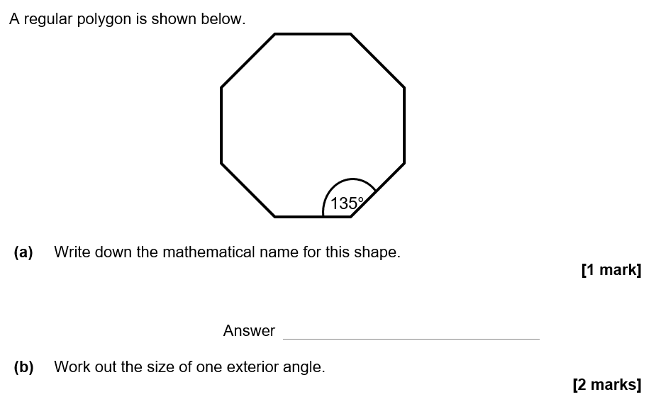
Exam Questions – AQA Topic Test

Slide 24


AQA Topic Test

Slide 25
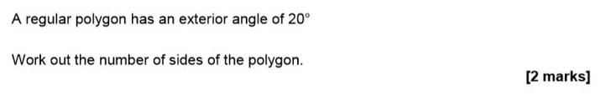
June 2017 Paper 1

Slide 26
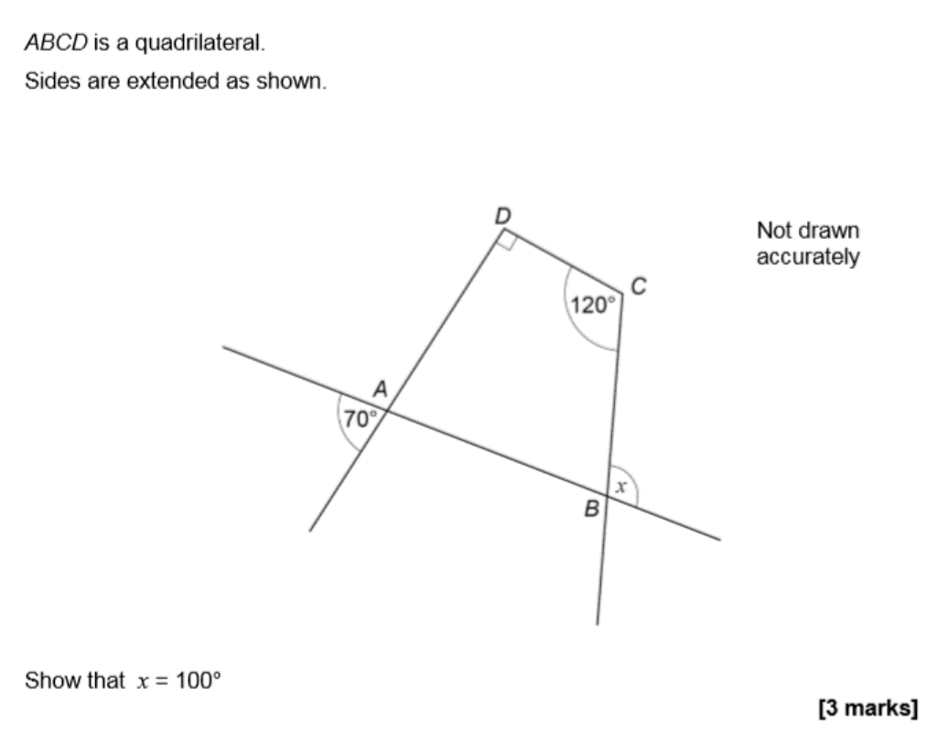
November 2017 Paper 1

