Slide 1


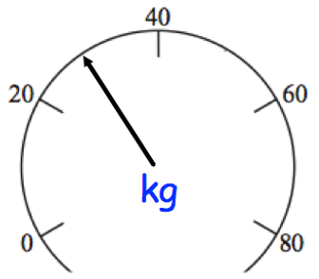


Percentage
Read, write, order and compare percentages in whole numbers
Calculate percentages of quantities, including simple percentage increases and decreases by 5% and multiples thereof
Recap
Convert the following:
700cm=_______m
850ml=________l
4600m=_______km
32cm=________km

Slide 2
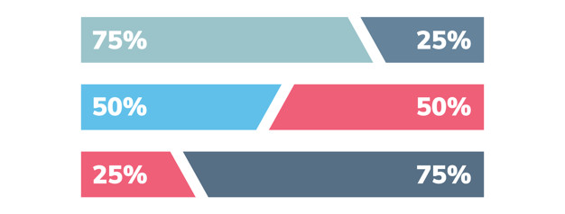
Percentage of Quantities
Calculate
11% of £290
24% of £1700
63% of £300
Calculate
17.5% of £84
40% of £6.50
110% of £200

Slide 3
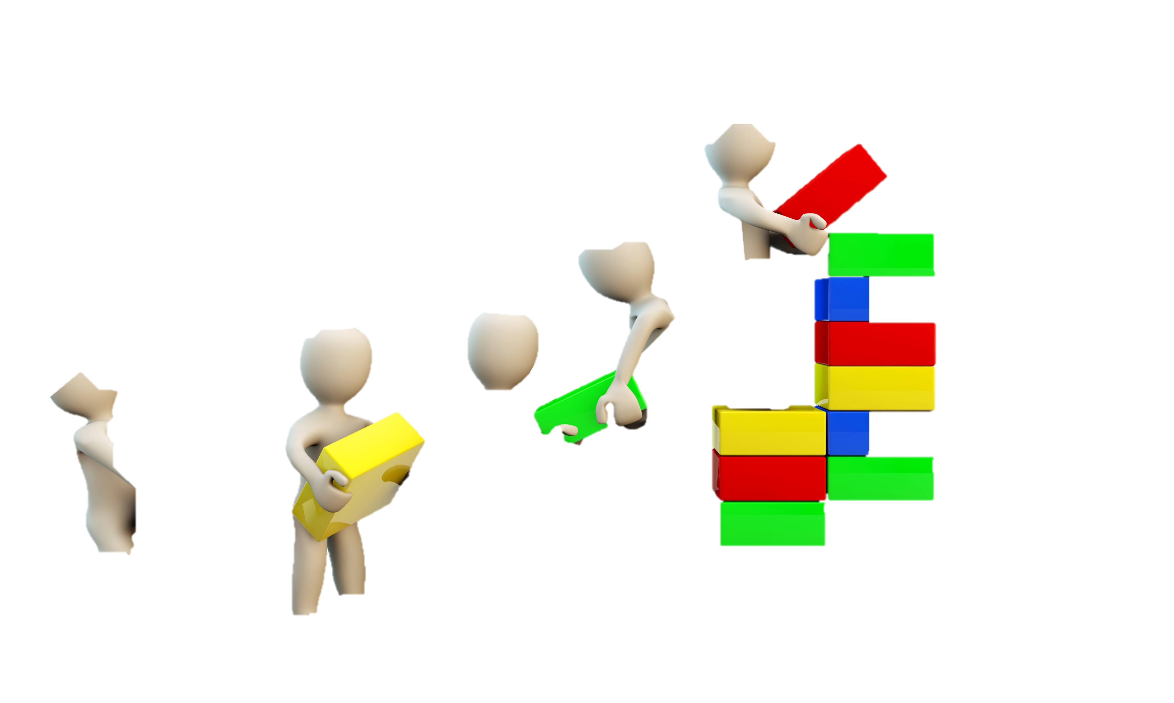
Percentage Increase and Decrease
Calculate
Increase 60 by 5%
Decrease 90 by 20%
Increase 40 by 15%
Decrease 70 by 10%.
Calculate
Increase £45 by 18%
Decrease £69 by 23%
Increase £56.80 by 30%
Decrease £3000 by 17.5%.

Slide 4
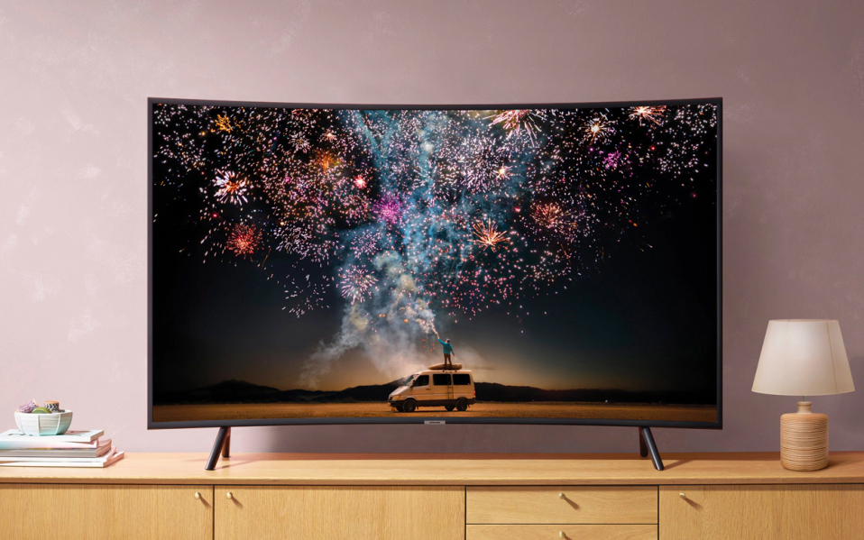
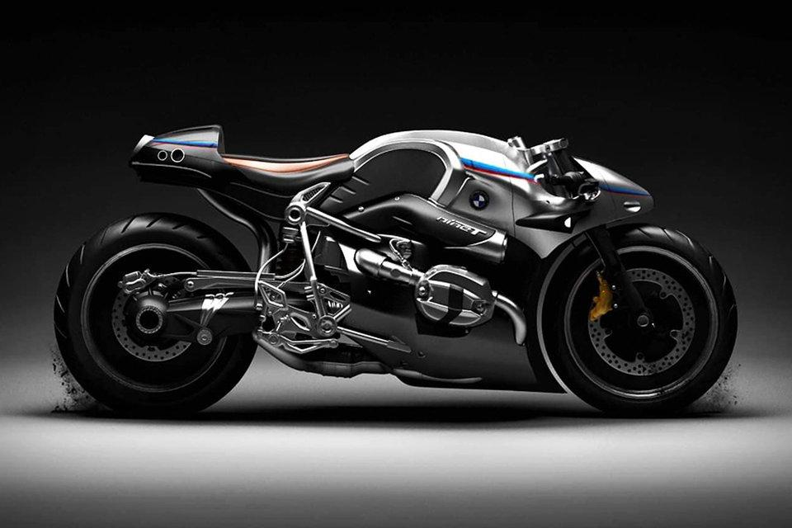
Worded Percentage of Quantities
Q1) There are 20,000 fans at a football match. 12% of the fans are women. Work out how many women attended the match.
Q2) A new TV is priced at £320. In a sale it is reduced by 45%.
Calculate the sale price.
Q3) Oliverʼs salary is £18,000 and he is due to get an increase of 5%. How much will this increase be?
Q4) Harry wants to buy a motorbike that costs £600.
He saves 30% of his wages each month.
Each month Harry earns £400.
Calculate how many months it will take Harry to save enough money.

Slide 5
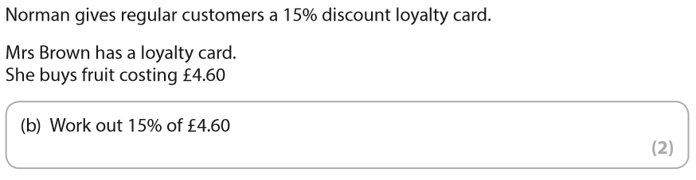

Exam Question

Slide 6
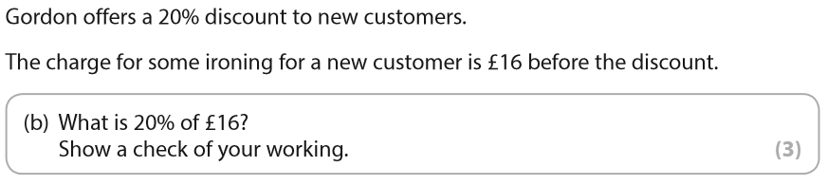
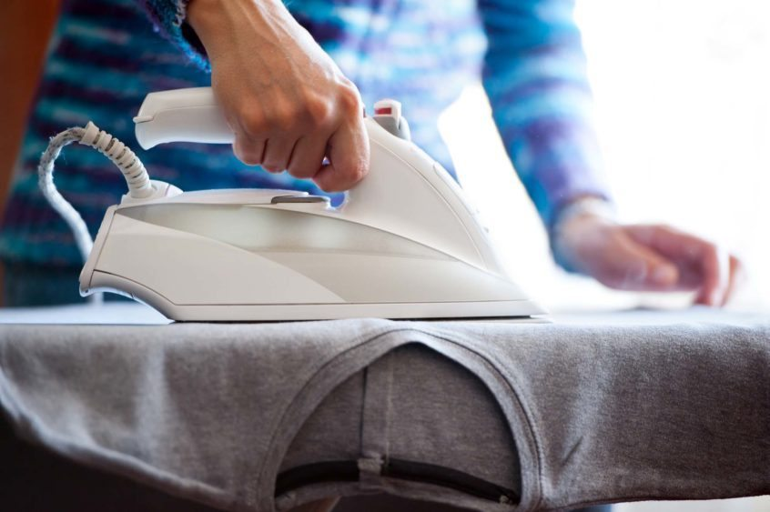
Exam Question

Slide 7
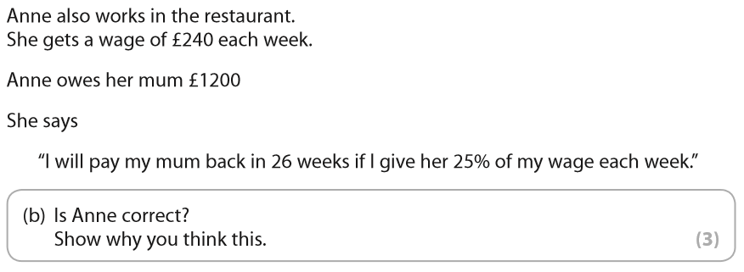
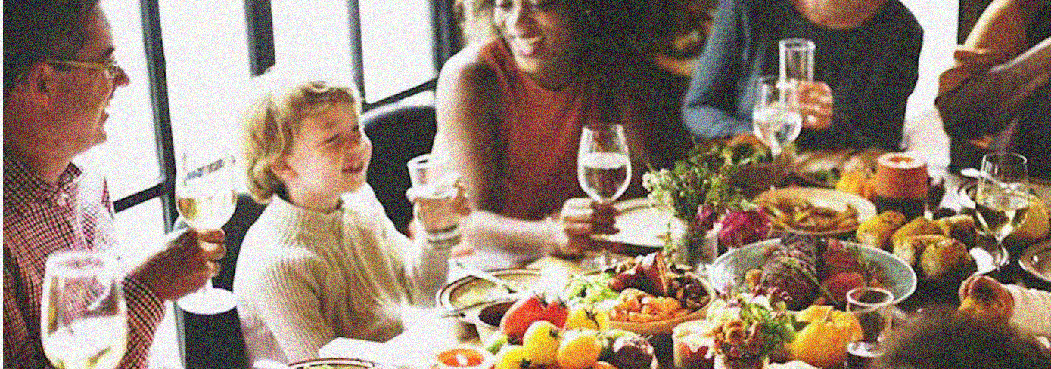
Exam Question

Slide 8
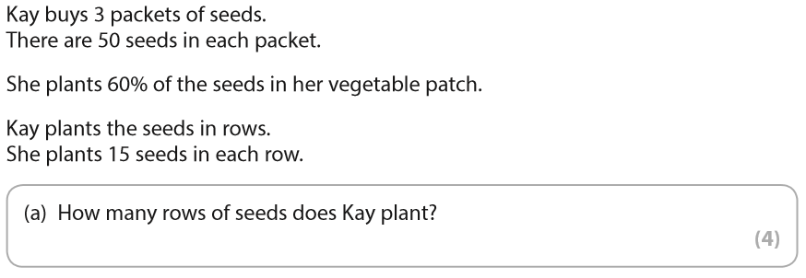

Exam Question

Slide 9
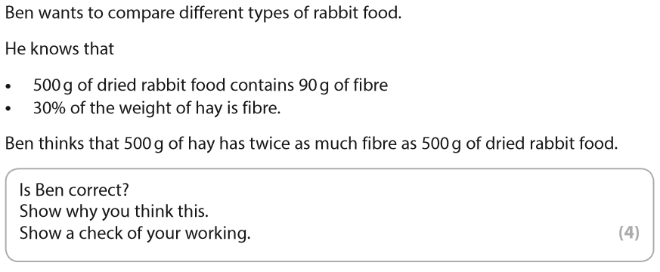
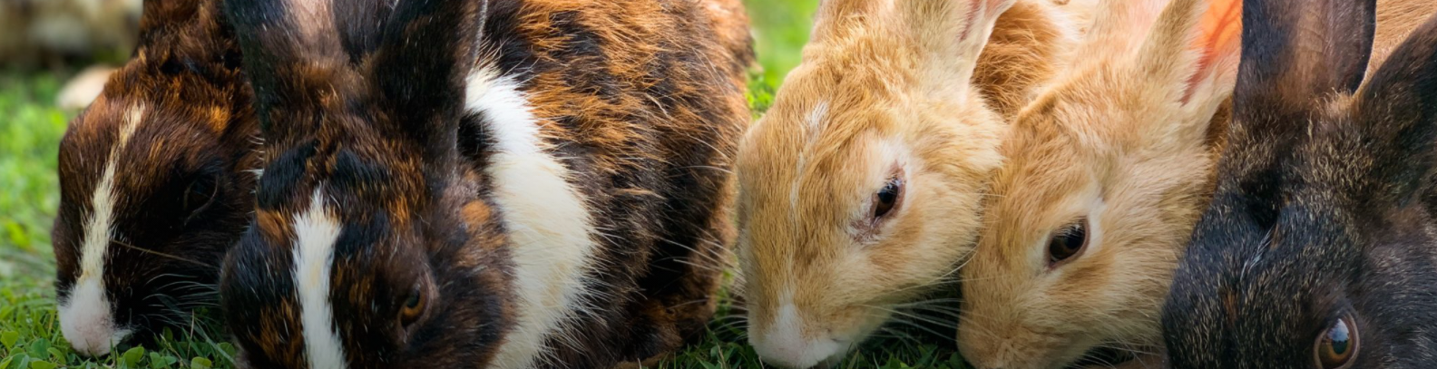
Exam Question

Slide 10
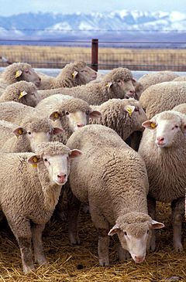
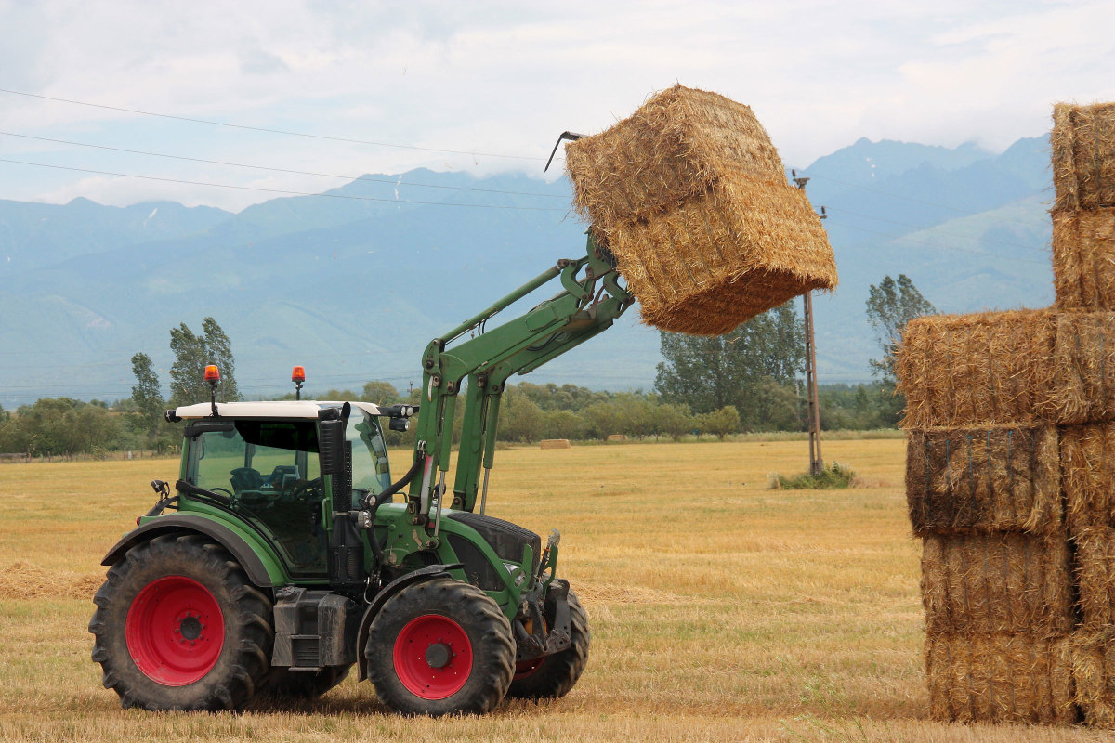
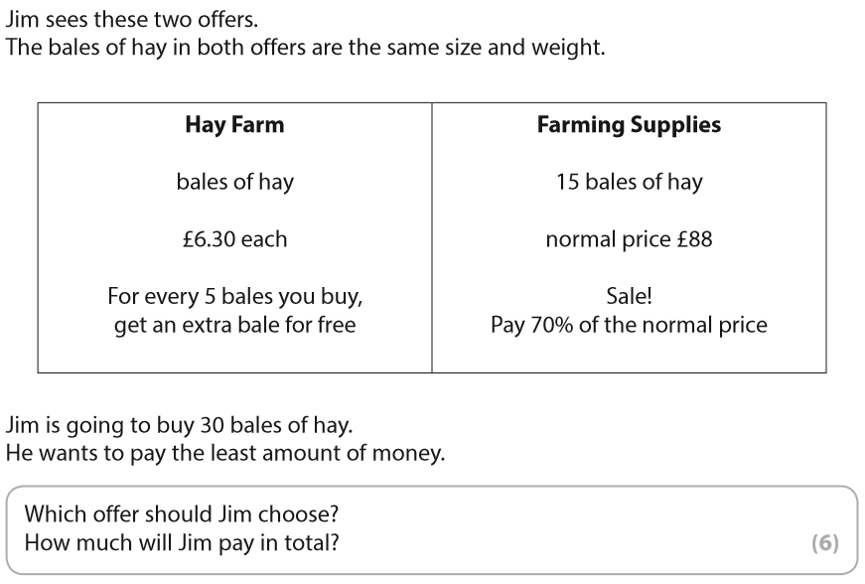
Exam Question

