Slide 1
Starter
1a) 29 x 65
b) 0.29 x 6.5
3) a) – 9 + 12 b) –8 – 7
c) – 9 x – 2
2a) 1638 ÷ 7
b) 42.5 ÷ 5
4) a) Find 3/7 of 84?
b) 2/4 ÷ 1/5?
5) Increase 60 by 15%.

Slide 2
Maps and Scales
Learning Objectives
To be able to :
To be able to use scale factors, scale diagrams and maps
To be able to measure line segments and angles in geometric figures, including interpreting maps and scale drawings and use of bearings
A tiled floor has blue and white tiles in the ratio 4 : 5. What fraction of the tiles are blue?
A piece of string is 180cm long. It is cut into 3 pieces in the ratio 2:3:4. Workout the longest piece.

Slide 3
Scale
A map has a scale of 1cm : 3 miles. On the map, the distance between two towns is 7cm. What is the actual distance between the two towns?
A map has a scale of 1cm : 4 kilometres. The actual distance between two cities is 52 kilometres. What is the distance between the cities on the map?

Slide 4
Your turn…
A map scale is given as 2cm:1km. Convert the following distances on the map to actual distances.
4cm b) 6cm c) 22cm d) 3cm e) 0.5cm
2. Using the same scale, convert the following actual distances to distances on the map.
a) 5km b) 8km c) 14km d) 3.5km e) 0.5km
2km
3km
11km
1.5km
0.25km
10cm
16cm
28cm
7cm
1cm

Slide 5
Scale Without Units
A model car has the length of 8cm. The scale of the model is 1:50 Work out the length of the real car. Give your answer in metres.
A map has the scale of 1:50000 The distance between two points on the map is 10 cm. Work out the real distance between the two points. Give your answer in kilometres.

Slide 6
Your turn…
A map has a scale of 1:4000. On the map, the distance between two houses is 9cm. What is the actual distance between the houses? Give your answer in metres.
A model plane has the length of 20cm. The scale of the model is 1:380. Work out the length of the real plane. Give your answer in metres.
A scale drawing has a scale of 1:20. In real life the length of a boat is 150m. What is the length of the boat on the scale drawing? Give your answer in centimetres.
The scale on a map is 1:25000. How many kilometres on the ground is represented by 6cm on the map?
360m
76m
750cm
1.5km

Slide 7

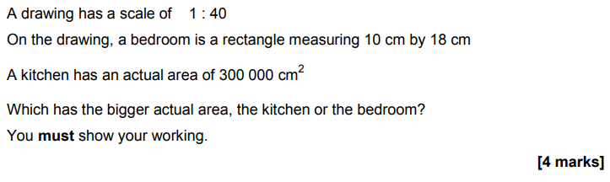

Slide 8
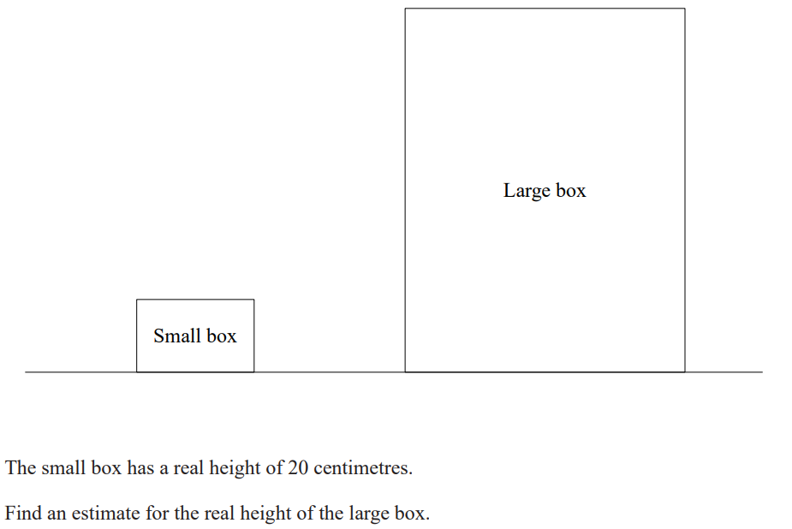
Scale Diagrams

Slide 9
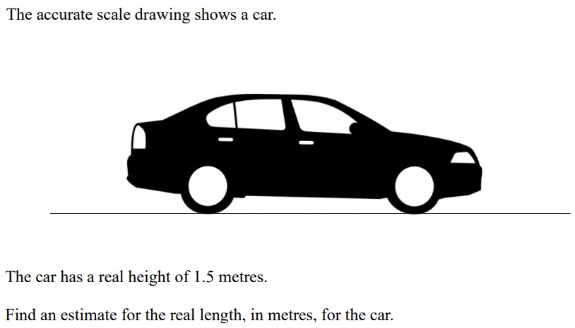
Your turn…

Slide 10
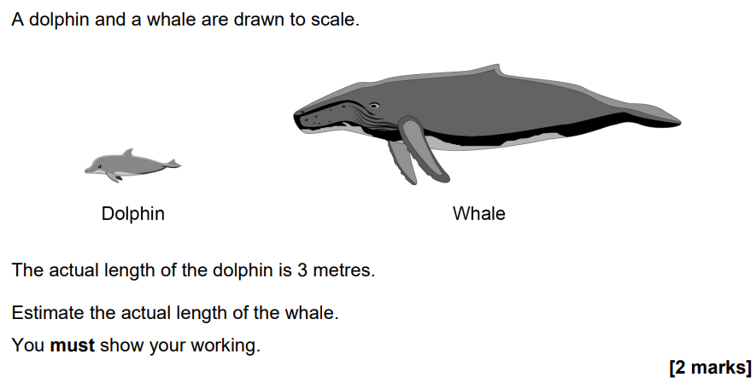

Slide 11
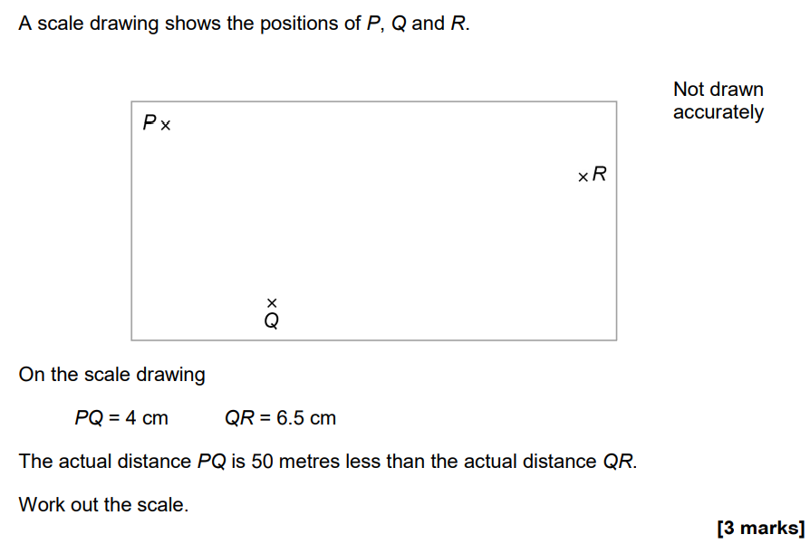

Slide 12
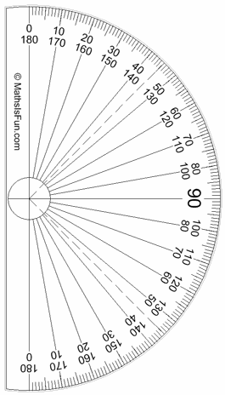
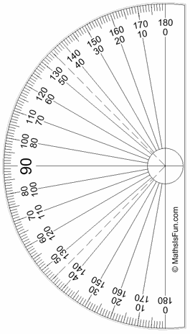
Bearings
Measure the bearing of B from A in each case.
Eg1
N
Eg2
N
Eg3
N
58º
64º
B
150º
B
A
A
A
B
Bearing = 058º
Bearing = 150º
Bearing =
360º – 64º =
296º

Slide 13
Your turn…
Measure the bearing of B from A in each case.
1
N
2
N
3
N
B
080º
037º
126º
B
A
A
A
4
N
5
N
6
N
B
225º
268º
156º
A
A
B
A
B
B

Slide 14
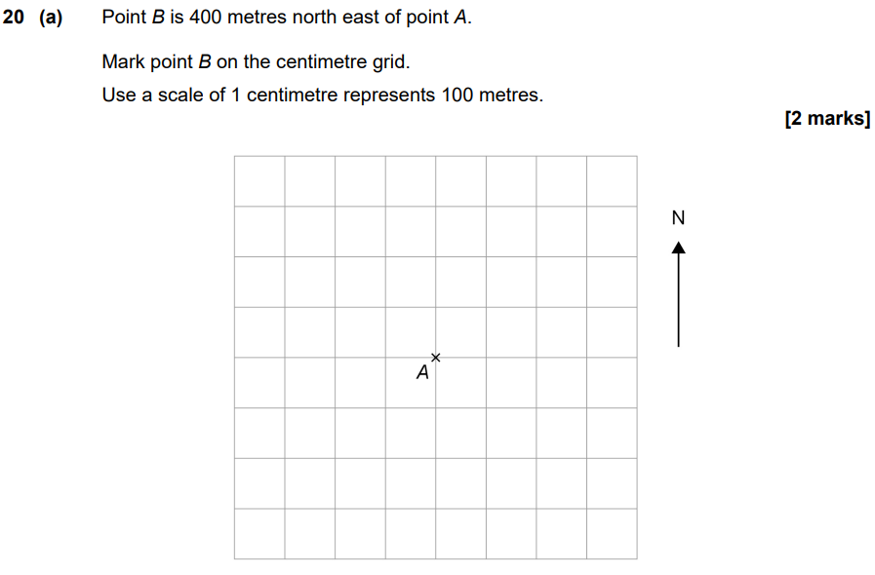

Slide 15
