Slide 1

STARTER
The volume of a cube is 512cm³.
Workout the width.
3. The mean of the following numbers is 5. What is the missing number?
3, 2, ?, 5, 8, 9, 6, 7, 1, 1
2. A pair of trousers are in a sale, they were £35 but they have been reduced by 25%.
What is the sale price?
4. What is this angle called?
5. What is the area of a rectangle that is 300m wide and 0.2km wide?

Slide 2


Recap
Fractions to Percent
Percent to decimals
Convert these fractions to percent
Convert these percent to decimals
8% = 80% =
Decimals to Fractions
Convert these decimals to fractions
0.75 = 0.15 = 0.6 =

Slide 3
Charts, Graphs and Data
Learning Objectives
To be able to :
Represent discrete data in tables, diagrams and charts including pie charts and bar charts, pictograms and tally charts
Group discrete data and represent grouped data graphically

Slide 4
Discrete data
Discrete data is ‘Data that can be counted’ and can only take on certain values.
How many people in….
How many marks in a test
Number of times something happened
Shoe size
This data is often displayed in frequency tables/tally charts, pie charts and bar/line graphs

Slide 5
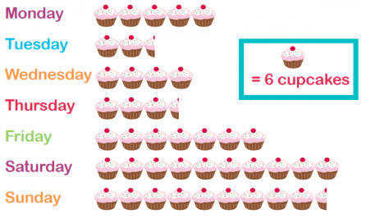
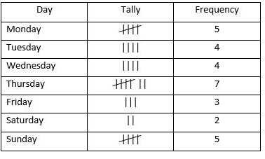
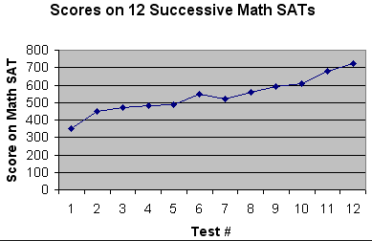
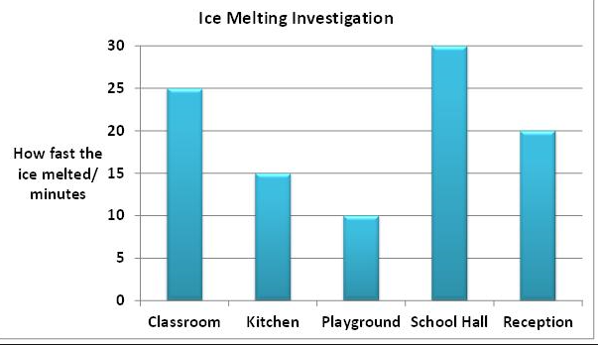

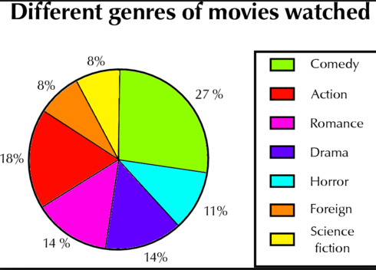
Types of Charts, Graphs and Tables
Pictogram | Frequency tables Line graph
Bar chart | Questionnaire/ survey Pie charts

Slide 6
PICTOGRAMS
P
The pictogram below shows the number of letters posted in a town centre post box last week. Use the information to work out:
(a) How many letters were posted on Monday.
(b) The total number of letters posted for the week.
 | Key:  Stands for 5 Letters
Monday | 
Tuesday | 
Wednesday | 
Thursday | 
Friday | 
Saturday | 

Slide 7


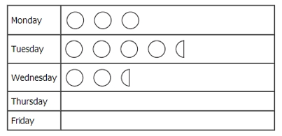
Your turn…
P
The pictogram shows the number of tins dog food sold on Monday, Tuesday and Wednesday last week.
On Thursday, 60 tins of dog food were sold.
On Friday, 35 tins of dog food were sold.
Use this information to complete the pictogram
b) How many more tins were sold on Tuesday than on Monday?

Slide 8

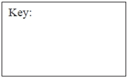
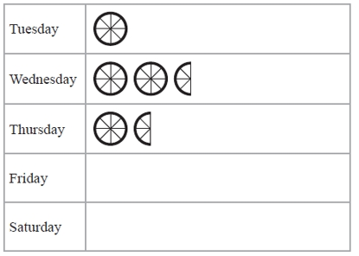

Your turn…
P
The incomplete pictogram shows information about the number cycles sold in a shop last week.
A total of 20 cycles were sold on Tuesday, Wednesday and Thursday.
8 cycles were sold on Friday
15 cycles were sold on Saturday
Using this information, complete the pictogram
and the key

Slide 9
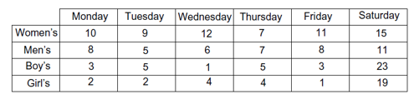
Lists and tables
This two way table shows the number of pairs of shoes sold in one week.
How many pairs of boy’s shoes were sold on Friday?
How many pairs of men’s shoes were sold that week?
How many pairs of shoes were sold in total?
Why do you think more children’s shoes were sold on Saturday?

Slide 10
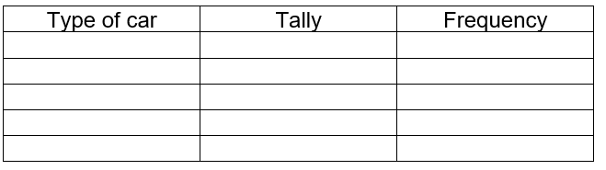
Frequency tables (Tally charts)
Ford | Fiat | Honda | BMW
Vauxhall | Fiat | Honda | Ford
Fiat | Ford | BMW | Vauxhall
BMW | BMW | Ford | Vauxhall
Fiat | Ford | Vauxhall | Ford
This data shows the type of car different people drive.
1. Complete the tally chart below.
2. What was the most popular car?
3. How many people were asked in in total?

Slide 11
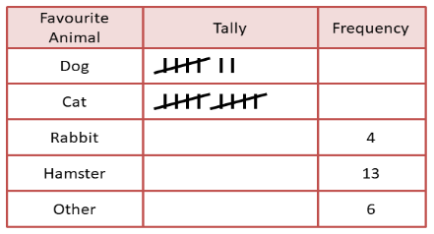
Your turn…
The table shows children’s favourite pet animal.
Complete the missing information on the tally chart.
How many more people have cats then rabbits?
How many children were surveyed?

Slide 12
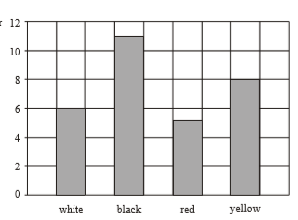
Bar charts
Elements of a bar chart
1. Title
2. Axis are labelled with x and y. Along the x axis you always have the variable item you’re measuring along the y axis you have the frequency (number)
3. The scale chosen on the y-axis is appropriate to the data give
4. The size of the bars always stay the same
5. The space between the bars always stay the same
Cars that pass by Monday morning
Number of cars
Colour

Slide 13
Bar charts
Favourite subject
14
Number of students
13
12
11
10
9
8
Which subject was the second most popular?
How many more people liked PE than History?
7
6
5
4
3
2
1
0
Maths
English
Science
Art
PE
History
Subjects

Slide 14

Your turn….
James and Lily wanted to find out the different colour cars on their street.
The table below shows their findings.
Can you draw a bar chart to show this data?
What is the most popular colour?
Is the total of the white and black more than blue?
Colour | Tally
Red
Black
White
Silver
Blue

Slide 15

Your turn….
1. Show the data above in a bar chart.
2. What is the most popular pet?
3. How many more people like fish than cats?

Slide 16
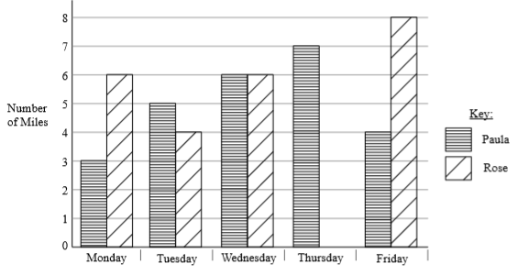
Here is a bar chart showing the number of miles Paula and Rose ran from Monday to Friday in a week
Rose runs further than Paula on Monday a) How much further?
Rose ran 6 miles on Thursday b) Use this information to complete the bar chart.
Your turn….

Slide 17

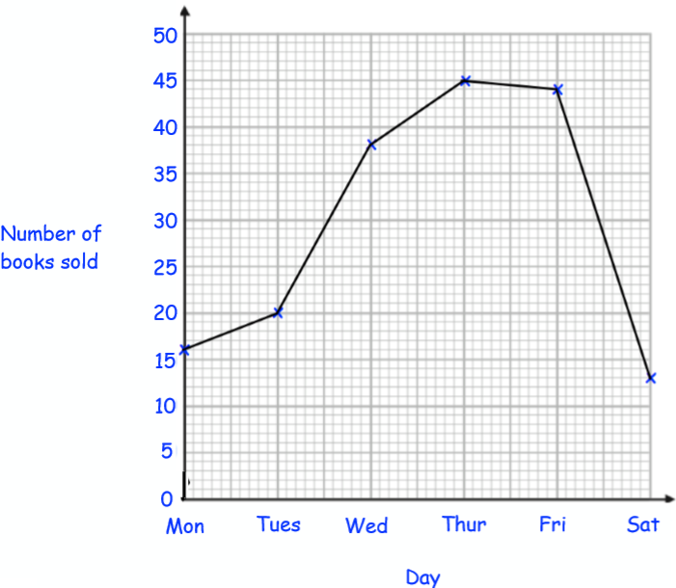
Line graphs
The line graphs show the number of books sold in a shop.
1. Which day did they sell the most books?
2. How many more books were sold on Tuesday than Saturday?

Slide 18
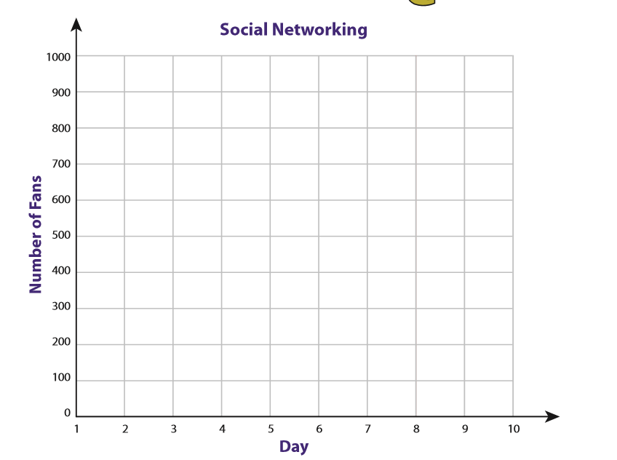
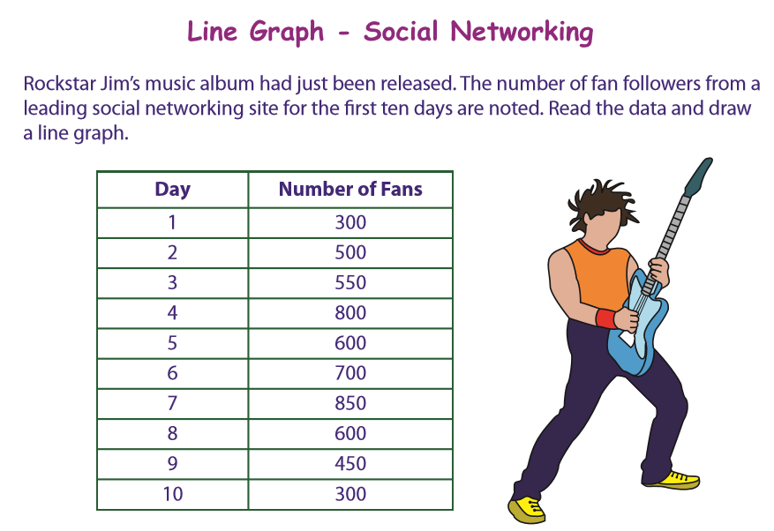
Your turn…
Ed Clearthan has just released a new album.
The increase in the number of followers on a social media site are recorded for the first 10 days.
Display the data below in a line graph.

Slide 19



Exam style questions
The table shows information about the number of Year 7 pupils absent from school last week.
A teacher wants to compare this information.
On the grid, draw a graph or chart.

Slide 20
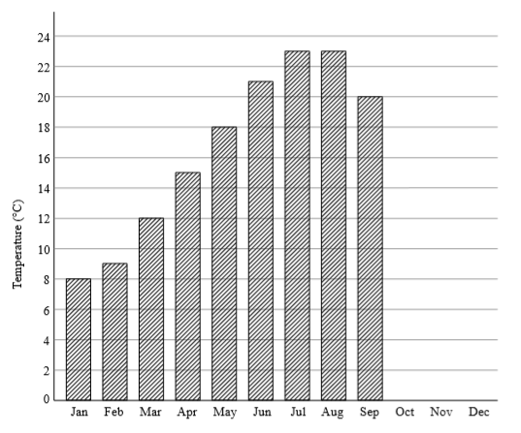
Exam style questions
Here is a bar chart showing the average maximum monthly temperature
(°C) in Greenwich.
October 16°C
November 11°C
December 8°C
Complete the bar chart to show this information
In which 2 months were the highest average temperatures recorded?

Slide 21


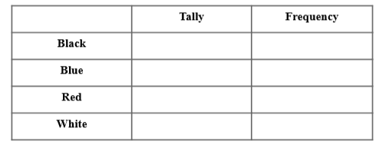
Exam style questions
Claire records the colours of the cars in the college car park. Here is the list of colours of the 20 cars.
a) Complete the table to show this information.
b) Draw a chart/graph for this information.

