Slide 1




Slide 2







Whole Number and Functions
ROUNDING

Slide 3






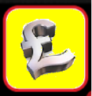


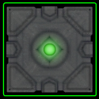


Course Content: Choose your topic …
Whole Number and Functions
place
value
add and
subtract
multiply
divide
round
numbers
fraction
decimal
numbers
MATHS E1 E2 E3
Parts of a whole
Time
temperature
2d and 3d Shapes
metric
measure
money
charts
data
Measure and Shape
Handling Data

Slide 4





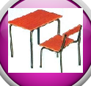







Home Revision Progress Check 1 Video/Discuss Vocab / jobs Lesson Activities Quizzes Topic Answers Progress Check 2 Cont. Learning
Topic Introduction : Round and Estimate
The maths process of rounding a number changes it so less place values are used. This means the number is no longer the real value it should be, but that’s ok in lots of real life situations. With less place values in a number it is easier to say, write and use in calculations. Rounding is not guessing however and there is a clear rule you will need to follow when rounding numbers.
After rounding a value the new number is called an ‘approximate’ value to its original. If you now use these new approximate values in a sum you will only get ‘estimates’. Getting this terminology correct, especially in exam questions, is very important.
Choose an icon to select where to start
Round and Estimate

Slide 5



Revision Exercises 1
Lets start today by revising ! Complete the above sums and multiplication grid

Slide 6
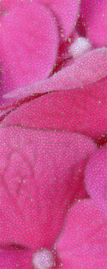

Revision Exercises 2

Slide 7
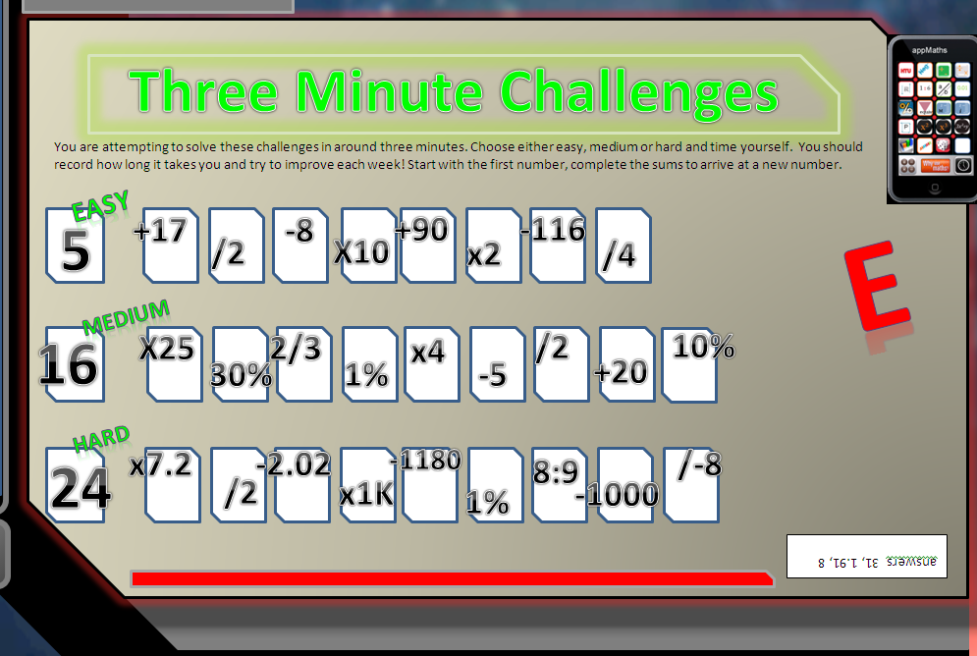

Revision Exercises 3

Slide 8

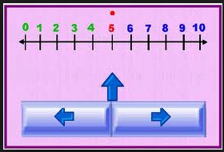
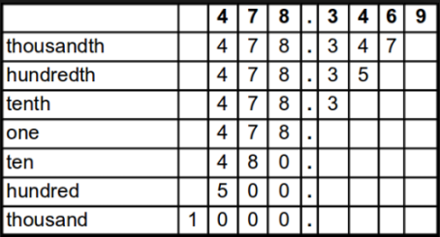
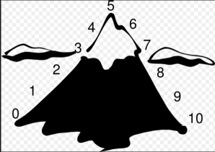
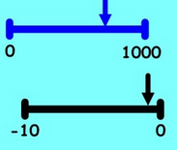
Progress Checker 1
What do you already know about Rounding ? What did you learn during the week? Examples…
How would you rate your skills in Rounding Numbers?
Excellent ability
Good ability, but working to improve
Ok, making a start but I know I have lots to still learn
The date I started studying: My aims are…
A Correctly round numbers to a given or chosen place value up to the thousands
B Use rounded numbers in calculations and real life to produce estimations
C Recognise terms such as round, approximate, estimate, actual…

Slide 9

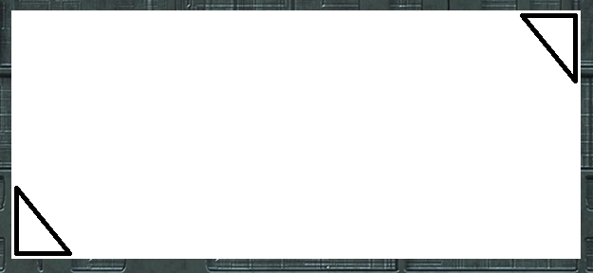
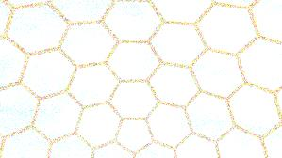

Introductory Video and Discussion
KHTU.
What is the best method for rounding ?
After rounding a number can you figure out what the original number was ?
When can we round numbers and when shouldn’t we ?
How does rounding make things easier ?
Can you round fractions, decimals, percentages ?
How do you know what place value to round to ?
Watch the introductory video and then discuss the above
Your thoughts..

Slide 10
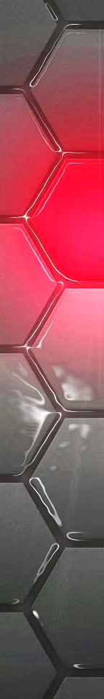
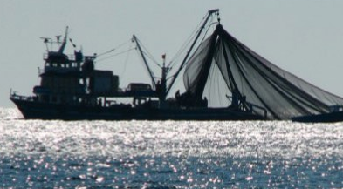
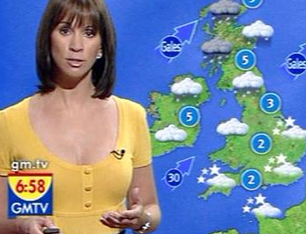
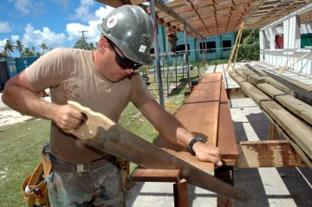


Vocabulary and Jobs
Round
Approximate
Estimate
Place Value
Almost
Around
About
Nearly
Half/Halfway
Rounding up
Rounding down
These are the word s you will use in this topic
Accountant
Government Stats
Builder
Newspaper
Chef
Manager
Weather
Fisherman
…. Can you think of more?
…………………………………
…………………………………

Slide 11
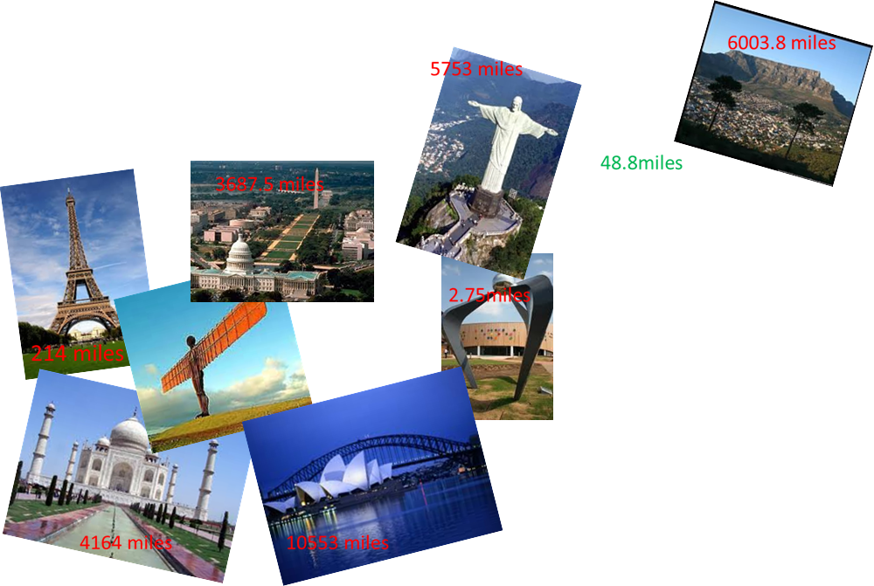
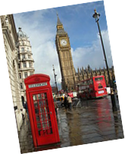

Lesson: Concept Activity
Around the world in 180 minutes
In Pairs: Turn these distances into numbers that you can more easily communicate. Be prepared to share your ideas with the group when you have finished.

Slide 12
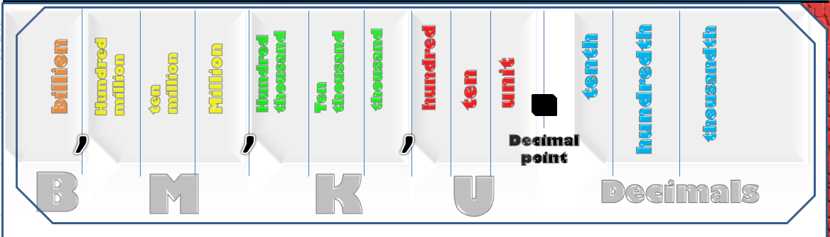
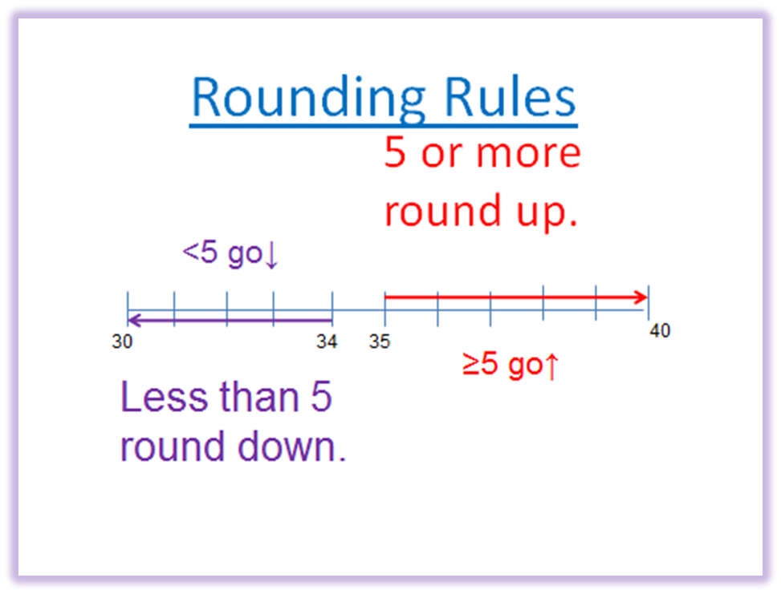
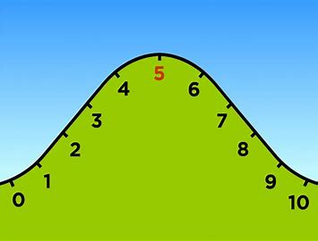
Lesson: Main Teach
When to round up or down
Round a number ‘UP’ when you have half or more
of your chosen place value

Slide 13
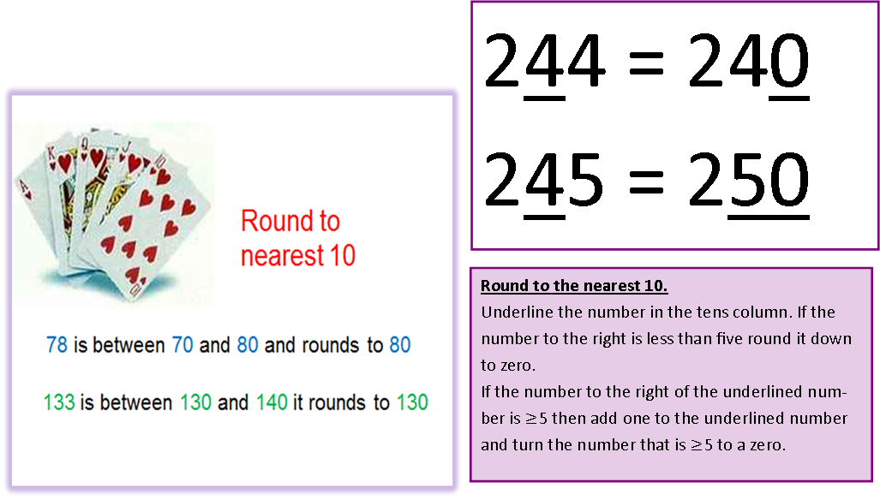
Lesson: Main Teach
When to round up or down
http://www.youtube.com/watch?v=3afU6JQG15I
http://www.youtube.com/watch?v=3afU6JQG15I

Slide 14
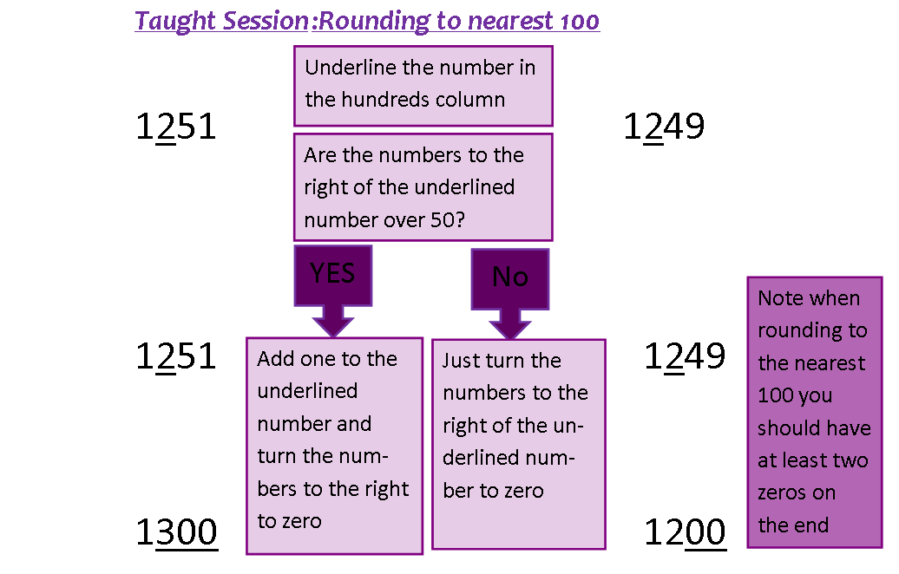
Lesson: Main Teach

Slide 15
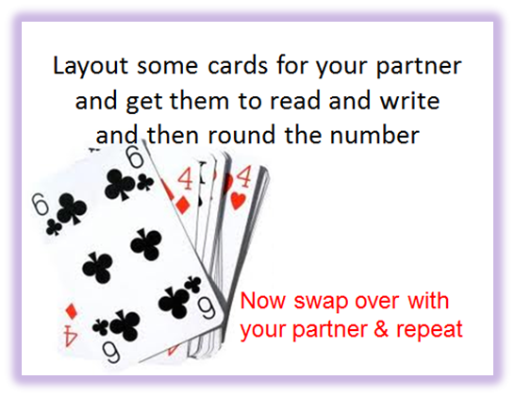
Lesson: Main Teach
Record answers on data collection sheet
Cards | Rounded to | Written rounded number

Slide 16

Lesson: Try out
Block 1 : Watch tutor led demo (in class or on video)
Try these, 1) 6 rounded to the nearest ten =
2) 14 rounded to the nearest ten =
3) 26 rounded to the nearest ten =
4) 85 rounded to the nearest ten =
Block 2 : Watch tutor led demo (in class or on video)
Try these, 5) 453 rounded to the nearest hundred =
6) 954 rounded to the nearest hundred =
7) 555 rounded to the nearest hundred =
8) 759 rounded to the nearest hundred =
Block 3 : Watch tutor led demo (in class or on video)
Try these, 12) 1,450 rounded to the nearest thousand =
13) 4,245 rounded to the nearest thousand =
14) 9,595 rounded to the nearest thousand =
15) 15,495 rounded to the nearest thousand =

Slide 17
Lesson: Websites and links
Rounding using a number line to visualise
http://www.oswego.org/ocsd-web/games/Estimate/estimate.html
Use a ‘dart board’ type game to create rounding questions or solve
http://www.kiwikidsnews.co.nz/games/2013/02/02/dart-board-rounding/
Rounding to 100 on a number line
http://mathszone.webspace.virginmedia.com/mw/rounding/nearest100.swf
Play ‘Pac Man’ and chase down the ghosts while rounding to the nearest million !
http://www.sheppardsoftware.com/mathgames/round/mathman_round_millions.htm
A sheet of rounding to 1000 questions to try
http://www.teachrkids.com/examples/rounding.asp?count=10&round_type=4&min_val=1000&max_val=99999
Hangman rounding of numbers in 1000’s
http://www.quia.com/hm/41141.html
A short help guide on rounding decimals and rounding examples to try
http://www.cimt.plymouth.ac.uk/projects/mepres/book8/bk8i4/bk8_4i5.htm
Two pages of rounding from 10 to billion
http://www.sinclair.edu/centers/tlc/pub/handouts_worksheets/mathematics/DEV085/1_whole_numbers/085_rounding_whole_numbers_2.pdf
The BBC website with large numbers, significant figures and decimals
http://www.bbc.co.uk/schools/gcsebitesize/maths/number/roundestimaterev5.shtml

Slide 18
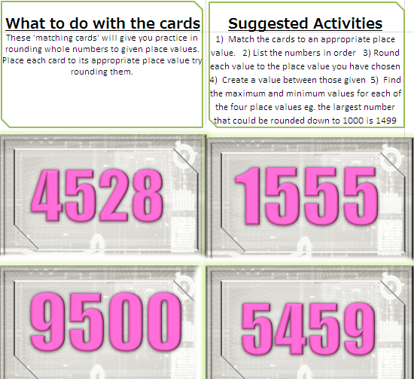

Lesson: Exploratory Activity A

Slide 19

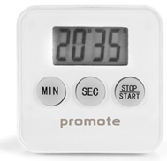

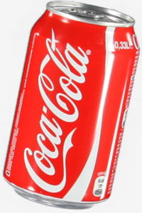
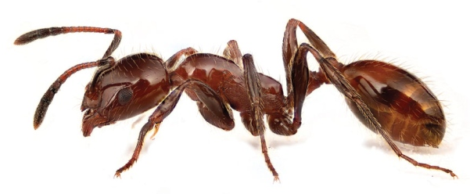
Lesson: Exploratory Activity B
Discussion Table !
Discuss each situation and decide if you would round a value associated with that situation.
Create a suitable value for the situation
Round the value if appropriate and discuss methods you
have used to do the rounding

Slide 20
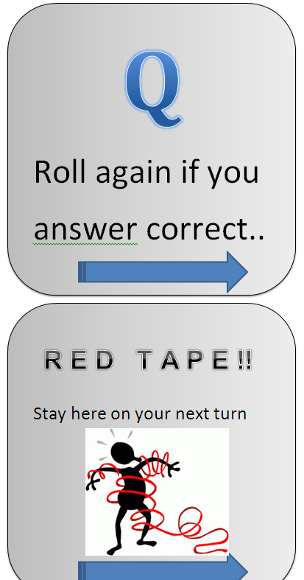

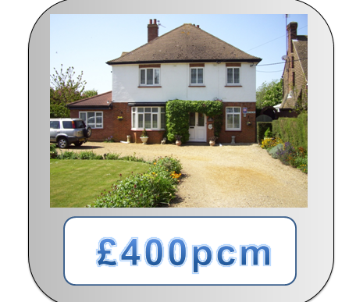
Lesson: Exploratory Activity B
Game Table !
Make the most money by
the end of the game
Pay rent each month (turn
around the board)
Collect new rents… pay
bills etc.. Have fun !!

Slide 21

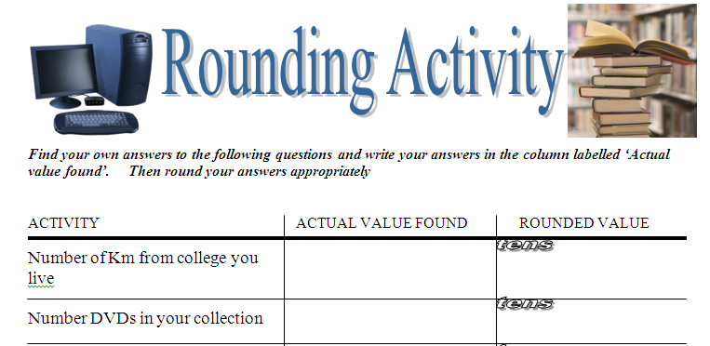
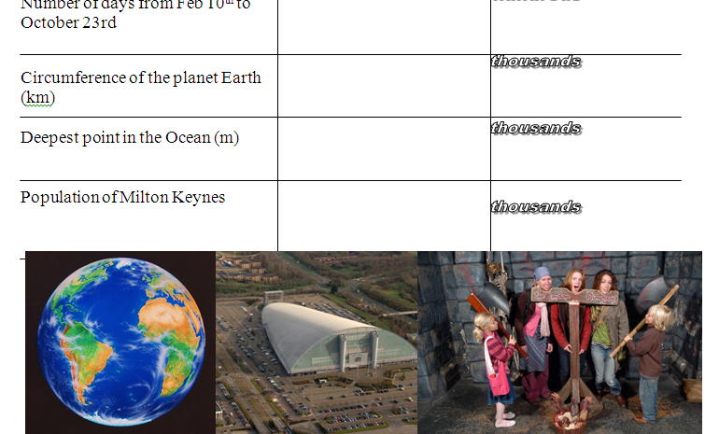
Lesson: Exploratory Activity C
On the computer create a spread sheet and find the values on the investigation sheet?
Round the values to ten, hundred or thousand as given on the sheet. Can you use the computer to do the rounding for you? Can you set the place value the computer rounds each value to?
Set up a table….
Rounds to 10 Rounds to 100 Rounds to 1000…. etc

Slide 22
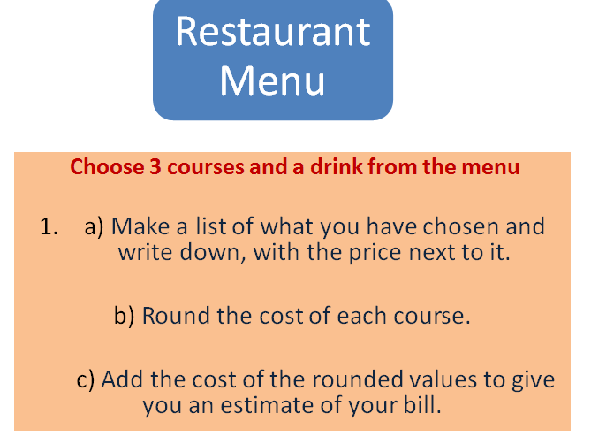

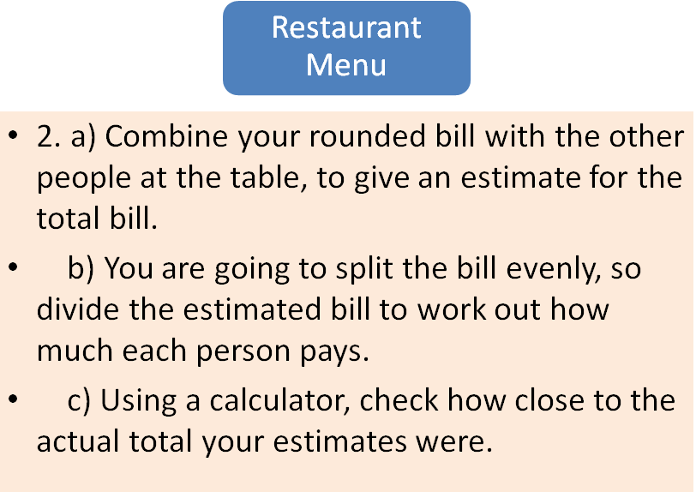
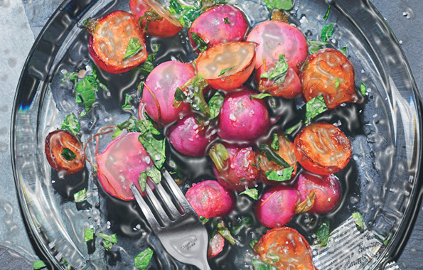
Lesson: Exploratory Activity D
Y

Slide 23

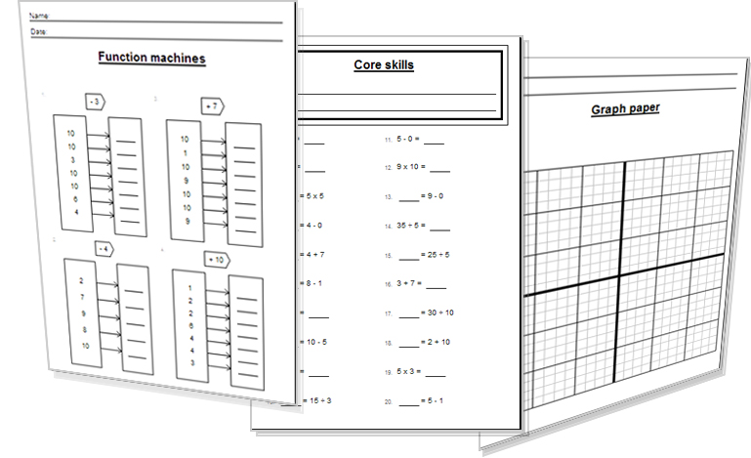

Lesson: Activity E
Try a variety of written practice
Worksheets
Workbooks
Practice Exam Papers
Maths Problems

Slide 24
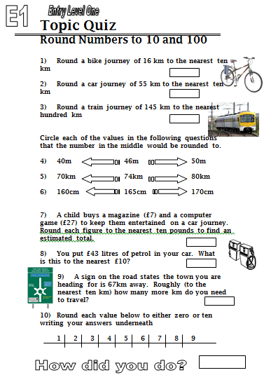

12a Homework: Quiz to assess E1

Slide 25
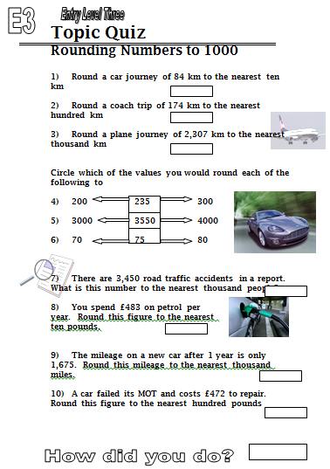
12b Homework: Quiz to assess E3

Slide 26
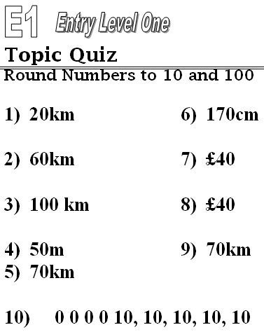
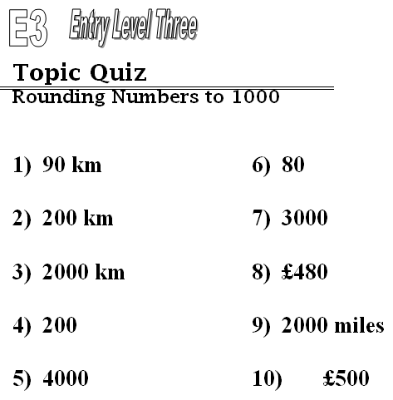
13 – TOPIC ANSWERS
80

Slide 27
Progress Checker 2
What do you now know about Rounding ? What did you learn during the session? Examples…
How would you now rate your skills in Rounding Numbers?
Excellent ability
Good ability, but working to improve
Ok, making a start but I know I have lots to still learn
The date I finished studying: My aims were…
A Correctly round numbers to a given or chosen place value up to the thousands
B Use rounded numbers in calculations and real life to produce estimations
C Recognise terms such as round, approximate, estimate, actual…

Slide 28
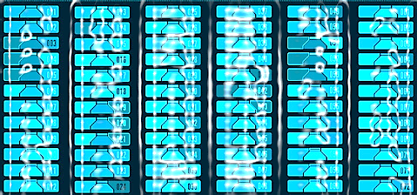

15 Continuing to Study and Learn
What else can you do to help yourself to learn and practice? Here are ten suggestions, record which you do each week and also record your progress.
Internet websites
Repeat the lesson, make notes, organise a folder, revise
Own maths workbook
Study together with a friend or family member
Finish activities in this book
Complete class handouts or tasks
Practice exams / past papers
Use maths skills learnt at home or at work in real situations
Play games
Experiment yourself, try new things ask yourself questions
Try making a graph of number of practice methods you use against your progress score in each topic. Are you showing more practice gives better results?

