Slide 1
Ratio
Work with simple Ratio and Direct proportion
Recap
1) 66.9 x 23.7 =
2) 57.9 ÷ 19.165 =
3) 289 x 1.987 =
4) James wants to buy 5 pens and 3 pencils. The pens cost £1.89 each and the pencils cost 45p.
Find an estimate for how much this will cost James.

Slide 2
Sharing in a Ratio
£50 is divided between Ann and Jim in the ratio 3 : 2
How much money does each get?
3:2
Altogether this is 5 Parts – so to find 1 part, we divide the total (£50) by the number of parts (5)
then multiply that back into the ratio.
3 x 10 = 30
2 x 10 = 20
50 ÷ 5 = 10
10=1 part

Slide 3
Where can use Ratio in everyday life?

Slide 4

Builders ratio
You mix concrete in the proportion of 3:1,
sand to cement.
This means we need 3 measures of sand
to one measure of cement.
If you have 3 bags of cement how
many bags of sand do you need?

Slide 5


Bakers ratio
A cake mixture is made by mixing flour,
butter and sugar in the ratio 4:1:2.
In the final mix 250g of sugar is used.
How much butter and flour is needed?

Slide 6


Hairdresser ratio
A hair colour is mixed in the ratio of
60mls of colour to 6mls of peroxide.
The salon uses 690mls of colour in a day.
How much peroxide does the salon use.
BACK

Slide 7
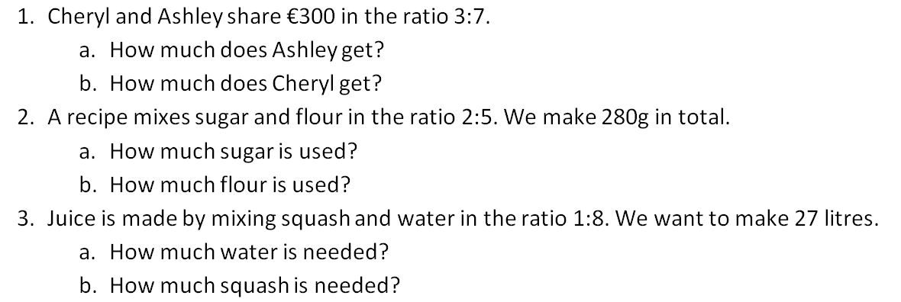
Practice questions

Slide 8
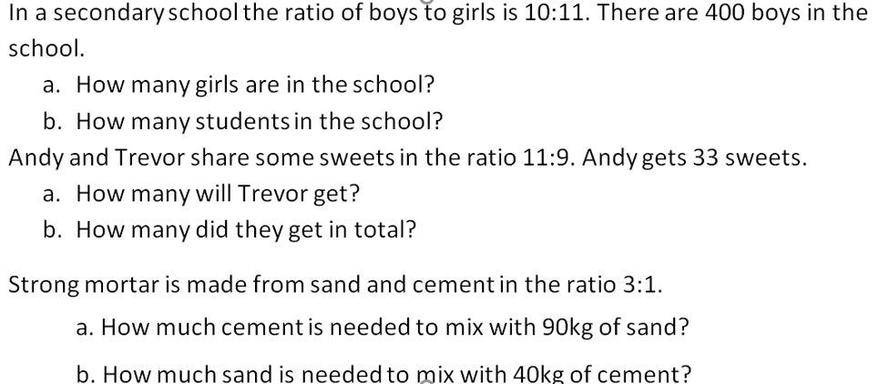
More practice

Slide 9
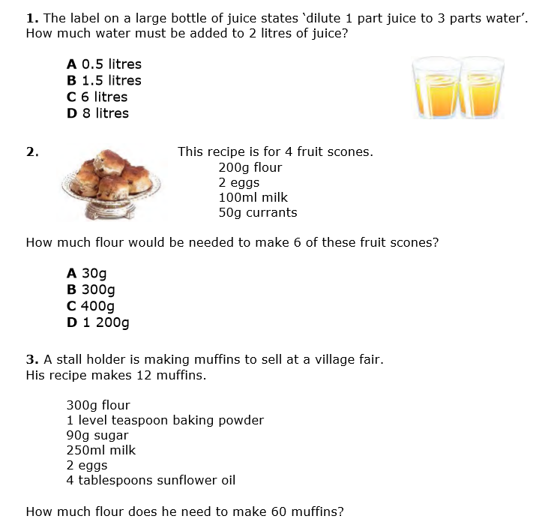
Everyday life questions

Slide 10
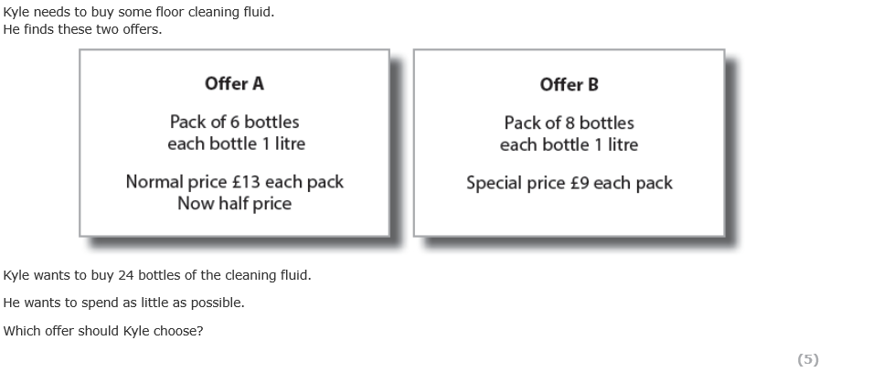
Exam Questions
March 2016

Slide 11
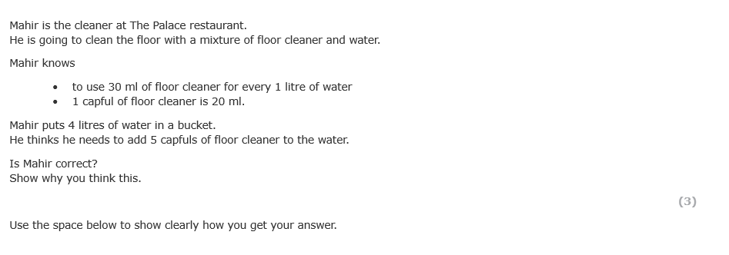
Exam Questions
November 2016

Slide 12
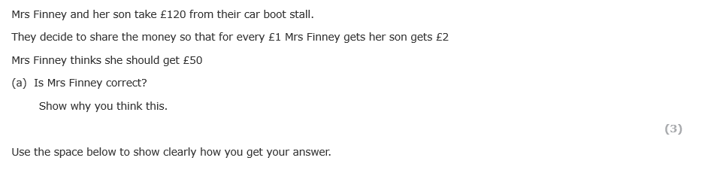
Exam Questions
July 2016

Slide 13
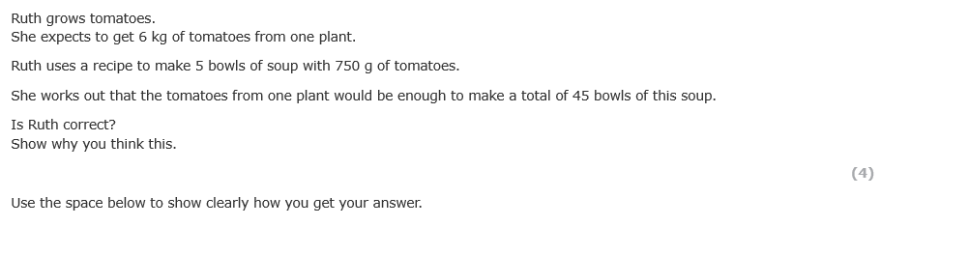
Exam Questions
October 2017

Slide 14
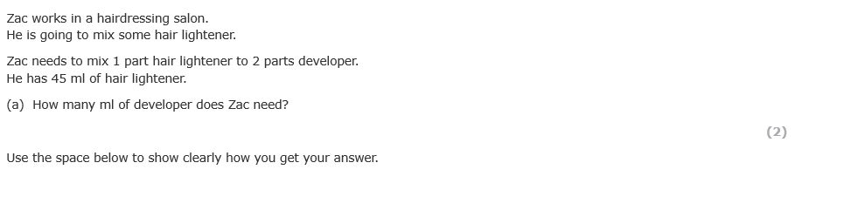
Exam questions
Feb 2016

