Slide 1
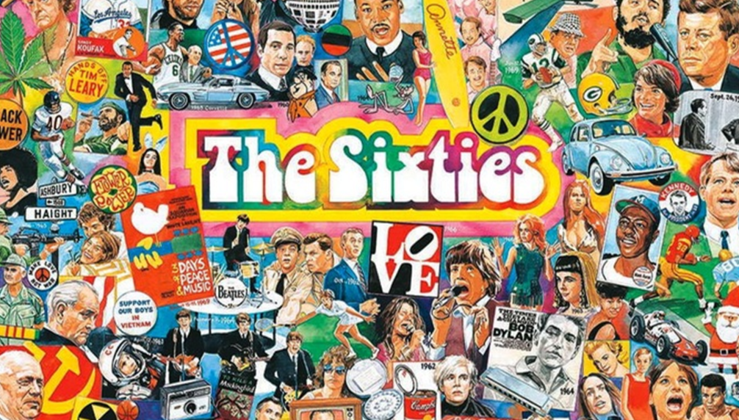
1960s?
Famous historical events?
1- The Vietnam war
2- The civil Rights movement in the USA
3- The cold war (between the USA and USSR)
4- Assassinations of JF Kennedy and Martin Luther King
5- Woodstock
6- First Landing on the moon
Famous artists?
1- Jimi Hendrix 7- Barbara Streisand
2- Bob Dylan 8- Janis Joplin
3- The Rolling Stones
4- Andy Warhol
5- Paul Newman
6- Elizabeth Taylor

Slide 2
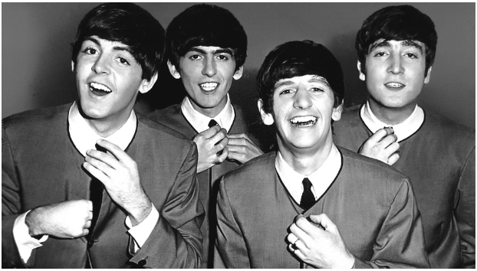
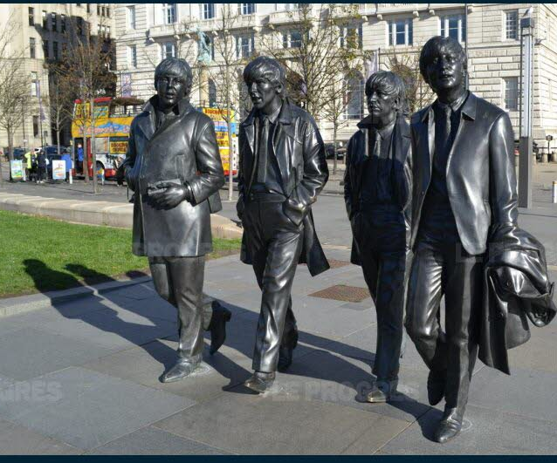
Who?
The Beatles!
Where?
In Liverpool, England!
John Lennon
Paul Mc Cartney
George Harrison
Ringo Starr

